Slide 1

The WHO-INTEGRATE
evidence-to-decision framework
Workshop, Practical exercise
World Health Organization, Geneva, 23-24 October 2019
Prof. Eva Rehfuess and Dr. Jan Stratil
Pettenkofer School of Public Health,
LMU Munich, Munich, Germany
rehfuess@ibe.med.uni-muenchen.de
stratil@ibe.med.uni-muenchen.de

Slide 2
Applying criteria and sub-criteria in practice

Slide 3
Practical exercise:
on 3 guidelines in 3 groups
3 guidelines
Guideline 1: …
Guideline 2: …
Guideline 3: …
3 groups comprising at least
1 content expert from WHO department developing the guideline
1 WHO guideline methodologist
1 external participant

Slide 4
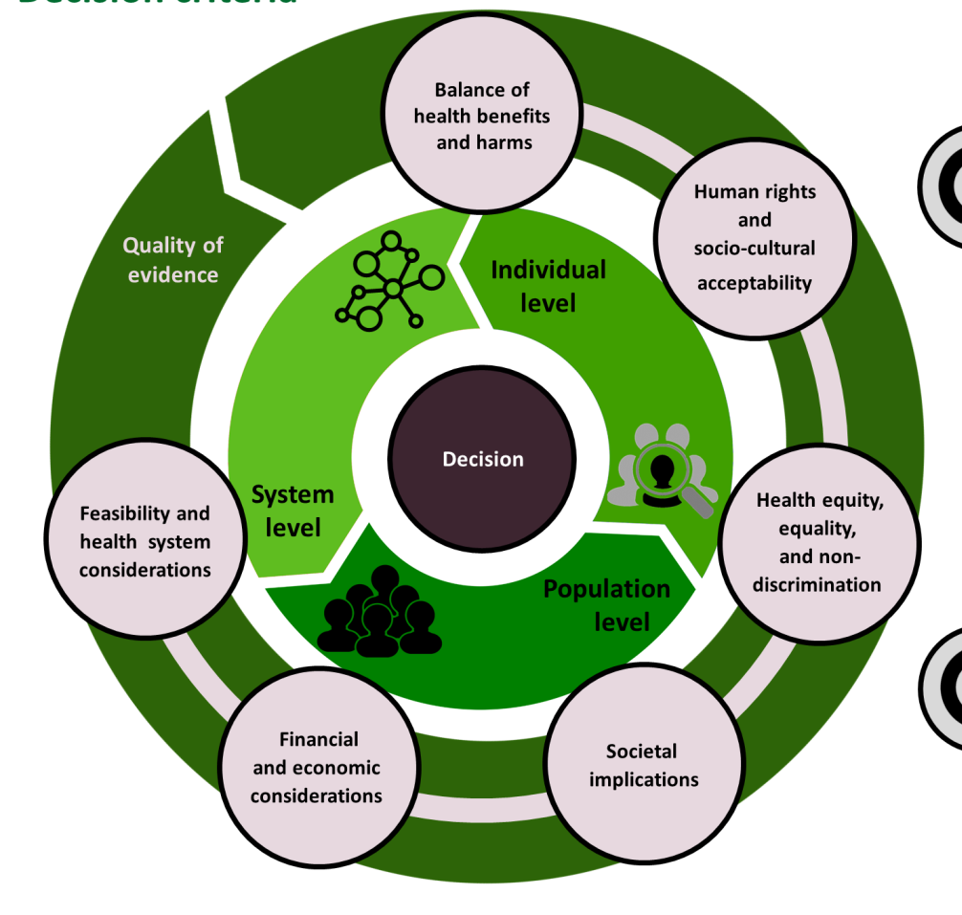
Practical exercise:
focus on 2 criteria

Slide 5
Criteria | Sub-criteria
Human rights and socio-cultural acceptability | Accordance with universal human rights standards Socio-cultural acceptability of intervention by beneficiaries Socio-cultural acceptability of intervention by those implementing Socio-cultural acceptability by public & other relevant stakeholder groups Impact on autonomy of concerned stakeholders Intrusiveness of intervention
Societal impact | Impact on society Impact on the environment

Slide 6
Practical exercise:
in 3 tasks
Task 1 (10 minutes): As individuals, familiarise yourself with the criterion, based on Table 2 and Table S2 (supplementary file) in the WHO-INTEGRATE paper i.e.
  definition
  sub-criteria
  example questions
Task 2 (15 minutes): In discussion as a group, select one sub-criterion and formulate a question in relation to your guideline, drawing on the example questions in Table S2 (supplementary file) in the WHO-INTEGRATE paper.
Task 3 (15 minutes): Discuss approaches to collect and appraise evidence towards answering this question, drawing on the information in Table 3 in the WHO-INTEGRATE paper.

Slide 7
Time management
All participants assemble into their group
  Group 1: …
  Group 2: …
  Group 3: …
WHO content expert introduces the guideline topic (5 minutes)
Group addresses criterion “societal impact” and works through tasks 1, 2 and 3 (40 minutes)
Address criterion “human rights and socio-cultural acceptability” and work through tasks 1, 2 and 3 (40 minutes)

Slide 8
Additional slides

Slide 9
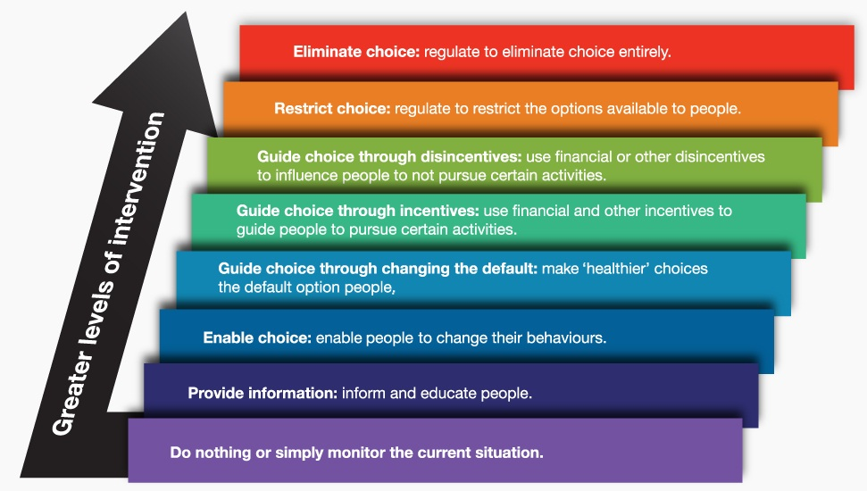
Intrusiveness
Nuffield Council on Bioethics (2007)

