Slide 1



Joint Risk Assessment at the Human-Animal-Environment Interface

Slide 2
Why do we need joint RA?

Slide 3
Differences among risk assessments done by sector
Sub-regional technical consultation on H7N9
April 2014, Myanmar
Animal Health sector assessment
Human Health sector assessment
Risk to poultry: Moderate to High
???
Risk to poultry: Low
Risk to humans: Moderate to High
Risk to humans: High

Slide 4
Zoonotic diseases need a different approach
Can not fully understand situation and risks without input from all relevant sectors/stakeholders
  Expertise
  Information
  perspectives
Where and why risks exist
Acceptable management and communication options
Minimise “Unintended impacts”

Slide 5
WHY can’t we just do a RA together using existing tools?
The AH and HH technical processes are in principle the same
  …but operationally different…
  have evolved to meet different needs and interests
  do not directly align
When sectors come together, there is misunderstanding and confusion
Example: GIP /FAO risk assessments during H7N9

Slide 6

Solution: JRA!

Slide 7
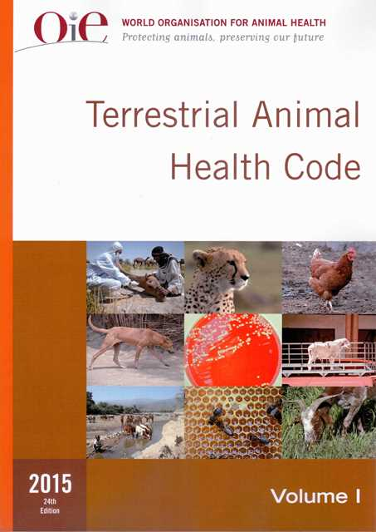
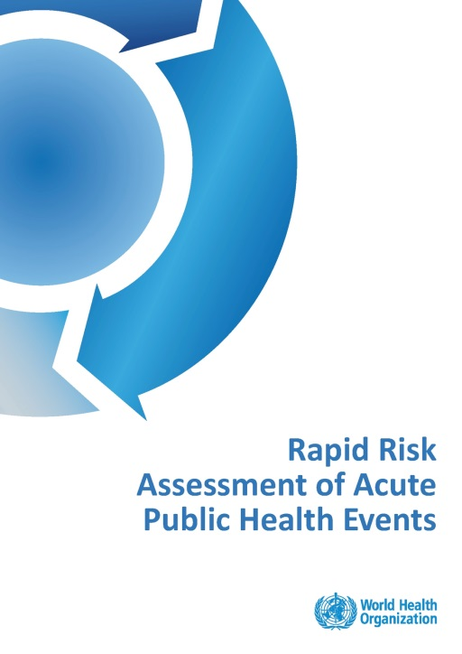
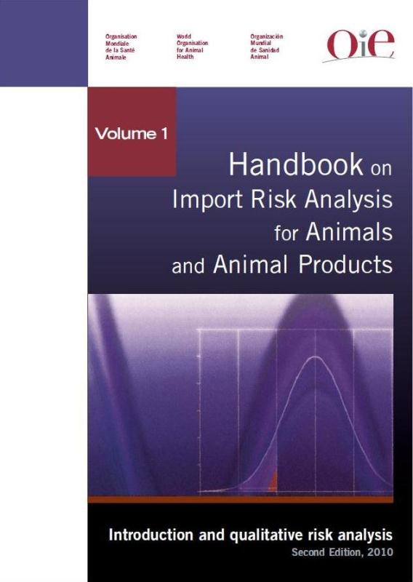
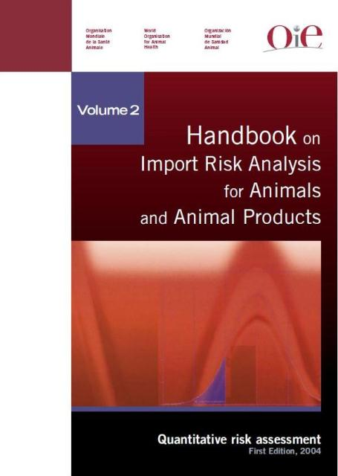
Starting from….

Slide 8
Objectives
Standard Tripartite (WHO-FAO-OIE) Operational Tool for conducting national risk assessments
    National level
    Joint (all relevant sectors)
    Qualitative
First: for zoonotic influenza
Later: for any zoonoses or other health issue at the human- animal- environment interface

Slide 9

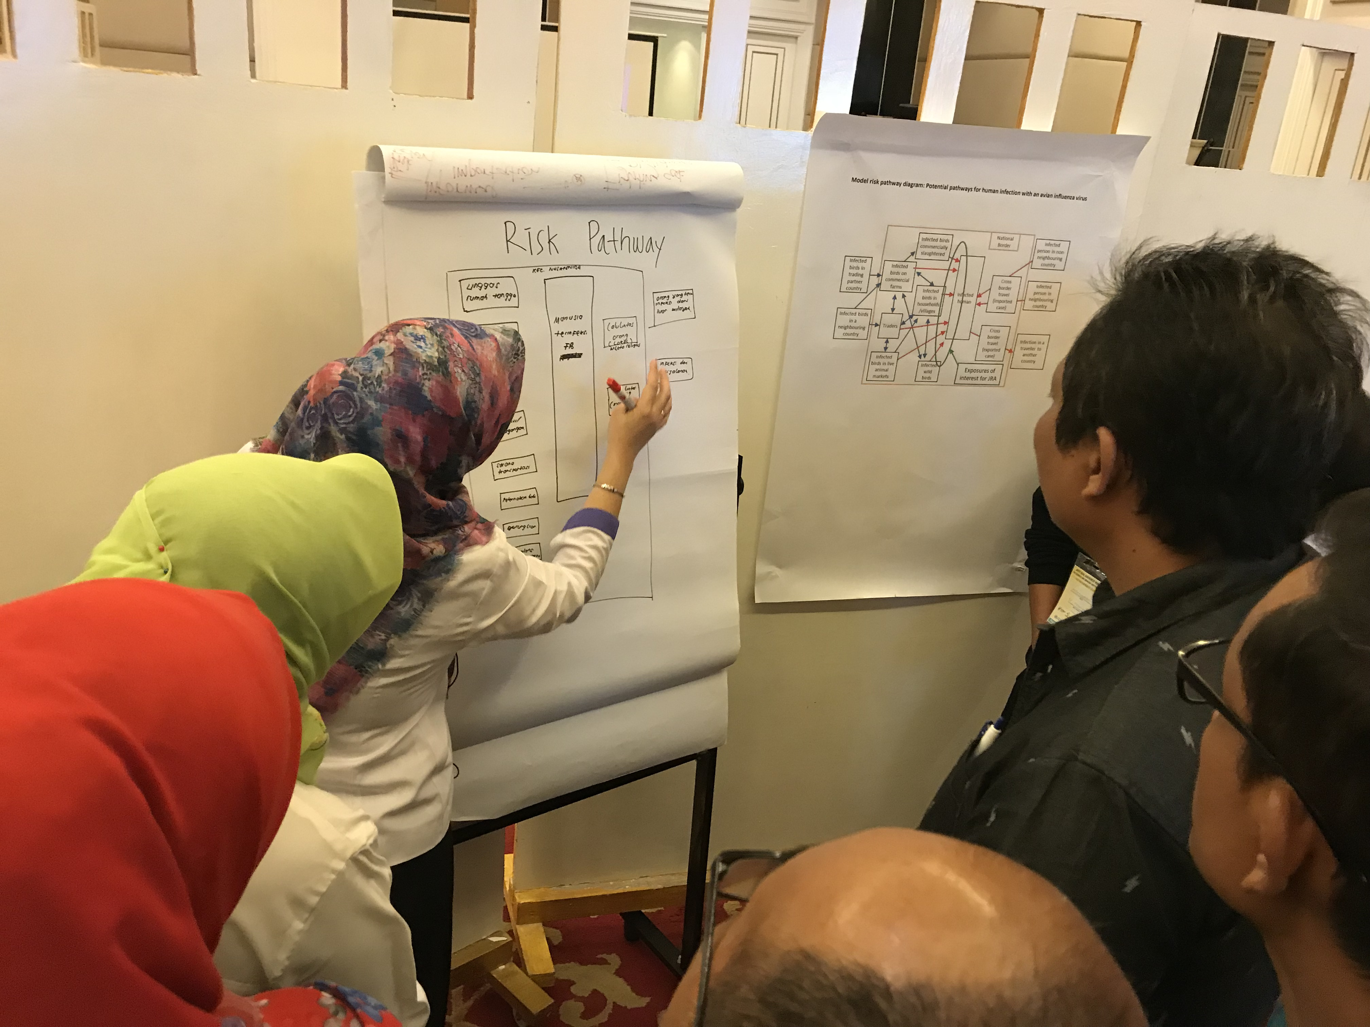
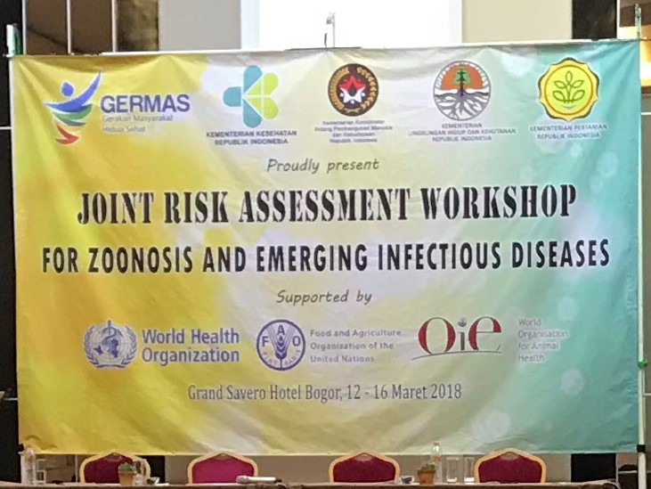

Slide 10
JRA Concept
Systematic approach using currently available knowledge
Iterative and updated regularly
  Context dependent (e.g. impact)
  Evidence-based: Allows science/evidence-based management and aligned communication messages
  Information shared and assessed jointly by sectors and disciplines
    Can (and should) be done even with little information
    ‘expert opinion’
Separate sector-specific risk assessments

Slide 11
JRA within Tripartite institutional processes
WHO
FAO
OIE
Internal WHO RA process:
3-level WHO RAs
Internal RA process
Internal RA process
HQ
Regional level
Country level
Information sharing according to existing institutional processes
Joint output
National Joint Risk Assessment
Ministry of Health
Ministry of Agriculture

Slide 12
Multi-sectoral inputs to JRA process
Role of
Establish and guide JRA process
Define JRA scope and objectives
Establish governance structure
Identify JRA Lead
Frame assessment (scope, purpose)
Establish JRA Stakeholder Group (Optional)
JRA Steering Committee
JRA Lead
JRA Technical Team
JRA Stakeholder Group
Modify if needed
Country-dependent
Lead and manage JRA process
Maintain communication among groups
Convene and lead JRA Technical Team
Operationalise assessment outcomes
Review JRA outputs
Make management and communication plan
Determine next steps
Re-evaluate JRA framing
Conduct technical assessment
Identify risk assessment questions
Identify and diagram risk pathways
Characterise the risk
Review and consider available information
Identify information gaps
Estimate likelihood, impact, and uncertainty
Provide technical interpretation
Data collection plus iterative assessment
Risk management
Identify communication & management options
Risk communication
Document the assessment

Slide 13
Using the JRA Tool
Main users:
  Government agencies responsible for human health, animal health, and the environment
  Other relevant sectors and private sector as needed
Includes principles and technical elements to follow
  Model documents, templates, etc, included
Components are applied as needed by countries
Components can be modified to fit the national context or existing mechanisms

Slide 14
Benefits of the JRA
Set up to gain consensus and produce a joint assessment
Allows decision makers to build and implement science-based risk management and communication messages aligned among the sectors
Regular exchange among sectors fosters ongoing intersectoral collaboration
Identifies critical missing information and gaps where capacity can be most usefully built
Technical teams in each sector understand the entire situation better, helping them in their daily work

Slide 15
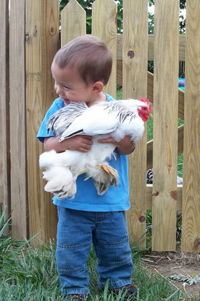
Questions?

