Slide 1
Recommendations for Risk Analysis within the Sendai Framework for Disaster Risk Reduction Global Workshop on Strategic Risk Analysis and Profiling for Health Emergencies 10 May 2018
Notes:
Recap on the work of the OIEWG and progress made, including development of the Sendai Framework Monitor
Progress on the integrated monitoring and reporting with the 2030 Agenda for SD
Ongoing and forthcoming work

Slide 2
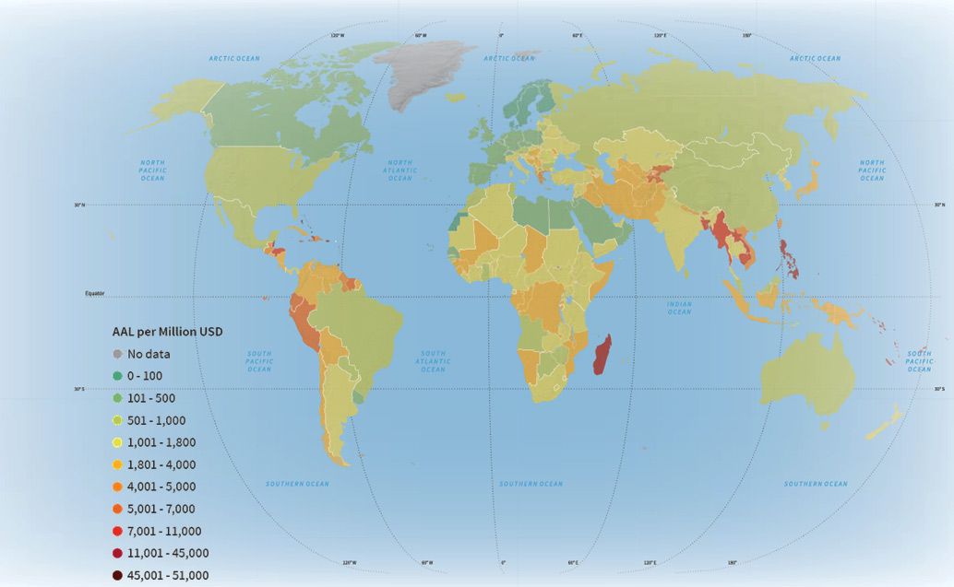
564.4 million
The number of people reported affected by natural disasters 2016
Notes:
The Global Risk Assessment outputs were published through GAR 2013 and 2015 and the GAR Atlas 2017.

Slide 3
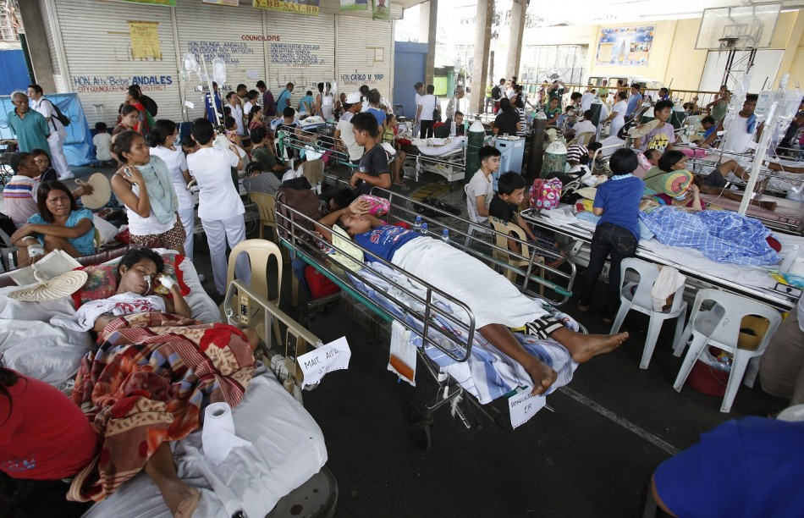
Disaster impact on health facilities - Philippines
Notes:
The Global Risk Assessment outputs were published through GAR 2013 and 2015 and the GAR Atlas 2017.

Slide 4
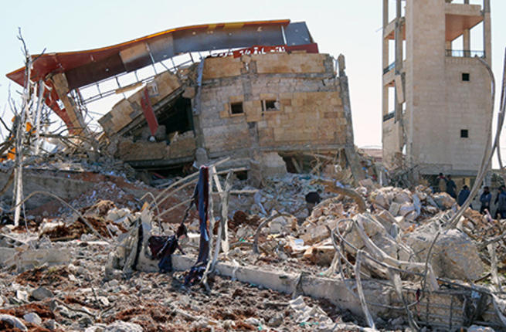
Destroyed hospital – Idlib, Syria
Notes:
The Global Risk Assessment outputs were published through GAR 2013 and 2015 and the GAR Atlas 2017.

Slide 5
The Global Risk Assessment Framework (GRAF) in support of
Sendai Framework & SDGs implementation
Sendai Framework Priority 1: Understanding disaster risk
Policies and practices for disaster risk management should be based on an understanding of disaster risk in all its dimensions of vulnerability, capacity, exposure of persons and assets, hazard characteristics and the environment.
Such knowledge can be leveraged for the purpose of pre-disaster risk assessment, for prevention and mitigation and for the development and implementation of appropriate preparedness and effective response to disasters.
Notes:
The Global Risk Assessment outputs were published through GAR 2013 and 2015 and the GAR Atlas 2017.

Slide 6
The Global Risk Assessment Framework (GRAF) in support of
Sendai Framework & SDGs implementation
Sendai Framework Global Target (d)
Substantially reduce disaster damage to critical infrastructure and disruption of basic services, among them health and educational facilities, including through developing their
resilience by 2030;
Notes:
The Global Risk Assessment outputs were published through GAR 2013 and 2015 and the GAR Atlas 2017.

Slide 7
The Global Risk Assessment Framework (GRAF) in support of
Sendai Framework & SDGs implementation

Slide 8
The Global Risk Assessment Framework (GRAF) in support of
Sendai Framework & SDGs implementation
The Sendai Framework addresses the risk of small-scale and large-scale, frequent and infrequent, sudden and slow-onset disasters caused by natural or man-made hazards….
……and related environmental, technological and biological hazards and risks
Demands a re-examination of the current Global Risk Assessment approach, so as to cover the full scope of the Sendai Framework
Notes:
The GRA was missing drought for example which made Africa Region a blind spot on the risk map, and focused on economic impacts rather than including social and environmental impacts.
Another reason for re-examination of the GRA approach is the small group of partners who used to work on the GRA.

Slide 9
The Global Risk Assessment Framework (GRAF) in support of
Sendai Framework & SDGs implementation
End-user assessment conducted with 11 governments (Oct. 2017) on challenges in using risk information :
Many risk models can only be used if adapted to context
Unavailability of some data impedes application of risk models
Risk information is not currently unified and standardized by format, content, scale, administrative division
Most respondents indicated a low level of familiarity with all / most risk metrics or tools
Notes:
Countries that participated in the survey are Cape Verde, Kenya, South Africa, Canada, Colombia, Jamaica, Armenia, Tajikistan, Jordan, Lebanon and the Occupied Palestinian Territory.

Slide 10
The Global Risk Assessment Framework (GRAF) in support of
Sendai Framework & SDGs implementation
Recommendations:
UNISDR to lead establishment of a Global Risk Assessment Framework (GRAF) for Sendai and the SDGs, bridging existing global with regional, national and local risk information
GRAF to develop common list of hazards, common data standards and common risk metrics
GRAF to convert and translate risk modelling outputs into usable and applicable information
GRAF to meet demand for openly accessible data, products and services
Notes:
Experts recommended the establishment of a Global Risk Assessment Framework (GRAF) that would represent the state of the art across a wider spectrum of hazards, with a greatly reinforced emphasis on, and understanding of, vulnerability, exposure and impact, at relevant and appropriate scale across sectors and geographies. The GRAF will allow a more complete articulation of risk that is relevant and simple enough to affect decision-making, policy guidance and provide possible solutions. The GRAF will examine systemic vulnerabilities that are the key drivers of disaster risk as well as potential solutions for risk reduction, and allow a contextualization of the progress reported by countries in implementing the Sendai Framework and the 2030 Agenda.
enhance capacity of SIDS and LDCs

Slide 11
Global Risk Assessment Framework (GRAF)
National Reporting
Sendai Framework Monitor
Sustainable societies and systems
(Sendai Framework, Paris Agreement, Agenda 2030 on Sustainable Development)
Global Assessment Report on DRR
National Disaster Loss Databases
Scenarios, options and dashboards for
end users
Intergovernmental organisations
National governments
Local governments
Sectors
Academia and science
Private sector
Investors and providers of capital
Civil society and communities
Prevention of risk creation and reduction of existing risk
Global Risk Assessment Platform
API
Impact Cube
API
Rapid Assessments/
INFORM
Ecological
API
Human
Infrastructure
Economic
Political
API
Probabilistic Hazard Models
Global
Risk-informed decisions and action
Vulnerability
Non-Probabilistic Hazard Models
National
Exposure
Hazards
GRAF Expert Group
Exposure Models
Sub- National
Local
Vulnerability Models
GRAF
Sub-Working Groups
Transformed behaviours
Interoperability
Data standards & protocols
Risk communication
End users
Data sets
GRAF Secretariat

Slide 12
The Global Risk Assessment Framework (GRAF) and the UN SGs ‘Integrated Platform for Prevention’
To address countries complex, interconnected sources of fragility, identifying most relevant risks and articulating needs for support is crucial
There is need for a system-wide risk analysis and early warning for decision-making rather than information sharing
This should allow intergated analysis at national, regional and global levels, and common information and analysis products, as well as a common communications and information technology platform
Notes:
While over 100 experts could attend the expert meeting in Geneva in person, additional 160 + expressed interest to work on the GRAF, such as ESRI, CYMMIT, NOA, UN-GGIM, Pardee RAND, the Mo Ibrahim Foundation etc.

Slide 13
The Global Risk Assessment Framework (GRAF) and WHO
It would be helpful if WHO could articulate needs of the health sector for risk information, product and format that could be factored into the developement of the GRAF
Risk Analysis in the health sector could benefit from comprehensive risk analysis including all risks
WHO can assist member states to define how they can assess health and biological risks, develop a common methodology and terminology
Notes:
While over 100 experts could attend the expert meeting in Geneva in person, additional 160 + expressed interest to work on the GRAF, such as ESRI, CYMMIT, NOA, UN-GGIM, Pardee RAND, the Mo Ibrahim Foundation etc.

