Slide 1
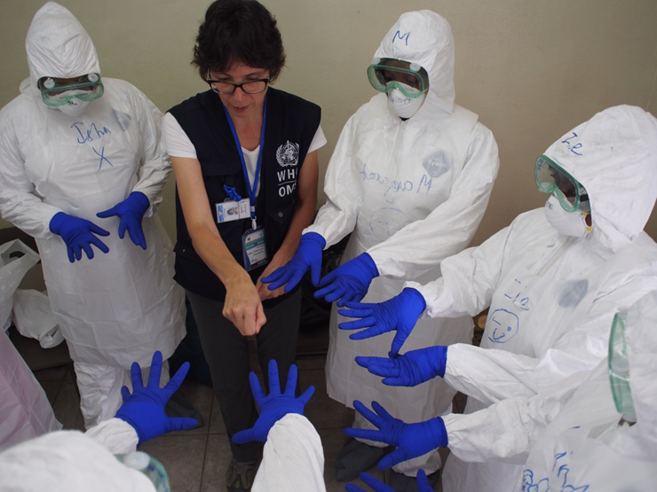
From risks to actions
Strategic risk analysis and profiling workshop
Geneva, 9 to 11 May 2018

Slide 2
What do we do with priority risks
Prioritization process
Decision making
Resources allocation
Effective & efficient
strategic planning
before
an emergency occurs

Slide 3
Mitigate the Level of Risk
Risk mitigation & preparedness to reduce likelihood and/or impact
Earthquake
Cholera
Measles
3
Notes:
World Health Organization
10 May 2018
3

Slide 4

Immediate Risk Mitigation Actions
pre-emptive vaccination
Include all actions to reduce the severity, probability of occurrence of, or exposure to, a given hazard and therefore lessen its impact
vector control
improved water and sanitation measures
risk communication
Notes:
Risk Mitigation actions includes all actions to reduce the severity, probability of occurrence of, or exposure to, a given hazard and therefore lessen its level of risk.
They often include actions such as vaccination, vector control measures, environmental measures such as WASH improvement, or risk communication to enhance community awareness on specific risks

Slide 5
Immediate Preparedness Actions
Refers to all actions to increase knowledge and capacity to anticipate, respond to and recover from the impact of one or more events
  Ensure Early Warning System is in place
  Preposition drugs, vaccines, medical supplies and other logistic items
  Identify potential treatment centers, train staff, ensure case management protocols are in place
  Organize a simulation exercise of the potential response
Notes:
Preparedness actions ensure resources are deployed to enable readiness to respond. They also refer to all actions to increase knowledge and capacity to anticipate, respond to and recover from the impact of one or more events.
They often include actions such as training, exercising, ensuring availability of case identification, confirmation, and case management protocols, organizing health care facilities so that they can accept more people or patients with a specific health needs such as trauma, or highly infectious diseases.

Slide 6

Contingency planning – Goal
GOAL
To address and prepare for each hazard with imminent or high risks for the health of people (as identified by the strategic risk analysis)
Notes:
High and imminent risks require the planning and implementation of measures to mitigate the potential health consequences of these risks and to be ready to respond in a more timely and effective manner should these risks cause an emergency.
These risks mitigation and response preparedness actions are organized into contingency plans which are hazard-specific and scenario-based. They are usually linked into a broader all-hazard emergency response plan.

Slide 7

Contingency planning – Results
RESULTS
A hazard specific action plan that:
List and organize all risks mitigation and preparedness measures needed to address the given risks
Clearly define roles and responsibilities for implementation of each planned actions
Notes:
Each hazard specific plan:
List and organize all risks mitigation and preparedness measures needed to address the given risks
Clearly define roles and responsibilities for implementation of each planned actions

Slide 8
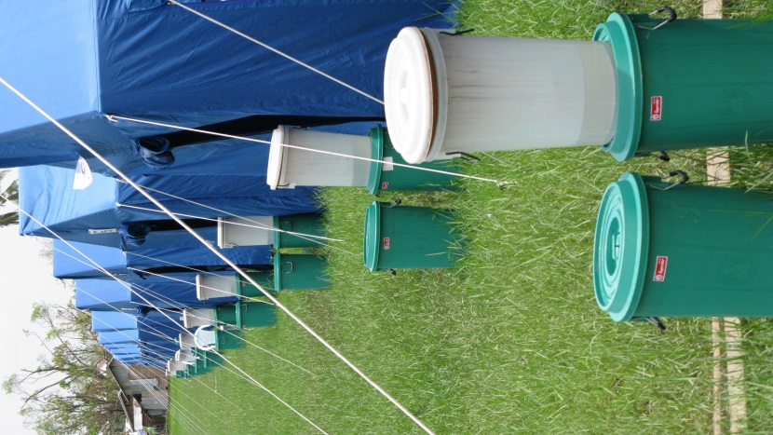
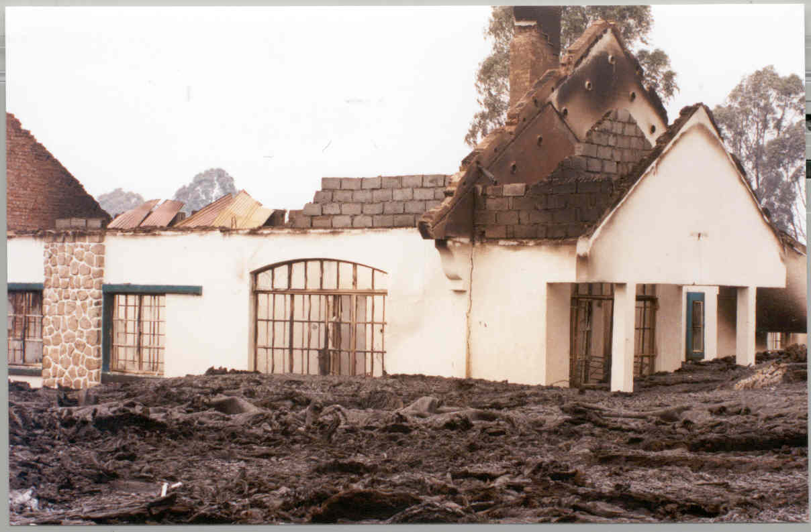
Contingency planning – Results
RESULTS
A hazard specific action plan that:
Identify all necessary means, resources needed for the implementation of these actions, including human resources, logistic or financial cost of implementation
Estimate time needed for implementation
Define how the plan implementation will be monitored
Notes:
Each hazard specific plan:
Identify all necessary means and resources needed for the implementation of these actions, including financial cost
Estimate time needed for implementation
Define how the plan implementation will be monitored

Slide 9
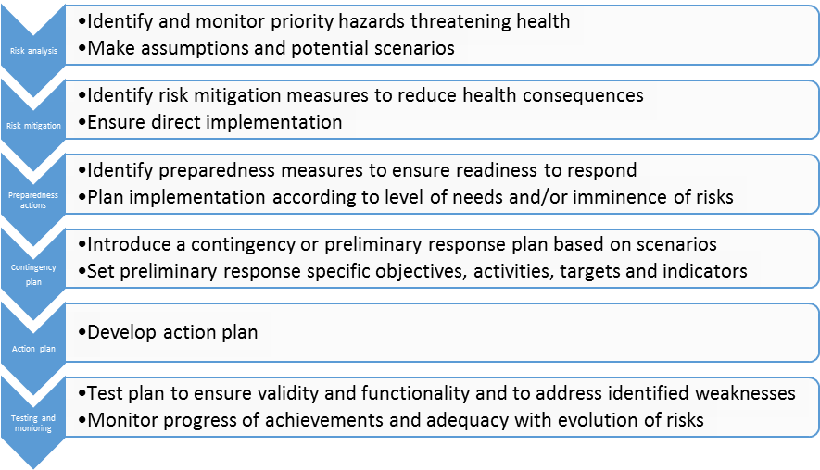
Contingency Planning: from risks to actions

Slide 10
Medium to long term planning for other risks
The risk matrix will compare and visualize the level of risks of different hazards:
Notes:
As indicated previously « Risk = Impact x Likelihood ».
Plotting hazards on a risk matrix will offer a visual and simple overview of the results of the risk assessment and the identification of those high risks that need to be prioritized for urgent actions and allocation of resources.
As a key function in the Risk Management Cycle, the purpose of the Strategic Risk Assessment is therefore to inform direct actions that will increase the level of preparedness of countries with respect to priority risks.
The likelihood and impact of a hazard (and hence the overall level of risk) can be reduced through risk mitigation and preparedness actions as we will see later.

Slide 11
Medium to long term planning
All hazard emergency preparedness plans
Core capacities according to relevant risks
National action planning for allocation of resources

Slide 12

Key elements
Good planning and appropriate allocation of resources
Notes:
Hazards and their related risks are fluid and need to be regularly monitored.
DEFINITION
Early warning systems are described as “The set of capacities needed to provide timely and meaningful information to enable individuals and communities threatened by hazards to act in sufficient time and in an appropriate manner to reduce the possibility of personal injury, loss of life and livelihoods, damage to property and the environment, and to prepare for effective response."

Slide 13
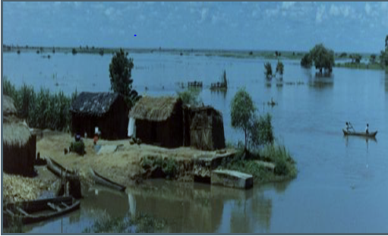
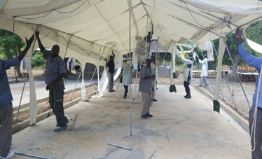
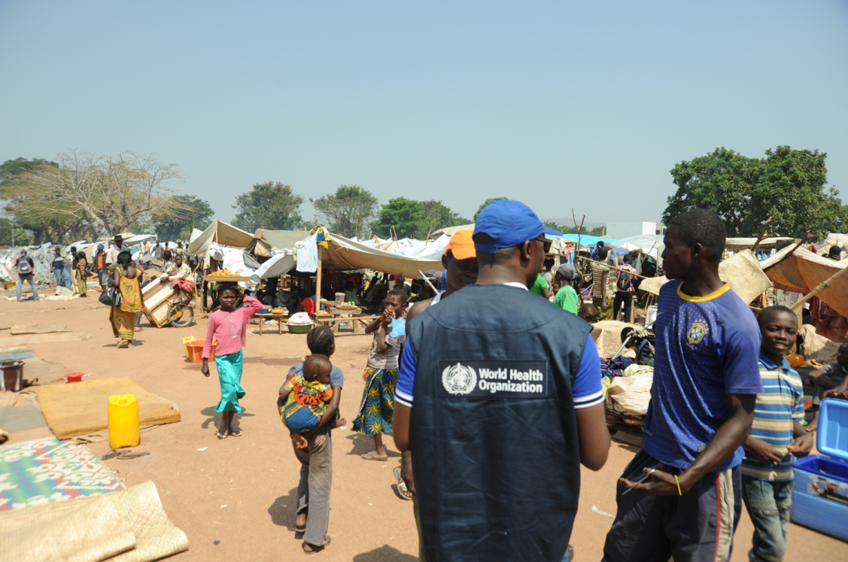
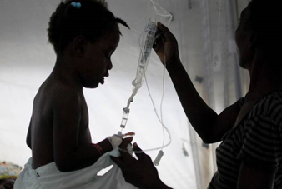
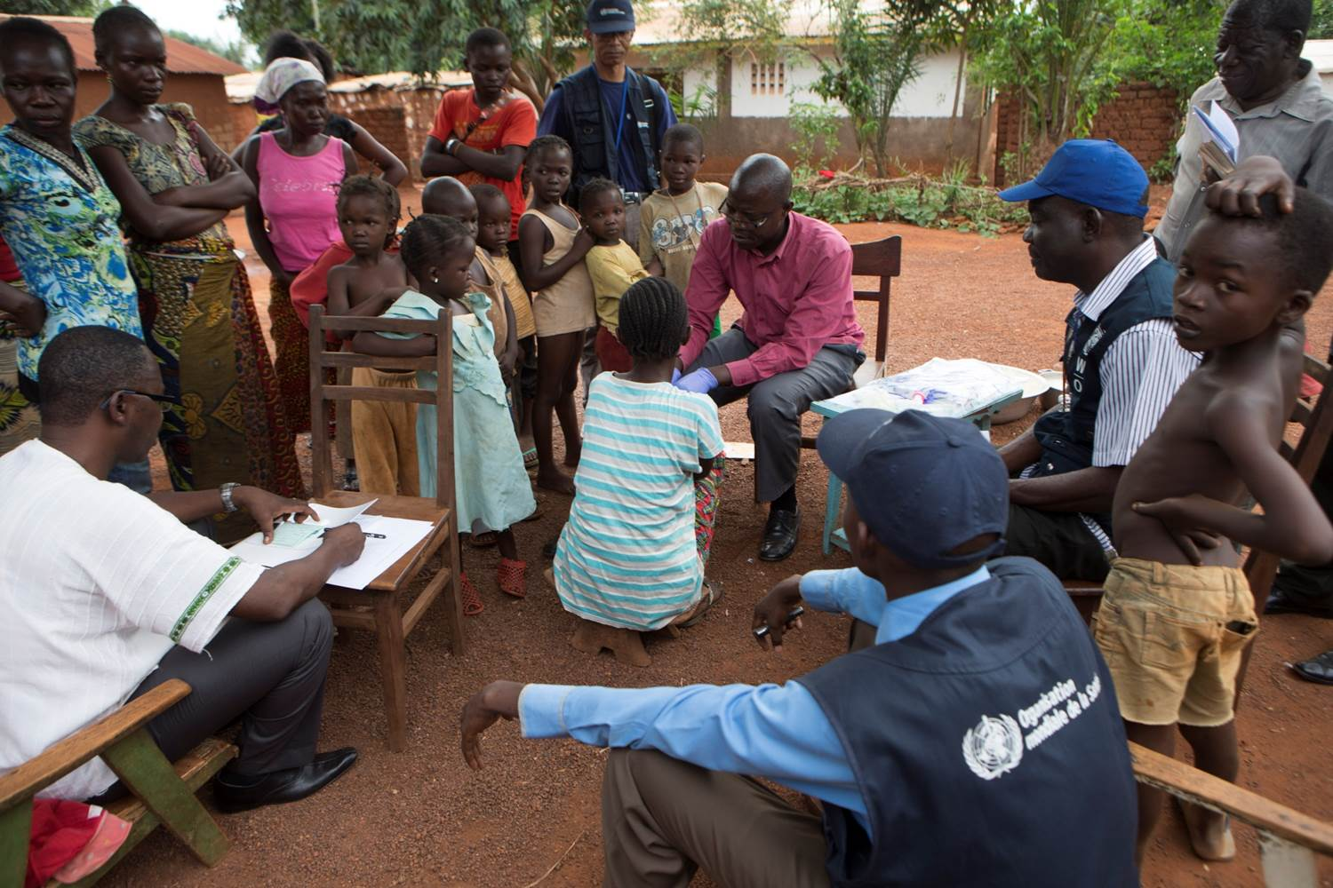
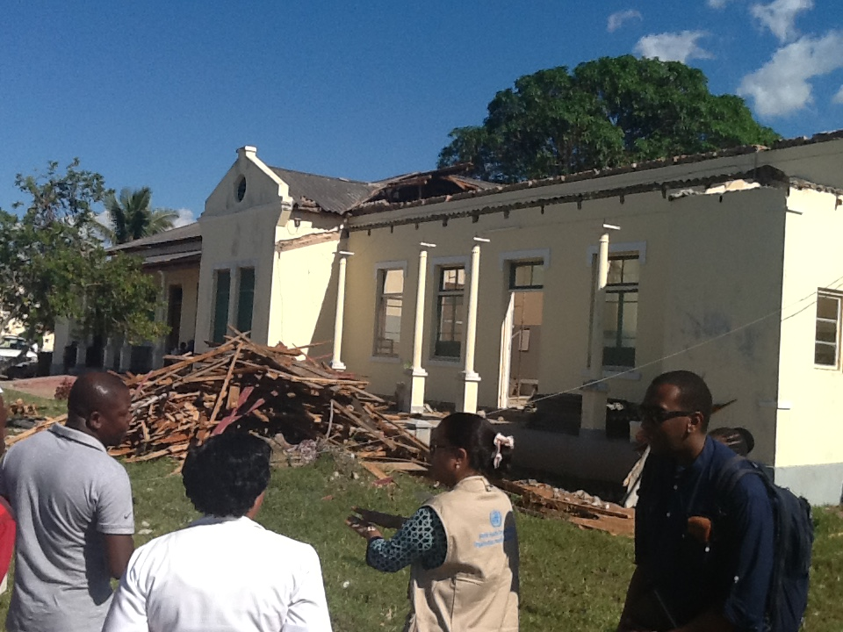

Questions?

Slide 14
Use of Strategic Health Risk assessments
Group 1:
Results communication (to who and how)
Group 2:
Actions for high and imminent risk(Planning for preparedness and response)
Group 3:
Actions for the all the risks
(core capacity building / resilience
Group 4:
Results to inform other country / international framework (such as elements of the IHRMEF)

