Slide 1
Influenza
Seasonal influenza
Zoonotic influenza
Pandemic influenza

Slide 2
Factors that support risk assessment for influenza
Asking the right risk assessment question.
Knowing seasonality and what is “normal”
Monitoring the viruses constantly
Understanding the capacity of a country to detect and respond
Having strong links with animal sector to understand risk of zoonotic influenza

Slide 3
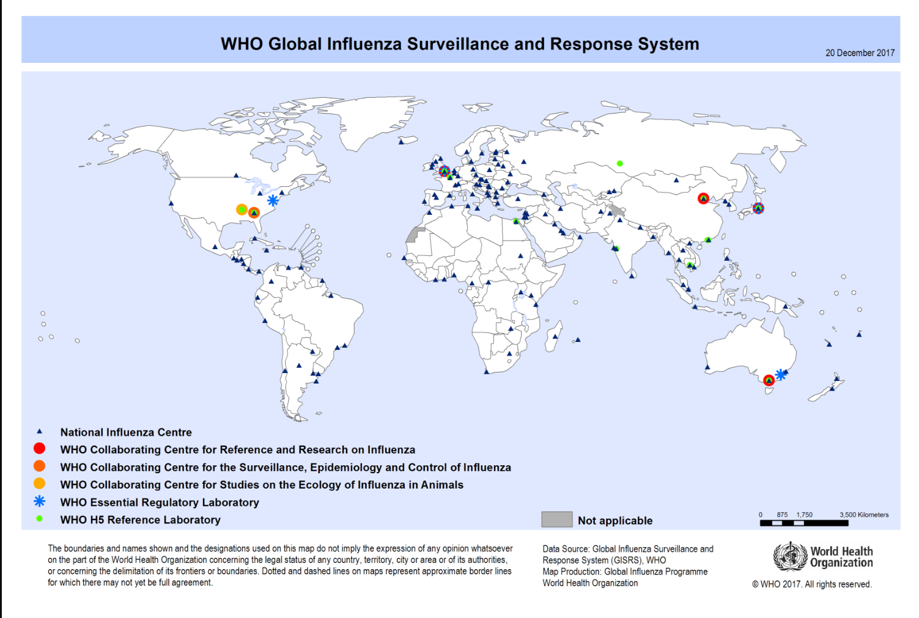
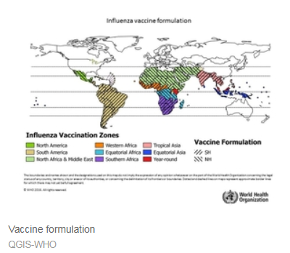
Knowing seasonality

Slide 5
The Review Committee on the Functioning of IHR (2005) in relation to Pandemic (H1N1) 2009
“The world is ill-prepared to respond to a severe influenza pandemic or to any similarly global, sustained and threatening public-health emergency”
Guidance was too rigid and directed to a pandemic of high severity.
Guidance should be flexible, simple, multi-sectorial, all hazard approach.
More emphasis to risk and severity assessment at national level.

Slide 6
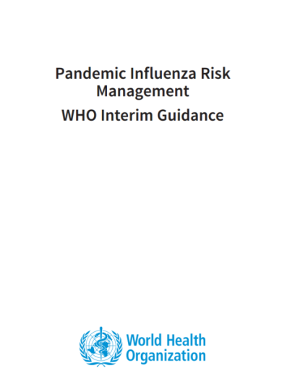
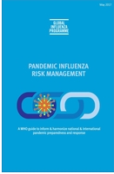
Pandemic Influenza Risk Management (PIRM)

Slide 7
(Pandemic) Influenza Severity Assessment (PISA)
Risk/severity assessment
Global Influenza Programme (GIP) World Health Organization Geneva, Switzerland
www.who.int

Slide 8
PISA Parameters: transmissibility, seriousness of disease and impact
Indicators are derived from parameters of virological, epidemiological, and clinical sources
Parameters are based on data collected routinely by established surveillance systems
Each country has unique surveillance systems and must choose parameters based on the data collected in their country

Slide 9
Steps in the PISA approach

Slide 10
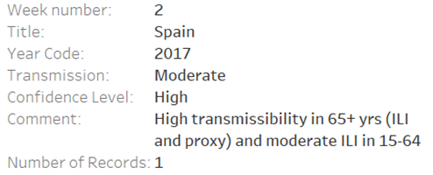
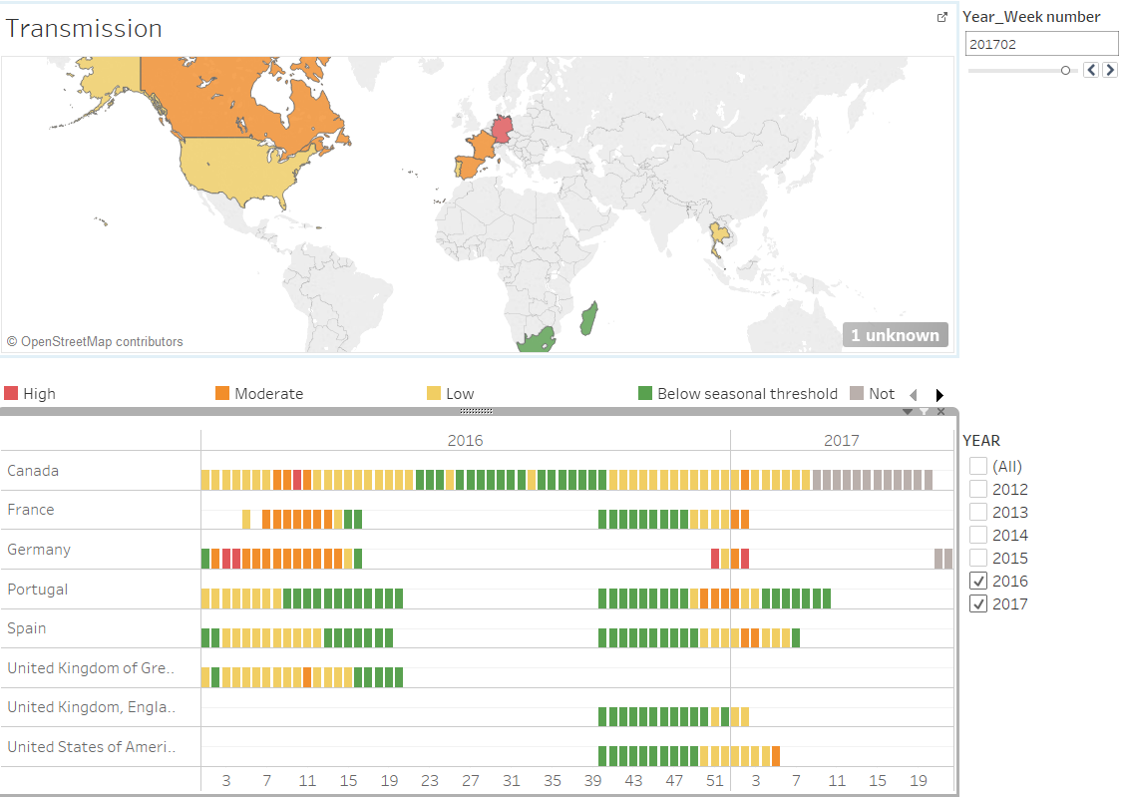
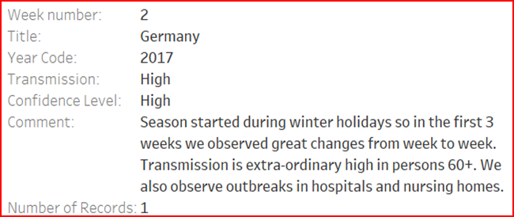
Global output for transmissibility

Slide 11
Looking for the unexpected and compare to the expected
H1N1v
Early detection needed to adequately respond to emerging pathogens
Routine sentinel surveillance of ILI and SARI alone will not be sufficient to pick up an emerging pathogen early, but is needed to know what is usual
Broad based involvement for detection
Triggers and reporting mechanism
H7
H3N2v
H5
SARS?
Other?
H2N1v
Novel coronavirus

Slide 12
Risk Question
What is the risk of sustained human-to-human transmission of the virus?
To evaluate this risk, two components, likelihood and impact, need to be evaluated:
Risk Question Component A: What is the likelihood of sustained human-to-human transmission of the virus?
Risk Question Component B: What is the impact to the human population of sustained human-to-human transmission of the virus?
Notes:
Both likelihood and impact are addressed

Slide 13
Multiple step process

Slide 14
Comparison with other viruses.
A(H5N6)
A(H7N9)
A(H5N6)
A(H1N1) TRIG
A(H1N1) TRIG
Notes:
Note: A(H5N6) risk assessment was done in April 2016, A(H7N9) in September 2016, A(H9N2) in December 2016.

Slide 15
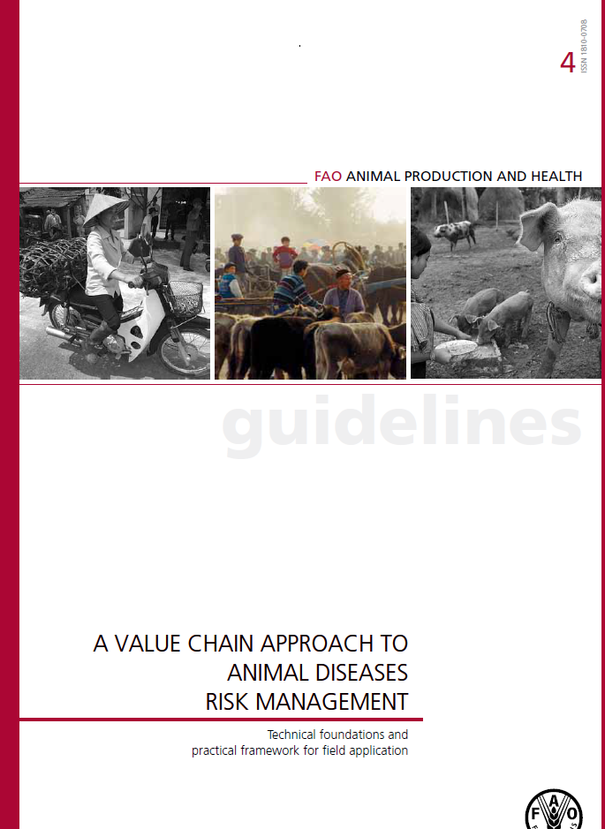
Strong collaboration with animal health sector

Slide 16
Actions taken based on assessments
Notification/communication of current risk
Seasonal start/end, severity
Recommendations for antivirals, elective surgery, bed distribution, vaccination
Vaccine development and switch
Interaction with animal site for actions on live stock

Slide 17
Acknowledgments
Global Influenza Programm
GISRS (Global Influezna surveillance and response systhem)
TIPRA and PISA partners

