Slide 1
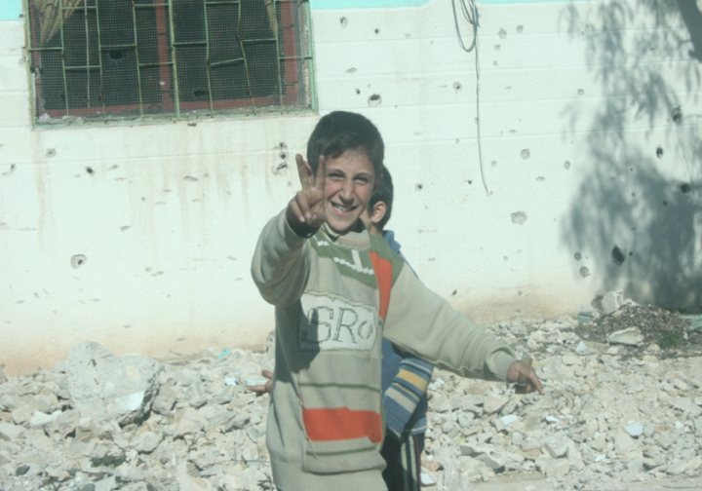
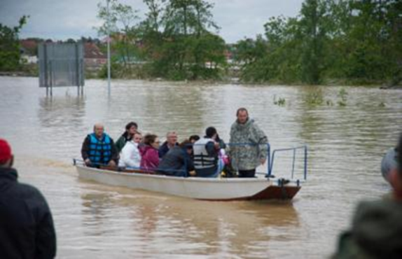
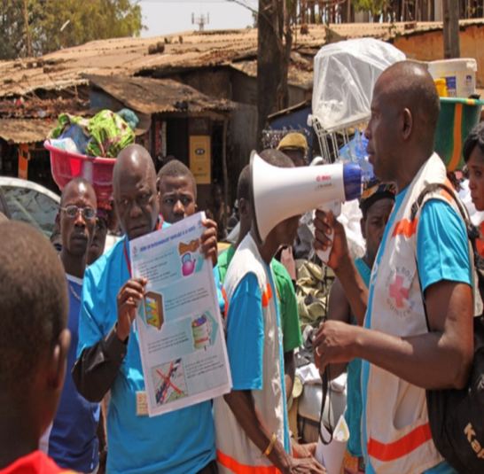
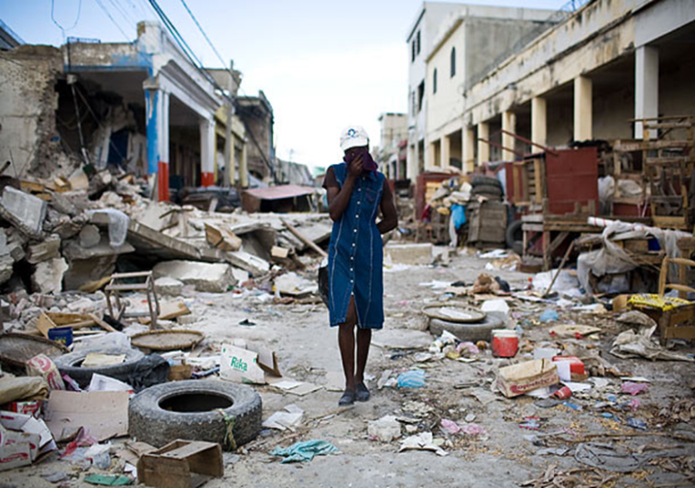
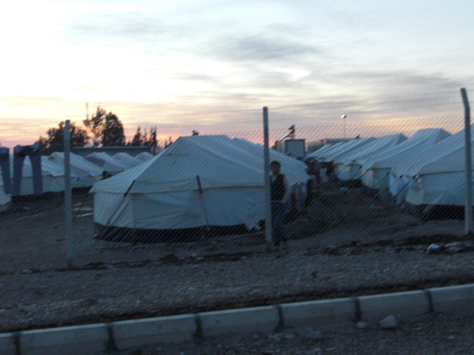
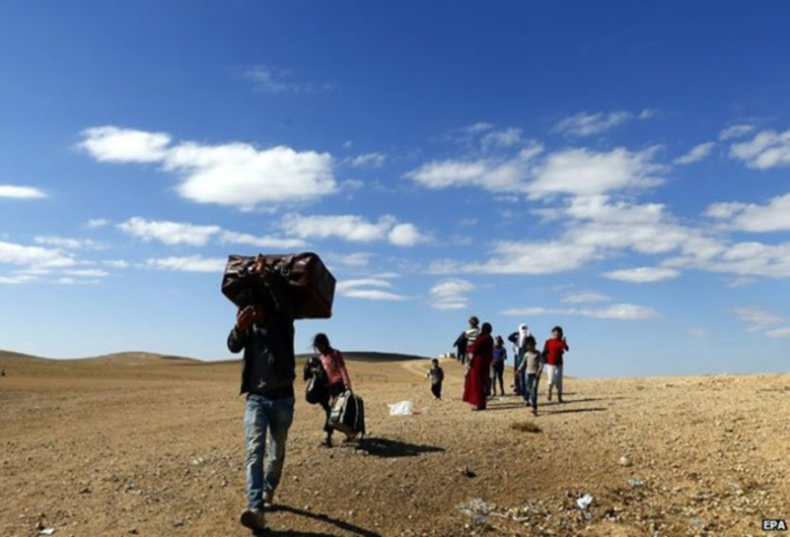
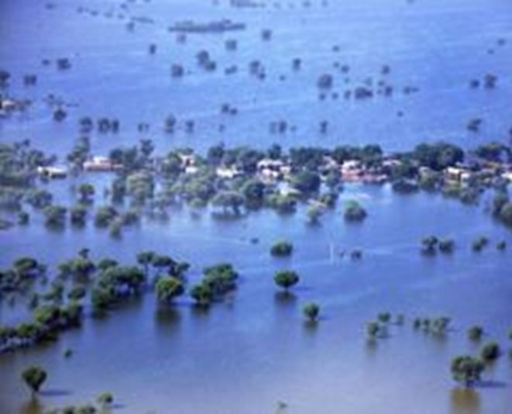
WHY?
Risk-Informed Planning and Smart Risk Management
Jetri Regmi and Irshad Shaikh
WHO Program on Emergencies (WHE)
Division of Communicable Diseases and Emergencies (DCE)
Country Health Preparedness and IHR (CPI)
WHO, EURO

Slide 2
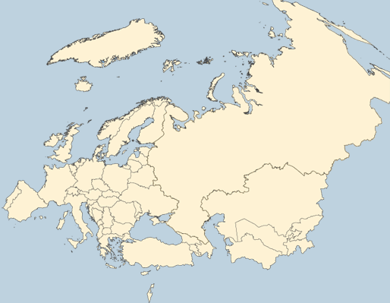
WHO European Region - Diversity and Variations/ Inequities
55 IHR States Parties (894 million people):
53 WHO Member States , The Holy See (observer) and Liechtenstein
Significant variations:
- By population size (2017):
San Marino: 33,000 people
Russian Federation: 144,031,000 people
- By GDP/Capita (2016):
Tajikistan: $ 818.63 [rank 163]
Luxembourg: $ 107,708 [rank 1]
WHO Country Offices (29/53)
Notes:
Rank out 185

Slide 3
Words of Wisdom
Failing to Prepare is Preparing to Fail!
“Problem of our times is that future isn’t what it used to be” French poet Valerie Davos 2008

Slide 4
Changing Face of Global (Health) Security Risks: nature, magnitude, scale, & partners
Paris! → intentional mass casualty events; Air France lost $76 million in one week of terrorist attacks
1997-2009: six major outbreaks of highly fatal zoonoses – e.g. Ebola, SARS, avian and H1N1 flu - an estimated $80 billion in economic losses
Post-Ebola - blurring between Global Security and Global Health Security
New-found partners (private sector e.g. reinsurance providers – $ 4 Billion losses from Pandemic)

Slide 5
Different Future - 2
Paradigm Shift in support for Risk Management - Highest levels of political advocacy:
G20 (Brisbane, November 2014) Leaders Statement on Ebola urged “the WBG and IMF to continue their strong support for the affected countries…
G7 Leaders Statement (June 2015) …. support the initiative taken by the World Bank and WHO to develop a Pandemic Emergency Facility (PEF). …..mechanisms for rapid deployment of multidisciplinary teams of experts coordinated through a common platform
EC: Health Security Committee, WG

Slide 6
All-Hazards Approach to Risk Management
An all-hazards approach to risk management does not imply that all hazards will be evaluated-addressed but that all hazards will be considered!

Slide 7
The Disaster Risk Perspective: Understanding Risk
All Hazards Approach - Conceptual Basis
Risk is a disaster that hasn’t happened (yet)
Risk = Hazard x Vulnerability
-----------------------------------
Capacity
Hazards cannot (always) be avoided – but disasters can!

Slide 8
Risk Assessment - Methodological Application in EURO
1. Risk Identification: identify all known/possible risks – establish a Risk Register
2. Risk Analysis: understand the nature and level of each risk in terms of its impact and likelihood
a) Likelihood/probability of occurrence
b) Impact Analysis
Geographic area at risk?
Population size and kind (healthy people and/or only frail, elderly, already sick, etc.) at risk?
Severity/contagiousness of the health problem?
Risk for cross-border/IHR implications?
Risk for the environment in the long term?
3) Risk Evaluation: prioritize risks in consultation with member states

Slide 9
Smart’ Risk Management
‘SMART’ RISK MANAGEMENT
Risk prevention when possible (e.g. outbreaks; environmental accidents)
Risk Reduction:
Mitigation to reduce probability (e.g. operational readiness steps; trainings)
Adaptation to reduce potential severity (climate change adaptation; trauma kits; prosthesis)
Risk Transfer - sharing/ pooling
social protection programs
Risk insurance (e.g. UHC)
Residual Risk Management
Emergency Preparedness
Operational Readiness
Emergency Response
Recovery (Build Back Better)

Slide 10
‘SMART’ RISK MANAGEMENT - II
EURO works with MS to create a baseline - common standing capability to deal with anticipated priority risks but that can also be modified to address the unexpected.

Slide 11
RISK = HAZARD X VULNERABILITY
----------------------------
COPING CAPACITIES
RISK ASSESSMENT PROCESS
HAZARDS
Fire
Explosion
Hazardous material /
Chemical
Natural Hazards
Terrorism
Pandemics
Utility Outages
Mechanical breakdown
Supplier Failure
Cyber attack
Assets at Risk
People
Property (Bldgs., critical infrastructure)
Supply Chain
Systems/ Equipment
Information Technology
Business Operations
Reputation/ Confidence
Environment
IMPACTS
-Casualties
Property damage
Business/ Service Interruption
Loss of customers/ confidence
Financial losses
Environmental damage
Fines and penalties
Lawsuits
Probability &
Magnitude
Vulnerability
HAZARD
IDENTIFICATION
VULNERABILITY
ASSESSMENT
IMPACT ANALYSIS

Slide 12
EURO: Major Risks and Trends
EURO – major health-related risks
Environmental Risks | Geopolitical Risks | Societal/CD Risks
Natural Disasters (e.g. earthquake, tsunami, volcanic eruption)/Extreme weather events (e.g. floods, storms, etc.) | Failure of national governance (e.g. failure of rule of law, corruption, political deadlock, etc.) | Emerging/Re-emerging pathogens/Rapid and massive spread of infectious diseases/ AMR/Pandemics
Man-made environmental disasters (e.g. oil spills, radioactive leaks)/ Intentional terrorist events (e.g. radio-nuclear devices) | Interstate conflict with regional consequences | - Failure of urban planning/Rapid Urbanization - Dilapidated/ Over- stretched Infrastructure
Major biodiversity loss and ecosystem collapse | Large-scale terrorist attacks | Large-scale involuntary migration
Failure of climate-change mitigation and adaptation | State collapse or crisis (e.g. civil conflict, military coup, failed states, etc.) | Profound social instability
 | WMDs | Water Crisis

Slide 13
Priority Countries in EURO
Based on hazards (all-hazards) and health system maturity, 15 priority countries identified.
Priority 1: Turkey and Ukraine (protracted emergencies)
Priority 2 : Georgia, Kyrgyzstan and Serbia (sub-regional hubs)
Others: Albania, Armenia, Azerbaijan, Bosnia and Herzegovina, Kazakhstan, Kosovo, Macedonia, Republic of Moldova, Tajikistan and Uzbekistan

Slide 14
From ‘Signals’ to Action
Capacity
Are there EPR systems in place?
Capability
How do these systems function?
Operational Readiness
How effective can these systems deliver/ perform in crises?

Slide 15
Pending Challenges to Risk Analysis in EURO
How to decide how much to invest in what kind of risk analysis?
How to conduct risk analysis when funds for risk analysis are not available?
How to determine stakeholder participation in risk analysis ?
How to conduct risk sensitivity analysis/modelling/predictive value?
End-user/Beneficiary fatigue (pandemic, terrorist threat, etc.)?
How to ensure government’s buy-in/private sector engagement?
(Ab)use of social media?
How to create structures for continuous risk analysis?
How to develop institutional capacity on risk-informed programming of: WCOs , Government counterparts, and Civil Society Partners

Slide 17
Implementation status of IHR core capacities 2010-2016
http://apps.who.int/iris/bitstream/handle/10665/84933/WHO_HSE_GCR_2013.2_eng.pdf?sequence=1
http://apps.who.int/iris/bitstream/handle/10665/255756/WHO-WHE-CPI-2017.41-eng.pdf?sequence=1
Data source: http://apps.who.int/gho/data/node.main-euro.IHR00ALLN?lang=en as of 20 April 2018

Slide 18
Example: Armenia

Slide 19
Example: Kyrgyzstan

Slide 20
L
I
K
E
L
I
H
O
O
D
EXTREME
WEATHER
EVENT
TOP 5 GLOBA L RISKS 2018
By Likelihood and Impact
GLOBAL RISKS LANDSCAPE 2018
World Economic Forum, Davos
1
NATURAL
DISASTERS
2
DATA
FRAUD/
THEFT
3
CYBER
ATTACKS
4
FAILURE OF
CLIMATE CHANGE
MITIGATION
5
WATER
CRISIS
FAILURE OF
CLIMATE CHANGE
MITIGATION
NATURAL
DISASTERS
EXTREME
WEATHER
EVENT
WMDs
5
4
3
2
1
I M P A C T

Slide 21
“….trouble occurs not because of one failure but because of the way many different pieces interact”
PG Neumann

Slide 22
Thank You

