Slide 1
RISK ANALYSIS AND ASSESSMENT
IN THE AFRICAN REGION
CPI/AFRO

Slide 2

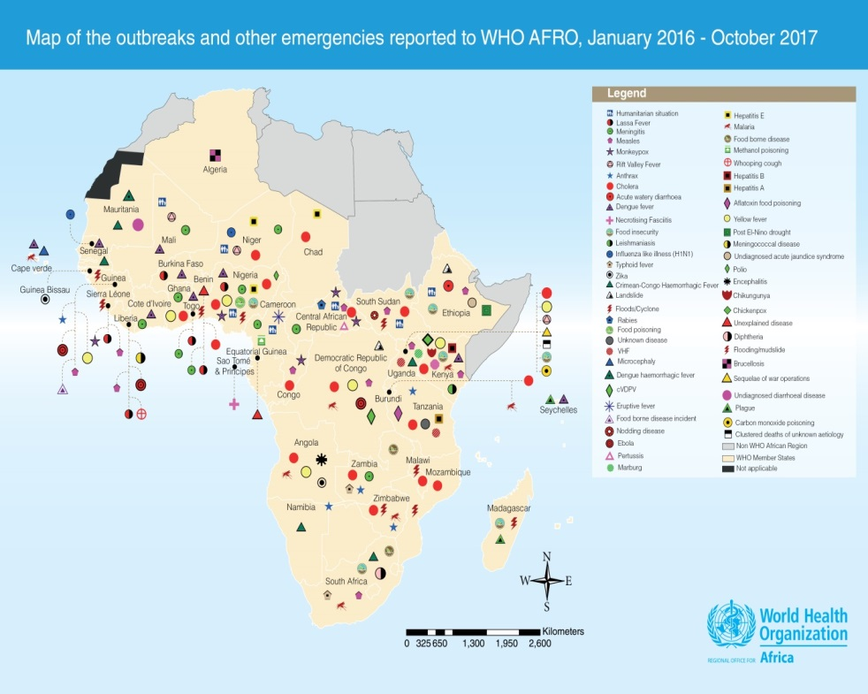
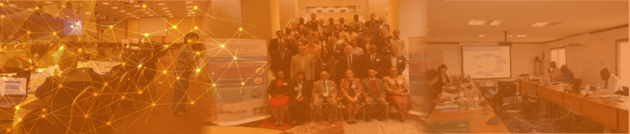
Introduction: Alarming reality
High risk of health emergencies
Very limited IHR core capacities
The impact of recurrent public health emergencies can be reduced by being well prepared, and engaging all relevant sectors.
Notes:
Member States of the World Health Organization (WHO) African Region are challenged by recurrent outbreaks and other health emergencies.
Despite progress made on preparedness and response to priority outbreak- prone diseases including other public health emergencies, Member States have lagged behind in establishing the International Health Regulations (2005) core capacities, the implementation of the Integrated Disease Surveillance and Response (IDSR) and the Regional Strategy for Disaster Risk Management (DRM). In addition, health system weaknesses in most Member States hamper emergency response.

Slide 3
Introduction……2
Risk assessment is a component of the Disaster Risk Management cycle.
The regional strategy for DRM-H (2012) proposed to Member States to strengthen disaster risk management
Risk profiling/assessment a requirement for capacity in the JEE
Assesses and maps the risks from a health sector perspective.

Slide 4
Preparedness for better response
PHE
Before
During
After
Detection
Recovery
Prevention
RRA
Prevention
Response
Preparedness +++++
Preparedness ++
Preparedness +++
STAR
VRAM
AAR
Readiness
NAPHS
Development & Implementation
NAPHS
Implementation
NAPHS
Implementation

Slide 5
2018-19 AFRO/CPI Results chain
Activities
Outputs
Outcomes
Impact
Core capacities assessed and NAPs developed
Core capacities for preparedness, DRM and IHR strengthened
Operational readiness plans (WHO and partners) in place and tested
Secretariat support provided for IHR implementation
Countries prepared to face all-hazard emergencies
Countries engaged in fulfilling their obligations to develop core capacities for preparedness and IHR
Decreased morbidity and mortality from public health events
STAR/VRAM
IHRMEF
NAPHS
IDSR
DRM-H
RRT training
IHR NFP Cap.building
WHO readiness
All countries assess and address critical gaps in core capacities for preparedness, IHR and for all-hazard health emergency risk management
Secretariat Accountability
Joint Responsibility with Member States & Partners

Slide 6
CPI implementation process/tools
Strategic vulnerability and risk profiling and mapping
STAR
1
VRAM
AAR
Core Capacity Assessment
SIMEX
2
JEE
CCA
3
Development of National action plans
NAPHS
Guides
Training modules
IDSR
4
Capacity building and training
IHR
DRM-H
5
Documentation, Monitoring & Evaluation
Articles
Reports
IHR AR
AFR TA

Slide 7
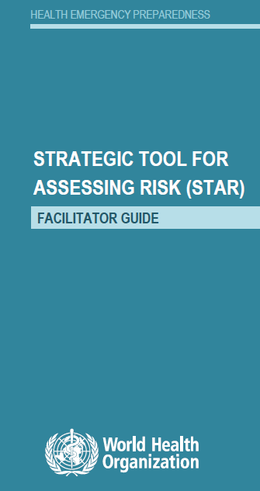
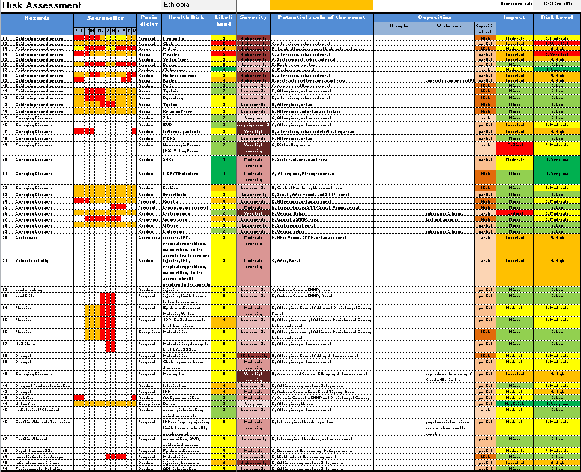
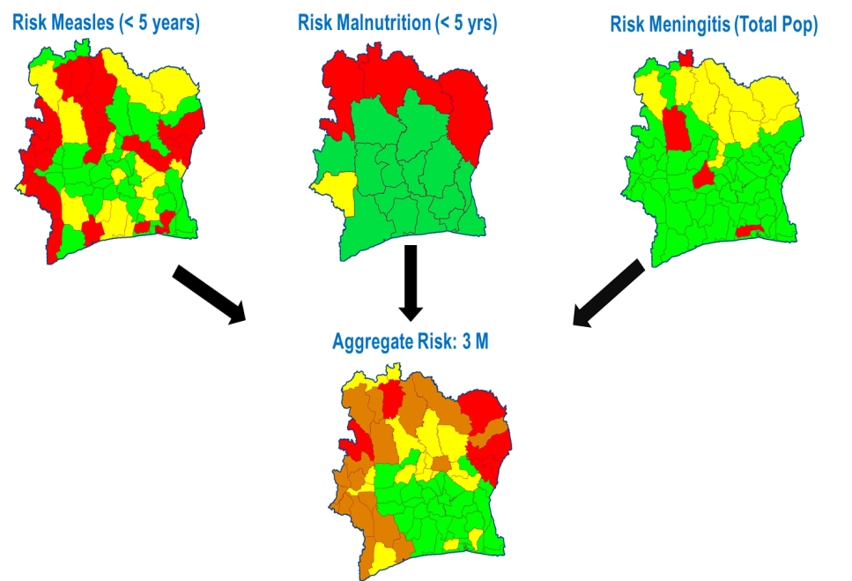
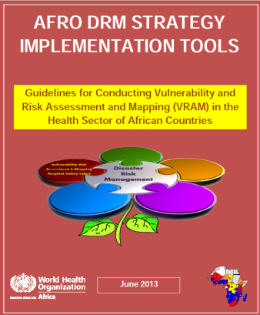
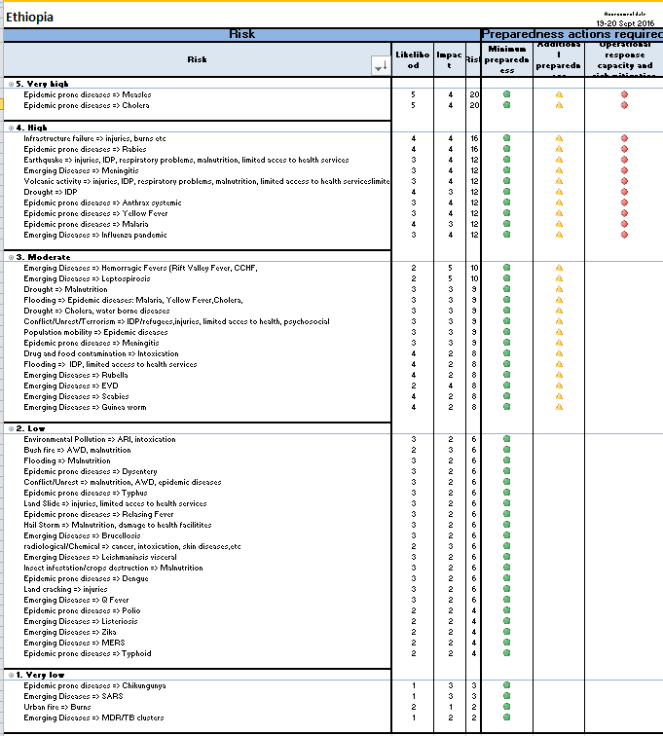
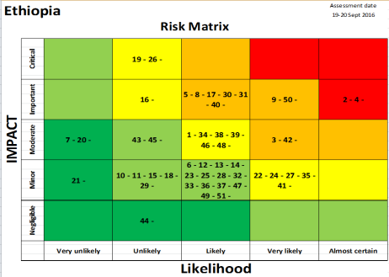
Risk Profiling, Assessment & Mapping tools
Strategic Tool for Assessing Risks (STAR)
Vulnerability risk assessment and mapping (VRAM)
Information for policy, planning, implementation, evaluation and monitoring including preparedness to build health system and community resilience to the public health impact of emergencies

Slide 8
Risk Profiling, Assessment & Mapping target 2018
At least 80% of Member States will have conducted outbreak and disaster risk analysis and mapping in a multisectoral approach by 2018
Baseline: VRAM-15%; STAR-51%
Risk profiling is undertaken before an event occurs
STAR at strategic, VRAM at operational level
Hazard Analysis
Vulnerability & Capacity Analysis
Risk Analysis
Mapping
Building Resilience
Process

Slide 9
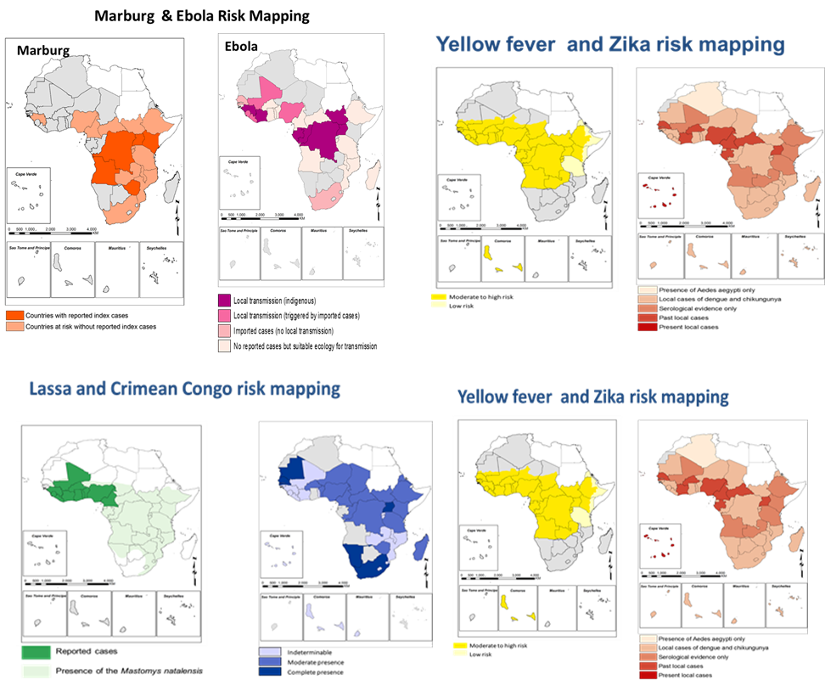
Risk mapping
Source: AFRO Surveillance and lab data base

Slide 10
Key Achievements
Health Sector DRM-H CCA conducted in 29/47countries
Multi-hazard VRAM conducted in 9 countries
Hazard Profiling (STAR) conducted in 24 countries
9 countries have developed National Action Plan for Health Security (NAPHs)
Established partnerships/collaboration with academic institutions
(Makerere University,Uganda and Ouidah School of Public Health, Benin)
Risk profiling/assessment (VRAM) for Zambia, Lesotho, South Sudan (Underway)

Slide 11
Key Challenges
Insufficient HR with experience in risk profiling/assessment in Member States
Limited awareness of the benefits and insufficient use of Risk profiling/ assessment by Member States
Limited critical mass of HR capacity for risk profiling/assessment in WCOs
Multiple emergencies with competing demand on WHO staff at regional level to implement of response vs. preparedness activities including risk profiling/assessment
Gaps in data availability /access

Slide 12
Priority actions (2018)
Harmonize approach to conducting STAR and VRAM in Member states
Support Member states to conduct risk profiling/assessment in Member States (achieve 2018 AFRO/CPI target-80%)
Strengthen partnerships and collaboration with other sectors, as well as intra- and inter- Programme collaboration (HSS, PHE, etc)
Support Member states to utilize risk profiling/assessment report in the all-hazard preparedness and response/ contingency Planning
Increase critical mass of HR capacity for risk profiling/assessment in AFRO,WCOs and MS

Slide 13
Thank You

