Slide 1
Public Health Situation Analysis
Health
emergencies
programme

Slide 2
Interactions between PHSA, RRA and STAR
Product / aim | Focus | Method | Aim | When | Team
Rapid Risk Assessment | Happening event and its risk | RRA | Providing risk assessment | Upon notification | DVA
Public Health Situation Analysis | Potential risks/vulnerabilities/hazards; Underlying factors | Secondary Data Review RRA | Providing overall situation analysis; Indentify priorities and info gaps | 48-72 hrs Upon request | MDC
Strategic Risk Assessment | Risk management cycle; All hazard approach | Expert judgement/workshop | Identify priorities for preparedness | Related to plan | CPI

Slide 3
Flow chart of Public Health Information Services
Public Health Situation Analysis (PHSA)
Rapid Health Assessment
Humanitarian Emergency Settings Perceived Needs (HESPER) Scale
Early Warning Alert and Response System (EWARS)
Population Mortality estimation
Monitoring Violence against Health (MVH)
core services
additional services
Health Status and Threats for affected Populations
context-specific services
Who, What Where (3W) matrix
Partners’ List
Health Resources Availability Monitoring System (HeRAMS)
Health Resources and Availability
Operational Indicator Monitoring
Health Management Information System (HMIS)
Vaccination coverage estimation
Health Cluster Bulletin
Ad hoc Infographics
Health System Performance
Health cluster action

Slide 4
Why ?
Public situation analysis due to crisis/event
Identify:
Overall potential risks/hazard
Capacity on the ground
Priorities
Action suggested/ Recommendations
Information gaps
Support grading process
Feed sectoral and intersectoral products (internal communication, HNO, MIRA)

Slide 5
When
upon request (EMO)
new event (48-72 hours later)
several countries involved
vulnerable context
need of update

Slide 6
Methodology
Data source: secondary data review
Lead by: MDC (level depending on situation)

Slide 7
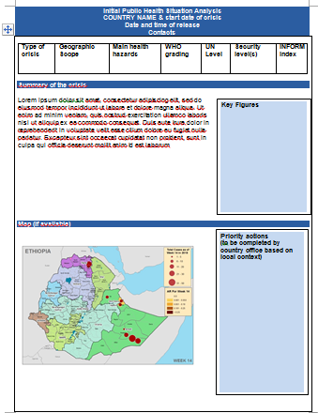
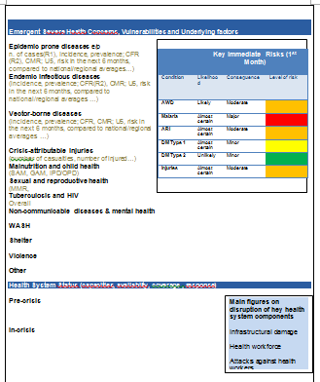
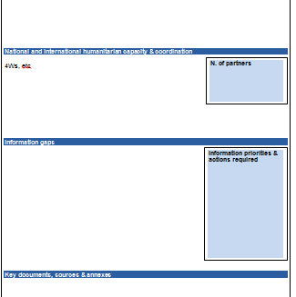
New Template

Slide 8
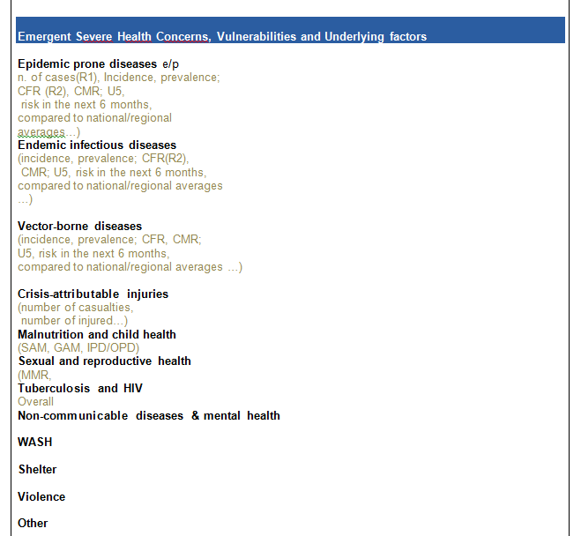
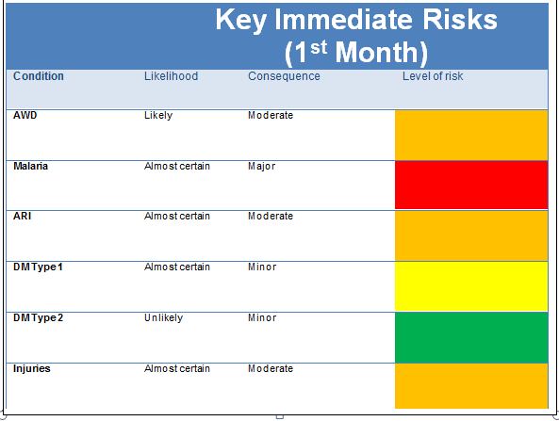
Underlying factors, Determinants of health
Context….

Slide 9
Conclusions
New template
Mixed methodology
Support grading
Complementary interaction with tools

