Slide 1
WHO
Rapid Risk Assessment - RRA
Sophie Ioos – WHE – HIM/DVA
Workshop and Training on Strategic Risk Analysis
and Profiling for Health Emergencies
9 - 11 May 2018, Domaine des Penthes, Geneva
Notes:
Health Emergency Information & Risk Assessment a.i.
Health Emergencies Programme
World Health Organization

Slide 2
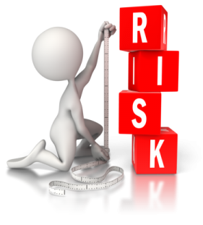
Overview of presentation
Background + Risk Assessment in general
What is a Rapid Risk Assessment (RRA) ?
Why ? (Objectives - Goal)
When ? (Criteria)
How ? (Process)
References

Slide 3
Background
Mandates
IHR (Art 5, 6, 7, 8, 9, 11) : results of the assessment - guides WHO‘s communication under IHR and type of communication support required
“WHO should communicate information to other States Parties that might help them in preventing the occurrence of similar incidents …” (Art 11, IHR, 2005)
2016 World Health Assembly - WHA
  Establishment of a WHO Health Emergencies Program
  Transparency, reliability, consistency
  Commitment to conduct and communicate risk
  Assessments for acute public health events
Reform of WHO’s work in health emergency management A69/30 (WHA 69, 2016)

Slide 4
Risk Assessment for public health
Evaluation of the information with a particular focus on human public health impact
Always requires various expertise and experiences to understand the hazard, exposure and context
Can be a “quick” assessment or very comprehensive with detailed documentation

Slide 5

What / Why RRA ?
Systematic and evidence based
  Hazard, exposure, context
  Risk characterisation
Done in a multidisciplinary team : 3 levels of the organization (HQ, RO, CO) and WHO technical teams- Potential consultation of external expert (WHO discretion)
Rapid/ finalized in one day / no more than two pieces of paper
Use existing WHO risk assessment framework
Repeated assessments until an event is considered low risk
-> Information for ACTION :
appropriate public health interventions
and recommendations regarding
acute public health events that occurred

Slide 6
What / Why WHO’s RRA ?
Document /formalize WHO’ assessment of risk posed by acute events (assess and characterize the risk)
Highlights urgent actions required (for decision makers, WHO operations/technical teams and partners)
Reflect WHO’s independent assessment including country’s capacities /vulnerabilities to control outbreak/event
Not public document
  Should/could be shared with Member State when finalized
  Shared with GOARN Steering committee
  Systematically shared with UN General Secretariat when overall risk “High or Very high”

Slide 7
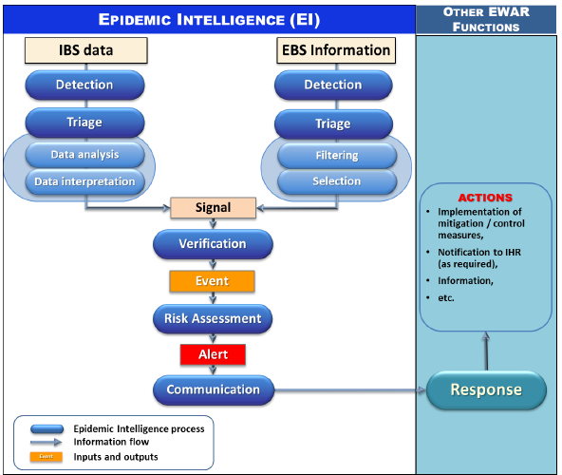

Slide 8
Verified signal = Event
Once signal is verified, it is considered/regarded as an event
Not all events are serious and require follow up
Criteria to do a risk assessment - Not done for all events

Slide 9
When to conduct a RRA ?
Criteria
For Acute Public health events :
  Meeting Annex 2 IHR criteria
  Complex issues involving multiple countries
  Insufficient information to adequately assess situation with high level of uncertainty
  WHO support/response anticipated/required
  Reputational risk for WHO
Preliminary step before further actions or response : grading, deployment
Notes:
Grading internal process, ERF
CBRN and intentional release

Slide 10
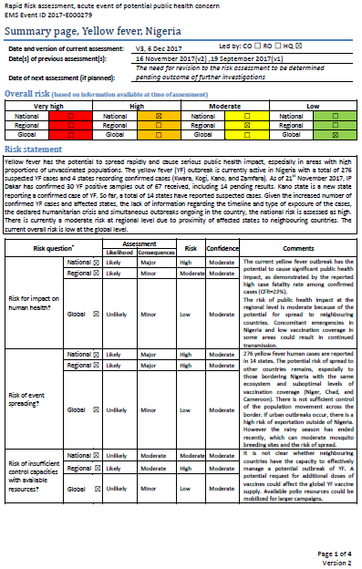
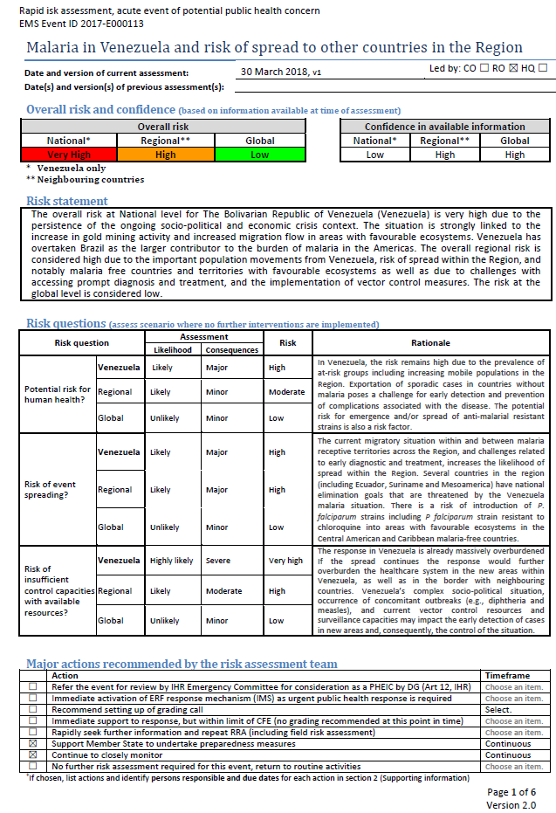
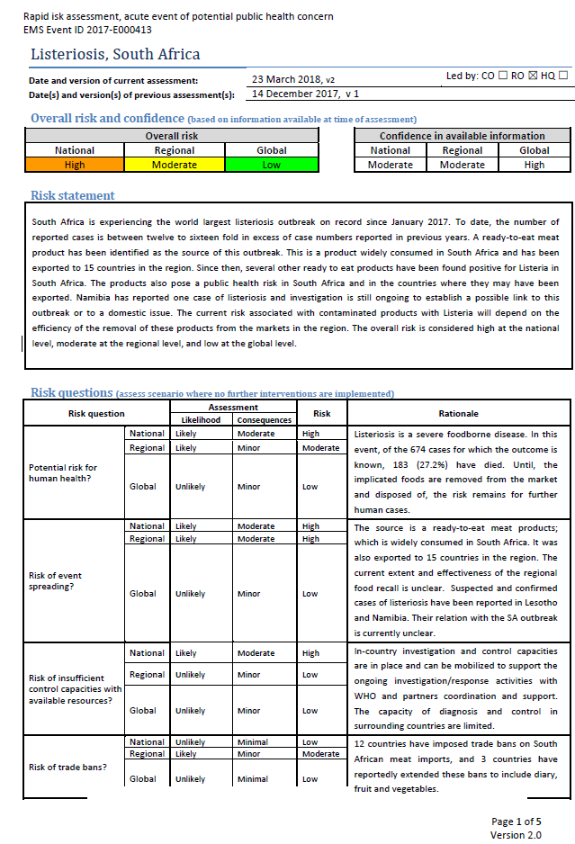
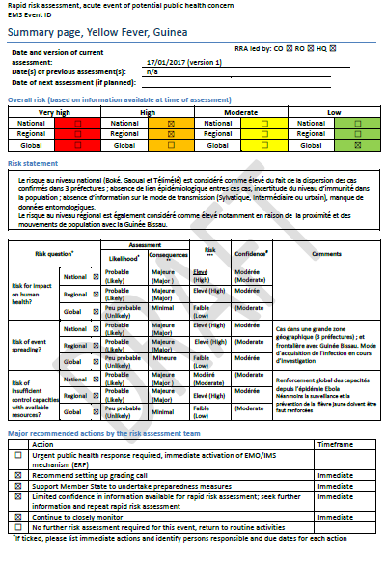
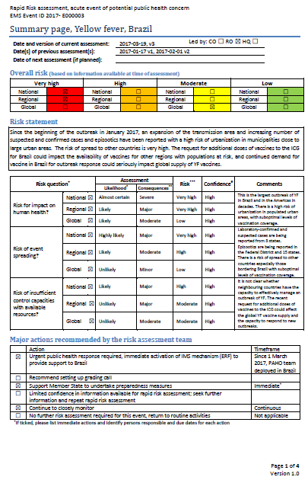
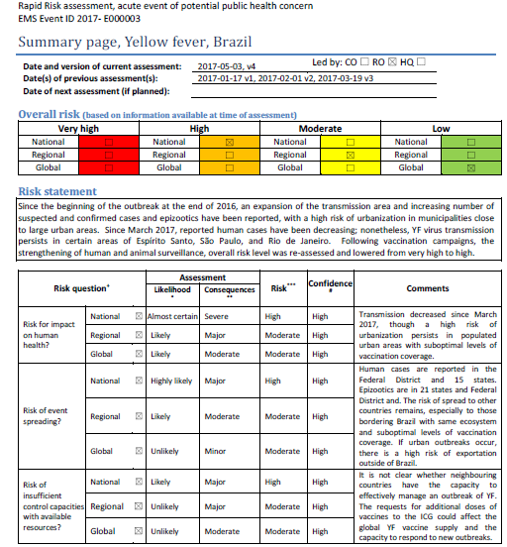

Slide 11

RRA - Process

Slide 12
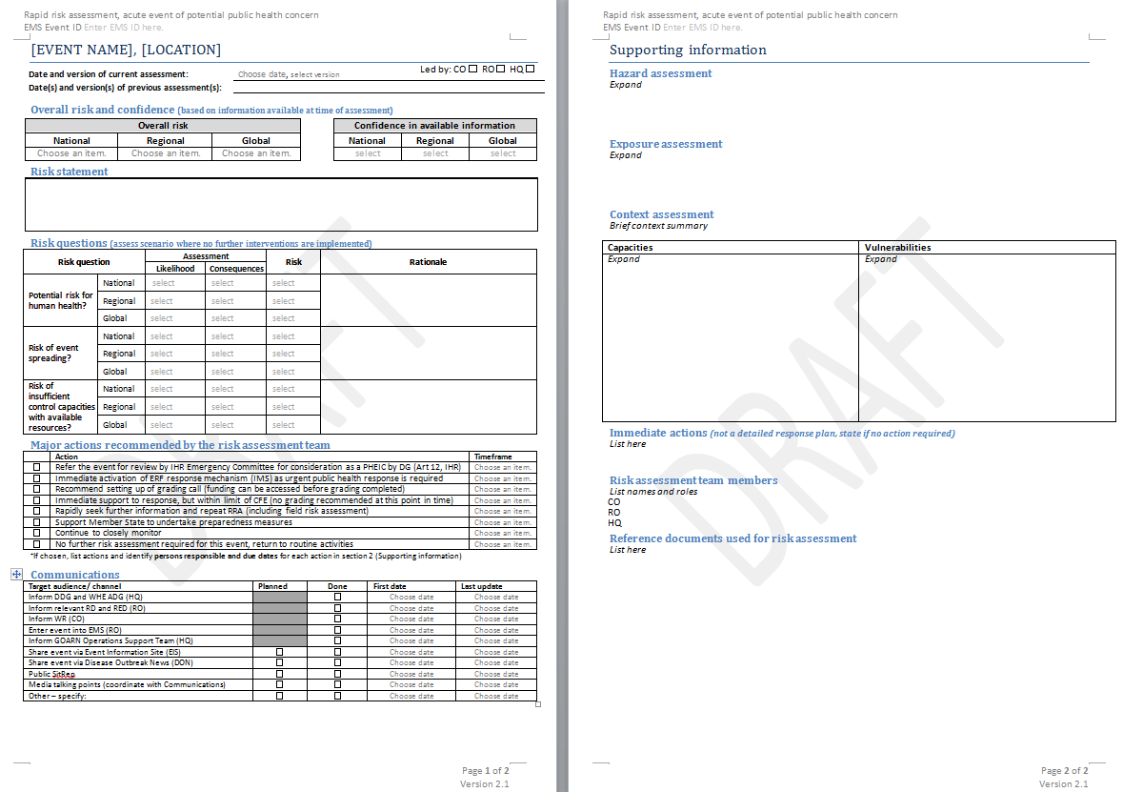
How can this be documented?

Slide 13
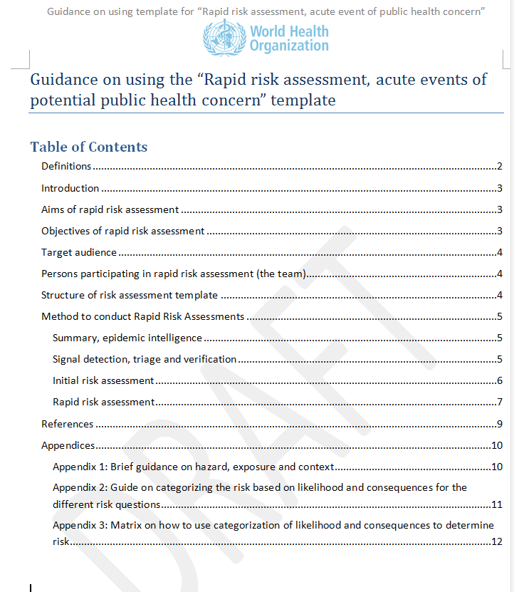
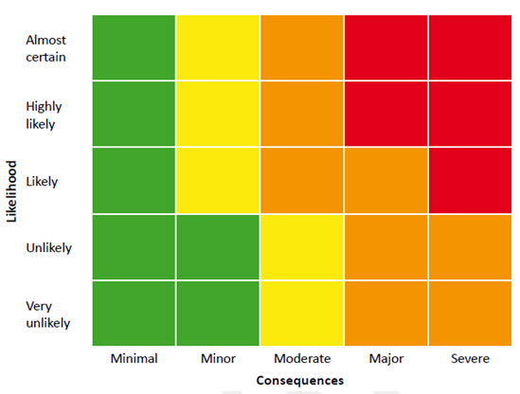
Rapid Risk Assessment guidelines

Slide 14
Gather RRA team
Assembled once event selected due to possible public health risk
Technical experts, depending on the event
  Epidemiologist
  Microbiologist
  Clinician
  Entomologist
  Food safety / Toxicologist / Chemical, radio-nuclear expert
  Animal health
  Logistic
Local knowledge/ Information background +++
Involve communication

Slide 15
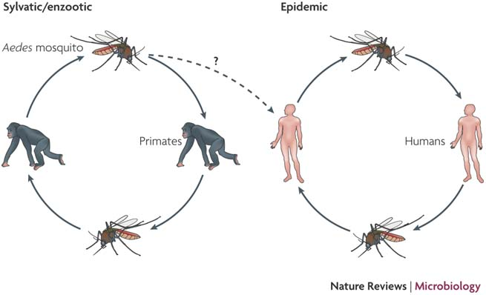
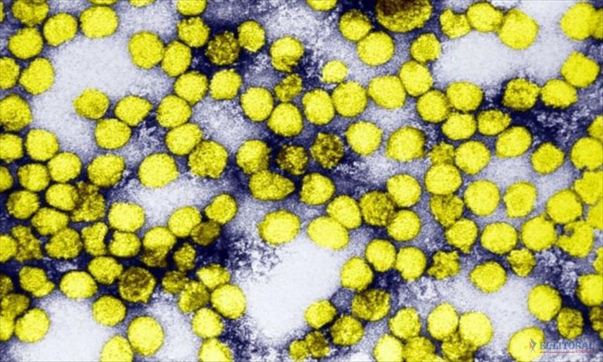
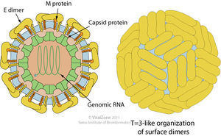
Hazard
Can include biological, chemical, physical and radionuclear hazards
Unknown hazard : more difficult to describe
General information : transmission, treatment, prevention
Laboratory confirmation
  List possible causes, differential diagnosis
  Liaise with laboratories

Slide 16
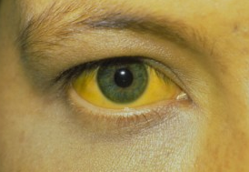


Exposure
Exposure of population (or individuals) to the hazard
  Describe in detail (clinical features, time, place, person, setting)
  How many people are likely to have been exposed/ are at risk of exposure? Susceptible ?
  Case fatality rate
  Incubation period
  Likelihood of transmission (R0)
  Immunity of the population
  Presence of vector/ hosts
  Dose-response

Slide 17
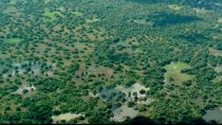
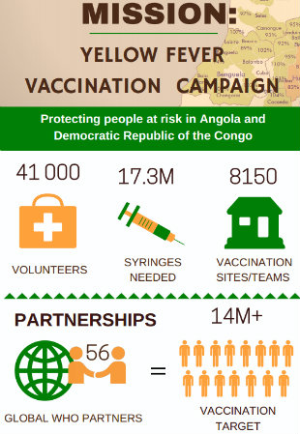
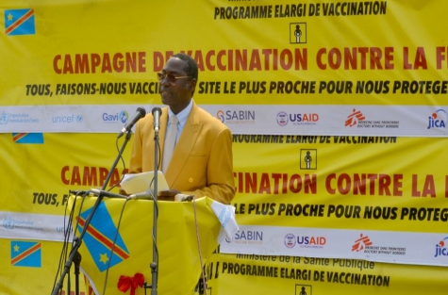
Context
Evalution of the environment in which the event takes place :
Physical
  Climate, vegetation, land use
  Water systems and sources
  Health of population
  Infrastructure (transport, health…)
Social
Political and policy
Cultural
Economic
→ Can increase or decrease the risk of an event (vulnerabilities /capacities)

Slide 18
How can this be documented?

Slide 19
Risk question(s)
Important to define at the beginning
Helps to define the scope of the assessment
Typically focusses on:
  Who and how many are likely to be affected?
  Who and how many are at risk of exposure?
  How likely is it that the event can be controlled with available resources?
Depending on the question, additional information and experts may be needed
Not too many!

Slide 20
Risk characterisation
Methodology / Based on the hazard, exposure and context
Evaluate the negative impact of the event on public health
The likelihood of the occurrence and the likely magnitude of the consequences of an adverse event to animal or human health in one place/geographical area during a specified time period

Slide 21
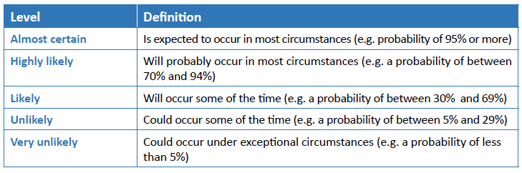
Likelihood

Slide 22
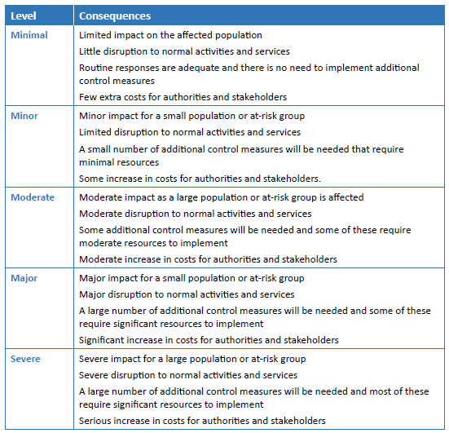
Consequences

Slide 23
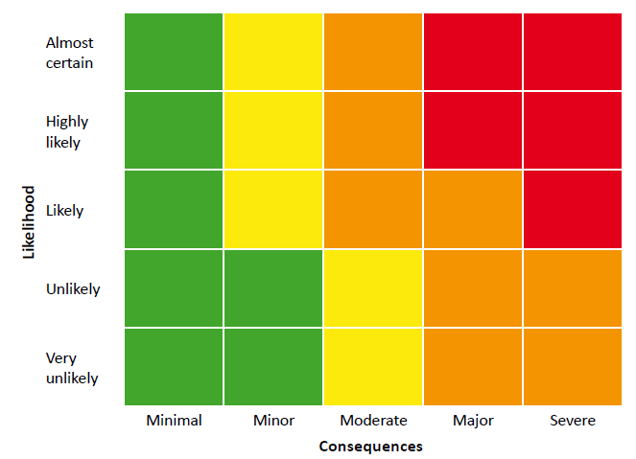
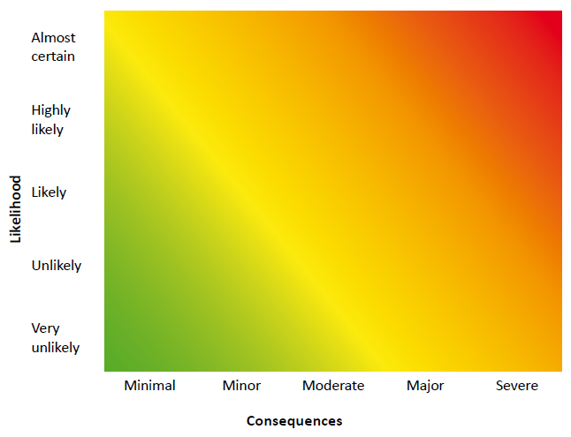
Risk characterization
Example matrix (delimited vs not delimited)

Slide 24
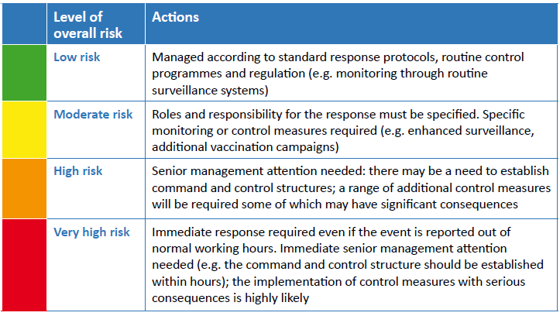

Slide 25
Conclusion
Challenges in the process :
  Adequate, timely information = to respond in appropriate manner / formulation recommendations
  Multidisciplinary / Cross Organization – WHO
  Time consuming
Real objectives of RRA ?
Dissemination process : Need to be broadly distributed to be useful / partners, Member States. Sensitive information, confidentiality, political issues.
Notes:
Useful document at national, regional and international levels: give a quick overview of what’s going on, what is the overall risk and where/what to improve for a better response. It is important to understand upstream the basic epidemiology of yellow fever, as well as the risk of its re-occurrence in previously endemic places or of transmission elsewhere, so that appropriate public health interventions and recommendations can be provided.

Slide 26
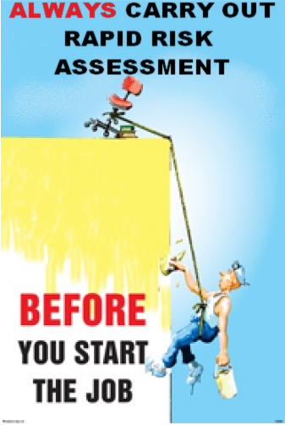
Thanks
Our team at HQ level / Detection Verification Assessment - DVA
DVA / HQ / Outbreak team : Lidia Alexandrova, Kazuaki Jindai, Johannes Schnitzler, Anastasia Smirnova, Annika Wentland, Dunja Selenic, Emilie Peron, Julie Fontaine, Priscilla Ajiji (interne) Philip Abdelmalik, Sophie Ioos, Philippe Barboza

Slide 27

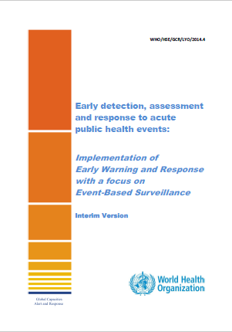
References
  Based on :
  WHO Rapid risk assessment of acute public health events manual (2012) http://www.who.int/csr/resources/publications/HSE_GAR_ARO_2012_1/en//
  Integrant part of WHO Early and Warning Function defined in :
    Early detection, assessment and response to acute public health events / Implementation of Early Warning and Response with a focus on Event-Based Surveillance (2014) http://www.who.int/ihr/publications/WHO_HSE_GCR_LYO_2014.4/en/
Notes:
Consultation process 2011

