Slide 1

Workshop and Training on Strategic Risk Analysis and Profiling for Health Emergencies
9 - 11 May 2018, Geneva
Linking risk assessments to
health emergency risk management and to the IHR
Jonathan Abrahams
CPI/CME/HPR
WHO Health Emergencies Programme
Photo: WHO/Lorenzo Pezzoli

Slide 2
Objectives
Situate strategic (health) emergency risk assessment in the range of risk assessments
Provide an overview of different types of risk assessment and definitions
Relate risk assessments to health emergency risk management and to IHR

Slide 3
Why are we here?
INTERNATIONAL HEALTH REGULATIONS
Prevent, protect against, control and provide a public health response to the international spread of disease in ways that are commensurate with and restricted to public health risks, and which avoid unnecessary interference with international traffic and trade. (Art. 2, IHR (2005)
SENDAI FRAMEWORK GOAL
Prevent new and reduce existing disaster risk through the implementation of integrated and inclusive economic, structural, legal, social, health, cultural, educational, environmental, technological, political and institutional measures that prevent and reduce hazard exposure and vulnerability to disaster, increase preparedness for response and recovery, and thus strengthen resilience.
WHE MISSION Our mission is to help countries, and to coordinate international action, to prevent, prepare for, detect, rapidly respond to, and recover from outbreaks and emergencies.
WHO OBJECTIVE: “attainment by all peoples of the highest possible level of health. Health is a state of complete physical, mental and social well-being and not merely the absence of disease or infirmity.”
Notes:
Sustainable development is development that meets the needs of the present without compromising the ability of future generations to meet their own needs." (Brundtland report – our common future)
Protect people; Protect investment; Facilitate development

Slide 4
What is this thing called “risk”?
Public health risk : Likelihood of an event that may affect adversely the health of human populations with an emphasis on one which may spread internationally or may present a serious and direct danger (IHR 2005).
Risk: The combination of the probability of an event & its consequences, which results from interactions between natural & human-induced hazards, vulnerability, exposure and capacity (WHO 2015).
Disaster risk: Potential loss of life, injury, or destroyed or damaged assets which could occur to a system, society or a community in a specific period of time, determined probabilistically as a function of hazard, exposure, vulnerability and capacity.
Risk reflects the concept of hazardous events and disasters as the outcome of continuously present conditions of risk. Disaster risk comprises different types of potential losses which are often difficult to quantify. With knowledge of the prevailing hazards and the patterns of population and socioeconomic development, disaster risks can be assessed and mapped, in broad terms at least (UNGA 2016)
Risk: “The effect of uncertainty on objectives” (ISO 31000)
Notes:
Risk = Likelihood x consequences (probabilistic) or deterministic
Risk is a relationship between hazards, exposure, vulnerability and capacities (phenomenological)

Slide 5
CAPACITIES
COPING
CAPACITIES
SOURCE
OF RISK
RISK
ELEMENTS
AT RISK
CONTEXT

Slide 6
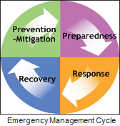
Risk management
Before 1970s - Emergency preparedness and response;
1970s – Emergency management: prevention, preparedness, response and recovery
1980-90s – Vulnerability, social determinants, disaster risk reduction, human security
2000s – Emergency/disaster risk management (ISO 31000); IHR (2005); health security
2010s – Resilience
Health emergency risk management is multisectoral and refers to the systematic analysis and management of health risks, posed by emergencies and disasters, through a combination of:
hazard and vulnerability reduction to prevent and mitigate risks
emergency preparedness
response
recovery measures (HEDRM Fact Sheets)
a) Avoid risk b) Reduce existing risk c)Transfer risk d) Manage residual risk
Notes:
Stop the creation of risk (e.g. remove/reduce the hazard, remove/reduce the exposure)
- improve water supply systems to reduce the bio-load in water
- people don’t leave in flood plain
Reduce the existing risk (modify the vulnerability)
- provide access to clean water
- people living in flood plain live on stilted housing
- routine vaccination
Manage the residual risk (event based prevention emergency preparedness, response and recovery)
- water supplies in emergencies
- evacuation shelters
- emergency vaccination/cholera treatment centres

Slide 7
IHR linkages
  Joint External Evaluation Tool
      RR1: Strategic emergency risk assessments conducted and emergency resources identified and mapped
  Annual reporting tool
  NAP for Health Security: Development of capacities (for what risks?)

Slide 8
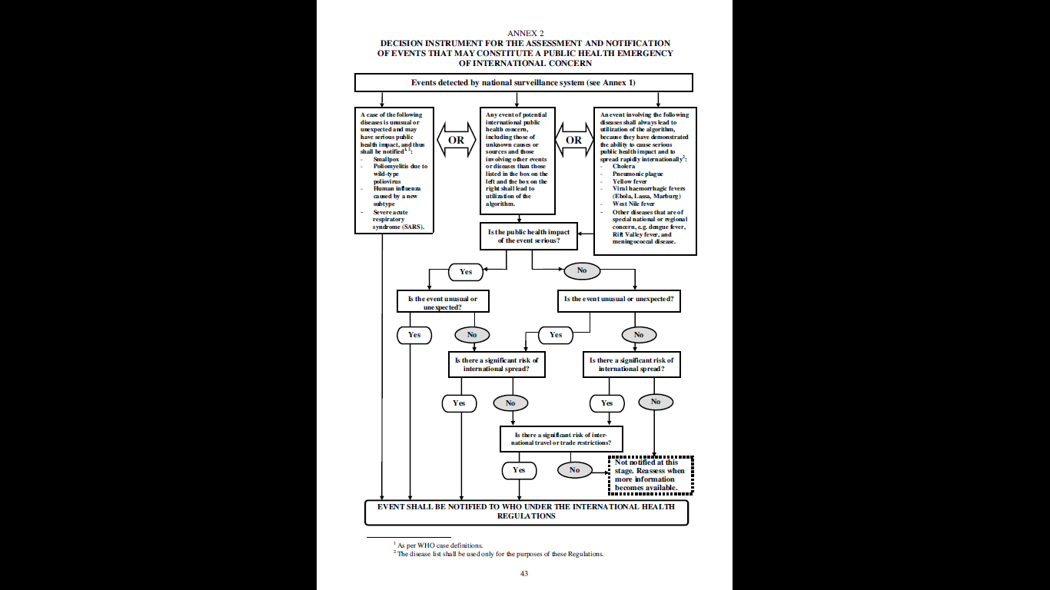

Slide 9
Risk assessment
Risk = Likelihood x impact (probabilistic/deterministic)
Risk is a relationship between hazards, exposure, vulnerability and capacities (phenomenological)
Risk assessment: The process of determining risks to be prioritized for risk management, by the combination of risk identification, risk analysis, and evaluation of the level of risk against predetermined standards, targets, risks or other criteria. (ISO 31000)
Risk assessments include a review of the technical characteristics of hazards, analysis of exposures and vulnerability and evaluation of the effectiveness or prevailing coping capacities in respect of likely risk scenarios (WHO, 2015).
Risk management is informed by different forms of assessment.
Notes:
Purposes
Scope (jurisdiction/organization, sector, hazards/vulnerabilities, planning horizon)
Levels of investment/resources available ($$, data, competency, time)
Models
Tools

Slide 10
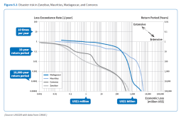
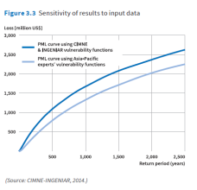
Type | Purpose/uses | Scope | Output | Investment
Probabilistic loss models | Models total expected losses (used by insurance industry) Models probable maximum loss Maps risks based on risk models | multi / single hazard exposure vulnerability conjoint risks cascading risks | Loss exceedance curves Risk maps | High
Strategic emergency risk assessment e.g. STAR, EMRO HERA, VRAM, VCA, Joint qualitative risk assessments for zoonotic diseases | Multi-hazard programming and planning tool Analyses risks by scenarios Assigns level of risk Prioritizes risk Emergency risk management programming Emergency preparedness | Risk analysis (hazard, vulnerability, capacity analyses At organization, local, sub-national, country levels | Risk matrix Risk profile | Low-medium-high

Slide 11

AFG | 10.0 | 8.7 | 6.4 | 7.7 | 7.1 | 7.2 | 7.8 | 7.5 | 7.7 | Very High | 4
ALB | 0.1 | 3.3 | 2.2 | 0.7 | 1.5 | 5.5 | 2.7 | 4.2 | 2.7 | Low | 123
DZA | 6.0 | 5.0 | 3.1 | 3.4 | 3.3 | 4.9 | 4.2 | 4.6 | 4.2 | Medium | 68
AGO | 6.0 | 4.3 | 4.4 | 4.8 | 4.6 | 6.5 | 8.0 | 7.3 | 5.2 | High | 36
ATG | 1.3 | 2.0 | 1.9 | 0.4 | 1.2 | 5.0 | 1.8 | 3.6 | 2.1 | Low | 147
ARG | 1.5 | 2.5 | 1.7 | 1.1 | 1.4 | 4.8 | 2.3 | 3.7 | 2.3 | Low | 140
ARM | 2.2 | 3.3 | 2.4 | 3.6 | 3.0 | 6.8 | 2.3 | 4.9 | 3.6 | Medium | 94
AUS | 0.1 | 3.3 | 0.6 | 2.8 | 1.8 | 2.2 | 1.8 | 2.0 | 2.3 | Low | 140
AUT | 0.0 | 1.3 | 0.8 | 0.1 | 0.5 | 2.2 | 0.5 | 1.4 | 1.0 | Very Low | 183
AZE | 5.4 | 5.0 | 1.5 | 6.5 | 4.5 | 6.3 | 2.5 | 4.7 | 4.7 | Medium | 53
BHS | 0.8 | 2.2 | 2.4 | 0.9 | 1.7 | 3.5 | 2.5 | 3.0 | 2.2 | Low | 144
BHR | 0.2 | 0.2 | 1.7 | 0.9 | 1.3 | 4.3 | 1.1 | 2.9 | 0.9 | Very Low | 187
BGD | 6.5 | 7.5 | 3.5 | 5.8 | 4.8 | 5.0 | 5.7 | 5.4 | 5.8 | High | 23
BRB | 0.0 | 1.3 | 1.7 | 0.6 | 1.2 | 3.2 | 2.0 | 2.6 | 1.6 | Very Low | 166
BLR | 1.6 | 2.0 | 1.0 | 1.3 | 1.2 | 4.4 | 1.4 | 3.0 | 1.9 | Very Low | 157

Slide 12
Type | Purpose/uses | Scope | Output | Investment
Event risk assessment (e.g. WHO Rapid Event RA Tool, WHO Event RA, TIPRA) | Analyses risks (likelihood and potential consequences) of existing events Characterises risk | Event focused Analysis of hazard, exposure, context | Level of risk Emergency response planning Actions required | Low - medium
Public health situational analysis | Situation analysis Describes potential consequences of event Describes existing capacities and gaps Identifies priorities/ recommendations | Event focused | Situational analysis report Priorities/ recommended actions | Low

Slide 13
Over to you,
honourable moderator
Discussion

Slide 14
Sendai Framework for DRR | WHO Health Systems/ UHC | IHR | Health EDRM Framework
Strengthening disaster risk governance | Leadership and governance | National legislation, policy and financing | Policies, legislation & strategies M & E
 | Health workforce Health financing | Human resources | Human resources Financial resources
Enhance disaster preparedness for effective response |  | Coordination/Role of IHR Focal Pts Preparedness Response | Planning & coordination
Understanding disaster risk | Health information | Surveillance Risk communication | Information mgt Risk comms
 | Medical products, vaccines & technology |  | Health infra-structure & logistics
Investing in DRR for resilience | Service delivery |  | Health & related services Community EDRM capacities

Slide 15
Plans - Health Emergency Risk Management and Health Systems Outline
National Development Plans - SDGs/National Security
UNDAF
UNCT Plans
(Sendai, Paris Agreement, Regional agreements
UN SG – New Way
IASC/Grand Bargain)
WHA, RC, CCS, GPW
National health development strategies
Multisectoral emergency risk management framework
Health Emergency Risk Management Framework
Sectoral plans
HEALTH SECURITY
UN agency, INGO and partners plans - global, regional, country
Notes:
DRR Plans
Climate Action Plans
Emergency management plans
Humanit response plansI

Slide 16
Plans - Health Emergency Risk Management and Health Systems
National Development Plans - SDGs/National Security
UNDAF
UNCT Plans
WHA, CCS, GPW
National health development strategies
Policy, finance, HR, pharm, services, infrastructure, HIS
IASC/Grand Bargain UN Plan for DRR
OPCW/BWC Plans
ICAO plans
IAEA radiation plan
Migration compact
Regional DRR plans
UNCT Prep/Response/ Contingency plans
Human Response
Plans
Climate change
Recovery plans
Multisectoral emergency
risk management plans
National DRR plans
Emergency mgt plans
Response/contingency plans/BCPs
Recovery/ Climate plans/MHEWS
Health Emergency Risk Management
National HEDRM policies, strategies
Health capacity development
Emerg preparedness/readiness plans
Prevention plans
Em response/ hazard subplans/ contingency plans/ BCPs
Mass casualty management
Service specific plans (Nut, MH
Finance/HR/Logs/HIM plans Service plans (Mental, SRH, WASH)
HEALTH SECURITY
Sectoral plans
Agriculture
Security, Transport,
Infrastructure, Communication,
Environment , etc
Nat Plans for Health Security
Biol, chem, rad hazard plans
Surveillance plans; EWARS
AMR plans; lab plans; etc
UN agency, INGO and partners plans - global, regional, country
Subnational, local plans
Organization Public/private sector
Subnational, local Health EDRM plans
Hospital plans
Organization plans
Subnational, local plans
Notes:
DRR Plans
Climate Action Plans
Emergency management plans
Humanit response plansI

