Slide 1
Welcome
United Nations Office at Geneva
Office of the Director-General
Political Affairs and Partnerships Section

Slide 2
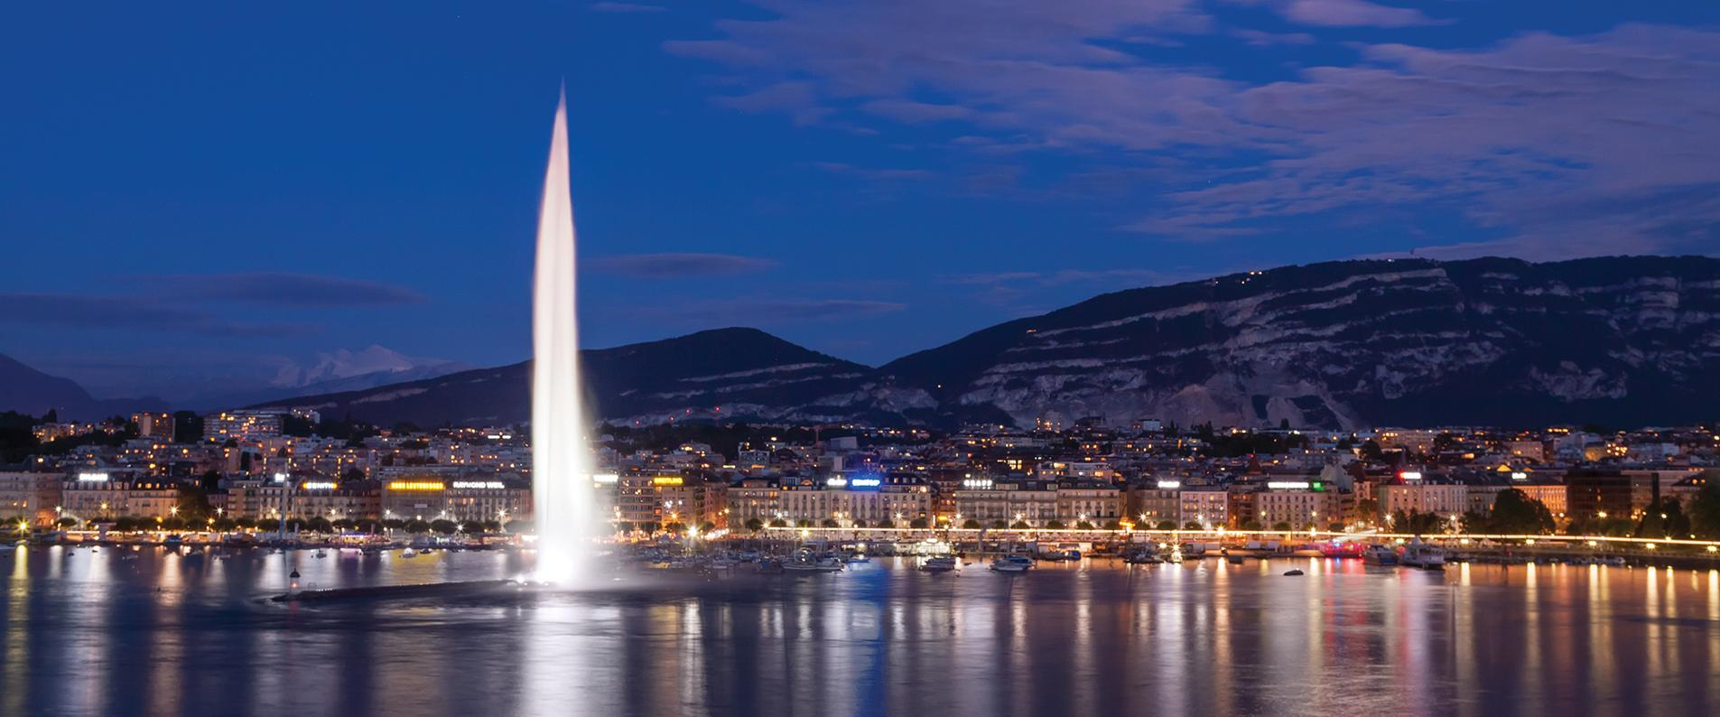
International Geneva
«City of Peace, Rights, and Wellbeing»

Slide 3
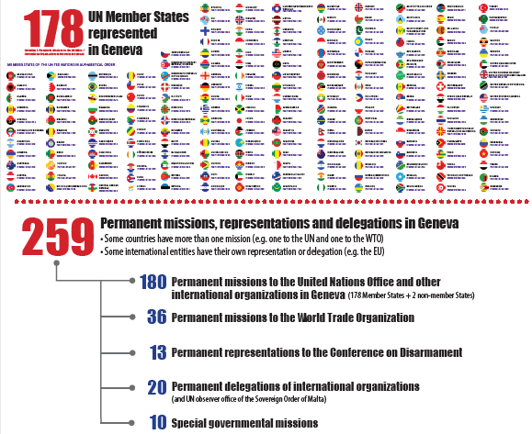

Slide 4
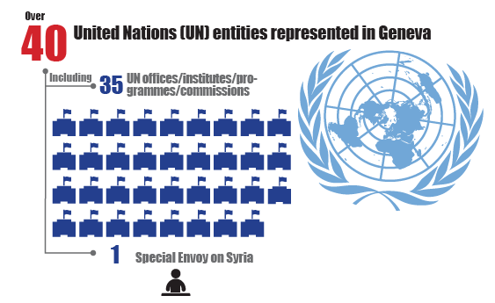

Slide 5
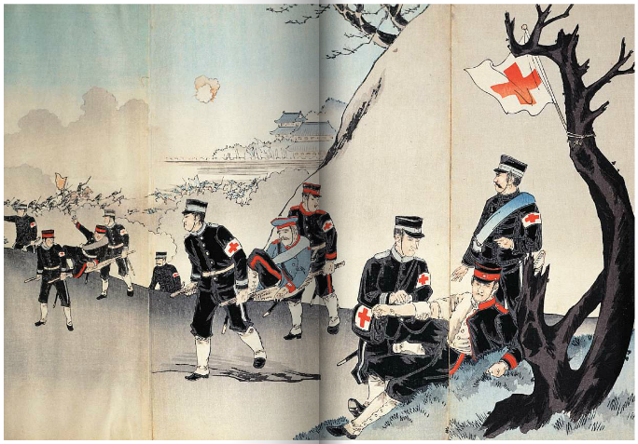
Geneva and the call of internationalism, a history, Joëlle Kuntz, Editions Zoé, 2011
Notes:
Charles Édouard Armand-Dumaresq – Geneva Convention (First)
1864; signature of Convention for the Amelioration of the Condition of the Wounded and Sick in Armed Forces in the Field“
Before the century ends: international conference on Peace, university, international peace bureau, jet d’eau, convention of Albama (1872, principles of international arbitration, launched interest in public international law)
Real rise of Geneva as a city for peace and humanitarian relief in the first half of the 20th century: WWI (League of Nations – neutrality – plaias 1938), could not prevent WWII (United Nations). UNHCR 81950) and research (1954 – invents the WWW)

Slide 6
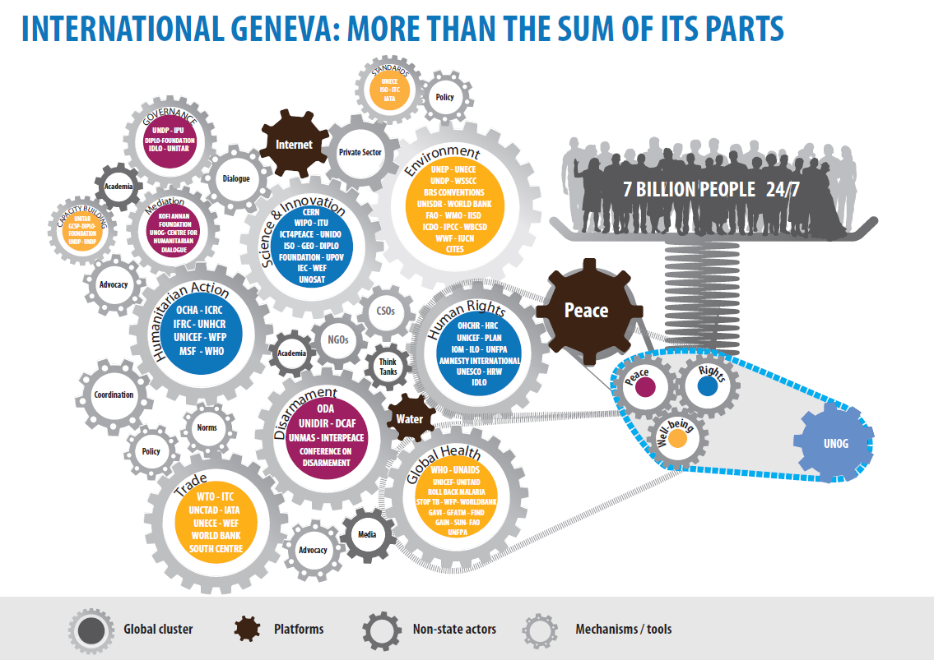

Slide 7
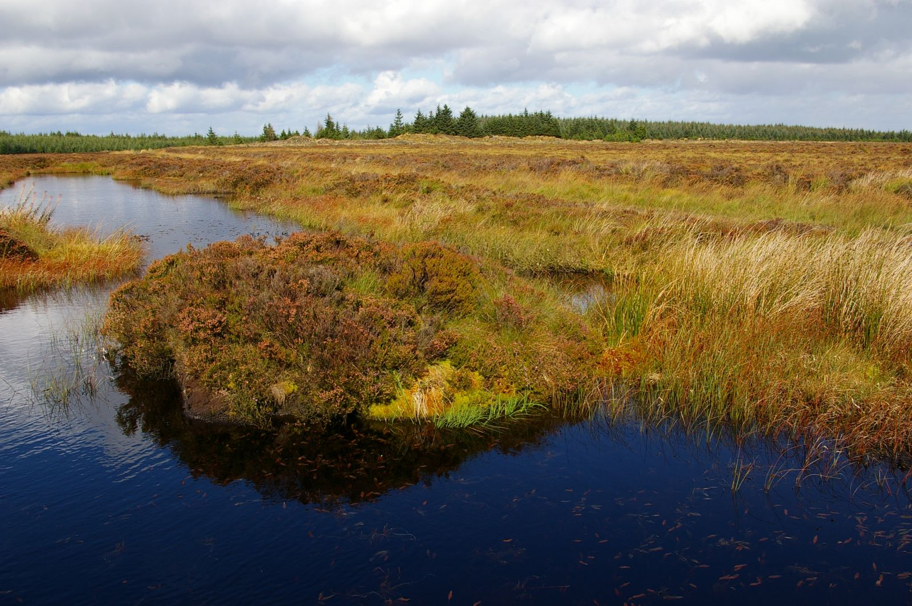
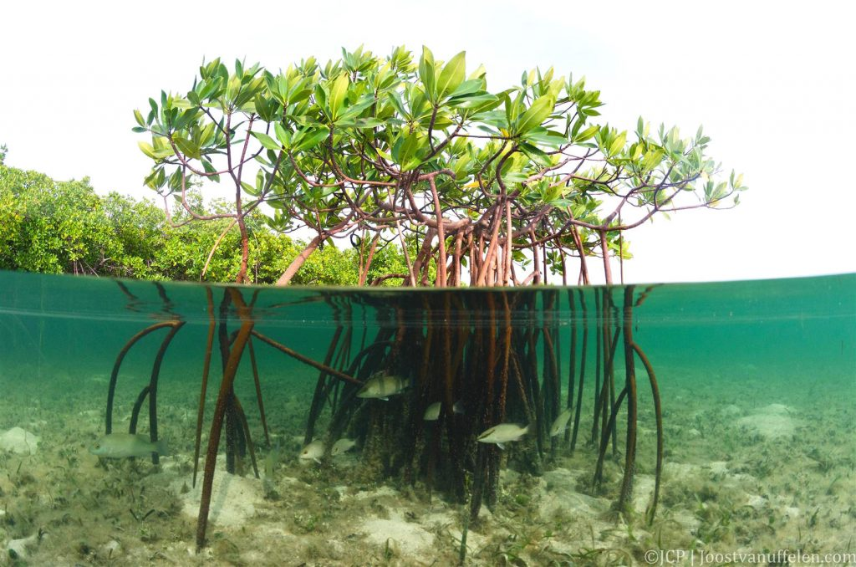
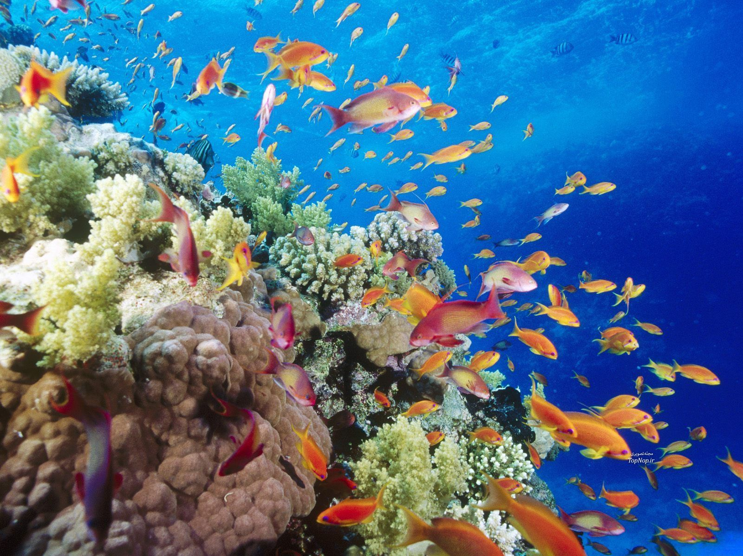


Slide 8



Slide 9
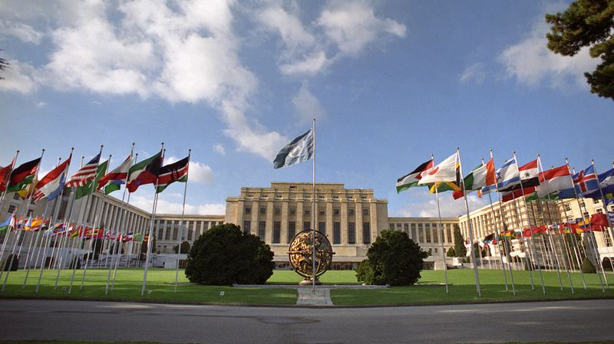
The Palais des Nations, a hub for multilateralism

Slide 10
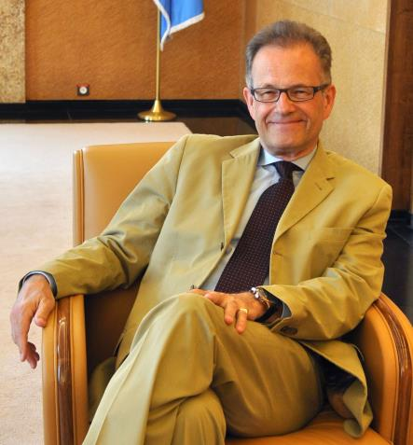
Director-General Michael Møller
In office since Nov. 2013
Represents the Secretary-General in relations with Member States in Geneva
Secretary-General of the Conference on Disarmament
Oversees the work of UNOG
Designated Security Official for Switzerland

Slide 11
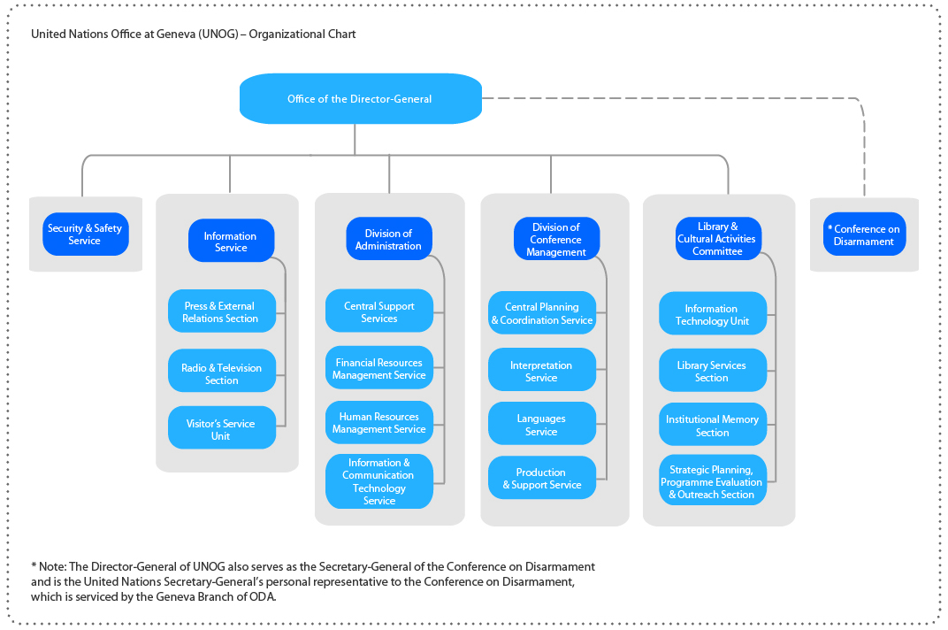

Slide 12

Office of the Director-General
Executive Office
Protocol and liaison
Legal liaison
Political Affairs and Partnerships
Non-governmental liaison
Perception Change Project (PCP)
Mediation Support Project
SDG Lab

Slide 13
Political Affairs and Partnerships Section
Supports the Director-General’s diplomatic efforts through political analysis and advice
Assists with coordination of high level events, talks and conferences at UNOG, such as the Intra-Syrian Talks in Geneva
Organizes Executive Briefings on relevant topics in multilateral affairs
Outreach: public events on political topics such as the Geneva Peace Talks and Geneva Peace Week
Notes:
Examples of Executive Briefings:
De Mistura
ICC Prosecutor
SDGs – different reps
etc

Slide 14


Slide 15
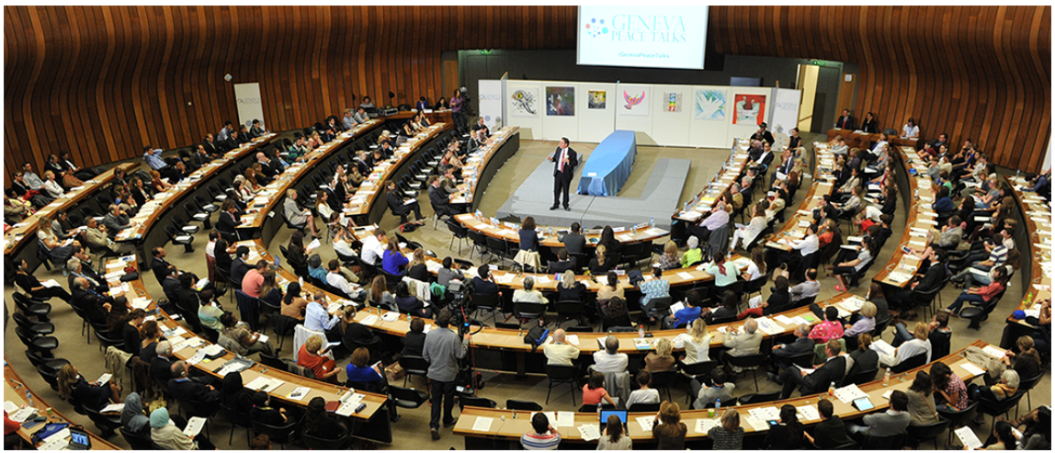
Geneva Peace Talks

Slide 17
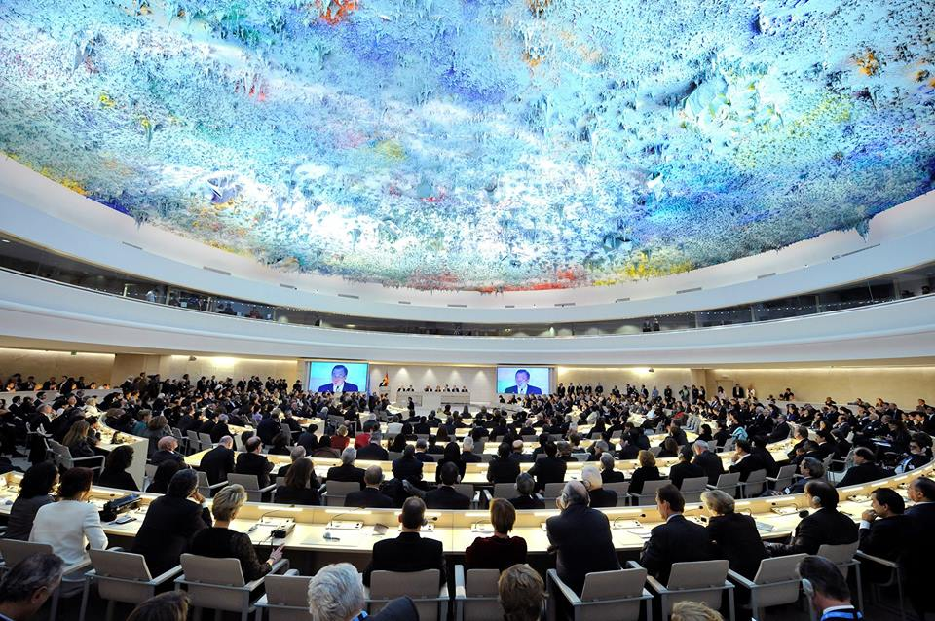
Geneva Lecture Series

Slide 18
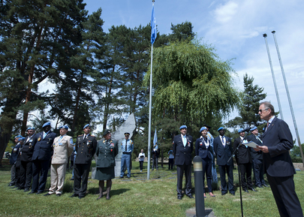
International Days

Slide 19



Cultural events

Slide 20
Thank you for your attention – question?

Slide 21
Quizz
Download the free app «Socrative – student» over your App Store
Type the room name: WEILENMANN809
Start and win prices!

