Slide 1
Disaster Risk Reduction: A Path to Conflict Prevention?
Jonathan Fowler
Public Information Officer
UNISDR

Slide 2
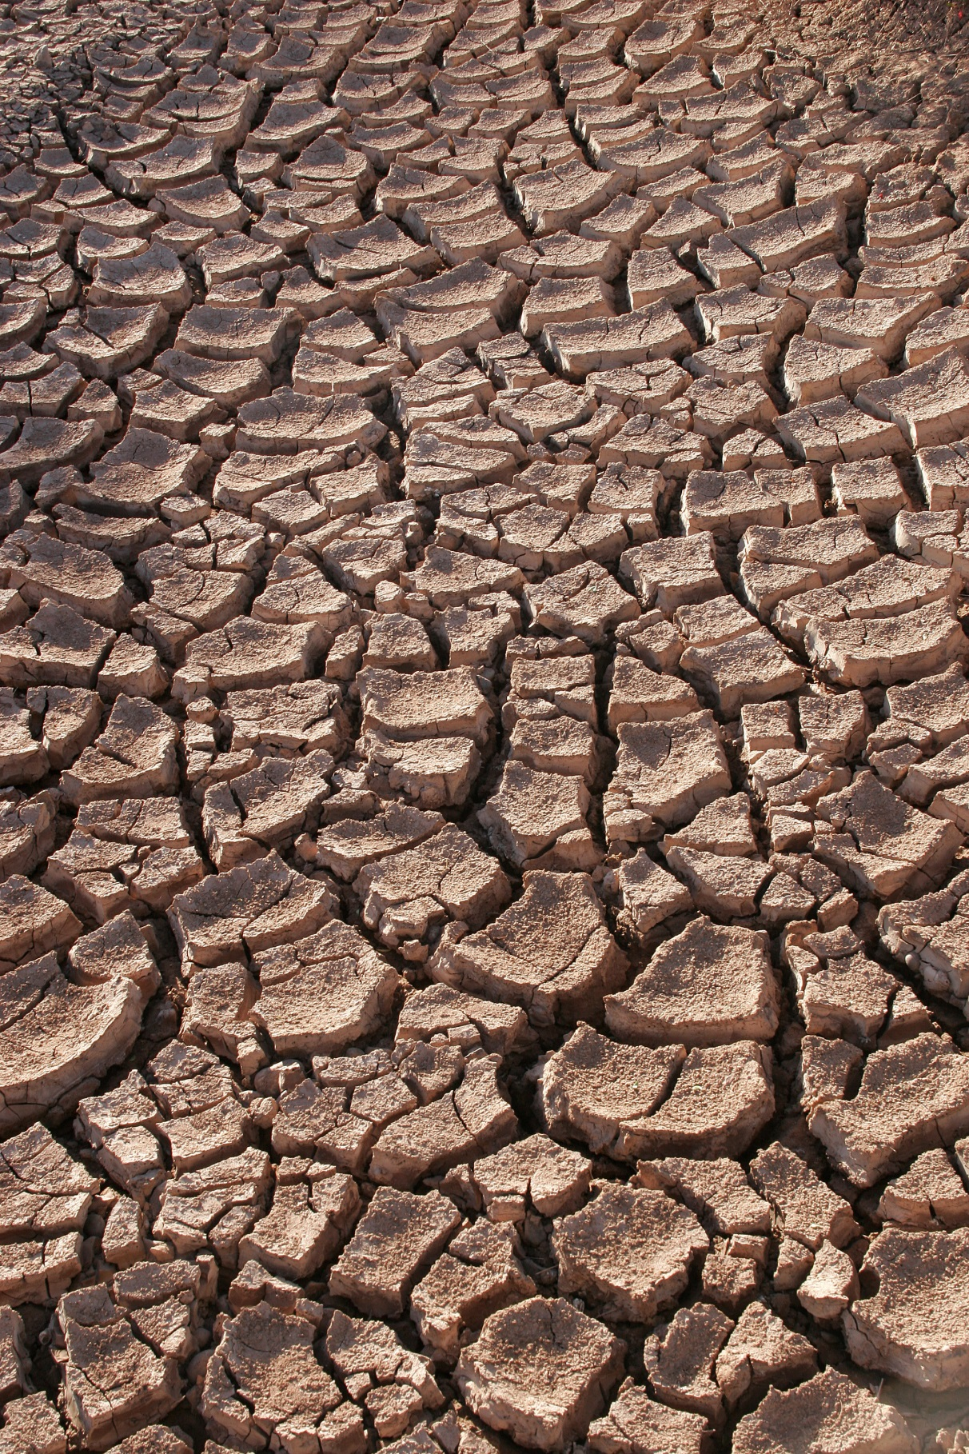

Slide 3


Slide 4


Slide 5
“At least 40% of internal conflicts over the last sixty years have a link to natural resources, and the risks of conflict relapse are elevated when the exploitation of natural resources cause environmental damage or when their benefits are unequally distributed.”
The Global Thematic Consultation on Conflict, Violence and Disaster, and the Post-2015 Development Agenda, May 2013

Slide 6
Disaster Risk: Stark Impacts
Between 2005 and 2014, disasters killed 700,000 people, affected 1.7 billion, and caused US$1.4 trillion in economic damage.
Over the period from 1995 to 2015, 90% of major disasters were weather-related, including floods, storms, heatwaves and droughts.
There were 19.2 million new displacements associated with disasters in 113 countries in 2015. Several of these countries are no strangers to conflict which gave rise to 8.6 million new displacements in 28 countries.

Slide 7
“The effects of climate change, population growth, rapid urbanization, and environmental degradation are contributing to greater competition for resources, adding to tensions and instability […] Our priority is prevention - prevention of conflict, of the worst effects of natural disasters, and of other manmade threats to the cohesion and wellbeing of societies.
The best means of prevention, and of sustaining peace, is inclusive and sustainable development.”
UN Secretary-General António Guterres, January 2017

Slide 8
“It is no coincidence that conflicts predominate in some of the world’s most disaster-exposed regions where weak institutional capacity to mitigate the impacts of disasters combines with other fragilities to create the conditions for conflict and civil unrest. […] The threat of conflict must be an important consideration in any cost-benefit analysis undertaken on the merits of investing in better preparedness, more resilient infrastructure and stronger institutions which will help reduce loss of life and economic losses from natural hazards and related technological, biological and environmental threats. […] Adequately resourced, disaster risk reduction promotes civility, civic mindedness and resilience, and therein lies a key element of its potential to boost understanding and contribute to sustainable peace.”
Robert Glasser, UN Secretary-General’s Special Representative for Disaster Risk Reduction and head of UNISDR, January 2017

Slide 9
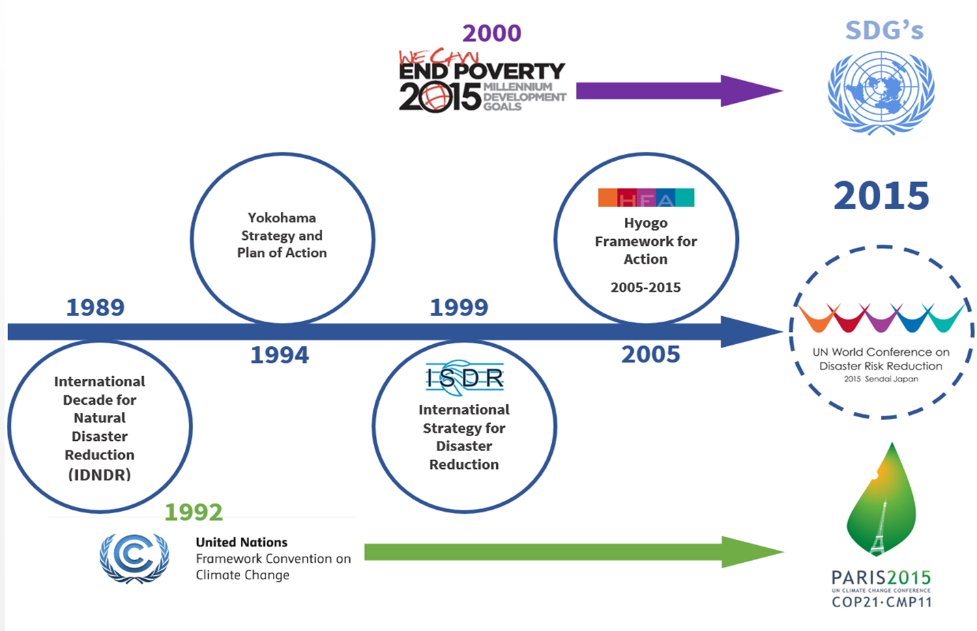
25 years of International Commitment to Disaster Risk Reduction

Slide 10
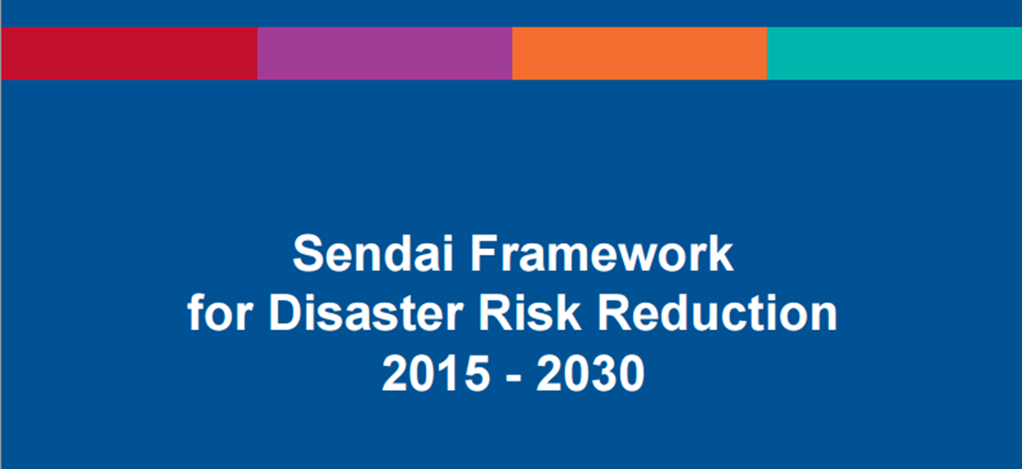

Slide 11
Goal
PREVENTION
REDUCTION
HAZARD EXPOSURE
VULNERABILITY
PREPAREDNESS
RESILIENCE

Slide 12
Targets
5
Increase national & local DRR strategies
1
4
Reduce Mortality
Reduce damage to critical infrastructure and disruption of basic services
2
Reduce number of affected people
6
Enhance international cooperation
7
3
Increase availability & access: early warning & risk information
Reduce Economic Loss

Slide 13
Priorities for Action
1. Understanding Disaster Risk
2. Strengthen Risk Governance
GLOBAL& REGIONAL
3. Investing in DRR for resilience
NATIONAL & LOCAL
4. Preparedness for Response, Recovery & Reconstruction

Slide 14
Highlights
Put the focus on prevention of new risks in the course of development – ‘Risk-informed development’
Shift from disaster loss to disaster risk
Call for coherence in policies and programmes across sustainable development, environment and climate to ensure the reduction of disaster risk
Shift from disaster management to disaster risk management
Shift from “what to do?” to “how to do?”
Primary responsibility of States for DRR, shared responsibility for DRR with stakeholders
Scope includes slow-onset, man-made and bio hazards

Slide 15
Conflict: Explicit or Implicit?
Hyogo Framework:
“integrated, multi-hazard approach to disaster risk reduction should be factored into policies, planning and programming related to sustainable development, relief, rehabilitation, and recovery activities in post-disaster and post-conflict situations in disaster-prone countries.”
Sendai Framework:
Two-fold challenge of conflict – as a man-made disaster, and how to address risk reduction in conflict zones – did arise during regional negotiations but was stripped out. That was due to concerns that talks would become hostage to debates about rights and obligations in situations of conflict, occupation and humanitarian response.
A problem?
Cutting the issue from the Sendai Framework is not necessarily negative, given that disaster risk reduction is now seen chiefly as a development matter, rather than as a reactive matter. The Sendai Framework’s broad scope reinforces the need for coherence in managing disaster risk across sectors. This scope implies that disaster risk reduction needs to be part of a broader and coherent national and, as appropriate, international disaster risk management system which integrates, as relevant, security-­related hazards.

Slide 16
Given the cross-­cutting nature of disaster risk reduction, the Sendai Framework transcends traditional dichotomies between development and humanitarian relief, developed and developing countries, or situations of conflict, fragility and peace. As a universal agreement, it applies to all countries without any distinction. It underlines that disaster risk reduction cannot be neglected in any situation and what may need to be adapted is the approach and the way the work is carried out.

Slide 17

#switch2sendai
@UNISDR @UN_JWF

Slide 18


