Slide 1
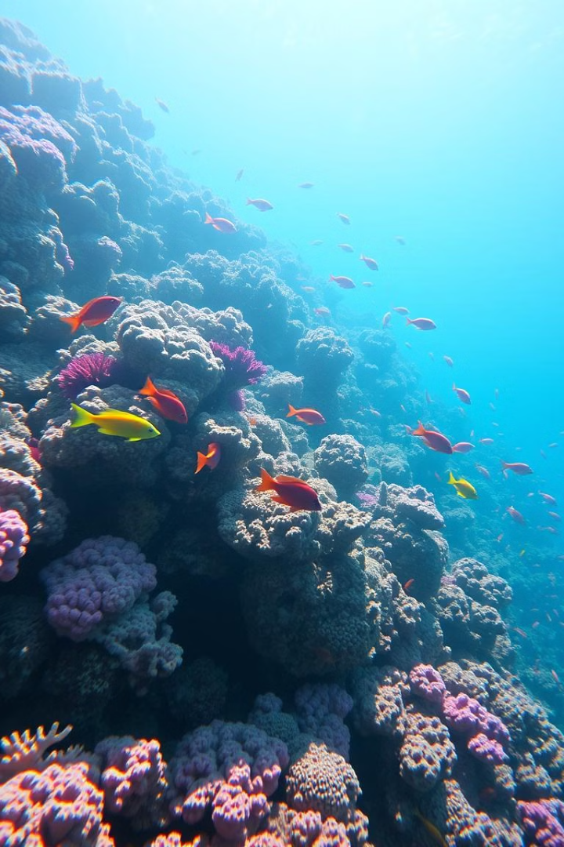
Introduction to the BBNJ Agreement: Key
provisions, Ratification and Domestication processes
Validation of the Africa Union Ocean Governance Strategy and Implementation Plan
and
Capacity Enhancement on the UNCLOS BBNJ Agreement
Dar es Salam, Tanzania
Holiday Inn Hotel and White Sands Hotel
1-4 April 2025
Yvonne Waweru
Research Fellow
Global Ocean Accounts Partnership

Slide 2
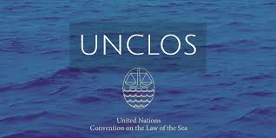
UNCLOS Regime
United Nations Convention on the Law of the Sea
Concluded 10 December 1982; in force 16 November 1994
320 articles + 9 Annexes
Provides the legal framework for all activities in the ocean and seas
3 Implementing Agreements
1994-Agreement relating to implementation of Part XI of UNCLOS (establishing the International Sea Bed Authority)
1995- Agreement for the Implementation of UNCLOS relating to the Conservation and Management of Straddling Fish Stocks and Highly Migratory Fish Stocks
2023-Agreement under UNCLOS on the conservation and sustainable use of marine biological diversity of areas beyond national jurisdiction (BBNJ Agreement)

Slide 3
UNCLOS Maritime Zones

Slide 4
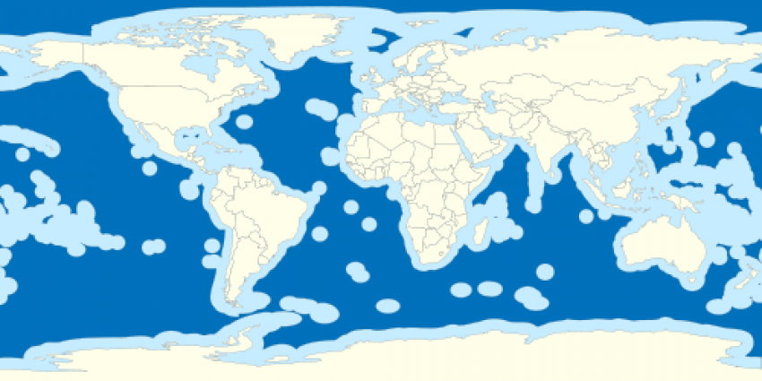
Areas Beyond National Jurisdiction- Home to Rich Biodiversity and Unique Marine Resources
Importance
High marine biodiversity e.g seamount, hydrothermal vent ecosystems and many species
Carbon sink and regulates the global climate
Supports fisheries and marine scientific research
Straddling species or transboundary ecosystems
Wikipedia Commons
These threats may have a cumulative impact
ABNJ comprises about 62 % of world’s ocean surface and 95% of their volume
Challenges:
Destruction of ABNJ habitats has been shown through several studies mainly through human activities including:
overexploitation of living marine resources, especially fisheries
destruction of habitats; pollution of the marine environment
emergence of threats linked to deep-sea mining
increased activities on marine genetic resources

Slide 5
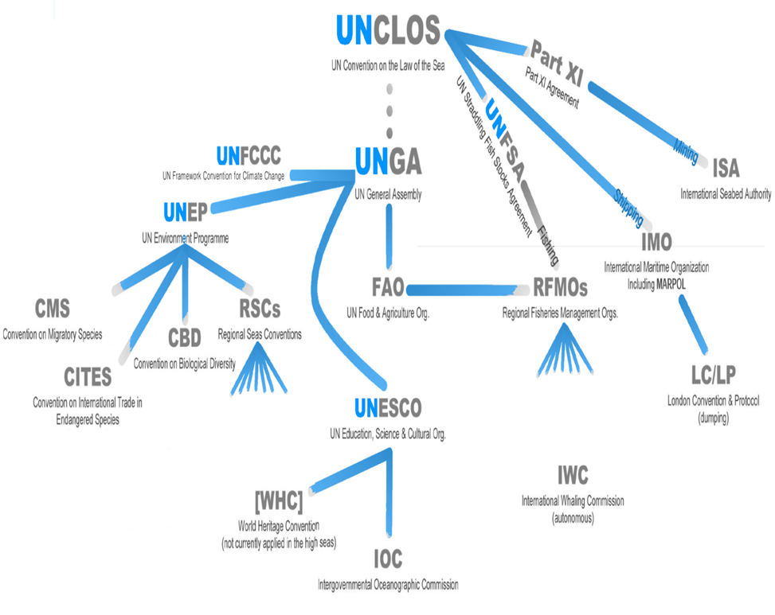
Areas Beyond National Jurisdiction- Fragmented Governance
… where several sectoral organizations have competence
... where there is no overall cross-sectoral coordinating
mechanism for management
... where different legal regimes apply (freedom of high seas; common heritage
of mankind)
Unger et. al 2014

Slide 6
BBNJ Agreement
Full Title: Agreement Under the United nations Convention on the Law of the Sea on the conservation and sustainable use of marine biological diversity of areas beyond national jurisdiction
Third UNCLOS Implementing Agreement, adopted by consensus on 19 June 2023
In accordance with its article 65, the Agreement shall be open for signature by all States and regional economic organizations on 20 September 2023, and shall remain open for signature at United Nations Headquarters in New York until 20 September 2025

Slide 7
What is in the BBNJ Agreement?
Why Does the BBNJ Agreement Matter for Africa?
Highlights
Preamble, 76 articles in
12 Parts, and 2 Annexes
A package of issues
Key principles
A new path towards greater equity
A vital step for our planet
A significant development for ocean governance

Slide 8
BBNJ Main Elements
Marine Genetic Resources MGRs and Digital Sequencing Information (DSI) on MGRs (Articles 9-16)
Robust notification requirements prior to the collection, use, and commercialization of genetic resources through BBNJ identifiers and the Clearing House Mechanism
Multi-lateral benefit-sharing mechanism for marine genetic resources and digital sequencing of information
Fair and equitable sharing of monetary and non-monetary benefits
Marine Genetic Resources are living organisms, which are used not for direct consumption as food, but as a source for biotechnological development. The interest for these resources is connected to three factors
Much more genetically diverse than life on land
Life in the deep seas in particular is much less explored
The hostile conditions in the ocean-depths, including immense pressure and complete darkness, have made organisms develop properties that are not seen elsewhere

Slide 9
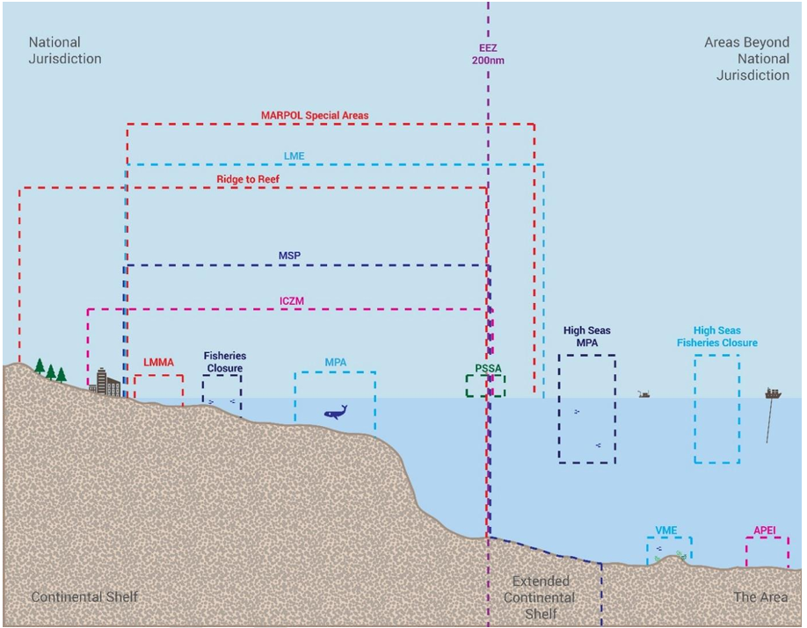
BBNJ Main Elements…….ctd
Measures such as Area-Based Management Tools, Including Marine Protected Areas
Establishment of a comprehensive system of ABMTs, with ecologically representative and well-connected networks of MPAs and strengthen cooperation and coordination in their use
Proposals on area-based management tools (AMBTs), including marine protected areas (MPAs) individually or collectively
Implementation of ABMTs
Credit:CBD

Slide 10
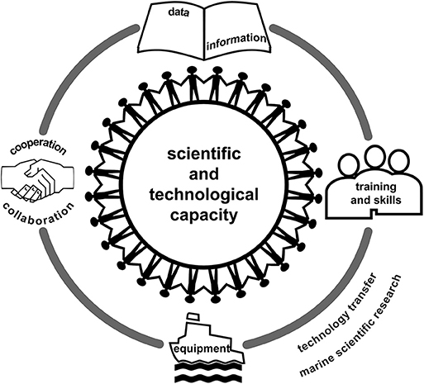
BBNJ Main Elements…….ctd
Capacity Building and Transfer of Marine Technology
Support developing states in developing marine scientific and technological capacity, and to achieve the BBNJ objectives
Obligation to cooperate in capacity-building (CB) and transfer of marine technology (TMT)
Modalities for CB&TMT
Types of CB&TMT

Slide 11
BBNJ Main Elements…….ctd
Environmental Impact Assessments
More robust regime for addressing potential impacts of projects both inside of national boundaries and ABNJ
Requirement for environmental impact assessments (EIAs)
State-led decision-making and monitoring
Environmental impact assessments must consider ‘cumulative impacts’
Strategic Environmental Assessments

Slide 12
Institutional Arrangements
Article | Institutional Arrangement
Article 47 | Conference of Parties
Article 49 | Scientific and Technical Body
Article 50 | Secretariat
Article 51 | Clearing House Mechanism
Article 15 | Access and Benefit-sharing Committee
Article 55 | Implementation and Compliance Committee
Article 46 | Capacity Building and Transfer of Marine Technology Committee
Article 52(14) | Finance Committee

Slide 13
Funding
Article | Type of Fund
Article 52(4)(a) | Voluntary Trust Fund established by the COP to facilitate the participation of representatives of developing States Parties, least developed countries, landlocked developing countries and small island developing States, in the meetings of the bodies under Agreement
Article 52(4)(b) | Special Fund: annual assessed contributions; payments from MGRs; contributions from states and private entities
Article 52(4)(c) | Global Environment Facility (GEF) Trust Fund
Article 52(5) | COP may consider the possibility to establish additional funds to finance rehabilitation and ecological restoration of BBNJ
Article 52(8) | Financial resources mobilized through public and private resources
Article 52(11) | An initial resources mobilization goal through to 2030

Slide 14
Other Provisions
Article | Provisions
Article 52(4)(a) | General provisions
Article 53-55 | Implementation and compliance
Article 56-61 | Settlement of disputes
Article 62 | Non-parties to the Agreement
Article 63 | Good faith and abuse of rights
Article 64-76 | Final provisions

Slide 15
Summary of BBNJ the Process
Agreement is adopted at Conference of Plenipotentiaries on 19 June 2023
60 Ratifications
Agreement enters into force
UNSG communicates to Contracting Parties
Agreement opens for signature on 20 September 2024
Negotiation commences
Implementation
State Y accedes to Agreement
Studies, analyses, awareness, legal/technical WG, policy development
State X accedes to Agreement
Contracting Parties sign Agreement subject to ratification, acceptance or approval
Agreement closes for signature on 20 September 2025
Full implementation of Agreement starts
States ratifies, accepts or approves Agreement

Slide 16
NB: Signing the Final Agreement does not create legal obligations or bind the signatory State to sign or ratify the treaty attached to it
A State establishes its consent to be bound by a treaty and also a commitment to undertake the obligations in the treaty by ratification or accession
The key difference is that ratification involves a state signing the treaty first, followed by a formal act of approval, while accession is when a state joins a treaty that is already open for signature without having initially signed it; essentially, accession is joining a treaty after the initial negotiation and signing phase is complete

Slide 17
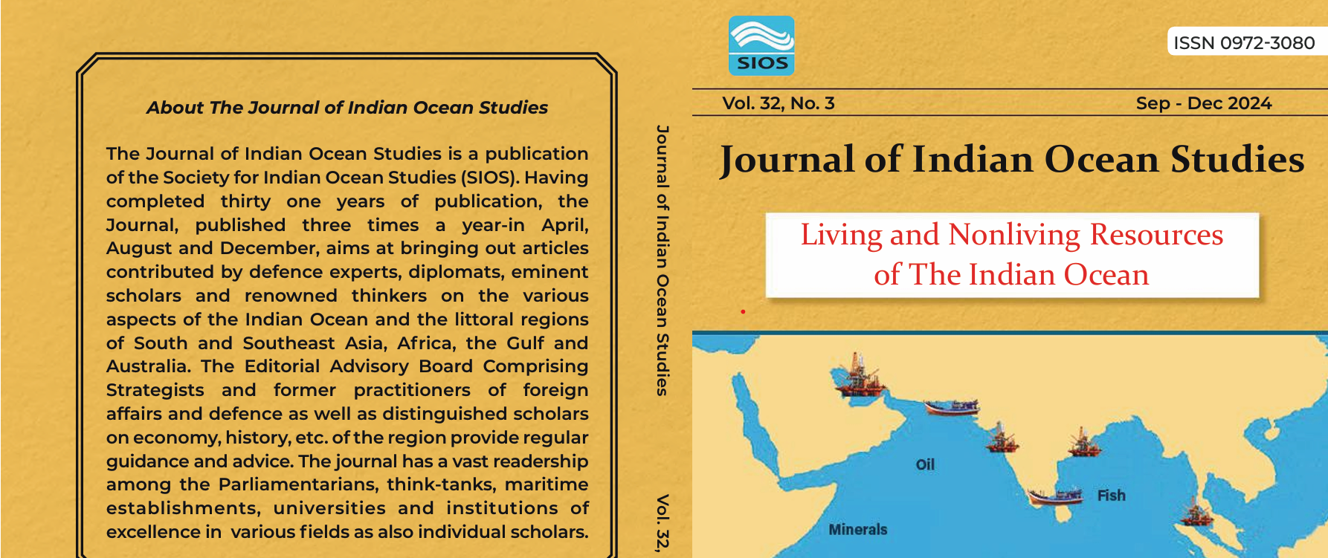
Implementation
Waweru Yvonne (2024) ‘Advancing an Indian Ocean-wide Governance Approach for Implementing Biodiversity Beyond National Jurisdiction Treaty through the Indian Ocean Rim Association’ Journal of Indian Ocean Studies 305-315

Slide 18
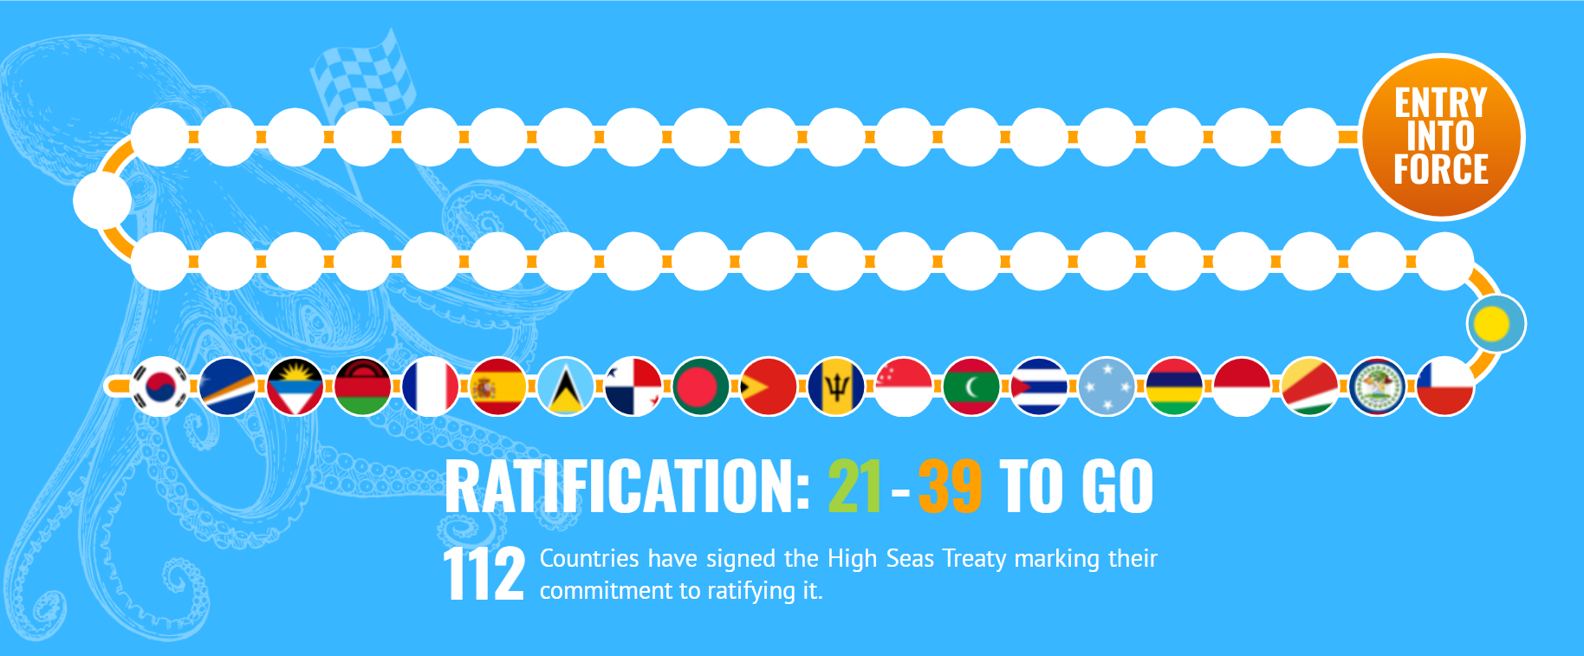
Possible BBNJ Implementation Pathways for Africa
Intervention 1
Sign and ratify the BBNJ Treaty
Mauritius, Seychelles and Malawi have ratified
https://highseasalliance.org/treaty-ratification/
In addition, Member States should be encouraged to sign and ratify all relevant international treaties on ABNJ and relevant regional organisations
Open for signature: 2 years from 20 September 2023
Entry into force: after ratification by 60 States
First meeting of the COP within one year after entry into force

Slide 19
Intervention 2
Development and review of AU policies on biodiversity to include measures on BBNJ
Intervention 3
Establishment of institutional cooperative mechanisms through the Africa Ocean Governance Strategy with competent organisations in the ABNJ such as tuna and non-tuna RFMOs, non-African regional seas programmes in the Indian Ocean, Atlantic ocean, Mediterranean and Red Seas
This would enable participation of AU in different organization’s meetings for exchange to tackle specific BBNJ related issues of common interest and provide a shared and coherent basis for common action

Slide 20
Intervention 4
Explore possibilities for establishing protected areas in the High Seas as below:
As soon as the BBNJ Treaty becomes operational, Africa Member States could make proposals for High Seas Marine Protected Areas in the Indian Ocean, Atlantic Ocean and Red Sea
The situation of the Mediterranean Sea is unique as there is no point located at a distance of more than 200 nautical miles from the closest land or island. Therefore, there would be no ABNJ in the Mediterranean if all coastal States declared their EEZs
African States could raise the possibility of developing spawning area closures through relevant RFMOs to restore and maintain tuna populations
Develop proposals for the establishment of Particularly Sensitive Sea Areas Areas (PSSAs) in high seas areas that are sensitive to impacts from shipping by engaging with the International Maritime Authority (IMO) for approval within its processes
Member States to promote strengthening of the Convention on Biological Diversity (CBD) and advocate the use of Ecologically and Biologically Significant Areas (EBSAs) as a scientific basis to develop ABMTs.
Consider declaring regional MPAs in ABNJ, through cross sectoral cooperation and coordination and cooperation between relevant competent organisations e.g. with RFMOs for fisheries, the ISA for deep seabed mining, and the IMO for shipping.

Slide 21
Intervention 5
Africa Group of Negotiators to play an active role in ISA conferences of parties e.g. by advocating for strong provisions in regulations related to the potential exploitation of marine mineral resources to identify particular areas thought to be representative of the full range of habitats, biodiversity and ecosystem structures and functions within the relevant management area and provide them with appropriate levels of protection
Intervention 6
AU member states in exercising flag state jurisdiction should take responsibility over their vessels and where possible prohibit or restrict activities that undermine marine biodiversity in the ABNJ by vessels flying their flag
Intervention 7
Developing a robust scientific knowledge base through existing AU centres of excellence and data and information platforms
Intervention 8
Creating a platform through AU Ocean Governance Strategy Platform for regular exchange and discussion on BBNJ which could be used to develop an AU voice in global processes e.g aligning with future BBNJ and ISA conferences of parties

Slide 22
Thank You

