Slide 1



Moving the BBNJ Agreement in Africa:
Session 2: Discussions on implications and readiness in Africa for the BBNJ Treaty
Jared Bosire
Head, Nairobi Convention
04 April 2025

Slide 2


1. Obligations to Parties
What do you understand as the obligations of Parties under the Treaty?
Which obligations are likely to be challenging in execution?
Possible mitigating actions to surmount the observed challenges
Chair: Peace Gbeckor-Kove

Slide 3
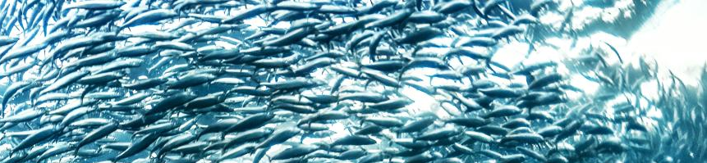
2. Institutional capacity needs
What policy and technical capacity Africa will need towards ratification and implementation of the Treaty?
Of the capacity needs identified above, where will investment be required the most
Proposed mechanisms of addressing the capacity needs above
Chair: Sheya Ndaendomwenyo

Slide 4

3. Coordination and synergies
Implementation of the Treaty will require regional, continental and global coordination/synergies
What coordination mechanisms will be necessary at the continental level
Coordination mechanisms at region level
Synergies with partners out of the continent
Chair: Terrance Crea

Slide 5


Thank you!
Nairobi Convention Secretariat
Ecosystems Division
United Nations Avenue, Gigiri
P O Box 30552, 00100
Nairobi, Kenya
https://www.nairobiconvention.org/
Busan, Korea, 28-30 April 2025

