Slide 1
Validation meeting of the Africa Ocean Governance Strategy and Capacity Building on BBNJ
Session 3: Strategic Intervention Pathway 1
Enhancing Means of Implementation
Objective: how the Strategy will be effectively
implemented in terms of finance and resource
mobilization; science and knowledge, and enhanced
capacity
Presentation by Yvonne Waweru
Global Ocean Accounts Partnership
Research Fellow, Sustainable Development Reform Hub
University of New South Wales, Australia
2 April 2025
Dar es Salaam, Tanzania

Slide 2
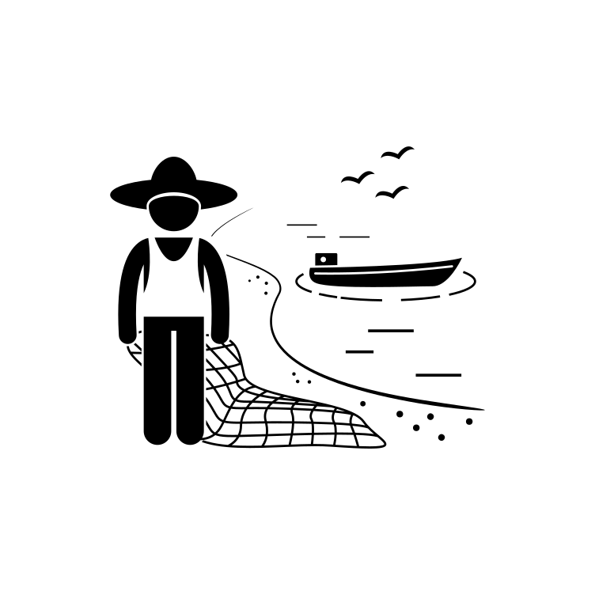
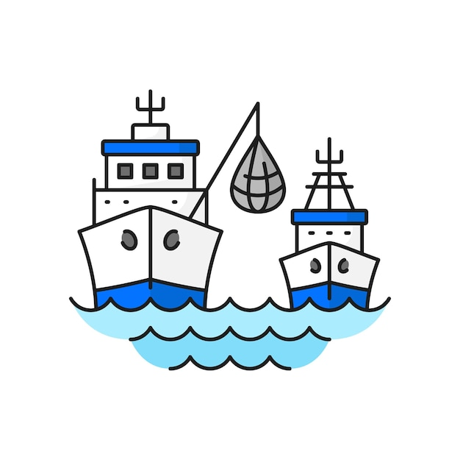
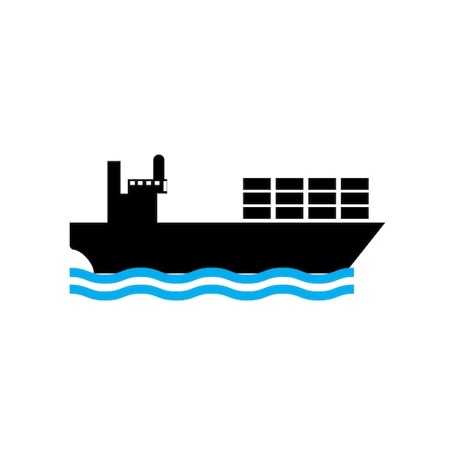
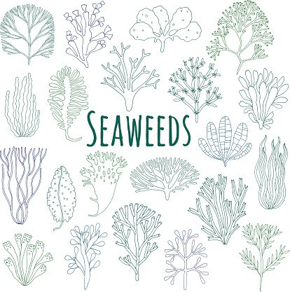
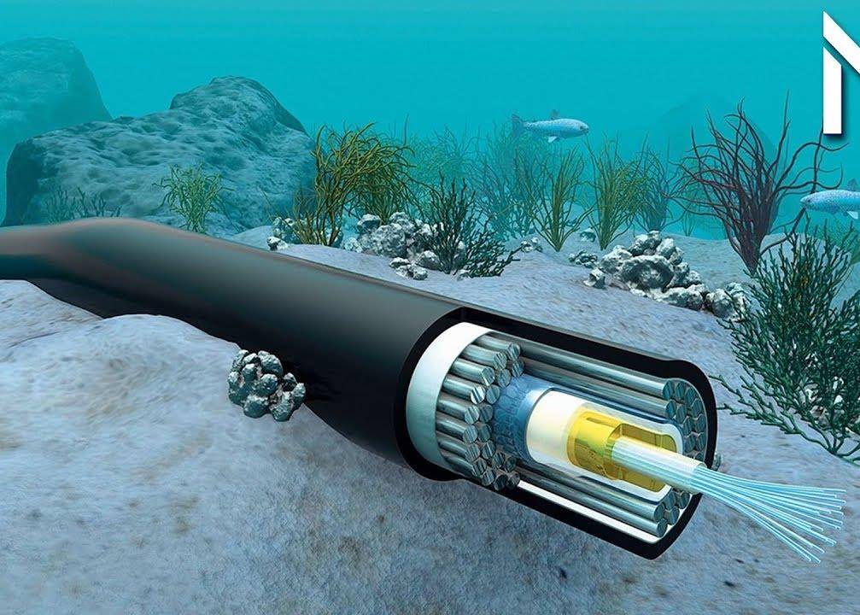
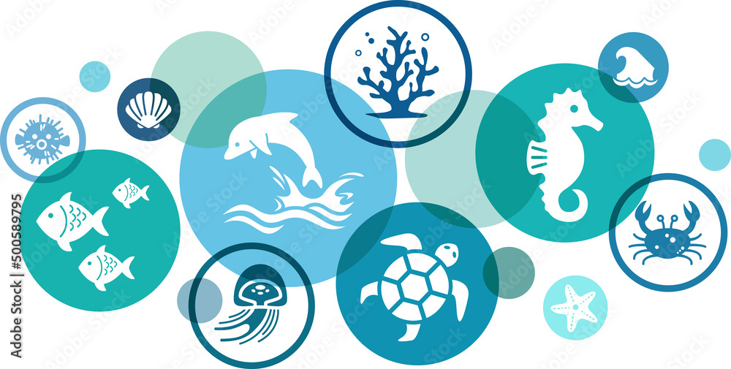
What oceans mean for Africa
To meet social and cultural needs
Achieve inclusive, sustainable blue economy
THE FOUNDATION
Healthy and productive oceans and coasts provide ecosystem goods and services
Supporting services
Provisioning services
Regulating services
Cultural services
OCEAN GOVERNANCE (global, continental, regional, national and sub-national levels)
Steering collective action across sectors, institutions and stakeholders
Inclusive
Sustainable
Blue Economy

Slide 3
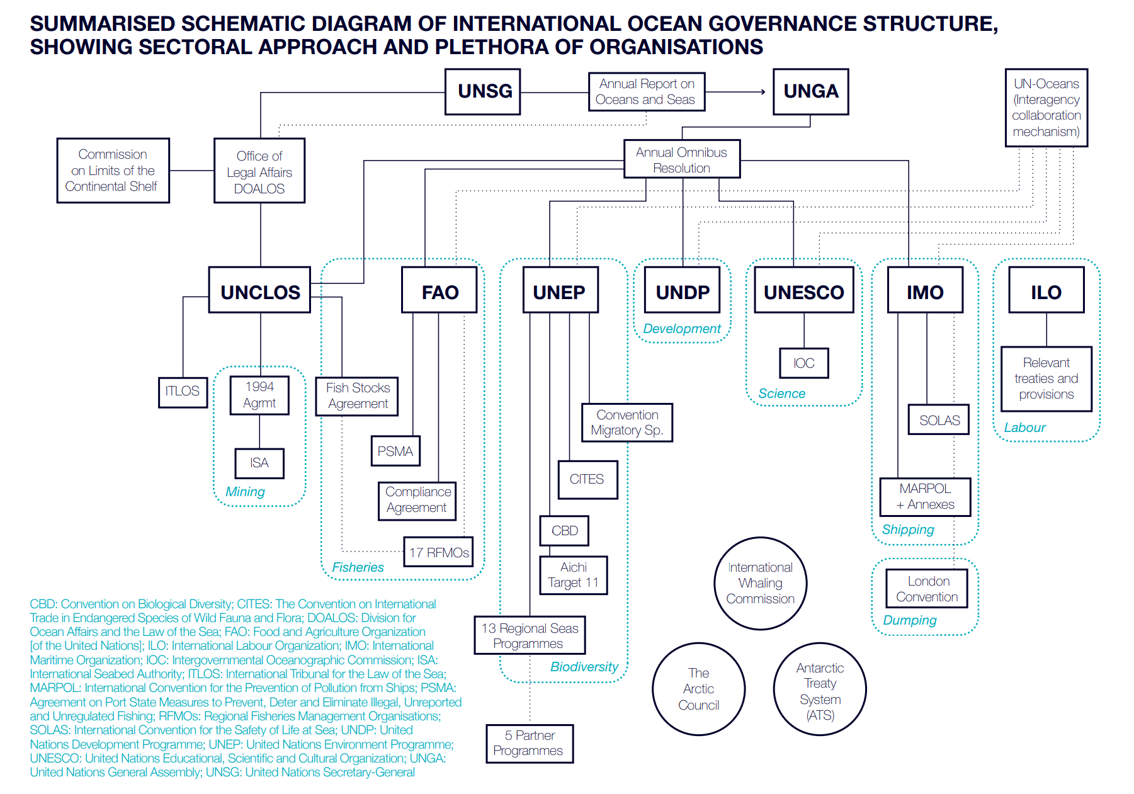
International Ocean Governance
Ocean governance is framed by:
state’s rights and obligations under international law, under regional agreements and national law;
the related policies, plans and norms (e.g., Rio+20, AU policies);
international codes, guidelines and approaches (e.g., the Code of Conduct for Responsible Fisheries and various International Maritime Organisation guidelines)
Law of the Sea
Maritime security
Climate Change
Marine pollution
Fisheries
Living natural resources
Ocean Science and Knowledge
Global Ocean Commission 2014

Slide 4
Global level
UNCLOS (BBNJ,ISA,UNFSA)
Global Commitments on Biodiversity, Climate, Trade
SDGs and 2030 Agenda
UNESCO
Decade for Ocean Science
IMO treaties
Continental
AU Ocean Governance Strategy
AU BE STRATEGY
AIMS 2050,Agenda 2063, Bamako Convention, Abuja Declaration on Fisheries, Lome Charter
RECs
VERTICAL
Regional Seas-Nairobi, Abidjan, Jeddah and Barcelona Conventions
Regional and Sub-regional Level
RFBs and RFMOs
IOC-UNESCO
Sub-Commission for Africa
Fragmentation across sectors at global, regional and national levels
National Implementation
National Blue Economy and Ocean Economy Strategies
Sectoral Laws and Policies working in their silos
HORIZONTAL

Slide 5
Therefore, the main aim of ocean governance at the continental level is to steer and coordinate collective action for the ocean by:
Enabling Member States to cooperate by sharing expertise, developing joint processes, and coordinating and harmonising their governance efforts
Enabling participation of non-state actors (private sector, civil society and local communities) in decision-making processes
Expanding resource mobilization efforts

Slide 6
Africa Ocean Governance Strategy
Strategic Intervention Pathway 1: Enhancing Means of Implementation
Effective ocean governance requires robust support mechanisms, including financial and resource mobilization, technology transfer, capacity building, and awareness creation
A deep understanding of the ocean’s social, economic, and technological dimensions—as well as the extent of communities' reliance on marine resources—is essential
Additionally, strengthening human and institutional capacity, facilitating technology transfer, and establishing mechanisms for communicating scientific consensus are fundamental to informed decision-making
These efforts will enhance coordination and ensure the successful implementation of the Africa Ocean Governance Strategy and Implementation Plan

Slide 7
Key Components of Strategic Intervention Pathway 1: Enhancing Means of Implementation
A. Finance and Resource Mobilization
Strengthening Financial Mechanisms by establishing a framework for financing ocean governance initiatives in Africa at continental, regional, sub-regional and national levels
B. Enhance mechanisms for knowledge dissemination and decision-making
Utilization of Existing Knowledge
Enhances mechanisms for knowledge dissemination and decision-making
Leverages expertise from institutions such as WIOMSA, CBD scientific centers of Africa, and centers of excellence
Synthesizes and verifies critical information across sectors and themes
Recognition and utilization of indigenous knowledge
Integration and Accessibility of Information
Develops platforms such as dashboards, hubs, or networks to link fragmented information
Ensures policymakers and stakeholders have access to comprehensive ocean data
C. Awareness Creation and Outreach
Public Awareness and Advocacy
Raises awareness of the importance of healthy oceans
Encourages political will for increased investment in sustainability
Promotes behavioral change to support ocean conservation efforts

Slide 8
Intervention Area I
Establish mechanisms to mobilise finance for ocean governance at scale in Africa
Guide joint strategic and sustainable investments through increased public, private and philanthropic investment in ocean governance
Support the integration of ocean governance in fiscal policy and public financial management systems
Support the implementation of policy, institutional and legal reforms for enhanced resource mobilization and scaled-up, transformative finance for ocean governance
Support conducive co-investment, knowledge sharing and B2B platforms to facilitate a sustainable financing and resource mobilisation mechanism for the successful implementation of the Strategy and Action Plan

Slide 9
Intervention Area II Establish mechanisms for knowledge management, technology transfer, capacity building, communication, education, awareness
Align programmes on ocean governance in Africa with the policy and science aspects
Strengthening the science to policy interface to support evidence-based decision making in AU policy processes
Incorporating indigenous and traditional knowledge in AU policy making processes
Developing and strengthening platform(s), institutions and networks for technology, assessment and reporting on the continent’s aquatic and marine waters and their associated values

Slide 10
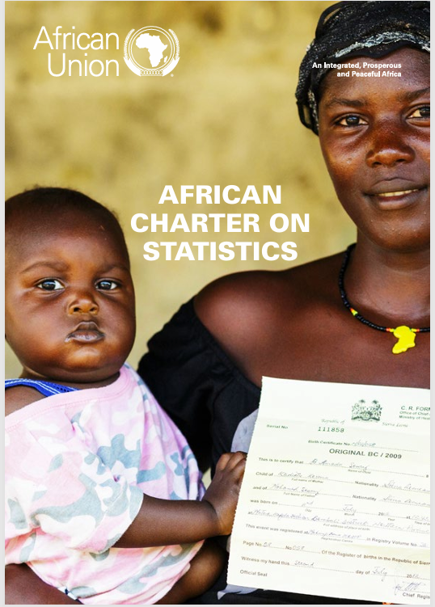
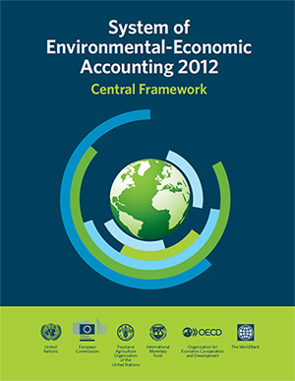
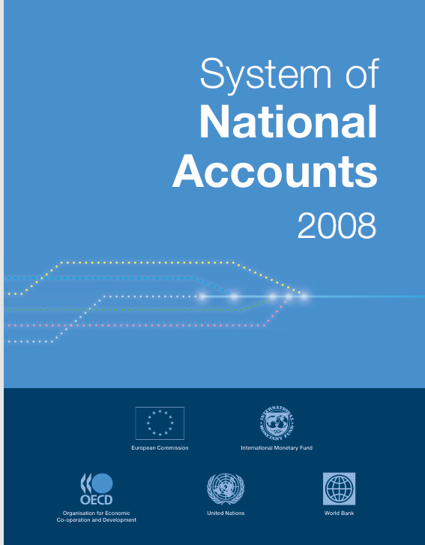
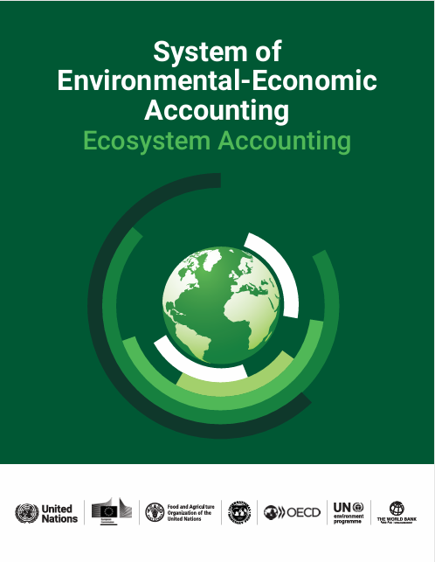
e) Aligning data and information on marine and coastal ecosystems to the African Statistical System
Ocean accounts are integrated records of regularly compiled and comparable data concerning ocean environment assets:
macro-economic data e.g fisheries, tourism, shipping, marine genetic resources
environmental-economic data (assets, flows, wastes, taxes)
Ecosystem data (extent, condition, ecosystem services)
Structured data on ocean beneficiaries, technology, and governance
Ocean Accounts system integrate satellite imagery, field measurements, economic models, local knowledge and social data and consistent monitoring to develop natural capital assessments

Slide 11
e) Aligning data and information on marine and coastal ecosystems to the African Statistical System…….ctd
Ocean Accounts are compatible/aligned with global statistical frameworks used by National Statistical Offices and Finance Ministries
System of National Accounts
System of Environmental Economic Accounting-Ecosystem Accounts
System of Environmental Economic Accounting-Ecosystem Accounts 2012-Central Framework
SNA, SEEA-CF and SEEA-EA use internationally agreed standard concepts, definitions, classifications, accounting rules and tables which have been adopted by the Africa Charter of Statistics

Slide 12
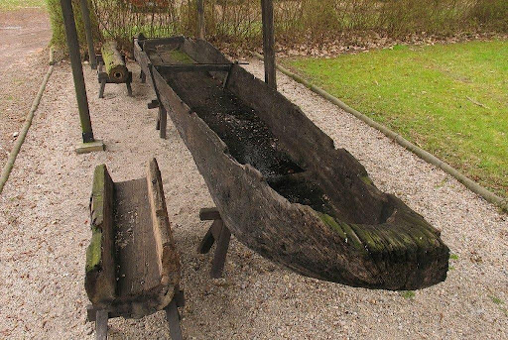
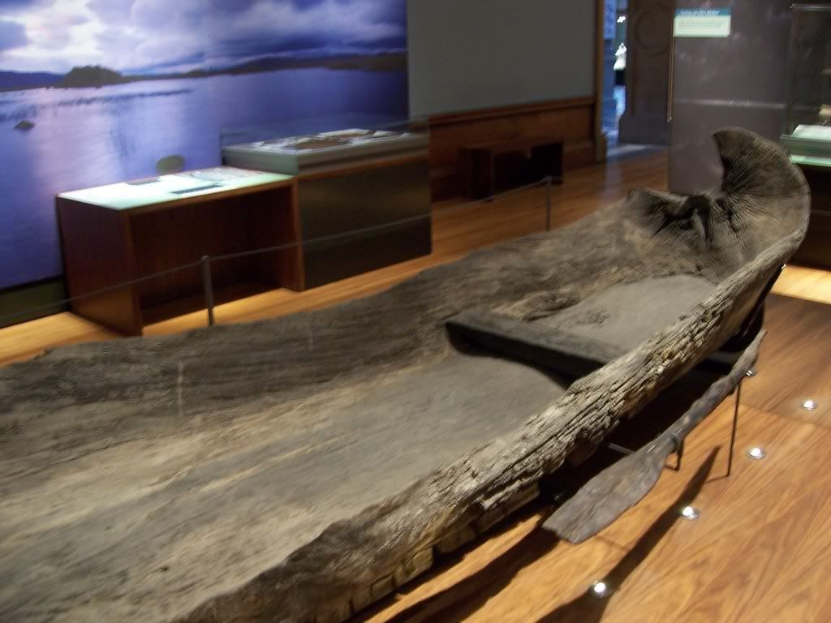
f) Developing and strengthening platforms and institutions for documenting and preserving Africa’s maritime history
Dufuna Canoe, Africa’s oldest boat

Slide 13
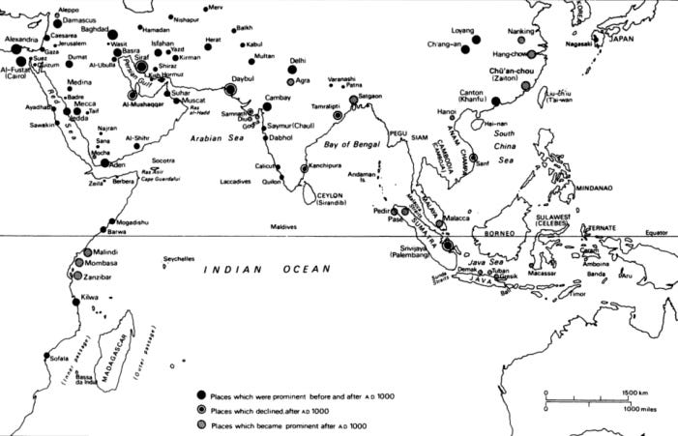
Indian Ocean Trade
Bajuni
Ajuran
Mediterranean
Nile Trade
Nubia
Atlantic Trade
Akan, Yoruba and Igbo
Trading ports and cities in the Indian ocean world 618-1500 by N. Chaudhuri

Slide 14
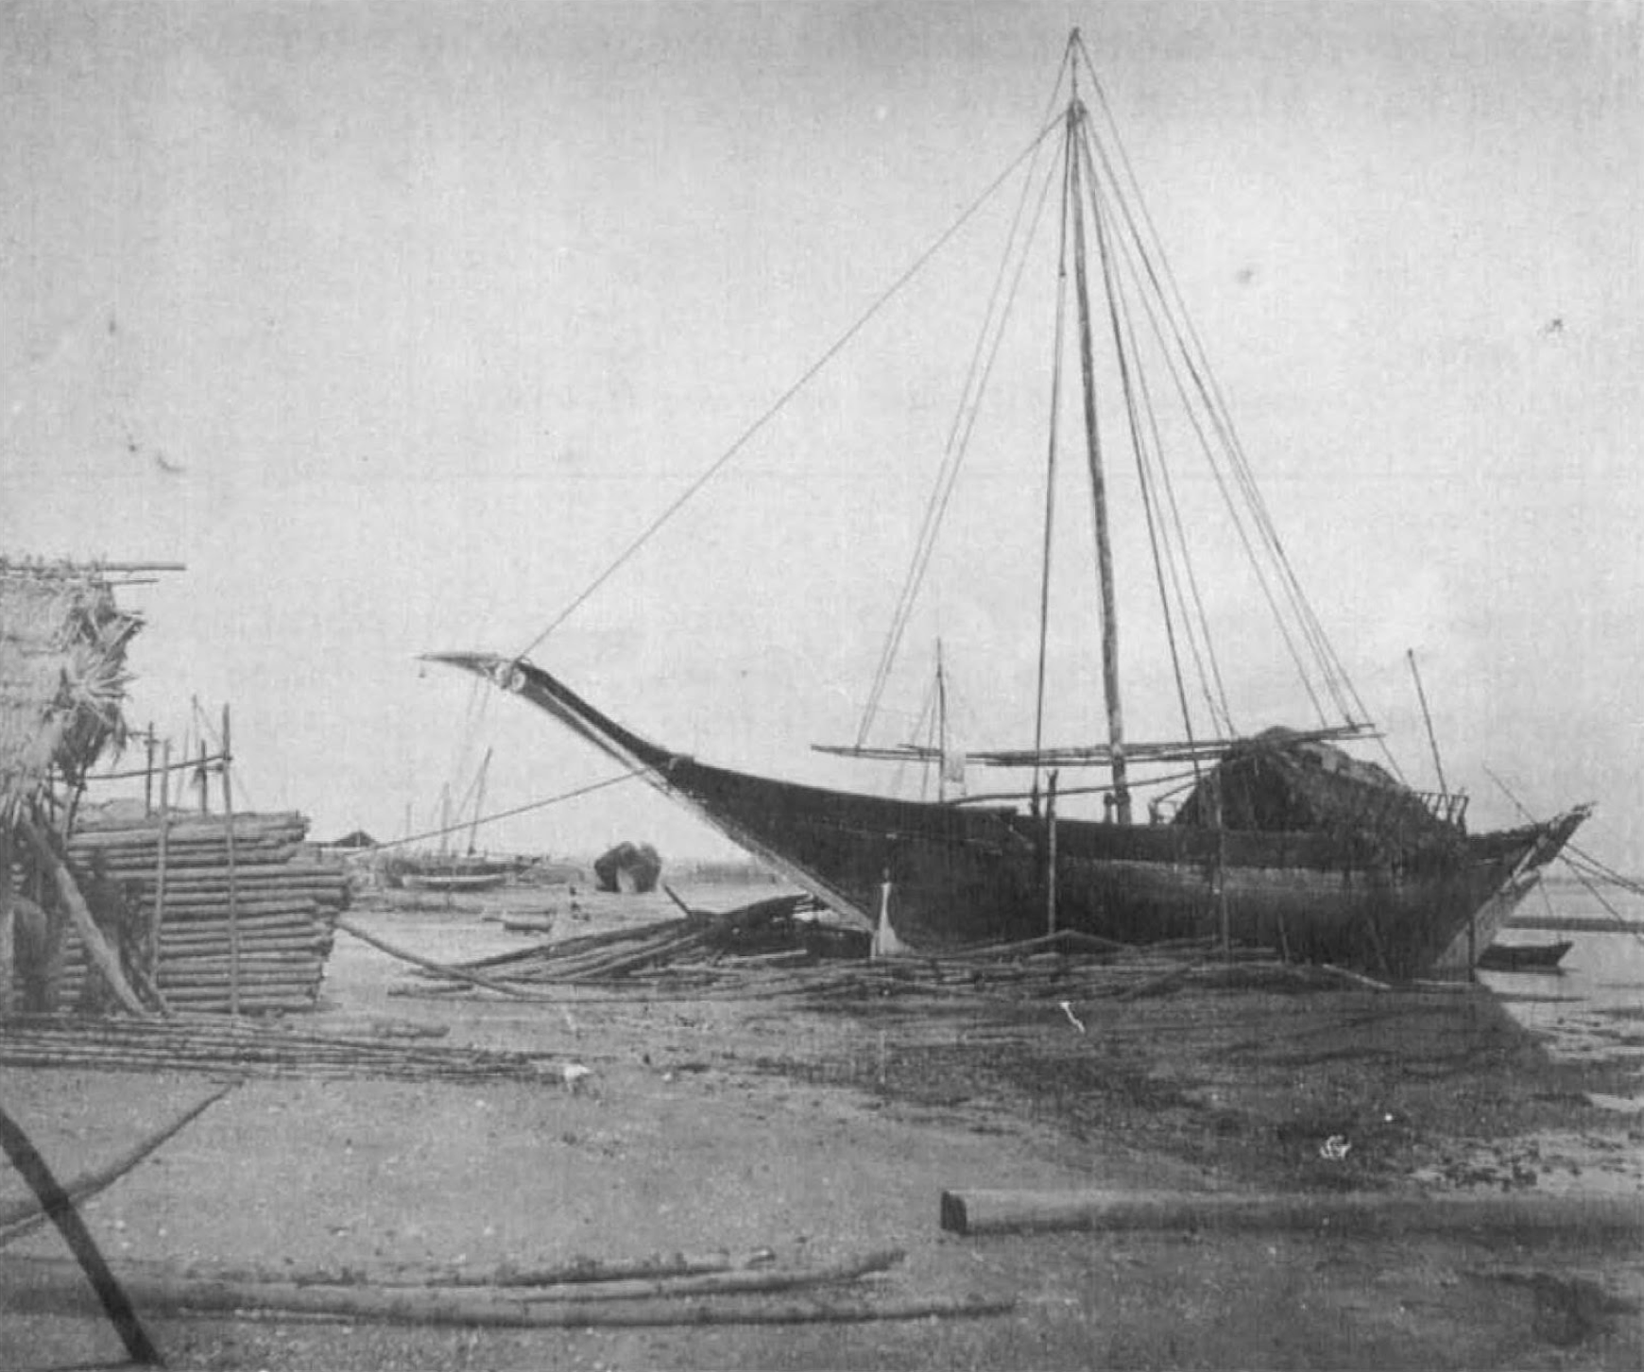
MTEPE-SEWN BOAT
Bojakowski, P.T., Sarathi, A., Berrocal, R.P. et al. Mtepe: Documentation and Analysis of a Sewn-Boat Reconstruction from Zanzibar, Tanzania. Afr Archaeol Rev 41, 139–159 (2024). https://doi.org/10.1007/s10437-024-09577-6

Slide 15
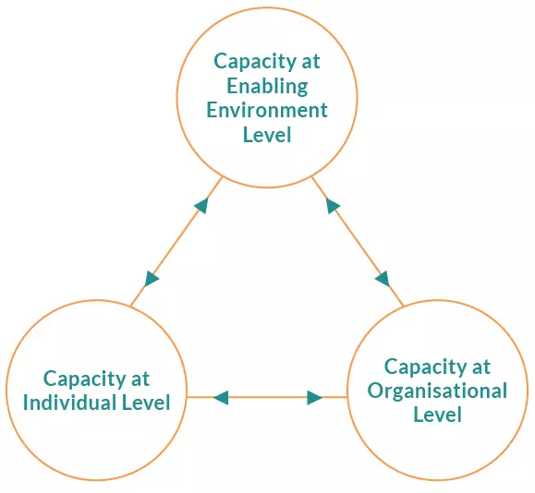
g) Strengthening human and institutional capacity

Slide 16
Intervention Area III
Strengthen implementation, compliance and enforcement of existing instruments and frameworks
Mobilize actors and stakeholders in the implementation of existing instruments, with a focus on compliance and enforcement
Enhance investment in capacity building, and financial resources for enforcement and compliance with ocean governance frameworks

Slide 17
Intervention Area IV
Strengthen monitoring systems and processes for ocean governance (monitoring pollution and resource use)
Establish and or strengthen systems and processes for monitoring
Develop or strengthen protocols for monitoring marine resources and pollution

Slide 18
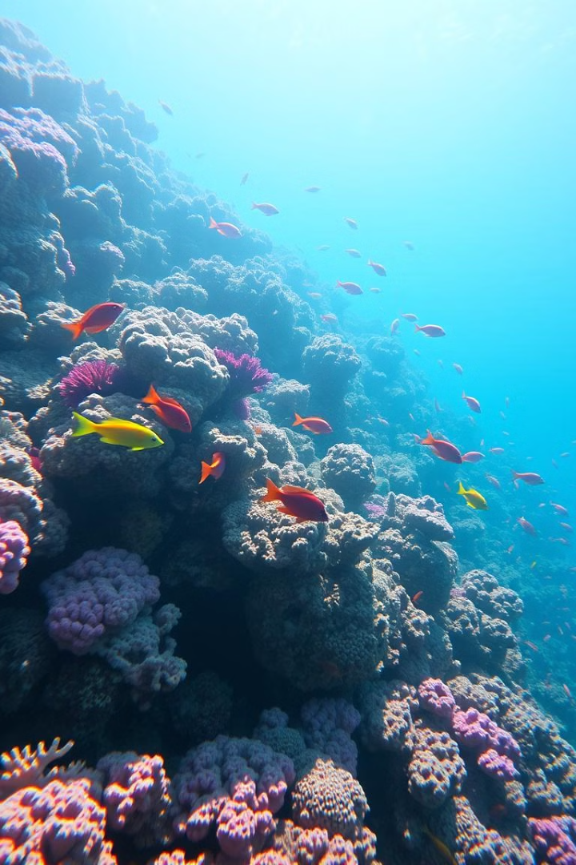
Thank You

