Slide 1
AFRICA OCEAN GOVERNANCE STRATEGY (AOGS) : presentation
By Georges MBA ASSEKO
Head BLUE ECONOMY Division

Slide 2
OUTLINE
Africa Ocean & Blue Economy
Justification and Scope
Interventions and pathways

Slide 3
AFRICA’S OCEAN & BLUE ECONOMY : ID
Geographical Overview
Marine & Coastal Resources
39 coastal countries
16 landlocked countries (with no direct sea access)
6 island states dependent on marine resources
2 oceans (Atlantic & Indian) & 2 semi-closed seas (Mediterranean & Red)
47,000 km of coastline with 100+ major ports
+13 million km² maritime zone (Territorial Waters & Economic Exclusive Zone (EEZ))
+6.5 million km² continental shelves (seabed territory)
Freshwater & Inland Waterways
63 international river basins (transboundary watersheds and routes)
World’s 2nd largest rivers (Nile & Congo)
24,000 km² of lakes including the African Great Lakes (27% of global surface freshwater)
64% of land covered by water bodies, including major basins (Congo, Nile, Zambezi, Niger, etc.)
Social & Economic Importance
Rich aquatic resources: water, fish stocks, minerals, oil & gas, and unique biodiversity
Ecosystem services essential for livelihoods & biodiversity sustainability
Growing coastal population reliant on marine and freshwater resources

Slide 4
GOVERNANCE NEEDS AND JUSTIFICATION
AUC's Core Responsibilities
Need for Ocean Governance Framework
Policy harmonization across the continent
Coordination of ocean governance efforts
Capacity building within member states
Resource mobilization for ocean initiatives
Monitoring and reporting on progress
Ensure sustainable & equitable management of Africa’s:
Marine resources
Aquatic spaces
Address continent’s vast & diverse coastal ecosystems management issues

Slide 5
OPPORTUNITIES IN OCEAN GOVERNANCE
Mobilization of financial and technical resources
Stakeholder engagement and participation
Strengthened decision-making using scientific data

Slide 6
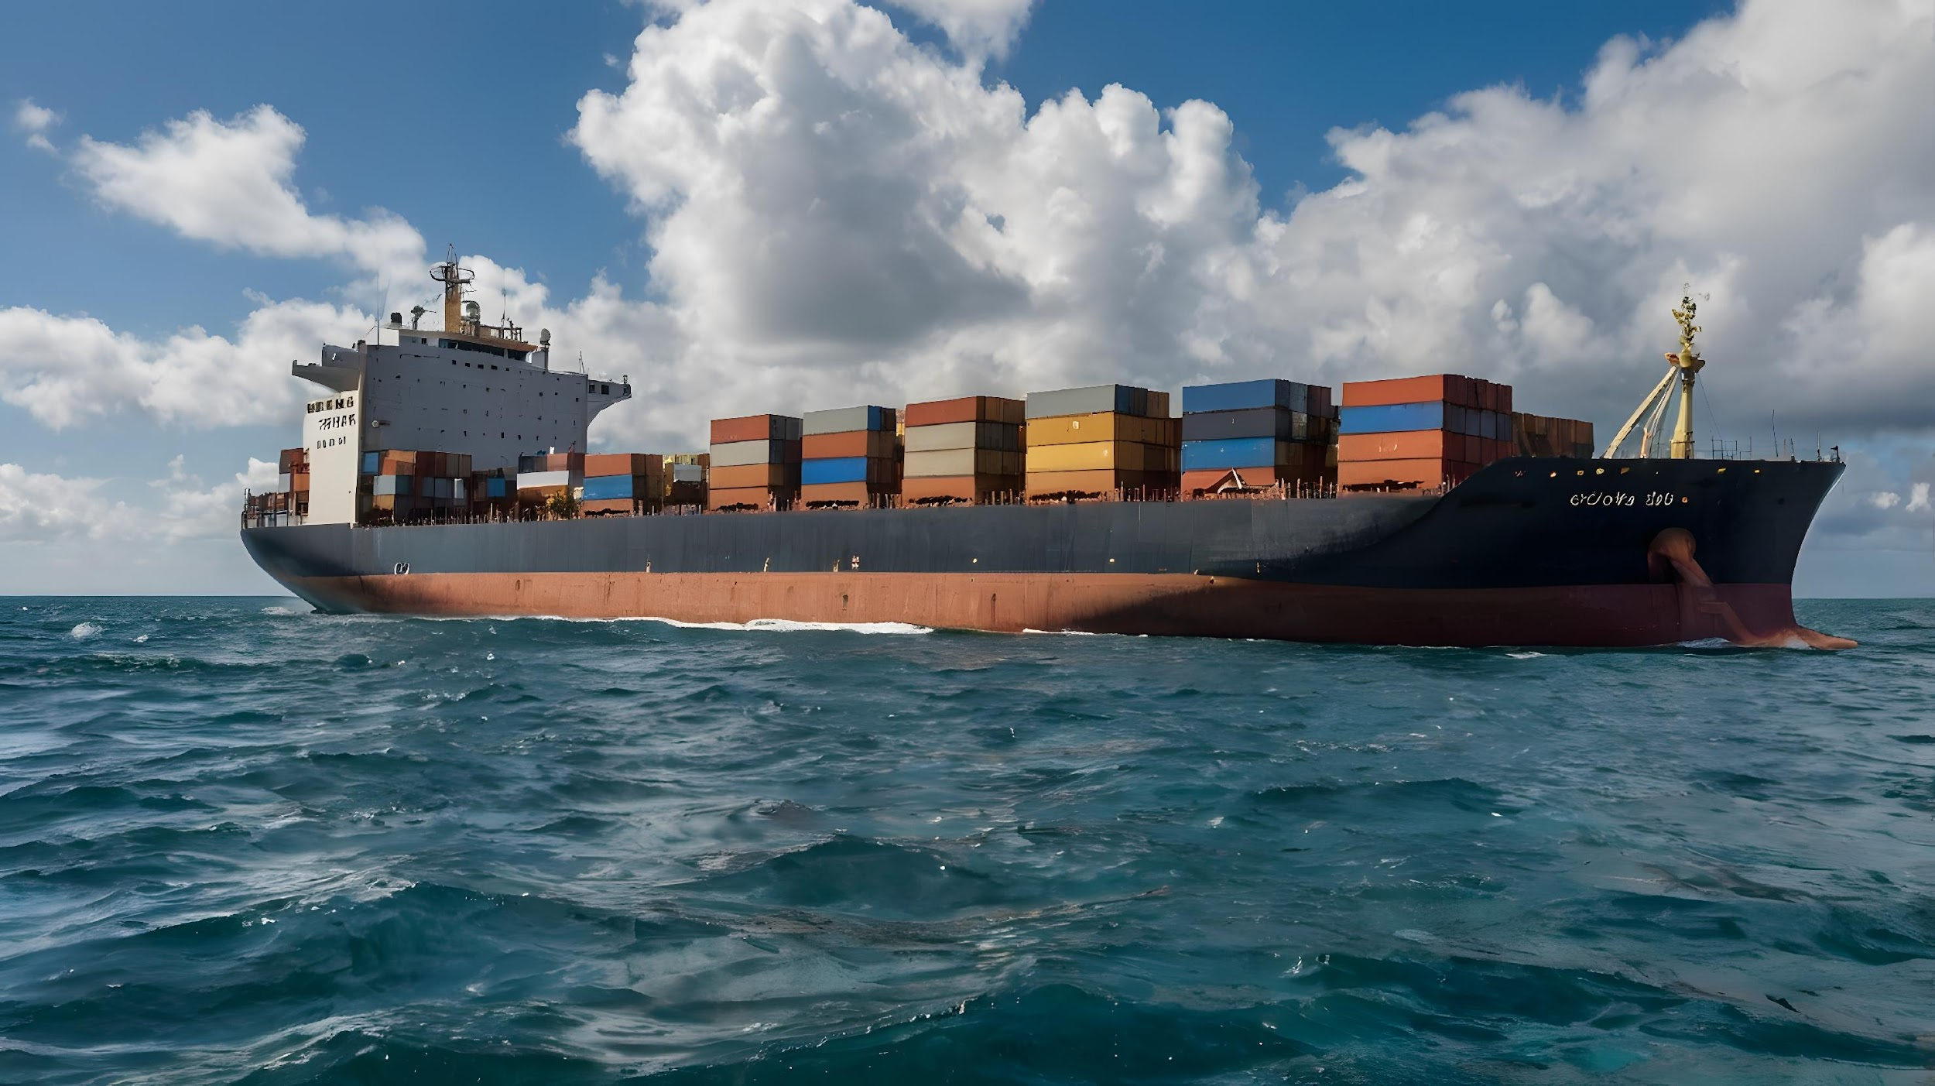
OBJECTIVE OF OCEAN GOVERNANCE
Ocean Governance Strategy (OGS) : Designed to close governance gaps, improve coordination and implementation, and promote sustainable economic opportunities for Africa's aquatic and marine resources.

Slide 7
OGS’ SCOPE
Marine spaces
Aquatic spaces
Comprehensive coverage
Internal & territorial waters;
Exclusive Economic Zones (EEZs)
Continental shelves
High seas
The Area (seabed beyond national jurisdiction)
Rivers, lakes & inland water bodies
Interconnected freshwater-marine systems
All associated aquatic/marine resources
Integrated management of linked ecosystems

Slide 8
OGS’ VISION
"A unified Africa with safe, secure, and sustainably managed aquatic & marine ecosystems that support prosperity for all.“
People-centered policies & actions
Integrated & coherent governance
Clean, healthy, and productive waters
Safe & secure marine spaces

Slide 9
OGS’ GOAL
Environmental protection
Social equity
Benefit coastal communities
Safeguard ecosystems
Economic growth
Enable sustainable blue economies

Slide 10
SPECIFIC OBJECTIVES
Establish an overarching ocean governance framework
Mobilize resources for strategy implementation
Catalyze sustainable investments in aquatic/marine spaces
Strengthen collaboration & partnerships
Enhance knowledge management for sustainable governance

Slide 11
FRAMING : Functions and Actions
Core functions
Key actions
Information exchange
Promote networking of national/regional data systems
Cooperation & coordination
Enhance collaboration across ocean-related sectors
Strengthen stakeholder & business engagement
Policy implementation review
Monitor effectiveness of existing instruments & strategies
Develop capacities for ocean governance in Africa
Mobilize national and regional political will
Promote networking of national and regional data systems
Foster cooperation across ocean-related industries and sectors
Engage stakeholders and businesses in ocean governance

Slide 12
STRATEGIC INTERVENTION PATHWAYS
1. Enhancing means of implementation
2. Coordination, cooperation, and stakeholder engagement
Objective
Strengthen mechanisms for putting the Strategy and Implementation Plan into action.
Key actions
Establish a financing framework;
Leverage existing knowledge from key institutions (e.g., WIOMSA, CBD centers);
Synthesize and verify critical cross-sectoral information;
Develop platforms (dashboards, hubs, repositories, etc.) to link fragmented data;
Raise public awareness to increase political will and promote behavioral change.
Objective
Foster effective coordination within the African Union, enhance collaboration with all relevant maritime actors, and increase stakeholder participation.
Benefits
Improved teamwork for effective delivery;
Stronger support for the implementation process;
Increased ownership and commitment from all actors;
Greater buy-in across all levels (macro, meso, micro).
Importance: Crucial for the successful implementation of the Strategy and Action Plan.
Enabling Factor: Requires harmonious collaboration towards a shared vision.

Slide 13
WAY FORWARD
Coordination mechanism and Plan for implementation
Monitoring and Reporting mechanism

Slide 15
kea leboha
Shoukran !
Obrigado !
Asante Sana !
Merci !

