Slide 1
Existing frameworks, gaps and opportunities in Ocean Governance in Africa

Slide 2
Global setting on Ocean Governance frameworks
United Nations Convention on the Law of the Sea (UNCLOS)
over-arching global legal framework for oceans and foundation of ocean governance at continental, regional, and national levels
MEAs – Biodiversity, Pollution, Meteorological, Maritime, Climate Change
Agenda 2030: Several interlinked SDGs are essential to the ocean and seas
Anchored on Goal 14—‘Life Below Water’—facilitating actions for ocean sustainability and fostering greater integration in ocean governance.
Key global governance issues: ocean management occurs in silos, sector by sector, with poor coordination between institutions. Management of aquatic environments is implemented across several economic sectors, jurisdictions, and spatial scales

Slide 3
Existing African Frameworks Categories African Union Frameworks Sub regional Frameworks Regional Economic Communities (RECs) Regional Seas Programmes Regional Fisheries Management Organizations (RFMOs) Ports and harbors frameworks National Frameworks

Slide 4
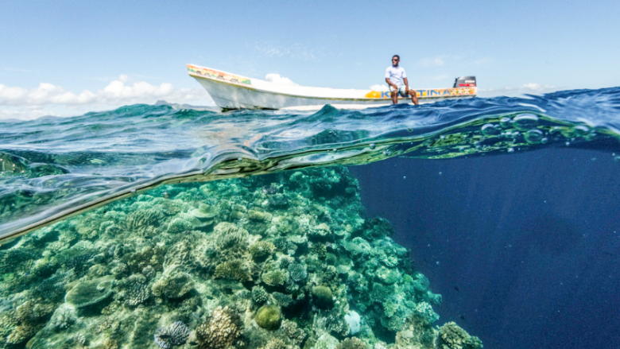
Key Gaps in Ocean Governance
Defining characteristic of governance of coastal and marine resources in Africa is the complexity, multiplicity and overlapping of mandates and jurisdictions with weak institutional frameworks.
While several mechanisms for ocean governance exist, gaps and duplication remain.
Cooperation and coordination of the frameworks across sectors has always proved challenging.
Oceans issues not on the high table – growing political will

Slide 5
Key Gaps in Ocean Governance
weak science-based management - insufficient valuation of ecosystem services; centrality of ecosystem-based management in decision-making; understanding of cumulative impacts, including in land-sea interfaces
weak implementation and enforcement
insufficient stakeholder engagement and in decision-making processes hindering effective implementation. Coastal communities, women and youth are often not included as major stakeholders in management and decision-making
transparency and accountability issues in ocean institutions

Slide 6
African Union Frameworks
Agenda 2063 of African Union
Lomé Charter on Maritime Security and Safety and Development in Africa
2050 Africa’s Integrated Maritime Strategy
African Continental Free Trade Area
Africa Blue Economy Strategy
Bamako Convention
New Partnership for Africa’s Development
Libreville Declaration on Health and Environment in Africa

Slide 7
Gaps in the African Union Frameworks

Slide 8
Integration and Coherence: existing ocean governance frameworks remains isolated and not fully integrated into the AU policy framework, leading to fragmented efforts
Sector-Specific Focus: Many AU strategies, such as the Policy Framework and Reform Strategy for Fisheries and Aquaculture, focus on specific sectors rather than a holistic approach to ocean governance. A heavy maritime security focus, creating an imbalance between security and developmental goals for a blue/ocean economy
Economic and Environmental Balance: Few strategies emphasize the protection of marine ecosystems or the economic potential of coastal and marine resources. Strategies often trade and economic frameworks are enhanced but not explicitly addressing the potential of coastal and marine resources as significant socio-economic drivers. While some strategies focus heavily on environmental and social pillars without considering economic aspects.

Slide 9
Health and Environmental Linkages: Some strategies imply that environmental degradation is linked to human health but fail to include health aspects comprehensively in ocean governance.
Adaptability and Emerging Issues: Existing frameworks lack flexibility to adapt to new and emerging issues such as illegal and illicit exploitation of resources, climate change and rapid economic growth impacts on marine ecosystems.

Slide 10
What works in the African Union Frameworks
Agenda 2063: widely recognized for its comprehensive approach to sustainable development, including ocean governance. It aims to transform Africa into a global powerhouse by promoting inclusive and sustainable development.
Africa Blue Economy Strategy: focuses on harnessing the potential of Africa's blue economy for economic growth, job creation, and environmental sustainability. It emphasizes the sustainable use of marine resources.

Slide 11
Sub Regional Frameworks
Regional Economic Communities (RECs)
Regional seas programmes
Regional Fisheries Management Organizations (RFMOs)

Slide 12
Gaps in the Sub Regional and National Frameworks

Slide 13
Poor Connectivity: Weak connections between natural resource and economic sector management - leads to unsustainable practices and parallel efforts. The inter-connection of freshwater/transport bodies and marine ones barely exist
Mechanisms for Economic Advancement: RECs weak effective mechanisms to advance the economic aspects of oceans
Management Mandate: RSP/Conventions traditionally do not have a direct mandate to manage or regulate economic activities. Regional maritime transport and ports agreements face challenges in implementation
Coordinated Approach: While RFMOs and RSP promote a coordinated approach to marine resource management, the multiplicity of instruments can lead to duplication of roles.

Slide 14
National Frameworks
Unclear mandates on oceans: ministries, departments and management committees, cities, blue economy, port authorities, ICZM committee, local governments, thematic task forces on the landward side but with conflicting mandates
Several successful ocean governance frameworks exist
Mostly central/national governments managing the seaward side of coastal and marine environment and their resources.

Slide 15
What works in the sub regional Frameworks
RFMOs are effective in promoting coordinated regional approaches to the long-term conservation and sustainable use of fisheries resources.
Regional Seas Programmes: e.g. Abidjan and Nairobi Conventions, strong on enhancing regional cooperation in the protection, management and development of marine and coastal environments including transboundary aspects
Ports management: sub-regional port associations under Pan-African Association for Port Co-operation (PAPC) fairly strong on cooperation in matters port development in Africa

Slide 16
Opportunities in African Ocean Governance
There are opportunities that will enable the use of marine resources in ways that keep them healthy, productive, safe, secure, and resilient.
Strengthened Continental Framework: Development of a continental institutional structure for enhanced coordination among national, regional and sub-regional bodies would facilitate unified actions in ocean governance.
Unified African Voice: creation of common policy positions, a stronger voice and enhancing Africa’s influence in international fora.
Accelerated Implementation: Leverage the African Union's political leadership to mobilize stakeholders and fast-track the implementation of existing instruments, with a focus on compliance and enforcement.

Slide 17
Opportunities in Ocean Governance
Cross-Sectoral Cooperation: cooperative linkages to institutionalize cross-sectoral mechanisms, strengthening institutional frameworks to enhance coherence across governance structures, avoid duplication for effective implementation.
Holistic Approaches: Encouraging integrated management approaches (blue economy) that recognize the interdependence of sectors, fostering synergies for sustainable ocean governance.
Promotion of investments: Opportunities for African governments and stakeholders to mobilise and pool together financial and technical resources for implementation.

Slide 18
Opportunities in Ocean Governance
Widening Inclusivity and Empowerment in Ocean Governance: Expansion of stakeholder engagement in management and decision-making, including women, youth, civil society, and the private sector, to optimize resource use and improve ocean governance outcomes.
Private Sector Partnerships: Foster systematic engagement of the private sector to leverage their expertise and resources in ocean governance initiatives.
Advancing role of science in policy making: Ability to strengthen decision-making on ocean-based economy and ocean management through use of scientific information and data and strengthening knowledge vase and networks and aaddressing institutional and human resource gaps

Slide 19
Thank you
Robert Wabunoha
robert.wabunoha@un.org

