Slide 1
Background Paper EAST AFRICAN COMMUNITY 1st – 4th April 2025 Dar es Salaam, Tanzania
Validation of the African Union Ocean Governance Strategy and Implementation Plan and
Capacity Enhancement on the UNCLOS BBNJ Agreement
How can maritime security and trade be more effectively governed within the ocean space?

Slide 2
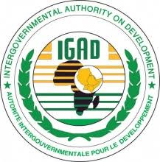
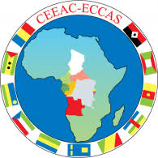
EAC is one of the 8 RECs under AU
8 Partner States
0.468
0.438
0.425
0.537
0.442
Burundi, DRC, FRS, Kenya, Rwanda, South Sudan, Uganda and United Republic of Tanzania
0.367
Size | 5.4 million square km
Population | 302.2 million citizens
GDP | US 312.9 bn
0.377
0.337

Slide 3
Objective of the Community (Article 5)
The objective of the Community shall be to develop policies and programmes aimed at widening and deepening co-operation among the Partner States in political, economic, social and cultural fields, research and technology, defence, security and legal and judicial affairs, for their mutual benefit.

Slide 4
EAC Treaty - Cooperation in Environment and Natural Resources
Chapter 19
Articles 111: Environment and Natural Resources 112: Management of Environment 114: Management of Natural Resources
ARTICLE 111: The Partner States agree to take concerted measures to foster co-operation in the joint and efficient management and the sustainable utilisation of natural resources within the Community for the mutual benefit of the Partner States
Article 112: The Partner States undertake to cooperate in the management of the environment
Article 114: Partner States agree to:
co-operate in the management of their natural resources for the conservation of the eco-systems and the arrest of environmental degradation;
to adopt common regulations for the protection of shared aquatic and terrestrial resources.

Slide 5
EAC TREATY
Customs
Union
Common
Market
Monetary Union
Political Federation
Vision 2050 and 6th EAC Development Strategy
Protocols - Environment and Natural Resources/Tourism and Wildlife Management
Terrestrial Ecosystems | Aquatic Ecosystems | Wildlife Management | Climate Change | Pollution & Waste Mgt | Disaster & Risk Mgt | Biosafety
Forestry Policy
Water Policy
Wildlife Policy
Climate Change
Policy
Forestry Strategy
IWRM Strategy
Wildlife Strategy
Climate Change
Strategy
Climate Finance Access
& Mobilization Strategy
DRRM Strategy
RBSAP
Blue Economy
Strategy
Antipoaching
Strategy
Climate Change
Masterplan
Arid & Semi Arid Areas Strategy
Bills: Forest Management and Protection; Polythene Materials Control; Climate Change; Transboundary Ecosystems; DRR
Joint Participation
in MEAs
WASH
Mountains
Platform
Economic Valuation of
Natural Capital
Transboundary
Network
CoE
Mission: “widen and deepen the economic, political, social and cultural integration in order to improve the quality of life of the people of East Africa
5

Slide 6
How can maritime security and trade be more effectively governed within the ocean space?
EAC is committed to strengthening maritime security and trade governance within the ocean and marine space.
This presentation aims to highlight effective strategies for enhancing security and governance by aligning with regional frameworks, improving coordination, and investing in critical infrastructure.

Slide 7
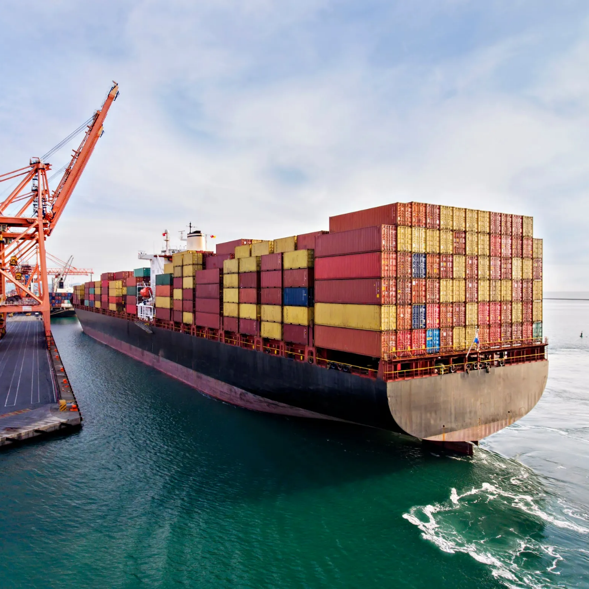
Introduction and Context
Maritime security is a fundamental pillar of sustainable ocean governance and economic development.
EAC recognizes that ensuring security in marine and freshwater environments is essential for trade facilitation, resource protection, and sovereignty.
However, challenges such as piracy, illegal fishing, smuggling, and weak institutional coordination continue to threaten the effective governance of ocean spaces.
By strengthening security measures and regional collaboration, EAC policy framework provides for an enabling environment that not only enhances maritime safety but also promotes sustainable trade and economic growth across member states.

Slide 8
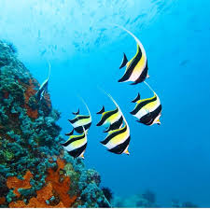
Key Security Challenges in Maritime Trade Governance
The ocean space within the EAC region faces numerous security threats that hinder effective trade governance. Piracy, maritime terrorism, and armed robbery at sea have significantly disrupted trade routes and increased the cost of shipping.
Illegal, unreported, and unregulated (IUU) fishing has also posed a major challenge by depleting marine resources and undermining local economies.
Additionally, transnational crimes such as drug trafficking, human smuggling, and contraband trade have flourished due to weak law enforcement and limited regional coordination.
The absence of a strong, harmonized security framework has further exacerbated these vulnerabilities, making it imperative for the EAC to strengthen its maritime governance strategy.

Slide 9
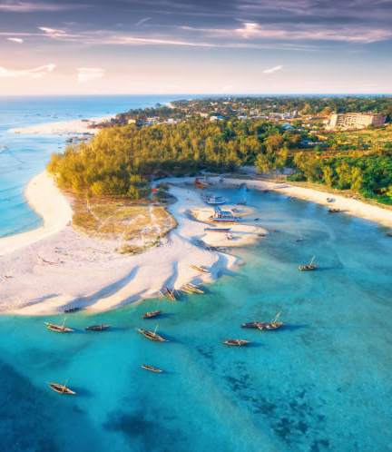
EAC’s Commitment to Maritime Security and Trade Governance
The EAC is committed to deepening regional integration through enhanced cooperation in security, trade, and economic development.
As part of its strategic vision, EAC Partner States have ratified various international maritime security instruments (e.g. Djibouti code of conduct -2008, Jeddah amendment 2017, Maritime Security and Safety and Development in Africa -Lomé Charter, IMO initiatives, etc) that support its goal of a well-regulated and safe ocean space.
Despite these efforts, gaps remain in the regional governance structure, particularly in addressing port security, maritime surveillance, and coordinated law enforcement.
The absence of a dedicated maritime security framework at the EAC level further complicates efforts to combat illicit activities and ensure smooth trade operations.
Moving forward, the region intends to work collectively to establish stronger institutions and policies that will safeguard maritime trade and security.

Slide 10
Enhancing Means of Implementation for Maritime Security
Strengthening maritime security within the EAC requires a comprehensive approach that includes financial investment, technology transfer, and capacity building.
Sustainable funding mechanisms must be established to support security infrastructure such as surveillance systems, coast guard operations, and emergency response units.
Technology transfer will play a critical role in enhancing monitoring and enforcement capabilities, particularly through satellite surveillance, automated tracking systems, and data-sharing platforms.
Capacity-building programs must also be prioritized to equip security personnel with the necessary skills and expertise to combat maritime threats effectively.

Slide 11
Coordination, Cooperation, and Stakeholder Engagement
Effective maritime security governance requires a coordinated effort among multiple stakeholders, including government agencies, regional bodies, and the private sector.
EAC is strengthening collaboration with institutions such as the Maritime Organization for Eastern, Southern, and Northern Africa (MOESNAA) and the Northern Corridor Transit and Transport Coordination Authority to enhance security operations.
Additionally, fostering partnerships with international organizations and law enforcement agencies will improve intelligence sharing, joint patrols, and crisis response mechanisms.
A regional maritime security framework should be developed to harmonize policies, facilitate cross-border cooperation, and ensure that all stakeholders work towards a unified security strategy.

Slide 12
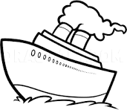
Strengthening Institutional and Policy Frameworks for Security Governance
A well-defined institutional and policy framework is crucial for achieving sustainable maritime security governance.
The Northern Corridor Transit and Transport Agreement (NCTTA) and the African Charter on Maritime Security (Lomé Charter) provide a foundation for policy alignment, but additional measures must be taken to ensure their effective enforcement.
By developing standardized regulations for port security, surveillance, and emergency response, EAC Partner States can create a cohesive and efficient governance system that protects trade interests and enhances regional security.

Slide 13
Investing in Security Infrastructure and Port Modernization
The modernization of ports and security infrastructure is a critical component of effective maritime governance.
The EAC must invest in expanding and upgrading existing ports to accommodate the increasing volume of trade while ensuring compliance with international security standards.
The deployment of advanced surveillance technologies, including satellite monitoring and automated vessel tracking, will improve maritime domain awareness and enhance response capabilities.
Furthermore, investments in inland waterway security will ensure that transboundary freshwater systems remain safe and navigable, supporting regional trade and economic activities.

Slide 14
Strategic Priorities for Strengthening Maritime Security and Trade Governance
To achieve its vision of a secure and well-governed maritime sector, EAC has identified key strategic priorities (part of EAC BE Strategy).
First, the region should establish a comprehensive maritime security framework that aligns with existing regional and international agreements.
Second, a regional enforcement mechanism should be developed to coordinate security operations and intelligence sharing among Partner States.
Third, EAC should enhance cooperation on joint patrols and surveillance missions to combat illegal activities at sea.
Fourth, sustainable financing models should be explored to support long-term security initiatives.
Finally, legal and institutional frameworks must be strengthened to ensure the effective implementation of maritime security policies across the region.

Slide 15
Thank You

