Slide 1
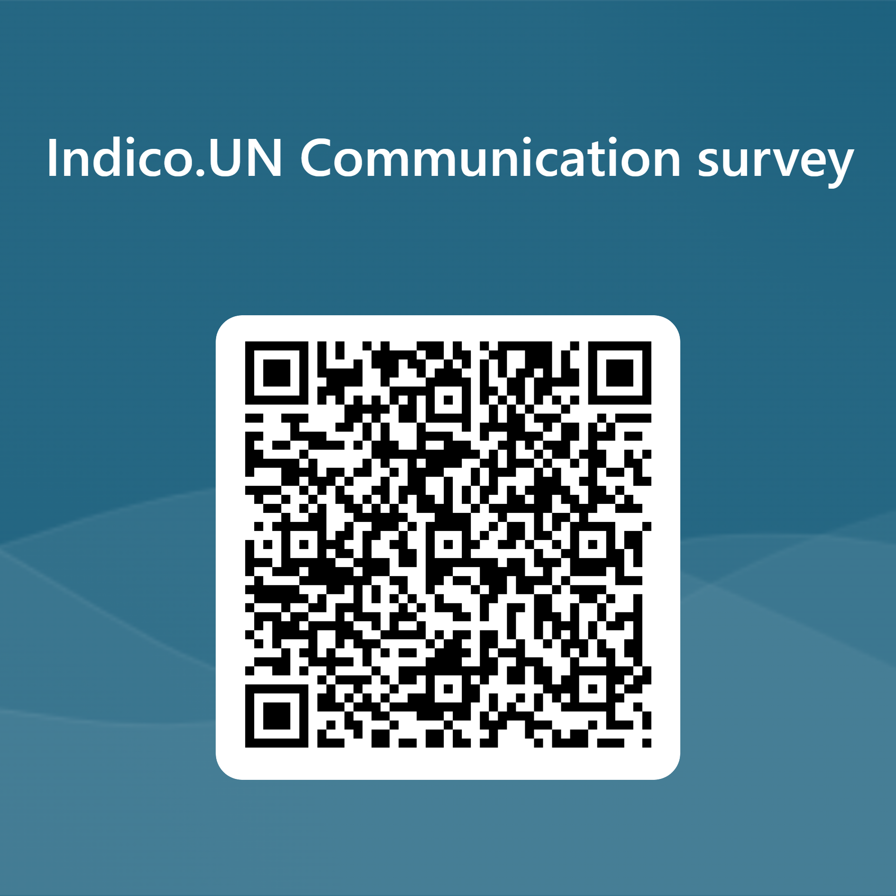
INDICO.UN Project Stakeholder MEETING
15 march2023
https://forms.microsoft.com/e/SDNMNpEwFk

Slide 2
Introduction
  Statistics
Indico.UN Project updates
  Upgrade to version 3 – Highlight the changes. (New slide)
Timeline and Achievements in 2022
  Plan 2023
  Accessibility ?
  Focus on MFA ??
  Digital badge – Chris De Santis or OIC
Documents and Services module
The way forward on the support of funded participants
Summer Camp 2023
Announcements
Q & A

Slide 3
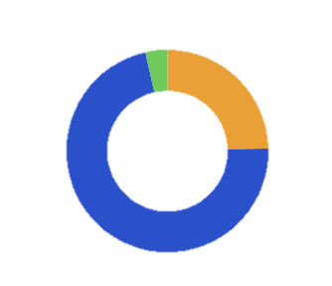
Indico.UN Statistics (as of 10 Mar 2023)
7,760 events/conferences … 36% synchronized from gMeets
975,000+ registrations … expected to reach 1Million registrations by April 2023
870,000+ approved participants
N. of events in 2022
N. of approved registrations in 2022
Events by arrangement type in 2022
Total 1790
Total 215,538
38,539
29,489
Virtual
54 (3.2%)
Hybrid
413 (23.1%)
216
233
253
22,597
20,549
175
189
17,766
15,100
15,422
108
125
102
99
158
13,696
11,972
13,516
In Person
1320 (73.7%)
53
79
7,976
8,916
Total 1,790
Jan
Feb
Mar
Apr
May
Jun
Jul
Aug
Sep
Oct
Nov
Dec
Jan
Feb
Mar
Apr
May
Jun
Jul
Aug
Sep
Oct
Nov
Dec
Top 3 events organized in 2022
  GP 2022 – 7th Session of the Global Platform for DRR – May 2022 counting ⁓7500 externals and ⁓ 3000 staff registrations
  UNCCD COP15 – May 2022 counting ⁓7600 approved registrations
  CSW67– UN WOMEN/DESA - Mar 2022 – 6000+ approved registrations
80+ established clients
Large (>100 events held): WHO, UNCTAD, OHCHR, DGC, ECE, ODA, UNEP, etc.
Medium (10> events held >100): UNFCCC, UNHCR, DESA, UNAIDS, ESCWA, OCHA etc.
Small (<10 events held): UNIDO, UNESCO, OPCW, etc.

Slide 4
Indico.UN web visits statistics
(June 2022 – 31 Jan 2023)
6,375,000 + views
504,000 visitors
(a visitor can have more than one view)

Slide 5
Indico.UN Project updates

Slide 6
2022 Indico.UN achievements
Disaster Recovery
Not yet started
In progress
Phasing out LSV & migration to v2
Completed
Integration with iNeed
Not approved/on hold
Integration completed in 2021
Progress decommissioning of support email
Legend
Analytical Module
Code freeze
Dec’22 - Feb‘23
Integration with Zoom
Transition to Python 3
Access Authorization Module (AAM)
MALU/UNIS completed in 2021
SHP
UNIS Vienna
Protocol & FIPOI
Int with booking system
UNOG Guided Tours
Integration
MALU NY
Geneva
Integration w/C-Cure
NY
Vienna
RC (ESCWA)
Umoja integration (now Support of funded participants)
BR 1,3
BR 2 –
Not appr.
Support of funded participants
Gap analysis
Accessibility & multilingualism
Technical analysis and consultation with CERN, Small Improvements
Jaws review
New onboardings
ECA, ESCAP, ESCWA, UNESCO
UNICRI (SLA)
Continuous improvements of existing functionalities
Dec ‘21
Mar ‘22
Jun ‘22
Sep ‘22
Dec ‘22
Mar ‘23
Jun ‘23
Sep ‘23
Dec ‘23

Slide 7
2022 Indico.UN achievements (continued)
New clients onboarded in 2022 include ECA, ESCAP, ESCWA, UNESCO, and Vienna-based organizations
CAPTCHA improvements
Documents and Services (DaS) (Virtual Kiosks) deployed for Geneva Secretariat entities
French translations of Indico.UN fields and help documents
Regular communication in the form of Stakeholders meetings, newsletters, and bulletins
  18 July 2022: Settings retained during migration to Indico.UN Version 2
  16 November 2022: Indico.UN Analytical Module
  1 December 2022: Zoom integration

Slide 8
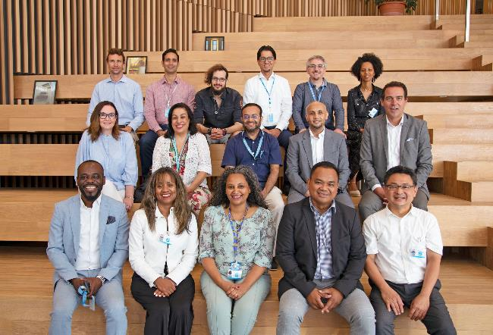
Indico.UN Summer camp, 8-12 Aug. 2022
What exactly is the Indico.UN summer camp, and what are its main objectives?
  It is a gathering of Indico.UN users and focal points from various organizations during few days with the following goals:
    Consolidate or deepen our knowledge of the Indico.UN solution
    Increase capacity through extensive and intensive training, presentations and hands-on sessions that cover all Indico.UN features
    Share your organization’s experiences and best practices
    Build a community of users, and get to know one another
Proof of concept with a few Indico.UN focal points:
  UNECA, Vienna, ESCAP and UNESCO (6 participants)
  Very positive feedback
  Decision to have a yearly edition that is open to all our stakeholders
Next edition and how to participate
  Date: First or second week of August 2023
  The participants’ expenses are covered by her or his organization
  Seats are limited, please express your interest early

Slide 9
Umoja integration update
In December 2022, ERPSD has shared a technical assessment on BR 4000000902 “Travel initiation triggered by Indico.UN (BR 2)” – not approved
NOT APPROVED
“The proposed integration between Indico.UN and the current Umoja Travel solution to meet the requirements in BR 4000000902, is not technically feasible since the required mandatory information to use and store the information in the Umoja Travel solution cannot be provided by the source. The Umoja Travel solution does not include capabilities for creating draft travel requests. Travel requests created in the system require all necessary mandatory information and result in budgetary postings upon creation...”
RECOMMENDATIONS
“- The current Umoja travel solution should be retained as the only solution to create travel request without creating parallel solutions or forms to create trips.
- The use of standard copy functionalities and other available features should be further explored from a procedural perspective as they will facilitate the processing of travel requests for groups of people traveling to the same location.”
BR 4000000902 (Travel initiation triggered by Indico.UN)_ERPSD Assessment.pdf
Notes:
Given that Umoja improvements are ongoing and UE/CEM is ongoing, we suggest that we will revisit with the PB early next year.

Slide 10
2023 Indico.UN plan
Code freeze
Dec’22 - Feb‘23
Transition to Python 3
Security improvements
2-factor authentication
Integration w/gMeets (outside Geneva)
Legend
Integration Paris and Vienna
Not yet started
Integration w/WHO security system (SLA)
In progress
Integration with Securiton
Digital badge Geneva
Completed
Digital badge for participants
Digital badge for AAM users
Not approved
Account analysis and clean-up
Access Authorization Module (AAM)
MALU/UNIS completed in 2021
SHP
UNIS Vienna
Int w/Analyt Module
UNESCO
Protocol & FIPOI
UNOG Visitors
Integration with booking system
UNOG Guided Tours
NY
Integration
DELAYED
Integration w/C-Cure
MALU NY
Geneva
Vienna
DELAYED
RC (ECA)
RC (ESCWA)
Nairobi
Umoja integration (now Support of funded participants)
BR 1,3
BR 2 –
Not appr.
Support of funded participants
SCOPE REVIEW
Gap analysis
Accessibility & multilingualism
Technical analysis and consultation with CERN, Small Improvements
Jaws review
External assessment
Transition to v3.2 and improvements
ML: Discussions with CERN
DELAYED
New onboardings
ECA, ESCAP, ESCWA, UNESCO
UNICRI (SLA)
UNICITRAL, UNON, FAO & ILO – TBD, DESA Training
Continuous improvements of existing functionalities
Dec ‘21
Mar ‘22
Jun ‘22
Sep ‘22
Dec ‘22
Mar ‘23
Jun ‘23
Sep ‘23
Dec ‘23

Slide 11
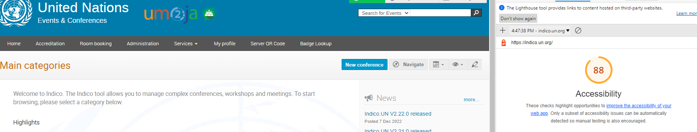
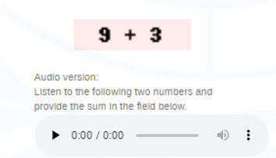
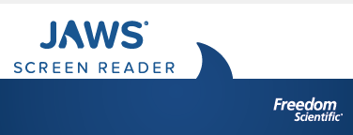
Accessibility – activities completed
Accessibility evaluation by User1st and technical assessment conducted with CERN
Testing through Google Lighthouse scoring Indico.UN at >85%.
Enhanced CAPTCHA functionality by adding audio player
The user accessibility test was conducted in Jan 2023 with two users with visual disability using the Jaws screen reader.
The test focused on participants’ experience using Indico.UN:
    accessing the event information;
    creating an Indico.UN profile;
    registering for the event.
  Improvements were identified and will be implemented in the coming months (i.e. order and description of interface elements, etc.)
Released on 7 Dec 2022

Slide 12



Accessibility – Plans for 2023
Organize regular accessibility testing in Indico.UN releases, using industry recognized tools (i.e. ANDI, Google Lighthouse, etc.)
Review and make Indico.UN training materials more accessible.
Update a dedicated Guide for conference organizers how to make events/registrations forms on Indico.UN more accessible.
Upgrade to Indico Version 3.2 to leverage substantial set of accessibility improvements
Conduct external accessibility review of Indico.UN and Indico core.
Additionally, 2023 funds were allocated to improve accessibility in future Indico core versions, in collaboration with CERN

Slide 13

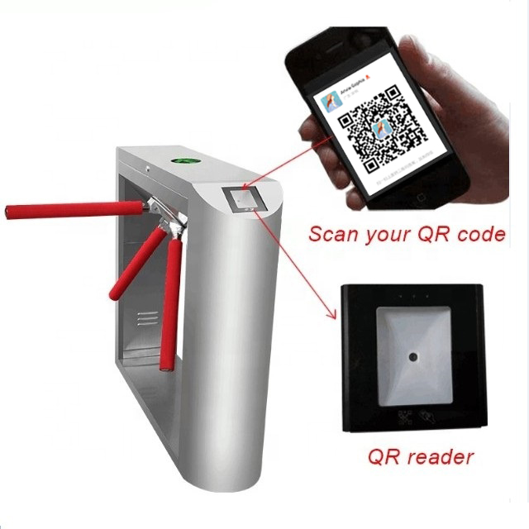
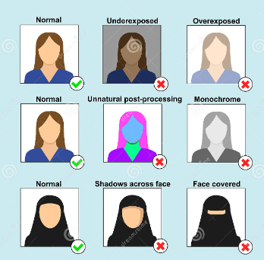
Digital badge
UNOG Security is redesigning the access control gates and requested new features to avoid badge printing for conference participants as well as to reduce the screening time and access-related queues
The project will mainly include development of:
  Digital, mobile-friendly badge
  New QR code (to open turnstiles)
  System check of the uploaded photo
The project implementation targeting event participants badges planned for April 2023 with further improvements in the following months

Slide 14
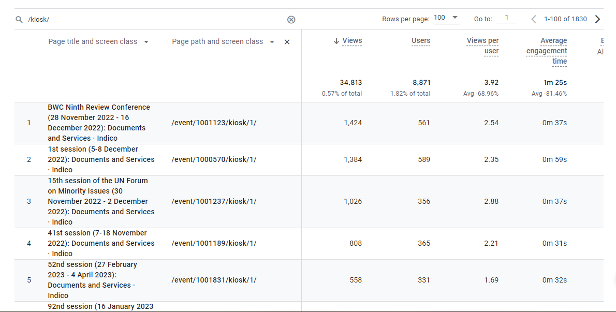
Documents and Services (DaS)
A feature used by the Distribution section of DCM in Geneva on behalf of clients.
Activated primarily for all meetings that require interpretation taking place in Geneva.
34,000+ visits to the DaS pages
DaS for other entities and duty stations upon request but needs to be customized and developed.
Contact us at indico@un.org or contact the Business Analysis team.

Slide 15
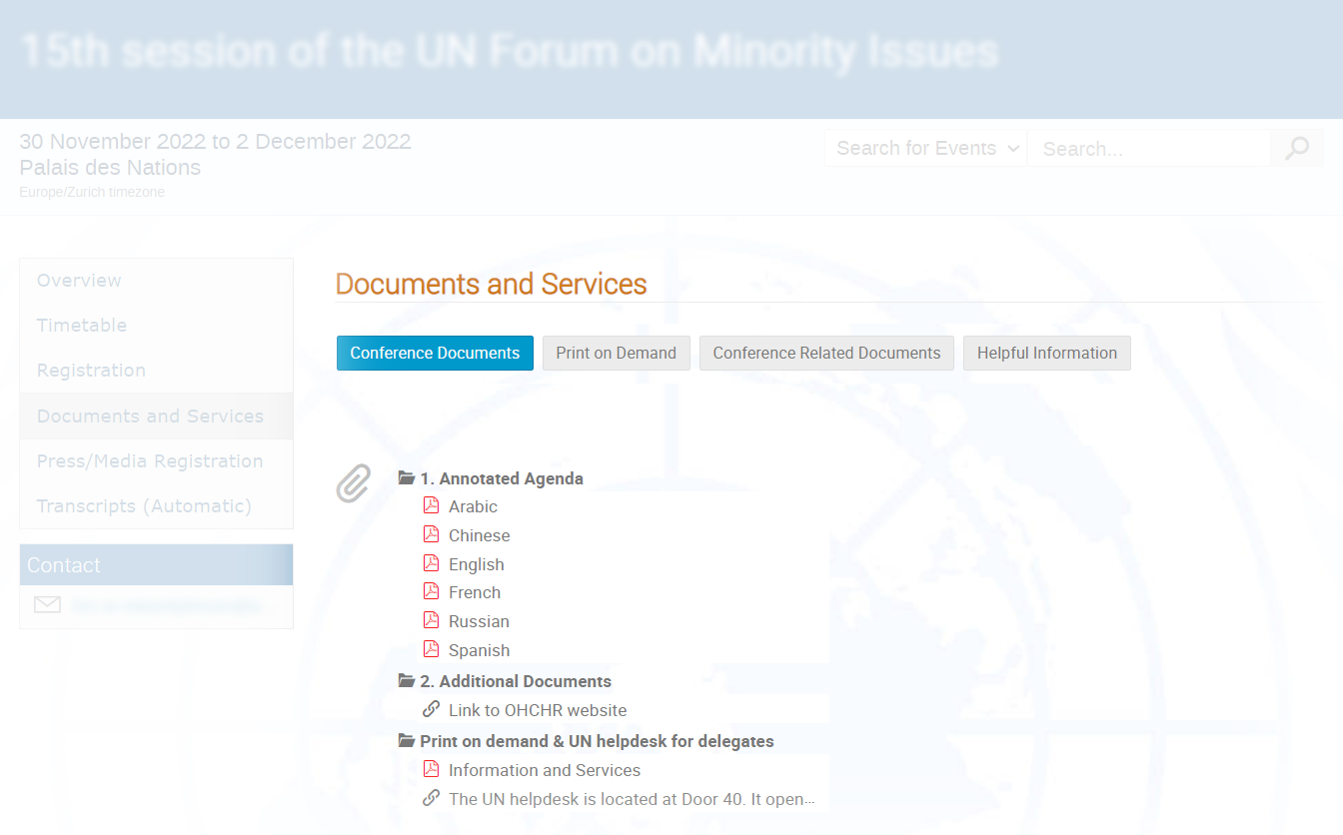
Documents and Services
Four tabs with a wealth of information
Conference Documents
Documents and links directly linked to the conference.
Print on Demand
Information on how delegates can have documents printed upon request at the UNOG Palais.
Conference Related Documents
Background information and documents as well as links to information pertaining to the conference.
Helpful information
Information on accessibility, directions and practical information regarding conferences support at UNOG as well as general resources useful to delegates visiting Geneva

Slide 16
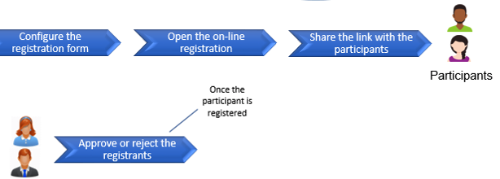


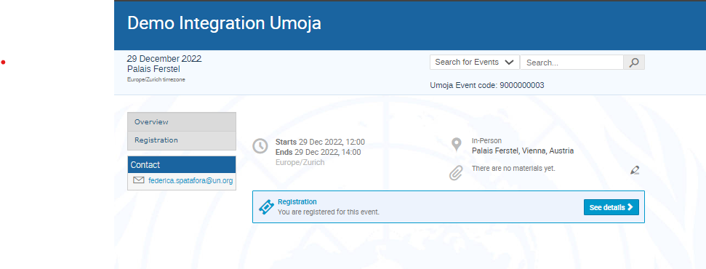
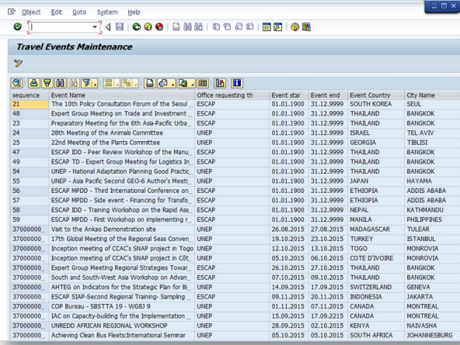







The way forward on support of funded participants
Original business case – Integration with Umoja
Travel initiation triggered by Indico.UN – CURRENT STATUS & INTEGRATION PROPOSAL
Meeting participants funded by Indico.UN event organizers in Umoja
Leveraging on Indico.UN proximity to the participants to collect relevant information to finalize travel request and travel claims
Event Mng
Travel administrator
BENEFITS
UMOJA INTEGRATION SCOPE
Umoja code: 400000096
Send location and event details - receive Umoja event code
Avoid duplication of efforts in the collection and input of participants and trip details
Move data ownership onto participants
Avoid the risk of sharing confidential data via email
Improve data quality and consistency
Improve reporting by increasing % of trips associated to events
Event synchronization
City/country dataset synchronization
Travel initiation triggered by Indico.UN – postponed
Registration
Travel requests
Personal ID
Banking details
Personal ID synchronization (GID*)
Banking details synchronization
Personal details
POST – EVENT PHASE:
Sync proof of travel docs
Share blacklisted participants
REPORTING
Common dataset
Trips details (scattered collection of these details)
Draft a travel request with trip details
Trips details
Input
Input
Funded participant
Travel Administrators

Slide 17




The way forward on support of funded participants
Proposed changes in Indico.UN
Travel initiation triggered by Indico.UN – PROPOSED CHANGES IN INDICO.UN – NO INTEGRATION W/UMOJA
Identify/mark funded participants from other participants
Collect trip details of funded participants through dedicated travel itinerary templates (matching Umoja trips fields) to be added at registration or later in the process
Create a dedicated approval process for travel itinerary sections and system notifications to funded participants confirming and sharing the Umoja event codes
Access to Travel admins as registrars to moderate trips details or be consulted with automatic notifications
Event Mng
Travel administrator
Not Funded
1. Possibility to mark funded participants
Funded
√
Registration
Travel requests
Personal ID
Banking details
Personal details
3. Dedicated approval process and notifications
2. Dedicated travel itinerary templates
Trips details
4. OPTION 1: Registrars = approving travel itinerary suggestions
Trips details
Umoja code
Umoja code
Input
OPTION 2
Involved party: System notifications to TAs (including trips details and Umoja event code)
Input
Funded participant
Travel Administrators

Slide 18
Summer camp
Deadline – Mid April – express intrest

Slide 19
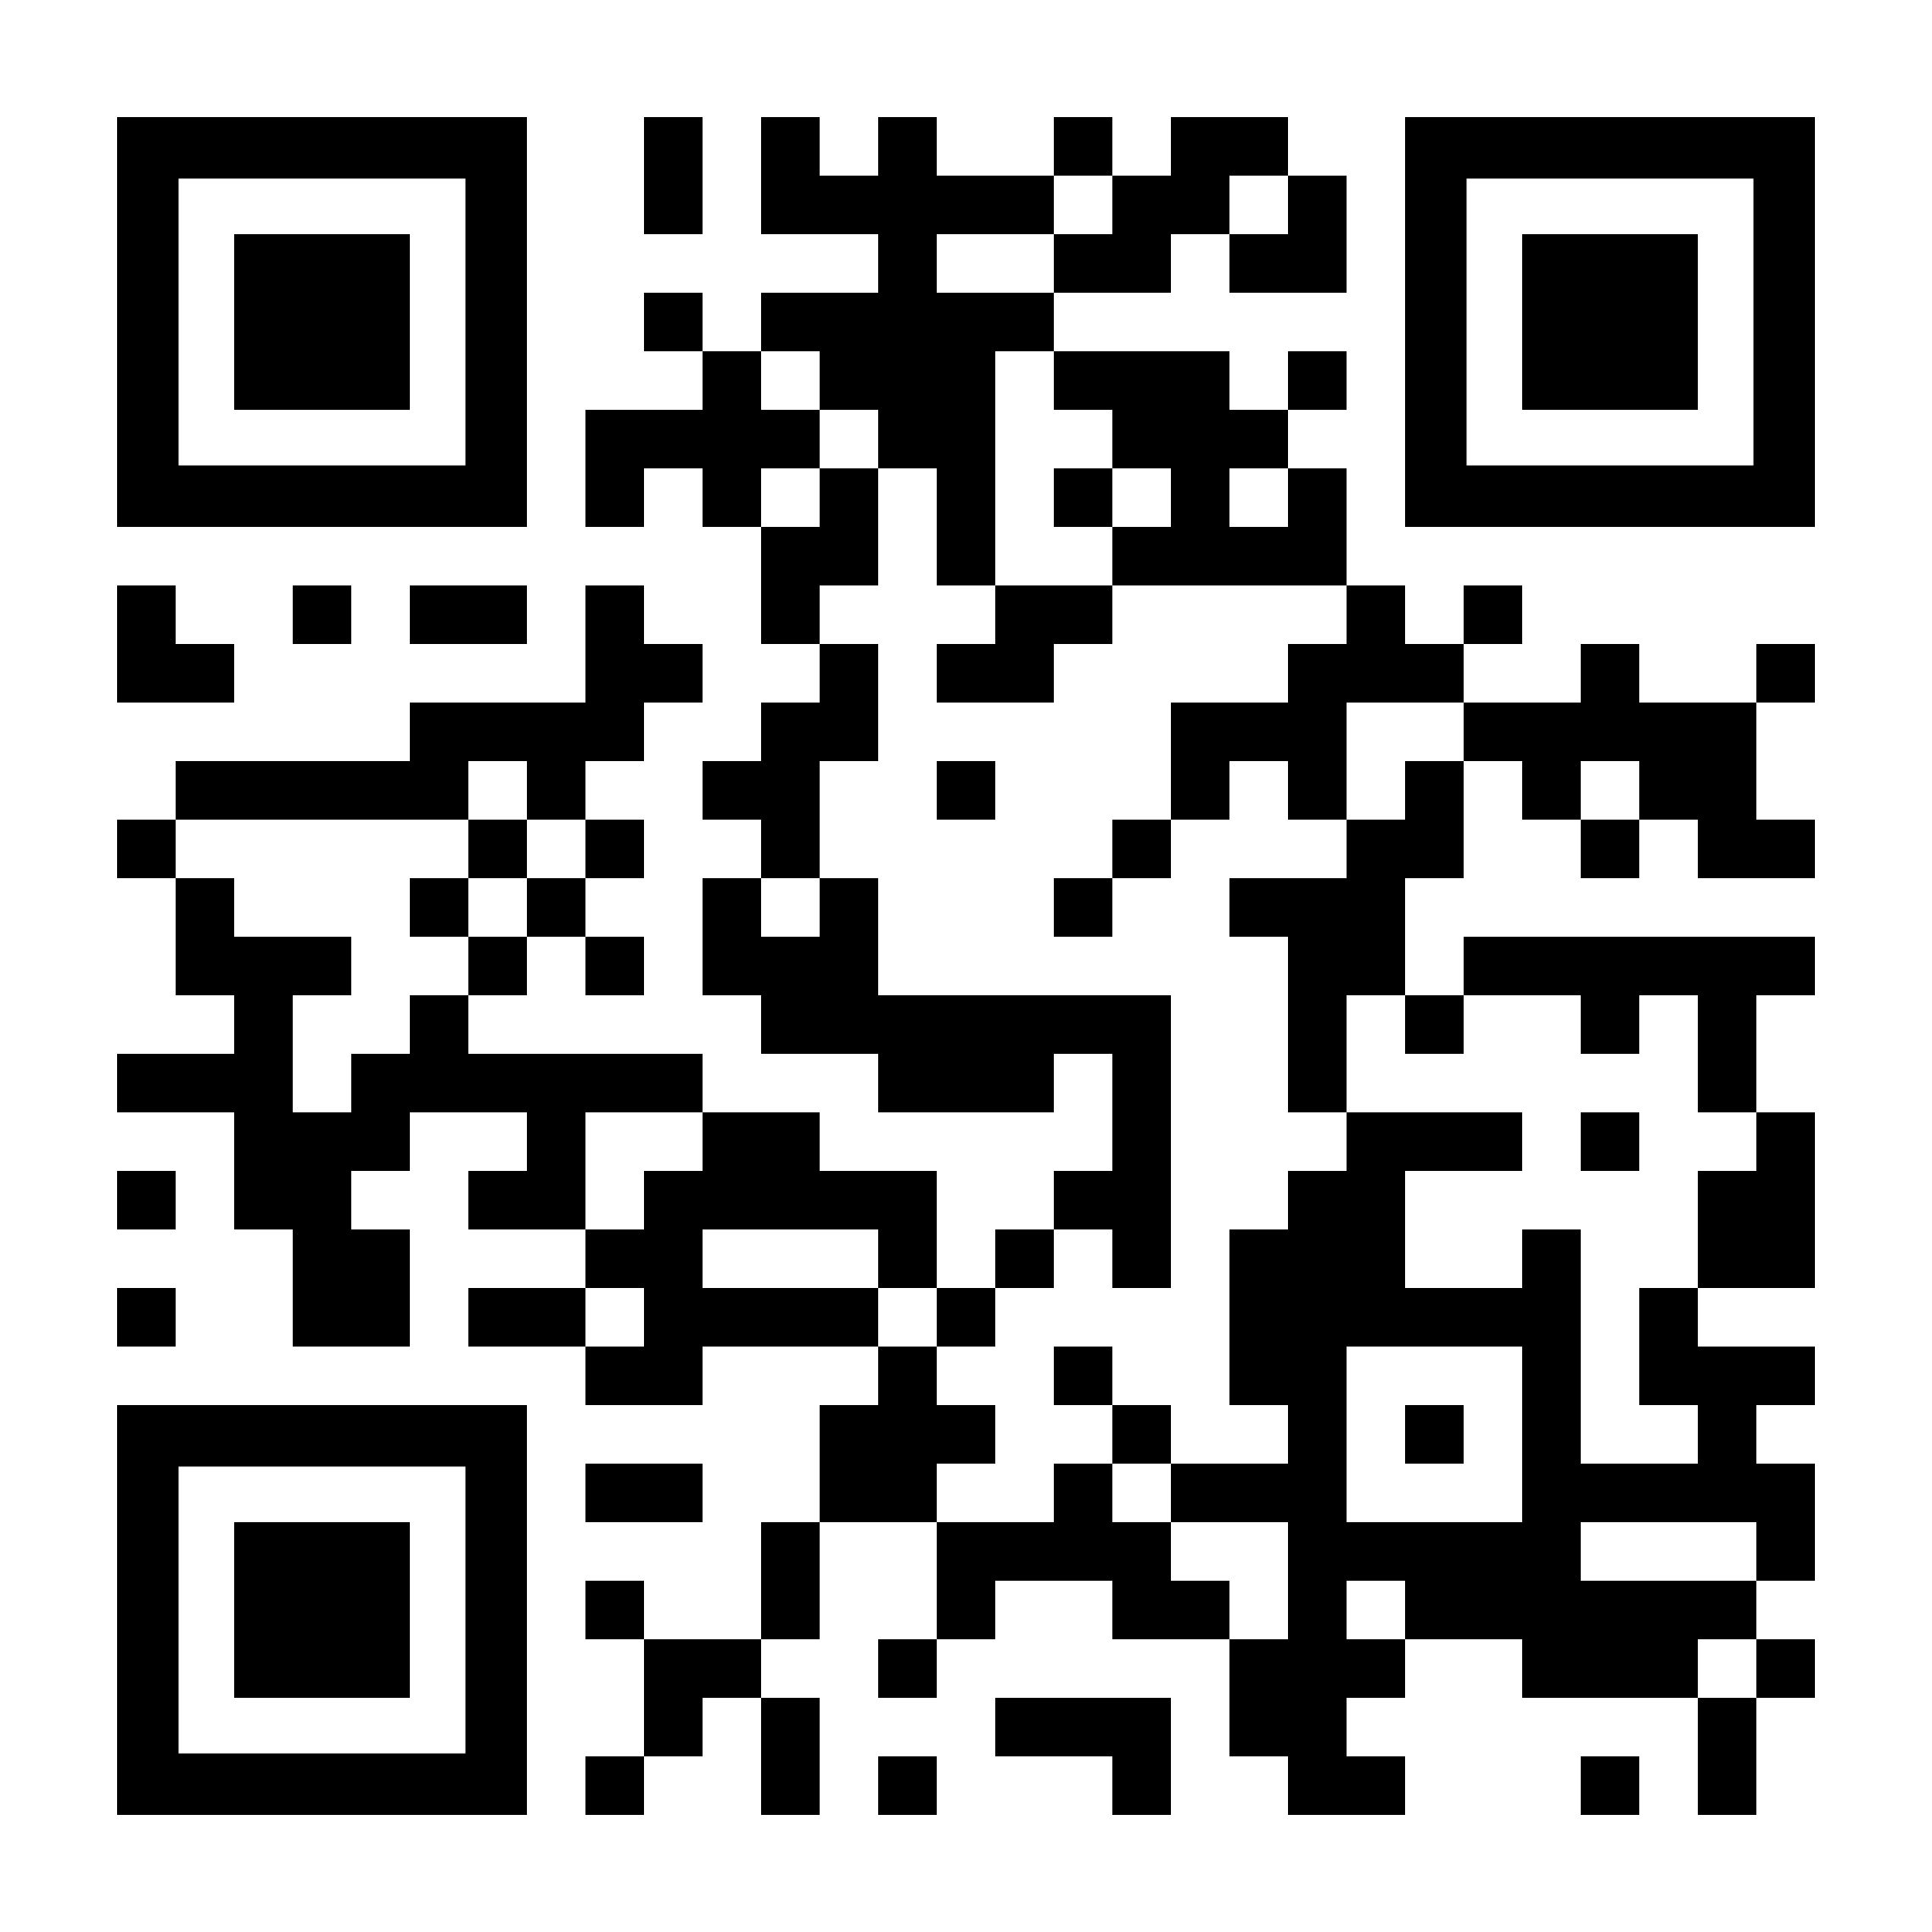
Announcements
Indico.UN is co-sponsoring the CERN technical workshop on Indico held on 20 & 21 March 2023.
Indico.UN will be participating in the Innovent 2023 event
https://indico.un.org/e/innovent-2 on the 30th of March.
https://indico.un.org/e/innovent-2
Ms. Kira Kruglikova remains the Project Executive, until a new DCM director is appointed.
Mr. Frank Moser will be on sabbatical break from mid-April until the end of August.
Mr. Nzete Da Sama Itoua will be OIC for the Indico.UN project during Frank’s absence.
Summer camp nominations to be done by XX/XX/2023
We invite you to provide us feedback on our project communications
(QR and link on next slide)

Slide 20
Q & A
Kindly raise your hand
https://forms.microsoft.com/e/SDNMNpEwFk

Slide 21
THANK YOU
https://forms.microsoft.com/e/SDNMNpEwFk

Slide 22
Access Authorization Module improvements???
MAIN OBJECTIVES
EXISTING and PROPOSED CLIENTS BY ORGANIZATION
Address Long-term and temporary accreditations requiring a badge to access the UN premises
Address accreditations requiring a badge renewal
United Nations Headquarter
Media
Guided Tour Office visitors ??
United Nations Office at Geneva
Media
UNOG Protocol - NEW from 2022
SHP contractors - NEW from 2022
FIPOI contractors - NEW from 2022
Guided Tour Office visitors
Staff Visitors
United Nations Office at Vienna
Media - NEW from 2022
UNESCO
TBD
ADDRESSED SCOPE
Direct accreditation by the requestor with an account
NEW
Accreditations requested by focal points on-behalf of users without an account
Events registrations for Media personnel linked to the AAM
Access restriction features, filtering and email notification improvements
TARGET USERS
Media
Permanent mission members and permanent observers
Contractors
Official and staff visitors
Guided Tours visitors
…

