Slide 1
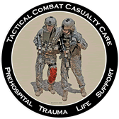
outline of FMAC TOT
FMAC TOT virtual Workshop

Slide 2
Objective
Learners will be able to
learn the necessary of TOT
know the FMAC

Slide 3
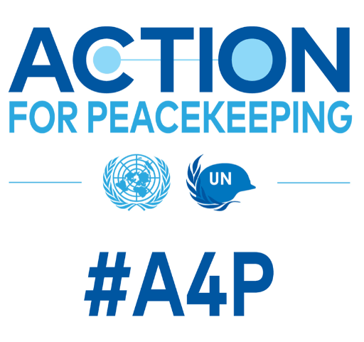
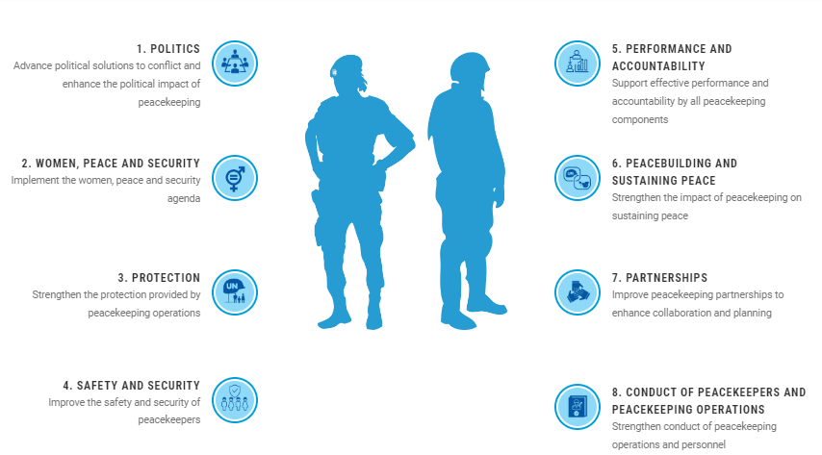
Action for Peace (A4P)

Slide 4
Why need FMAC TOT
Strengthen peacekeeping through T/PCC trainings
Control training quality
Establish trainer’s pool

Slide 5
FMAC TOT
TOT = Theoretical part (Virtual Workshop) + Practical part (in-person FMAC)
Theoretical part (Virtual Workshop)
Outline of FMAC
Teaching Methodology thru Mock lecture
Sharing lessons learned
Practical part (in-person FMAC)
Performing as a trainer
Using real FMAC equipment
Training real/pre peacekeepers
Working together international trainers
Certified Head Trainer after practical part

Slide 6
Target for FMAC
Non-Medical licensed people
Current peacekeepers or pre-deployment personnel
MONUSCO; DR Congo, UNISFA; Abyei, UNMISS; South Sudan
Kenya, & Uganda (ATMIS; Somalia)

Slide 7
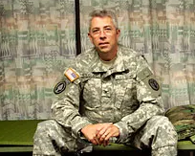

Joint Trauma System
John Holcombe – Founder of the JTS
"It was intimately clear as I went into Iraq in May 2003 and talked to young medics, forward operating bases, forward surgical teams, combat missions, and combat support hospitals and found there was absolutely no connection of anything to anybody. There was no communication from prehospital providers to ground units or between the ground units and to Landstuhl where casualties were sent.”
The result – A Trauma System
CENTCOM Joint Theatre Trauma System (JTTS)
Joint Trauma System
DoD Trauma Registry
Combat Casualty Care Conferences

Slide 8
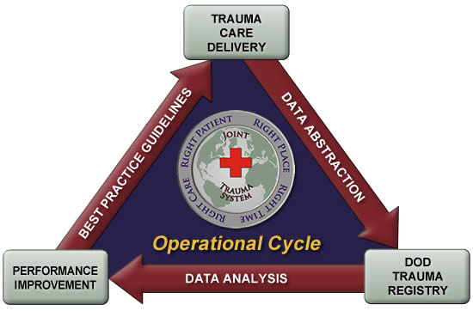

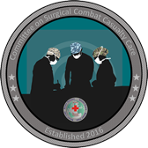
JTS
How it works
TCCC
ERCCC
SCCC

Slide 9

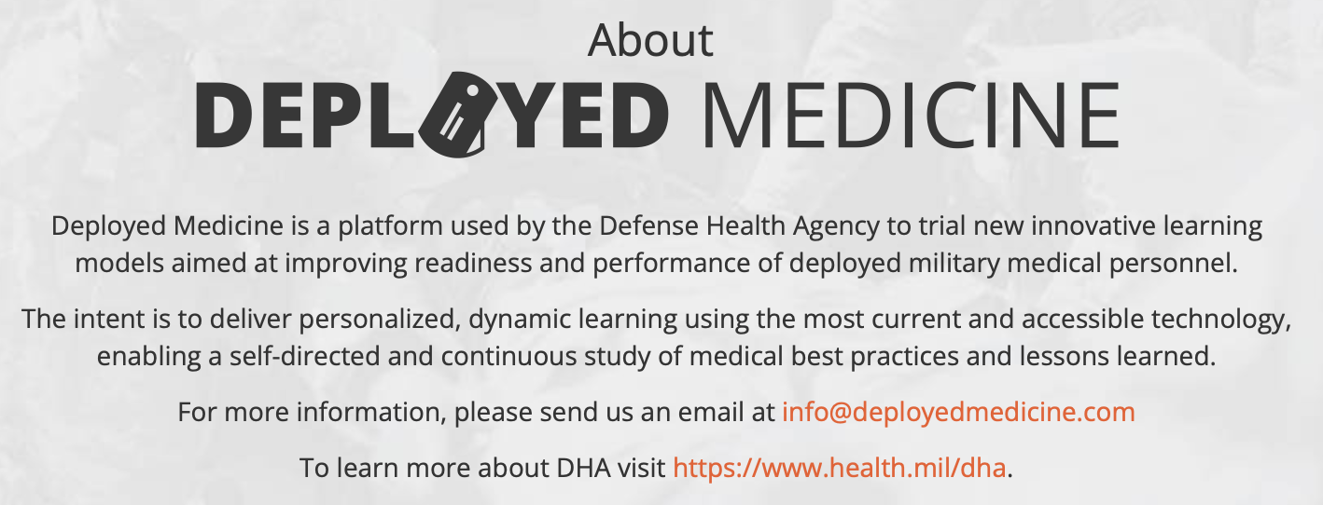
Deployed medicine

Slide 10
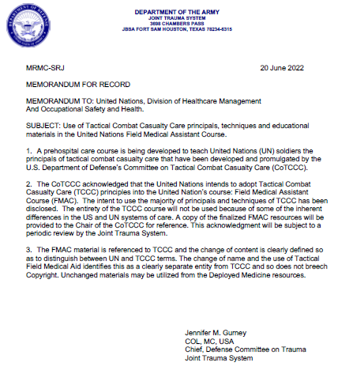
Adopt TCCC Principals For FMAC

Slide 11
Summary
Contribute A4P
Strengthen peacekeeping through T/PCC trainings
Adopt / utilize scientific evidences (TCCC)

Slide 12
ANY QUESTIONS?

