Slide 1

Contents of FMAC
FMAC TOT virtual Workshop

Slide 2
Objective
Learners will be able to
learn outline of in-person FMAC
know lessons learned of previous course

Slide 3
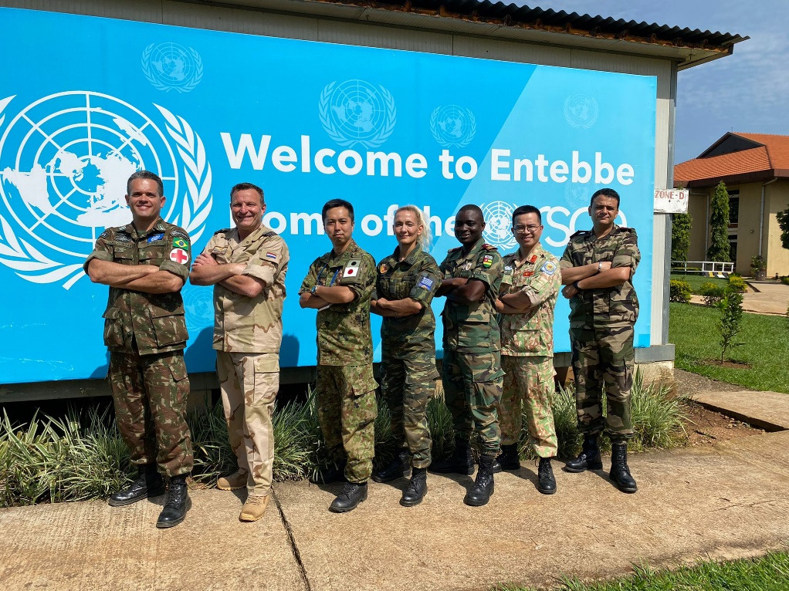
Overview of FMAC in June 2022
Duration; 13-17 June 2022
Trainees; 21 peacekeepers (3x MONUSCO, 10x UNISFA, 8x UNMISS)
Head Trainers; Patrick Thompson (UN contractor)
Trainers (TOT participants); 7 trainers (Brazil, Greece, Japan, Morocco, Netherlands, Togo, Viet Nam)

Slide 4
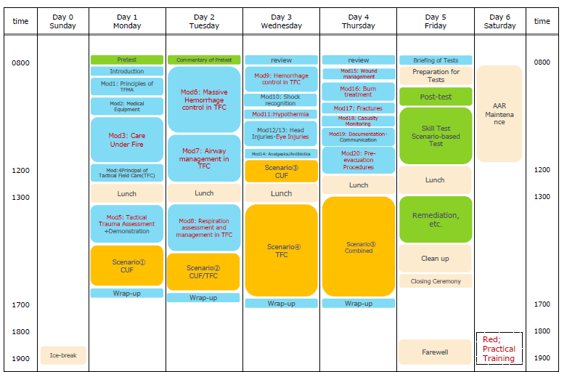
Course Schedule for June 2022

Slide 5
General way
Before FMAC, pre-course instruction
Sharing “Student Handbook” and instruct to study/review “Buddy First Aid”
Day 1; Written Pre-Test
Check the knowledge of Buddy First Aid
Day 1-4;
module 1-20
Lecture
Demonstration
Drill (skill station)
Wrap up
Scenario Based training on the ground with mock weapons
CUF
TFC
Mid-evaluation (Day 3)
Combined Scenario (Day4)
Day 5; Final Exam
Written Teat
Individual Skill Test
Scenario-Based Test as a Team

Slide 6
Support Scheme for trainees
Pre-course instruction
5-6 people / group with Mentor
Sharing materials via WhatsApp for reviewing
Mid-evaluation (Day 3)
Remediation (Day 5)

Slide 7
Video

Slide 8
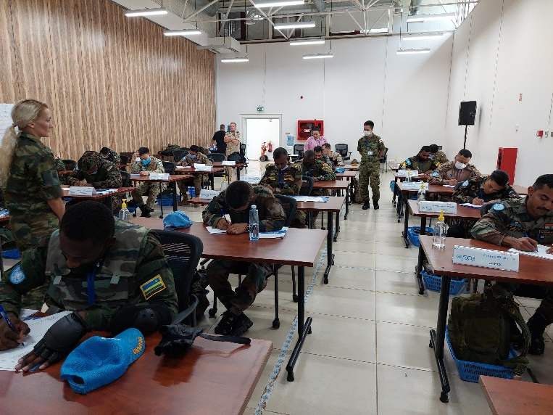
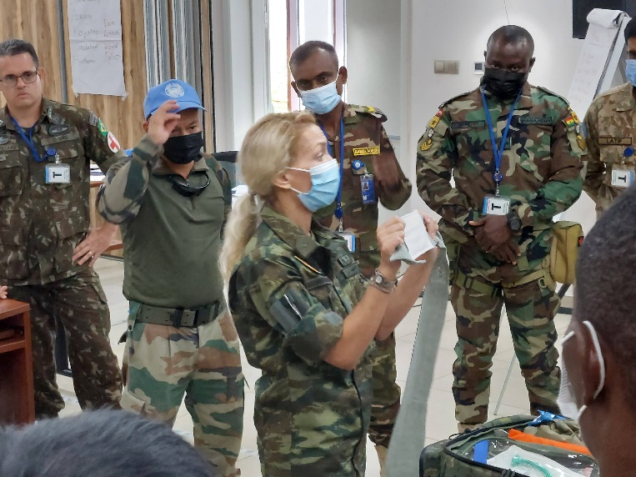
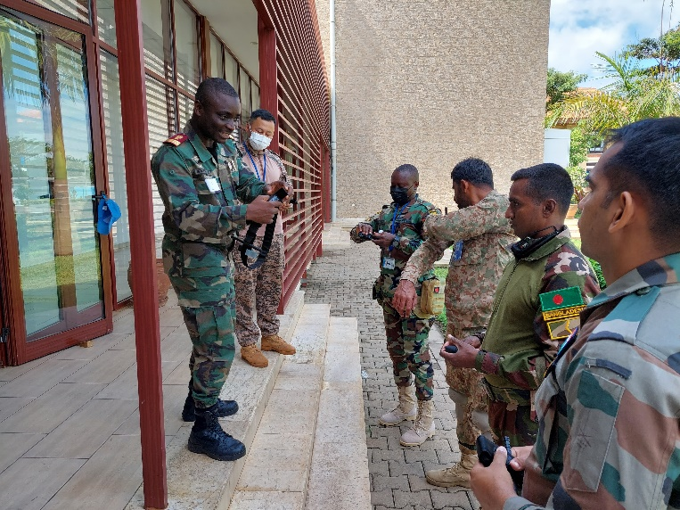
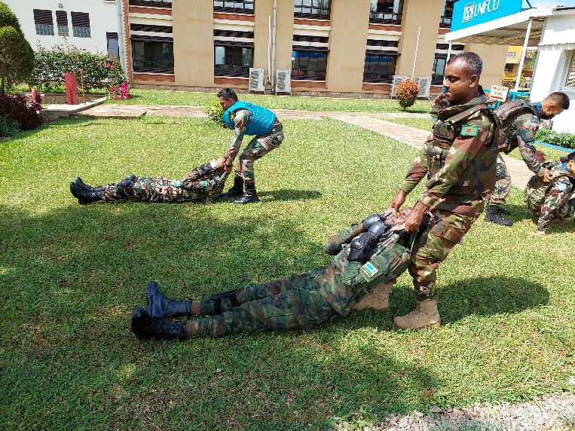
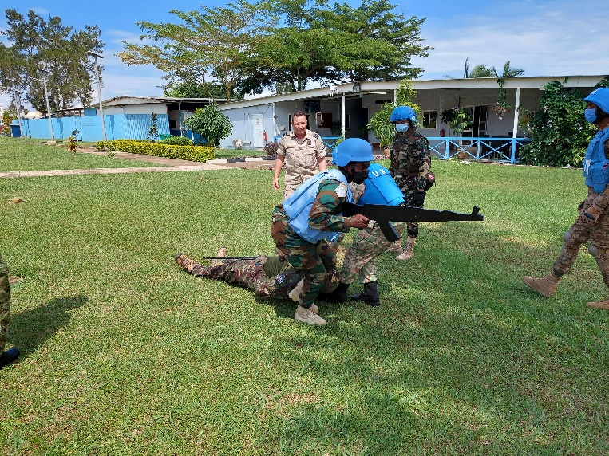
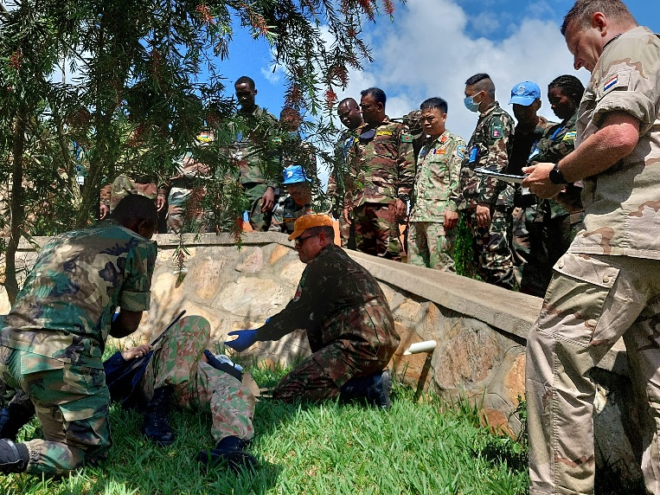
Day 1

Slide 9
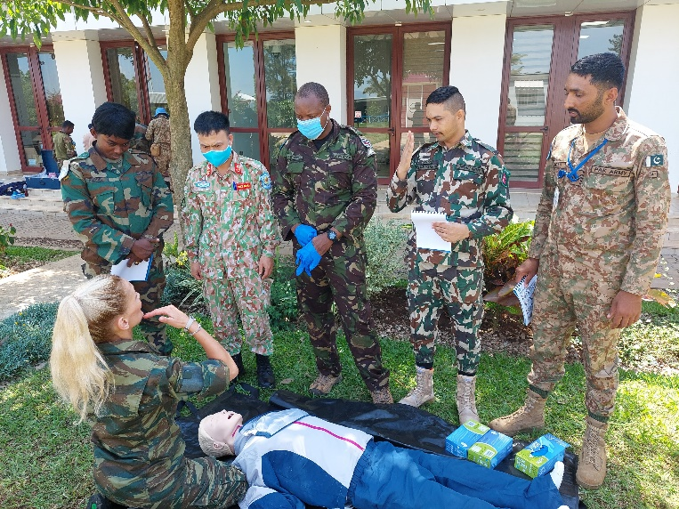
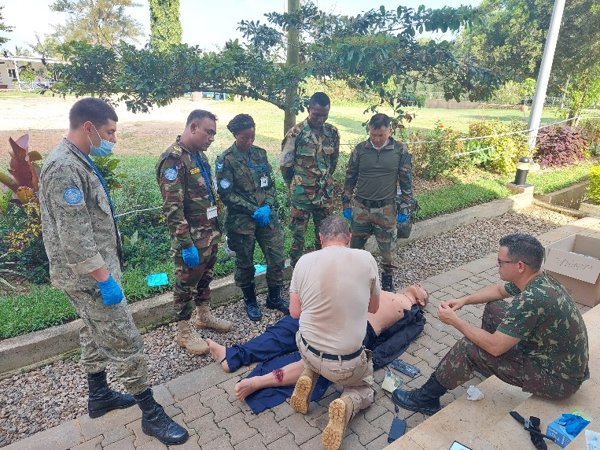
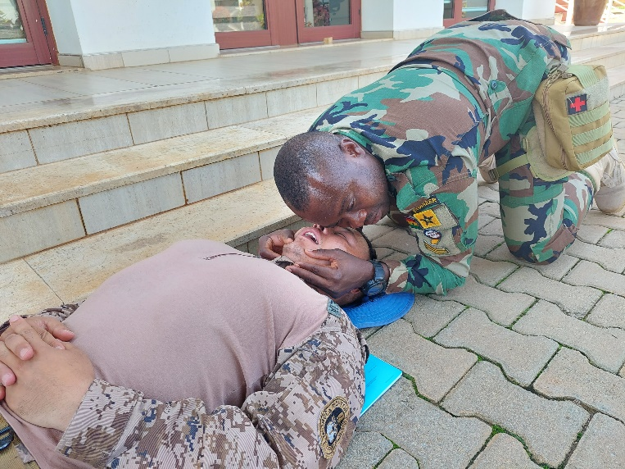
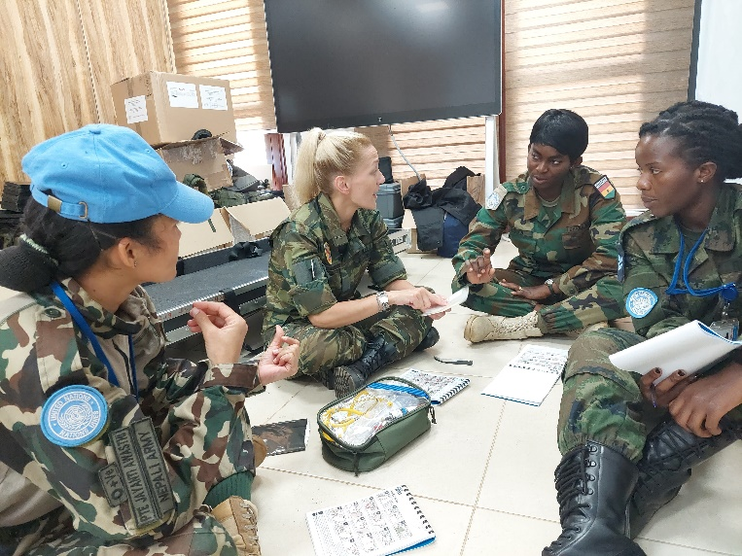
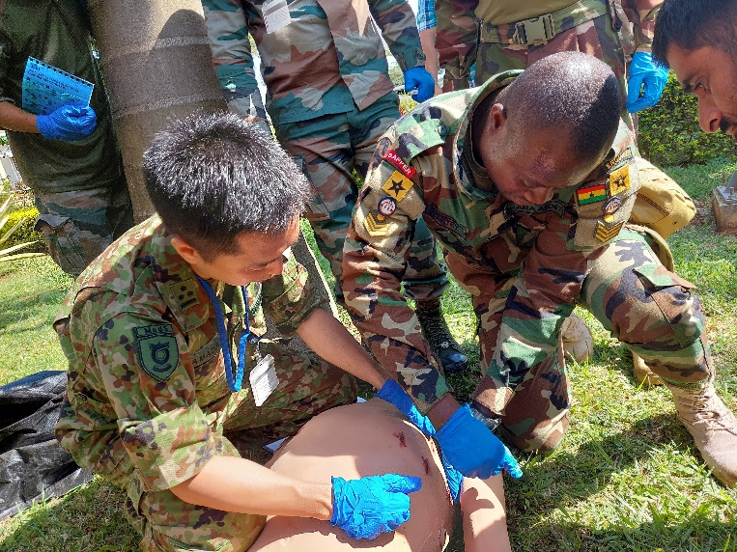
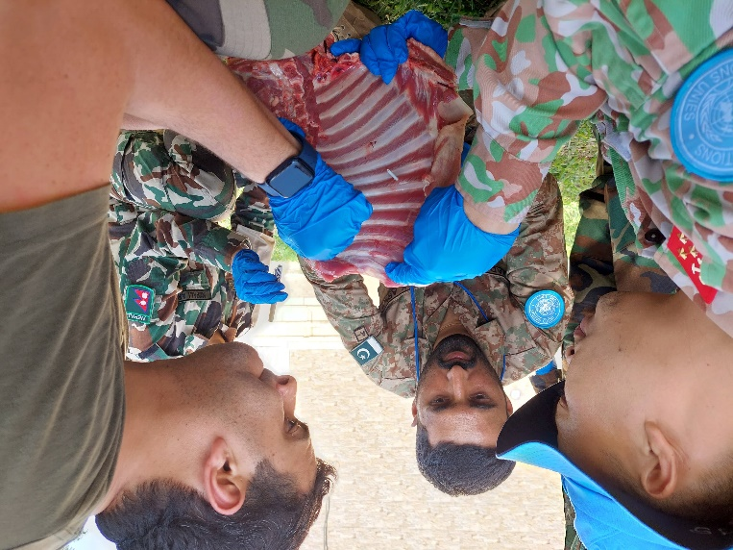
Day 2 - 4

Slide 10
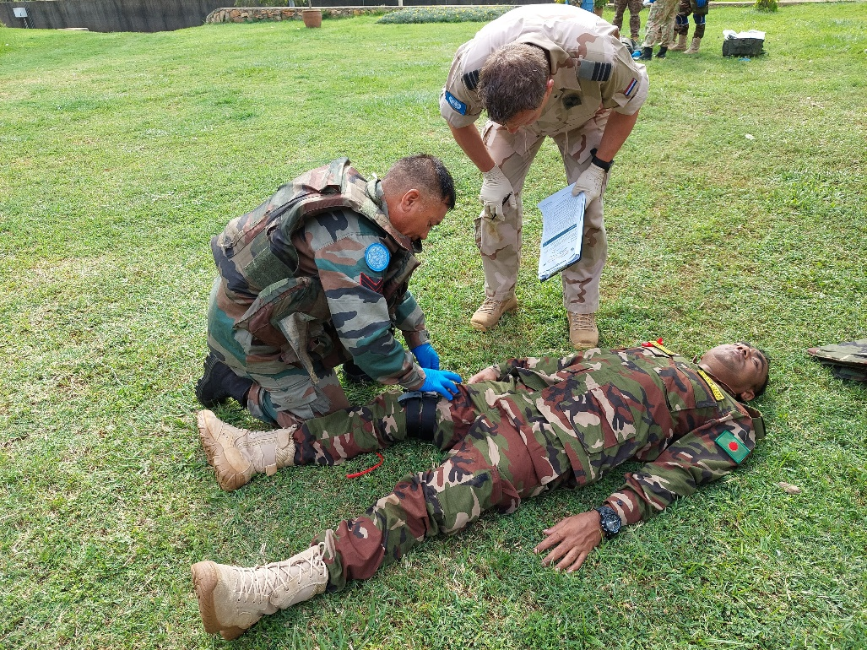
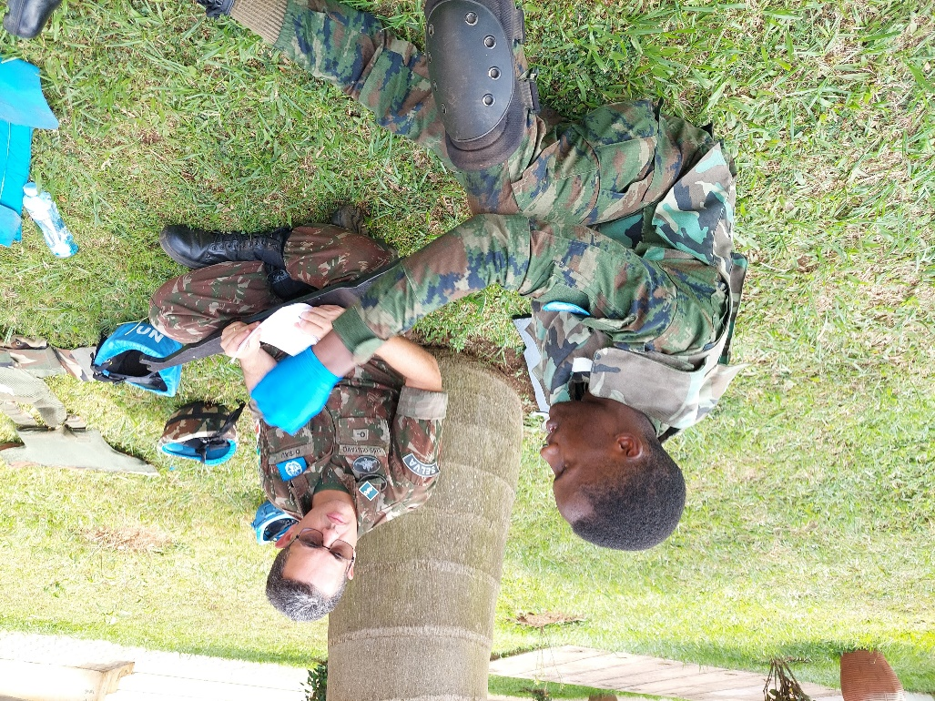
Day 3 & 5 Evaluation
17/21 passed the final exam

Slide 11
Summary
Module & Scenario Based training
Lecture - Demonstration - Drill (skill station) - Wrap up
Evaluation & Feedback
Support trainees

Slide 12
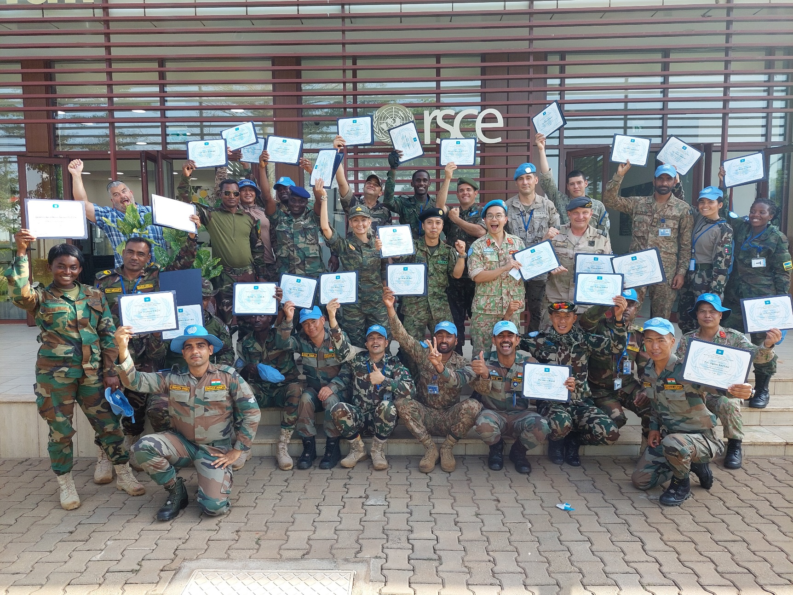
ANY QUESTIONS?

