Slide 1

Teaching & Learning Strategy
FMAC TOT virtual Workshop

Slide 2
Objective
Learners will be able to
Design activities with a logical learning sequence to meet learning objectives and tailored for the needs of the target audience
Learn BOPPPS framework
Learn tips for delivery of training

Slide 3
STM on TOT
https://peacekeepingresourcehub.un.org/en/training/stm/tot
  provide trainers with the knowledge and skills needed to effectively deliver pre-deployment and other UN peacekeeping training.
  include five modules on the training cycle, training design & theories of learning, training evaluation & reporting, lesson development, and training delivery.

Slide 4
Designing a lesson
Sequence
  Simple to complex
  Known to unknown
  Cause to effect
Timing
  Time management
Approach
  Learning objective
  Target audience analysis
  Adult learning principles

Slide 5
Learning Style
Visual
  Handouts
  Use slides and video, etc.
Auditory
  Explaining directions out loud
  Oral feedback on activities
Kinesthetic
  Demonstration of techniques/skills
  Activities that involve physical movement

Slide 6
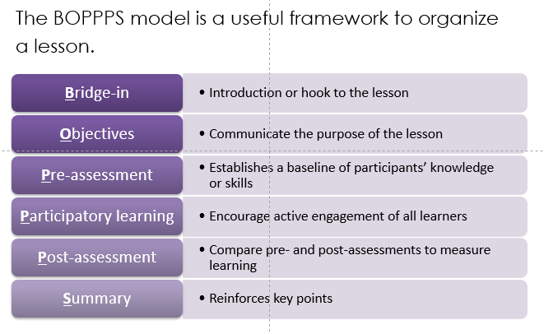
BOPPPS model

Slide 7
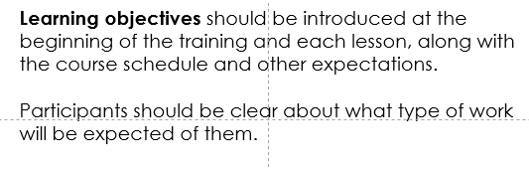
Delivering training

Slide 8
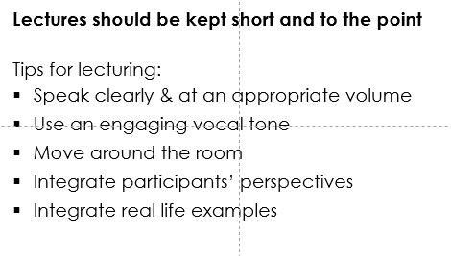
Delivering training

Slide 9
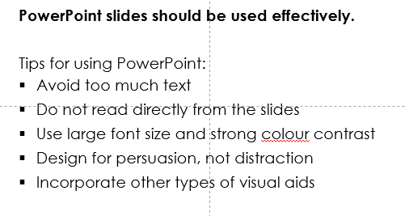
Delivering training

Slide 10
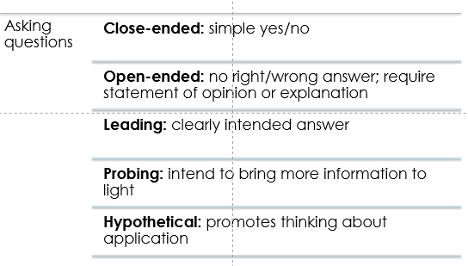
Delivering training

Slide 11
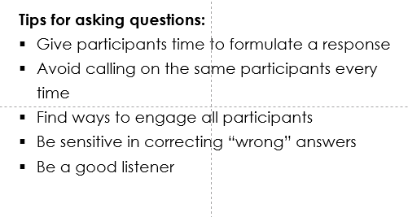
Delivering training

Slide 12
Summary
Design effective lessons
Interact with audiences during lectures

Slide 13
ANY QUESTIONS?

