Slide 1
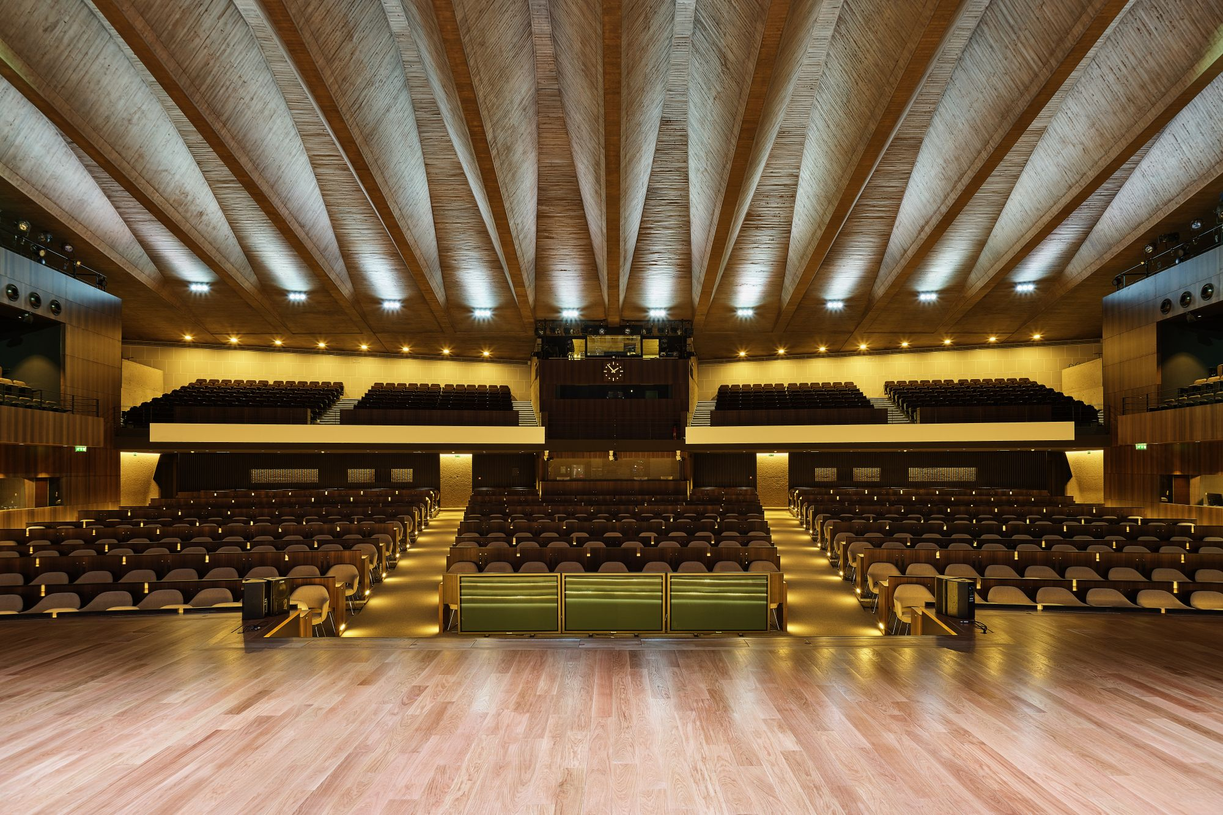
INDICO.UN.ORG Focal Points

Slide 2
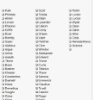
Designation of Focal Points
UNESCO Secretariat requests Permanent Missions to send a list of their designated focal points.
UNESCO Secretariat adds Focal Points to the system. A confirmation email is sent to the Permanent Missions.

Slide 3
Access the Registrant List
1. Log in and click the pencil icon
2. Click Registration and then click Registrations beside the named form

Slide 4
Access the Registrant List
1. Log in and click the pencil icon
2. Click Registration and then click Registrations beside the named form

Slide 5
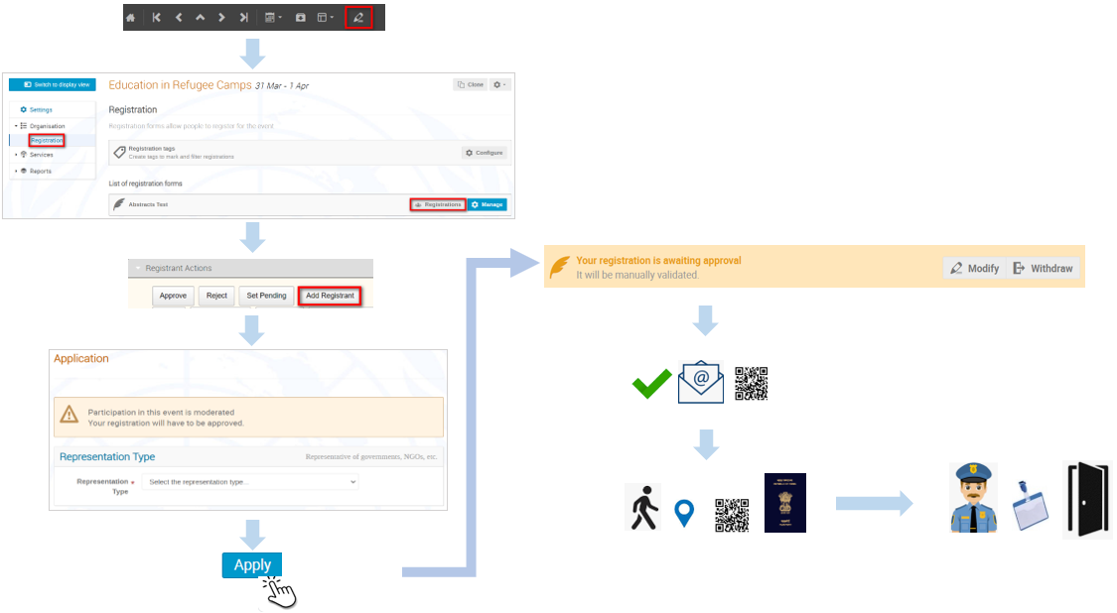
Focal Point Workflow

