Slide 1
An Overview of Indico

Slide 2
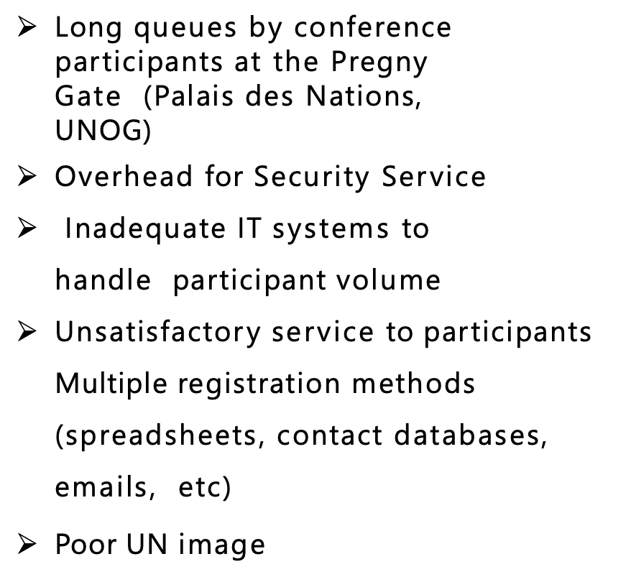
Why was Indico introduced at UNOG?

Slide 3
What is Indico and where did it come from?
Indico is a free open-source online event and participant management solution developed by CERN in 2004. It’s used by over 40 institutions and organizations globally.
It’s a modular (plug-ins), customizable and scalable solution.
In consultation with UNOG Security and event organizers within the various Secretariats, Indico was launched at UNOG in mid-2015.
Its first pilot event outside the duty station was UNCTAD XIV in July 2016 in Nairobi. Some 7,000 registrations were processed, and 6,600 badges printed from the system.
Experienced benefits: increased efficiency; expanded services to conference organizers; harmonization and rationalization of IT systems.
Indico is steadily expanding across the UN family: regional commissions ( ESCAP, UNECA, ESCWA, …), UNCCD, UNFCCC, WHO, OPCW, UNIDO, UNWOMEN, CTBTO, OHCHR, …

Slide 4
Data security, storage, accessibility and multilingualism?
Hosted at the UN data center in Valencia with a business continuity backup in Brindisi
Improvements will be made year:
in terms of multilingualism this year to support right to left languages and data entry in multiple languages
Accessibility review of the new version and default registration information to improve the tool accessibility
UN data privacy is the common bases but each organization will be able to set its own data privacy starting from Q3 of this year

Slide 5
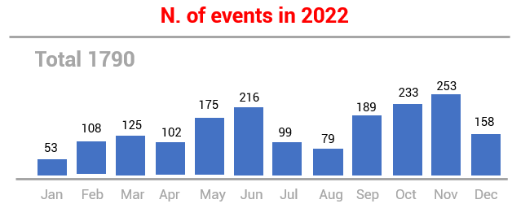
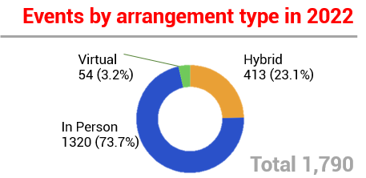
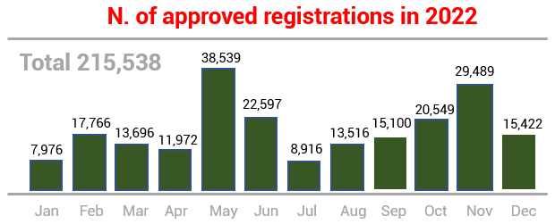
Some statistics (as of 10 March 2023)
7,760 events/conferences (36% of which have been synchronized from gMeets)
975,000+ registrations (1million expected by April 2023)
870,000+ approved registrants
Top 3 events in 2022
GP 2022 – 7th Session of the Global Platform for DRR – May 2022 counting ⁓7500 externals and ⁓ 3,000 staff registrations
UNCCD COP15 – May 2022 counting ⁓7,600 approved registrations
CSW67– UN WOMEN/DESA - Mar 2022 – 6,000+ approved registrations
80+ established clients
Large (>100 events held): WHO, UNCTAD, OHCHR, DGC, ECE, ODA, UNEP, etc.
Medium (10> events held >100): UNFCCC, UNHCR, DESA, UNAIDS, ESCWA, OCHA etc.
Small (<10 events held): UNIDO, UNESCO, OPCW, etc.

Slide 6
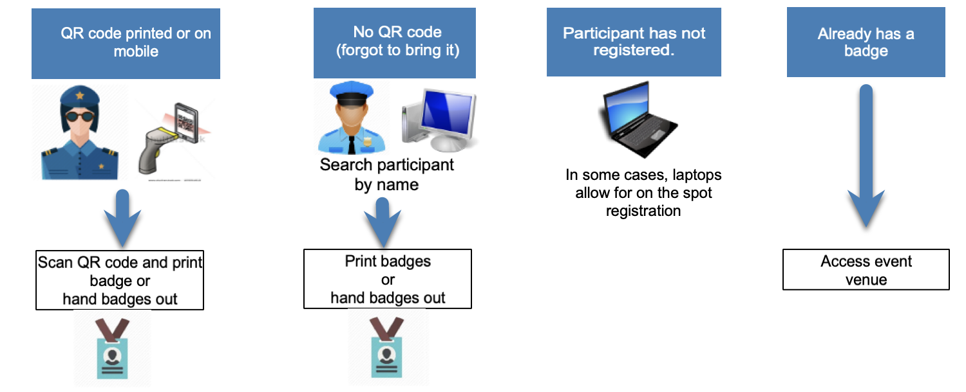
Workflow

Slide 7
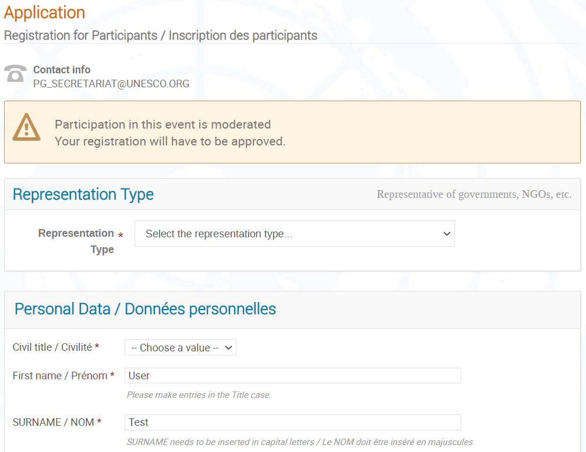
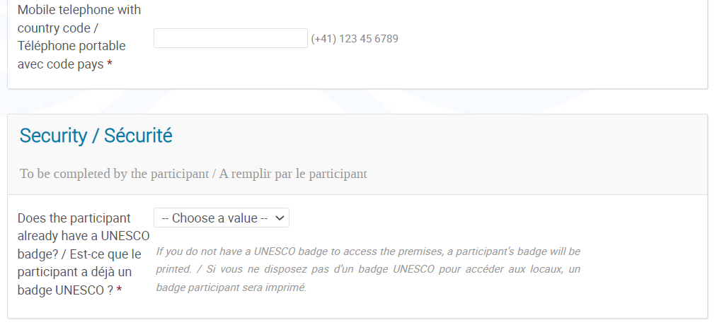
Example of the Executive Board – Self registration

Slide 8
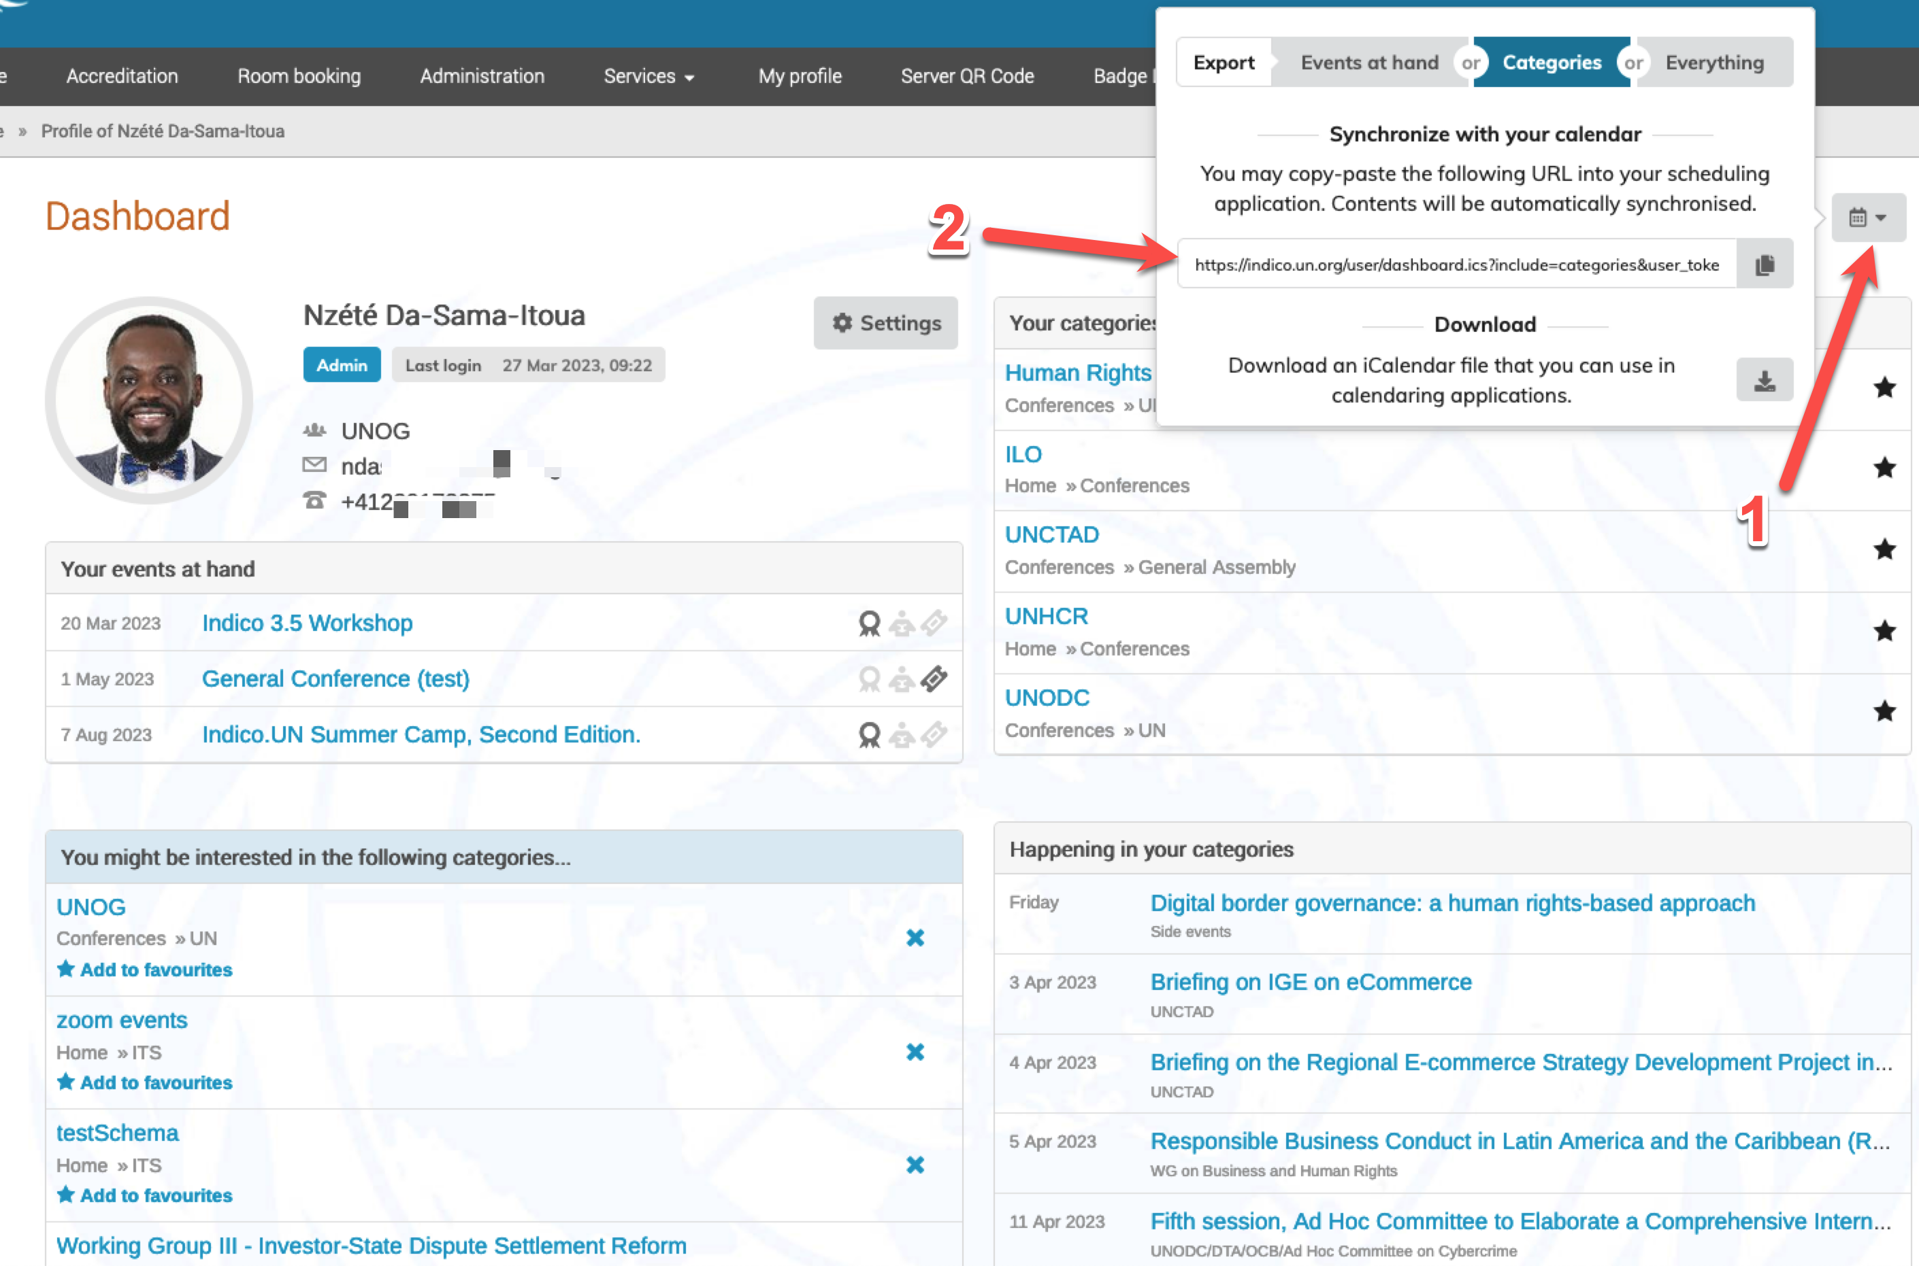
Example of the Executive Board – Self registration

Slide 9
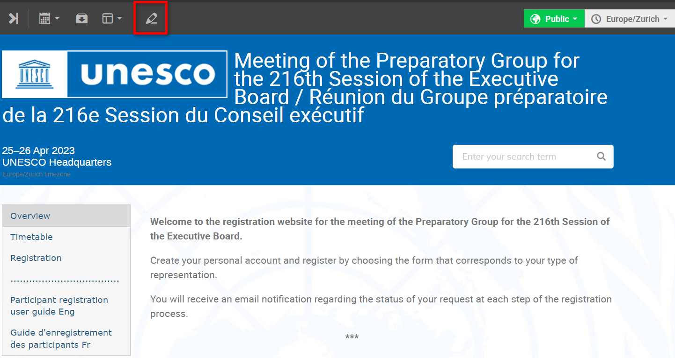
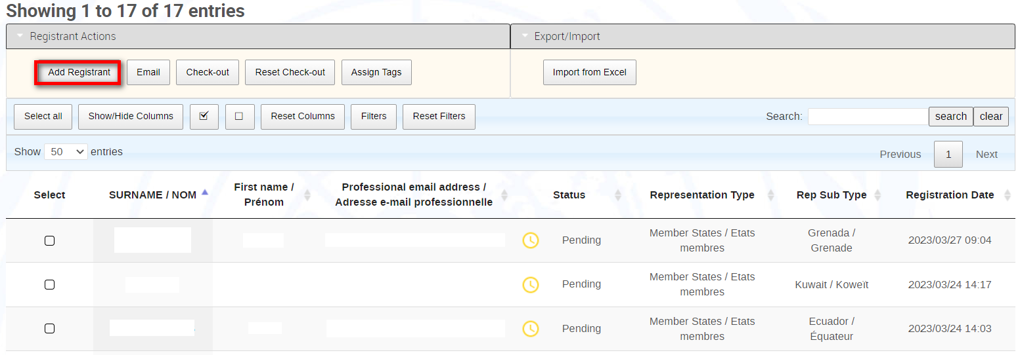
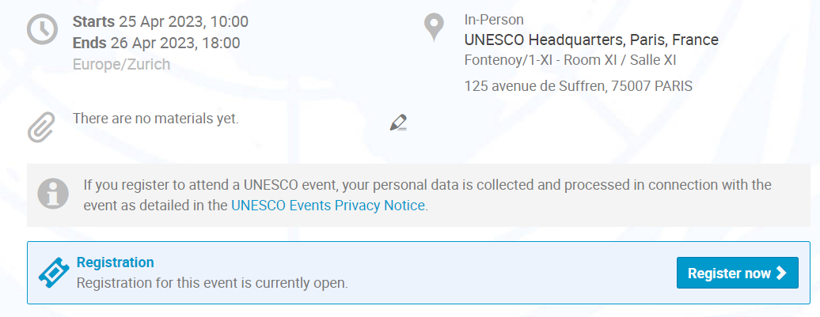
The Executive Board – Focal points on-behalf registration

Slide 10
Indico features
Features for event managers
Features for security
Web pages dedicated to individual events
Permission and role management e.g,. assigning focal points
Document sharing and protection
Custom registration forms
Self-registration, on-behalf registration, bulk registration
Approval workflows
In-system email communication with registrants
Custom emails and visa letter automation
List of participants
Import and export of registrant data
Statistics
Surveys
Reminders
Event logs and registrant logs
Limit participation i.e.,s set quotas
QR scanning
Badge printing
Check-in / check-out
Forecast of badges to print and on-site numbers
Watchlist
Analytics
VIP management
Site access management
Mobile application (scan, print and check-in)

