Slide 1
analytical MODULE
11 Aug 2022

Slide 2
Introduction to the new Analytical Module
OBJECTIVES
To provide a reporting tool for all Indico.UN’s players
To improve clients’ analytical reporting capabilities and ease the event planning process
To provide clients with client-specific reports addressing their needs
To introduce innovative visualizations
SOLUTION
PBI standard dashboards for the whole client base
Visualizations tailored to the clients requirements
Daily data refreshes shared with all UN and non-UN domain clients
Visualization for projection and past trends for Indico.UN
Client-level security … data accessible exclusively by resources belonging to each client organization
Infrastructure allowing for collaboration with other reporting tools

Slide 3
Analytical Module – the progress
Strategic paper created
Infrastructure and access management implementation
User acceptance testing
Training material on the Help portal
Working group started for the requirements collection
Delivered in production
Trainings to first group of users
MAINTENANCE
May 2021
Jul -Sep 2021
Sep - Nov 2021
Dec 2021
Feb 2022
Mar 2022
May 2022
Q3-Q4 2022
Client-based reporting continuous additions/update
Real time data provision improvement
Series interface improvements

Slide 4
Analytical Module – roles
New role: REPORTER
  The reporter is required to have an Indico.UN account
  Only resources assigned with this role can access the Analytical module and visualise the redirecting button in Indico.UN
  Permissions allowing reporter users to visualize only the data they are assigned to (by category and by location)
  The permission process takes from 24 to 56 hours depending on the user domain account
Access management
Latest solution:
  The reporter is selected by the organization and assigned by the category manager to a category or subcategory
  The reporter is selected and assigned by the Security officer to a location(s)

Slide 5
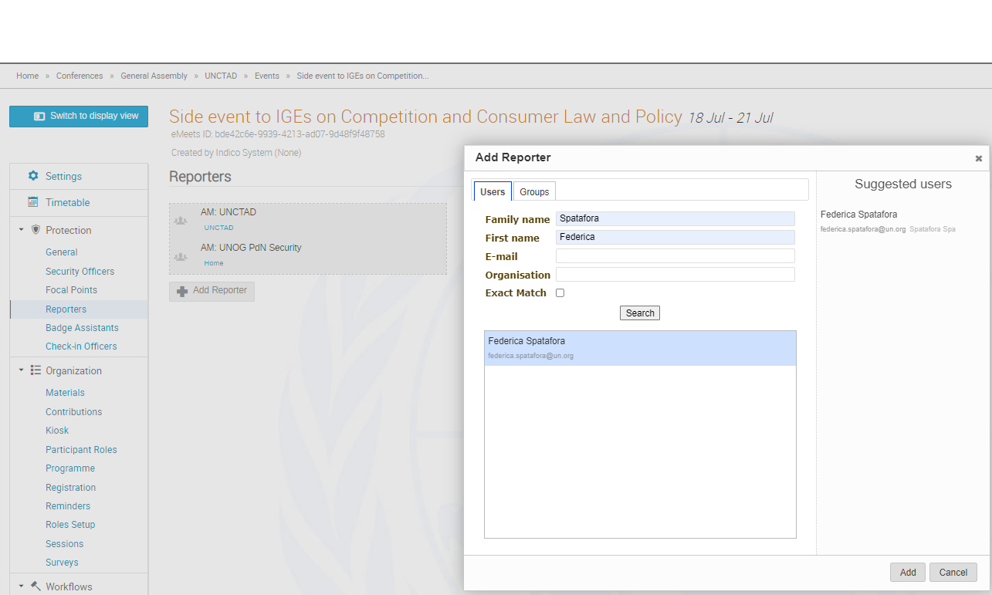
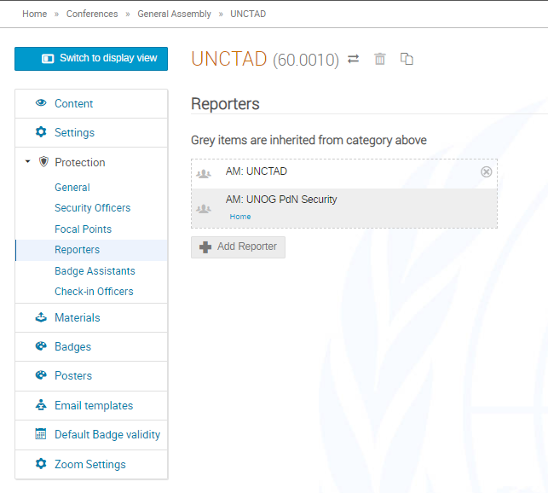

How can Category Managers grant access at category, subcategory or event level?
Assign rights to reporters at category level
Assign rights to reporters at event level

Slide 6
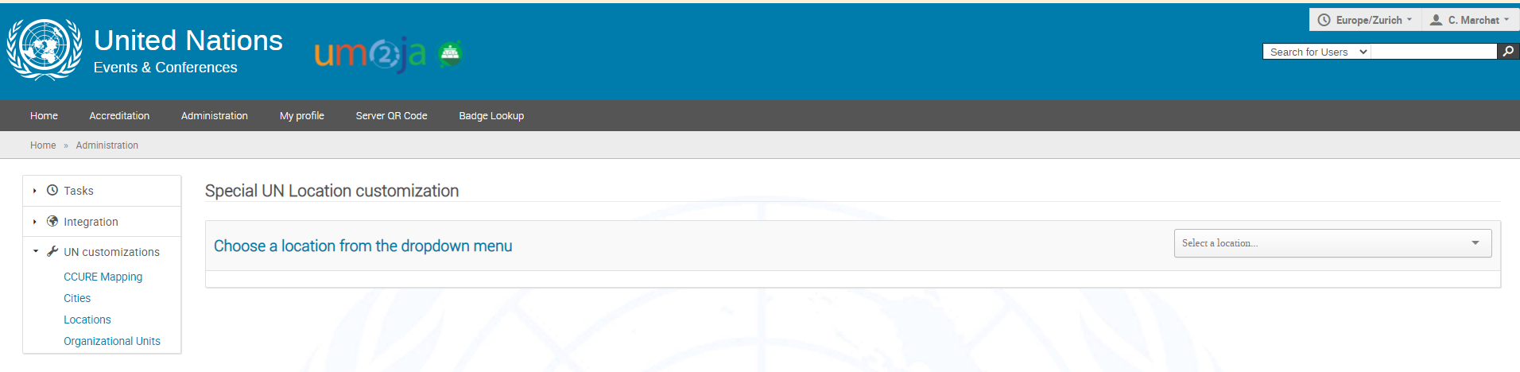
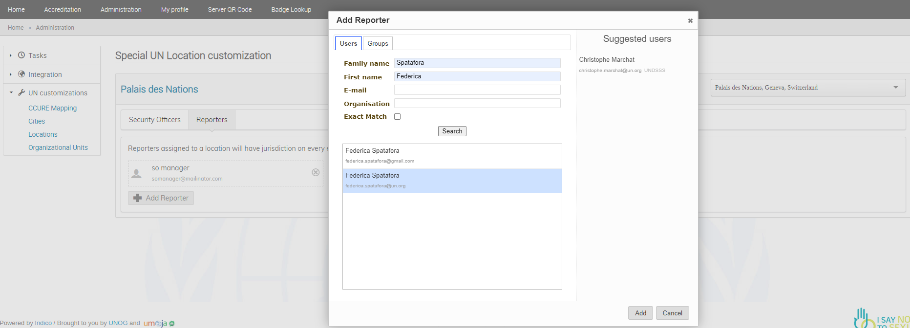
How can Security Officer Managers grant access to other users at location level?
Assign rights to reporters at location level

Slide 7
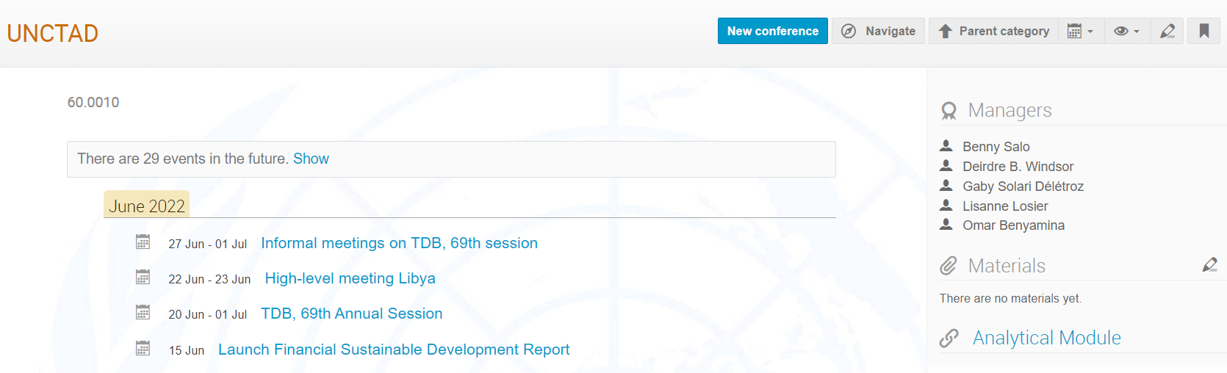
How to access the analytical module?
  The permission process takes from 24 to 56 hours depending on the user domain account
z

Slide 8
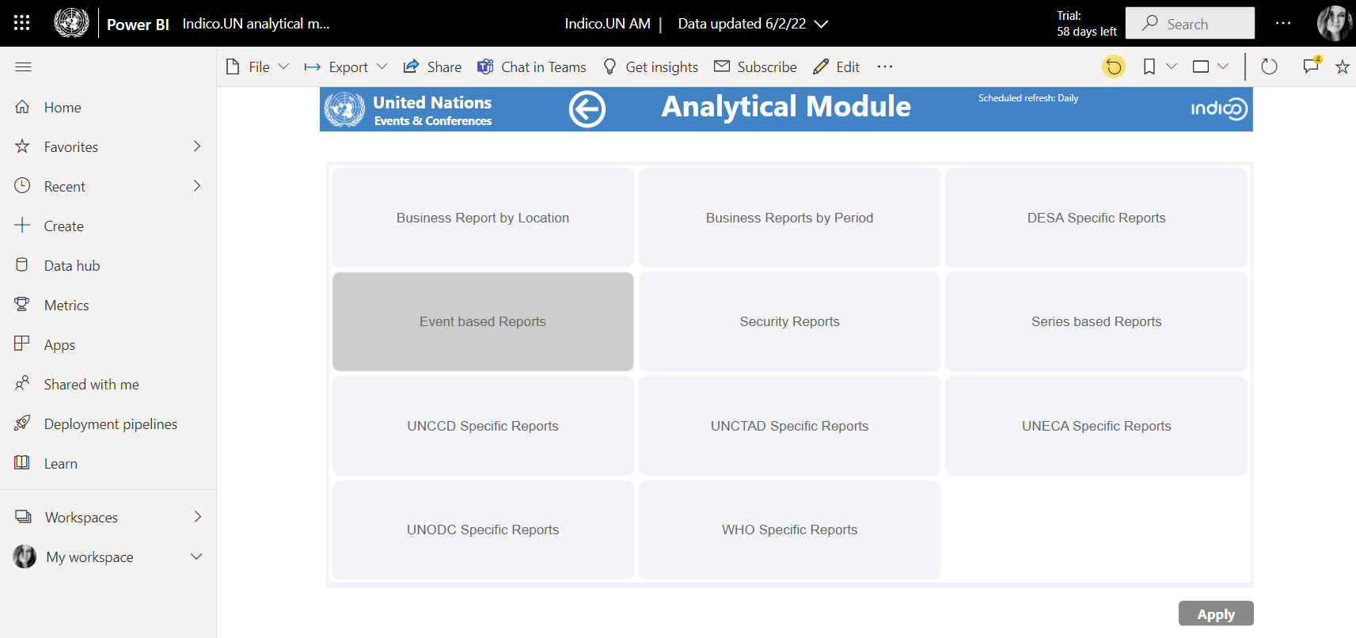
Analytical Module – navigation pane

Slide 9
THANK YOU

