Slide 1
ListFlow

Slide 2
List of Participants
For users who require a LoP, Indico provides one in Word in a standard format.
Many users, however, prefer a different format.
One size does not fit all.

Slide 3
What if the LoP in Indico is not a suitable format for my entity?
Then there is ListFlow: A stand-alone module created specifically so that clients can manage the layout of their LoP whilst using data captured in Indico on registrants.

Slide 4
3 required elements for ListFlow

Slide 5
Data source
Important that registration forms contain mandatory fields for the data that is required later to populate the LoP e.g. if you want a registrant’s functional title to appear on the LoP, then there should be a field on the form.

Slide 6
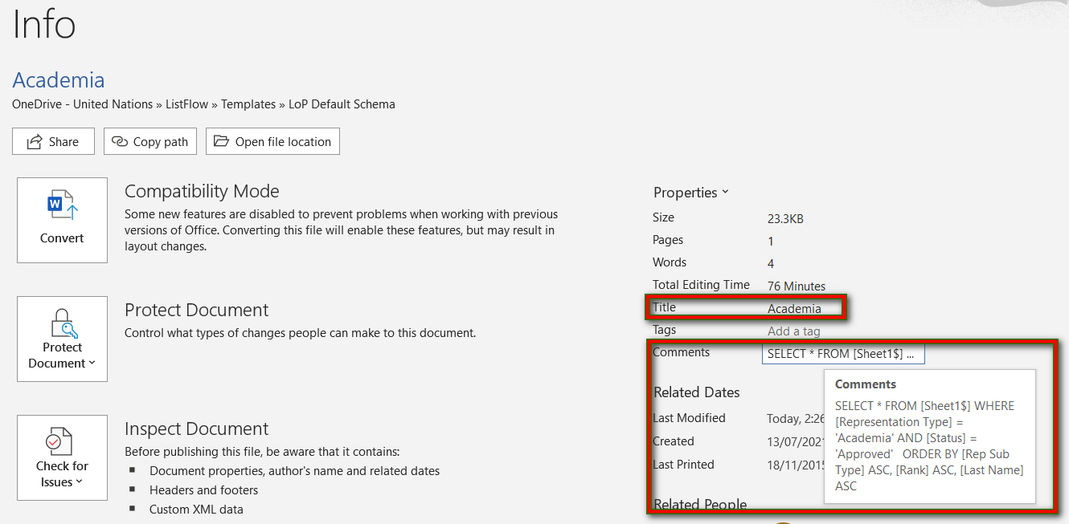
Rep type docs
Each rep type in your schema must have a rep type doc linked to a source.
Each contains merge fields that pull data from the source needed for the type of registrant the doc is named after.
Each rep type doc must have a title (name) and a query. The query is a command the merge follows to extract data from the source.

Slide 7
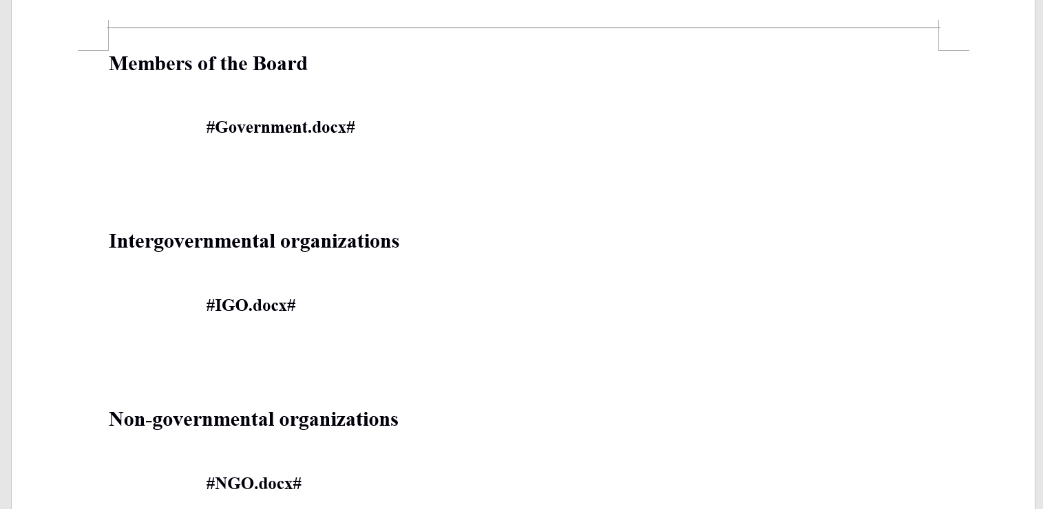
Main.doc
The Main.docx compiles all the content of the rep docs into one location.
Arrange the order of the rep types and enter beneath the name (tag) of the corresponding rep type doc sandwiched between # e.g. #NGO.docx#
The content of those docs will appear where the tag appears.

Slide 8
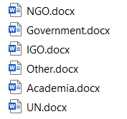
Suggested structure to work with

Slide 9
Create a Rep Type Template Simply

Slide 10
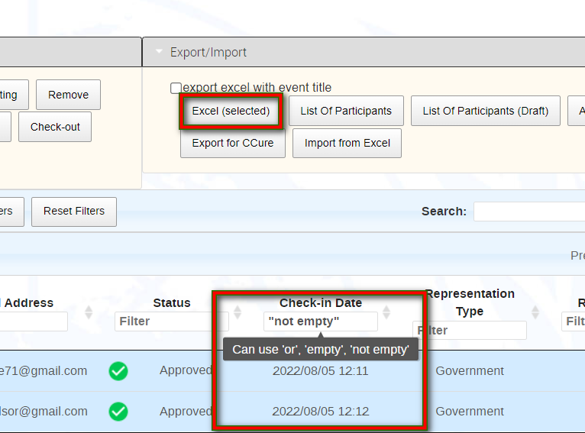
1: Get a data source
Download to xls approved registrants with a check-in date.
Check-in date is an indicator that a person was in attendance (a badge has been issued for him/her).
Save the xls for use later. This is your DATA SOURCE.

Slide 11
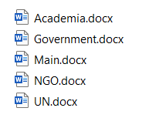
2: Create rep type Word docs
Each rep doc should be named after a representation type e.g. Academia
Create as many as you need for your rep types.

Slide 12
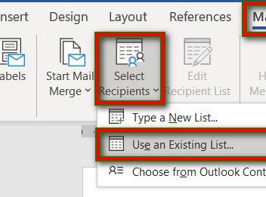
3: Link the rep type doc to the data source
In each rep doc use the Mailings feature in Word.
From Select Recipients, identify the data source you are linking to.

Slide 13
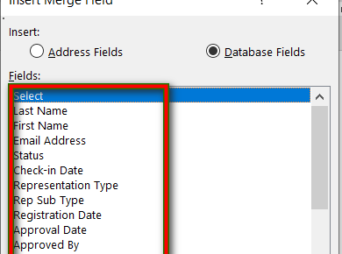
4: Insert merge fields into the rep type doc
In each rep doc use the Mailings feature in Word.
From Insert Merge Field, select and insert the fields you want. These fields dictate the information on participants that will be displayed on the LoP.
You will notice that these merge fields mirror the column names in your data source.

Slide 14
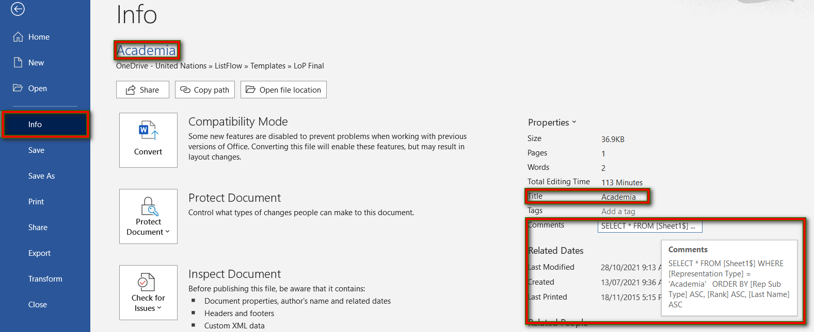
5: Add a query to the rep type doc
File → Info interface: In each rep doc a query tells ListFlow to search the data source for the rep type and to display it in a particular order (if applicable).
Examples:
SELECT * FROM [Sheet1$] WHERE [Representation Type] = 'Government' AND [Status] = 'Approved' ORDER BY [Rep Sub Type] ASC, [Rank] ASC, [Last Name] ASC
We have a document available that lists the queries you may use for the 8 standard rep types used.

Slide 15
6: ListFlow
Once you have set up all your rep type docs and Main.docx you are ready to launch ListFlow.

Slide 16
Can I use an existing rep type doc to create another one?
Yes.
Copy the original doc to create a new one and give it a new name according to the rep type it will be used for.

Slide 17
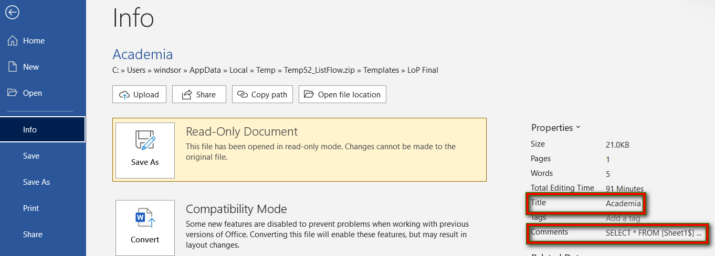
Update the title and the query.

Slide 18
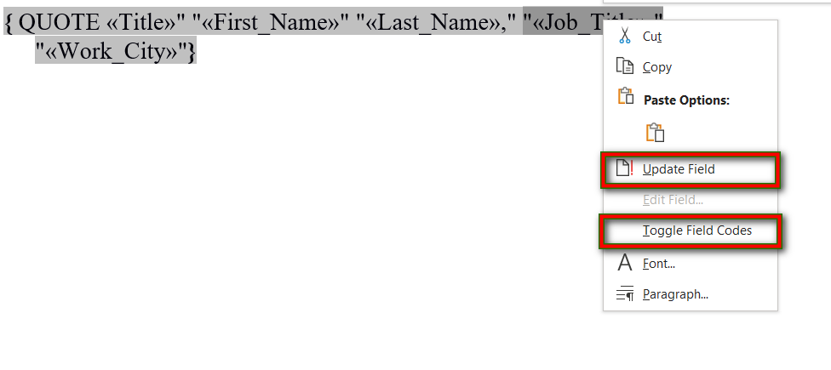
To remove existing merge fields:
Right-click into the field to remove and select Toggle Field Codes. Remove the field and the quotes it is in e.g. "«Job_Title»".
Right-click anywhere in the QUOTE and click Update Field.
Save.

Slide 19
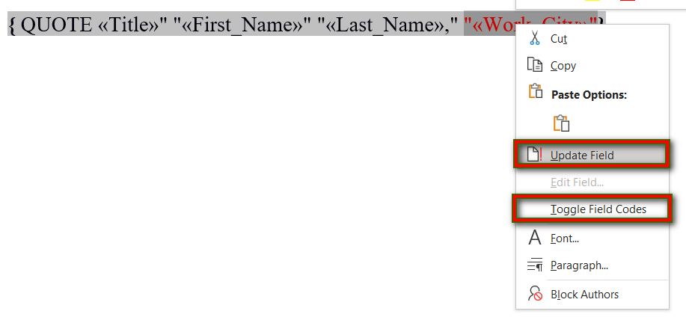
To format existing merge fields:
Right-click into the field to format and select Toggle Field Codes. Format the field and the quotes it is in e.g. "«Work_City»".
Right-click anywhere in the QUOTE and click Update Field.
Save.

Slide 20
To add a new merge field:
You will have to link the doc to a data source first.
Then right-click into a field and select Toggle Field Codes.
Place the cursor where the new field is to be placed.
Use Mailings – Insert Merge Field and insert the required field.
Right-click anywhere in the QUOTE and click Update Field.
Save.

