Slide 1
Access Authorization Module
Authorizing the issuance of United Nations passes …

Slide 2
Introduction
Problems resolved
Workflow
Functionalities based on Users
Demo
Take up Questions

Slide 3
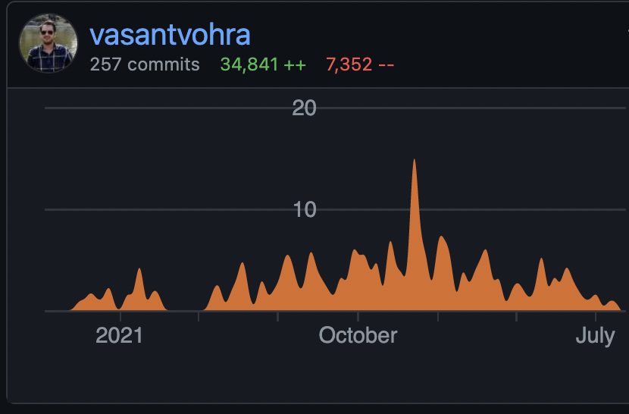
A bit about me …
My name is Vasant Vohra, I'm part of Indico.UN Development team.
I contribute to overall Indico, Indico.UN and Indico at CERN for our required customization.
Primarily, I’m designing, and developing The Access Authorization Module to fulfil our requirements from Indico to manage accreditations beyond events and conferences.
I started working remotely from October 2020.
I’m based in New Delhi, India, and 25 y/o :)
Basically, Design and Develop Indico.UN

Slide 4
Access Authorization Module
Manage accreditation requests to provide access to premises for a long-term or temporary purpose.
Long-term requests are for a few months to a year, and can be renewed.
Temporary accreditation requests are shorter based on specific purpose of an assignment or for one or multiple events.
Released in January’2022 for UN Information Service, Geneva & Media Accreditation and Liaison Unit

Slide 5
Access Authorization Module
Journalist accreditations for UN Headquarters are managed by the Media Accreditation and Liaison Unit.
Journalist accreditations for the UN Office of Geneva, Palais Wilson are managed by the United Nations Information Service, Geneva.
Contractor accreditations for building restructuring work at the Palais des Nations will be managed by SHP.
Long-Term accreditations from personnel of permanent missions of Member States, permanent observer missions and permanent observer offices will be managed by PLS, Geneva.
Releasing in November’2022 for Strategic Heritage Plan & Protocol and Liaison Service, Geneva

Slide 6
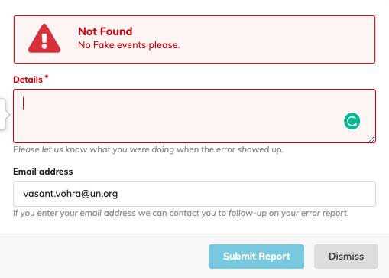
Problems resolved
Reduced the need of creating Fake events for long-term accreditation purposes.
MALU, and UNIS has a record of journalists attending different conferences at one place.
A bit customized workflow diverging from Indico Core (CERN).
Fast applications, direct link, pre-filled form for renewals.
Not much set-up required.
Releasing in November’2022 for Strategic Heritage Plan & Protocol and Liaison Service, Geneva

Slide 7
Basic Workflow
Managers
Configuring the landing page and
email notification
Admin of job titles and assignment type
Assign rights to Focal points, Security
Managers/Security Officers
Set up the badge template
Focal Points/Managers
Send links to final users to trigger accreditations
Final user
Create profiles in Indico.UN and submit initial requests
Focal Points/Managers
Create registration on behalf of the final users in Indico.UN
Managers
Vet
Accreditations
-
Confirm/enter badge validity
-
Define the badge type
Security Officers
Confirm/enter the badge validity dates
-
Print the badges
Final user
Apply for a renewal
Focal Points /Managers
Create renewal requests on behalf
Managers
Vet renewal
-
Confirm/enter new badge validity dates
-
Define the badge type
Security Officers
Confirm/enter the badge validity dates
-
Print the badges

Slide 8
Users
Security Officers
Managers
Applicants
Focal Points
Configure the Landing Page information
Create Email Templates, Common reasons for rejections
Apply for a Temporary or Long-term request
Apply for a Temporary or Long-term request on behalf
Assign/remove rights – focal points, Security
Check status of their submitted applications
Check status of their submitted applications by group they belong to
Submit initial request, renewals on behalf
Check-in Applicants
Moderation -> Approve, Reject, on-hold
Receive automatic notifications on status updates or renewal reminders
Receive automatic notifications on status updates or renewal reminders on your common group email
Adjust badge validity
Adjust badge validity
Review the accreditations in bulk from list.
View their submitted requests, apply for renewals or withdraw a request stating a reason (optional).
Print Paper badge or Send to CCURE
View Applicant history
Print Paper badge or Send to CCURE

Slide 9
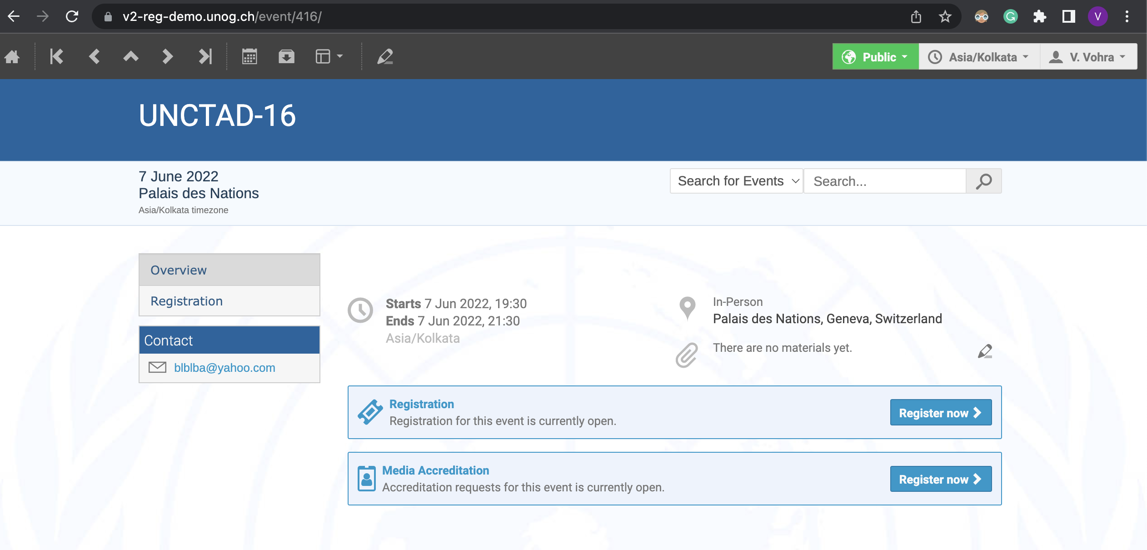
Demo
https://v2-reg-demo.unog.ch/event/416/

Slide 10
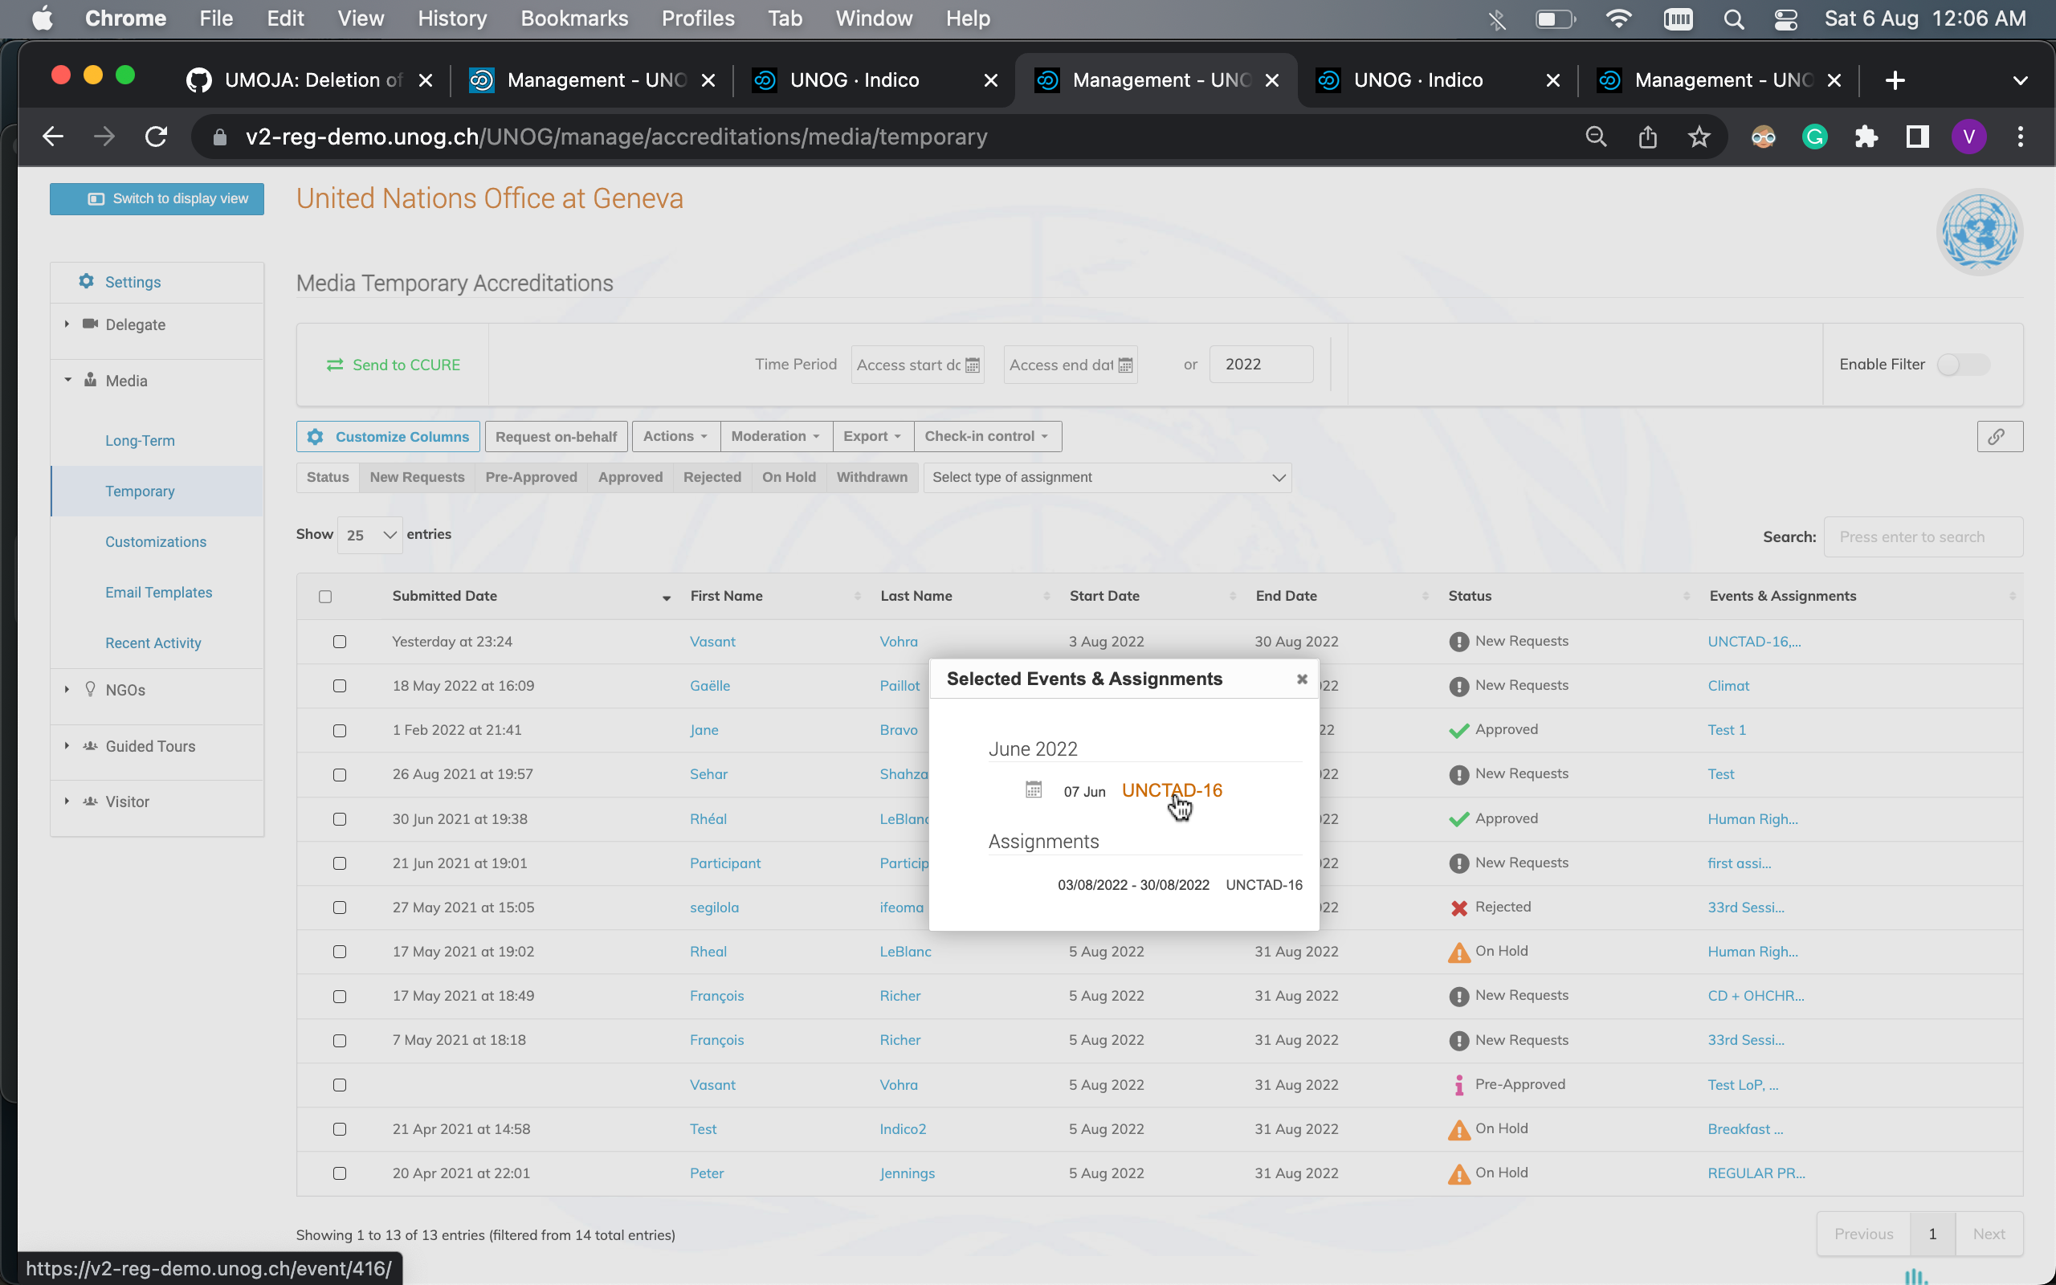
Demo
Manage all different events requests at one place.
https://v2-reg-demo.unog.ch/UNOG/manage/

Slide 11
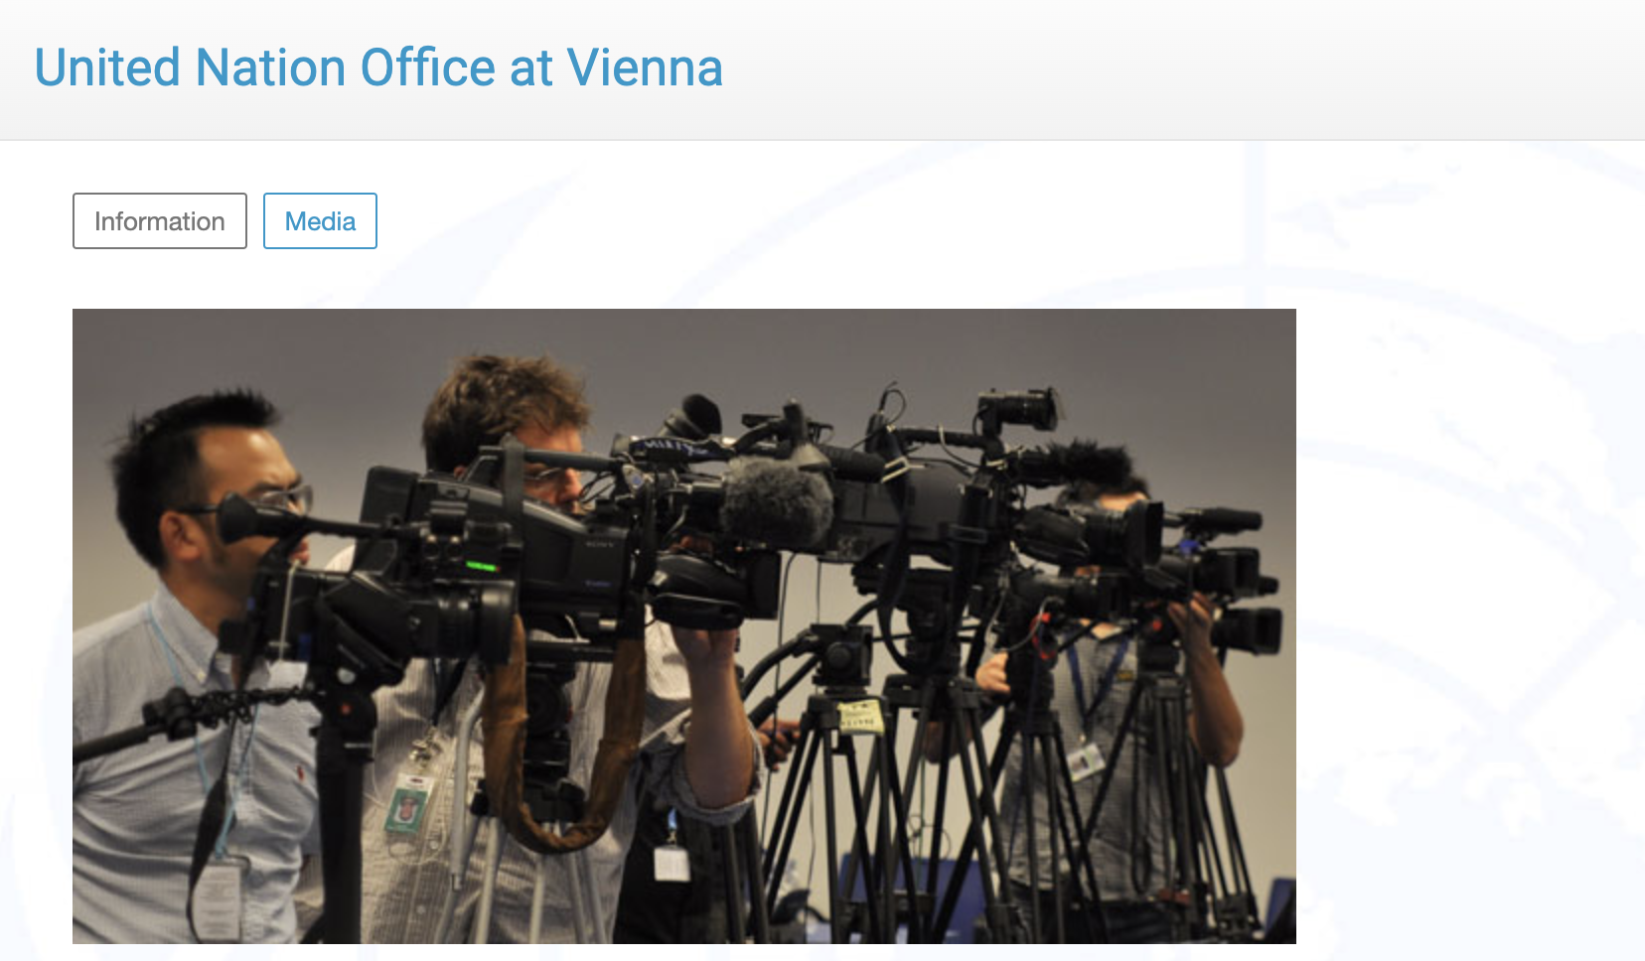
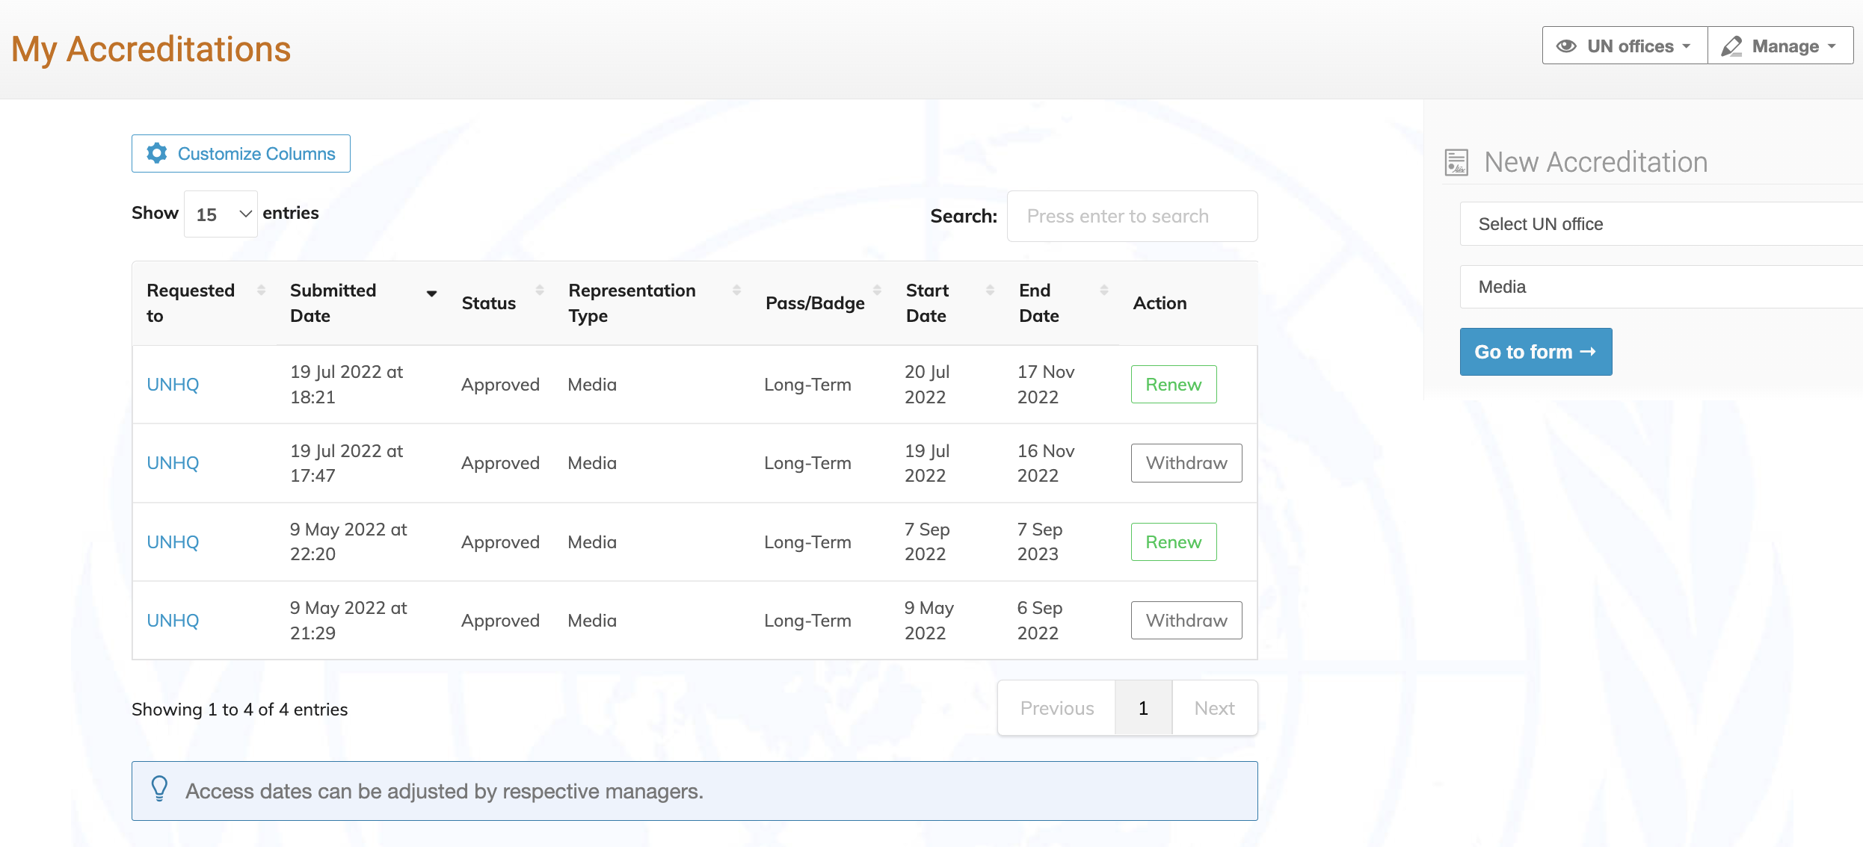
Questions?

Slide 12
Interested?
Overall objective:
Manage accreditations for the issuance of a pass to enter premises
Renew long-term passes
Send a request to Indico.UN management requesting a call with the business analysts to start the discussion.

