Slide 1
Migration of v1 events to version 2

Slide 2
Introduction
We will decommission Indico.UN v1 in early October and only use Indico.UN v2
Most clients are already migrated to v2 but old events are still in v1
If your organization or team is not yet migrated to version 2, contact the Indico.UN support team immediately
The migration will copy the event data from the v1 system to the v2 system in October
Information regarding the migration has been shared previously
Paper on the Decommissioning of Indico.UN version 1
Indico.UN Bulletin #2022/1 - Settings and fields retained during the migration of past events to version 2
This presentation will cover the contents of the Bulletin and only applies to organizations that started using Indico.UN on v1

Slide 3
General settings (1/2)
All settings that are enclosed in green boxes will be migrated
Settings that will not be migrated include:
Default style
Event type (Will be defaulted to the default value in version 2 with no impact for events)
All event URLs will be migrated, ensuring that event invitees and the public can access the event page. In addition, if a short URL was defined for an event in version 1, it will continue working after the migration to version 2 unless the same short URL was used twice, in which case it will only be retained for the most recent event.

Slide 4
General settings (2/2)
As the events are in the past and badges no longer need to be printed, Security Settings won’t be migrated.
Fields that won’t be migrated include:
Chairpersons
Type of contributions
Custom lists
Badge Templates
Do not sync with gMeets
The Custom class field will be mapped to the equivalent representation type schema in version 2.

Slide 5
Timetable
Session
All settings that are enclosed in green boxes will be migrated
Fields that won’t be migrated include:
Sub-Title
Session Type
Break
All fields will be migrated
Contribution
Contribution will not be migrated to version 2

Slide 6
Material
All fields and uploaded files will be migrated.

Slide 7
Registration (1/4)
All meeting participant registrant data will be migrated to version 2.
Meeting managers will be able to access historic registration data once the migration to version 2 is completed.
The following slides detail the registration configuration fields that will be (and will not be) migrated.

Slide 8
Registration (2/4)
Setup
All fields that are enclosed in green boxes will be migrated.
The following fields will not be migrated as registrations for these events will already be closed.
Max no of registrants
Automatic notification on approve/reject
Email registrant
Limit NGO badge's validity
Limit Public badge's validity
Restrict NGO selection to the approved list
Quota for NGO Approvals
Quota for NGO Approvals Per Session
Registration Quota
Must have an account
Allow renewal registration
Always display full list of registrations
Excluded Representation Types

Slide 9
Registration (3/4)
Edit
As the registration form is built dynamically using fields, the section below will detail the sections and field types that will and will not be migrated.
Sections

Slide 10
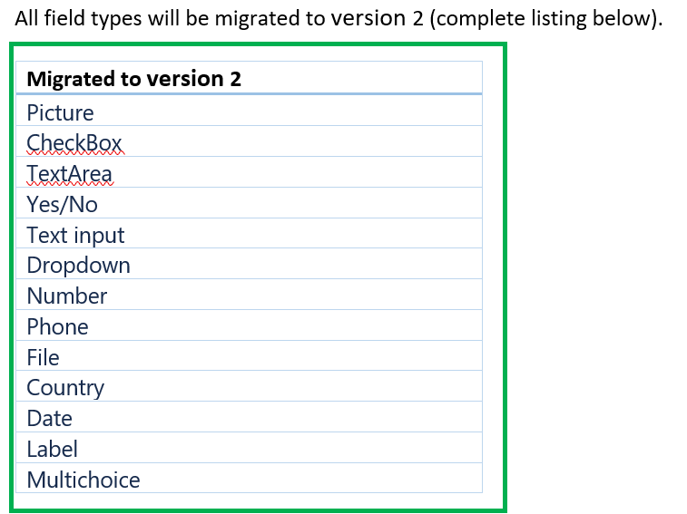
Registration (4/4)
Field Types

Slide 11
Protection
All fields that are enclosed in green boxes will be migrated
The following fields will not be migrated:
Modification Key
Session coordinator's rights
The above fields are not migrated as there has been minimal use of them in version 1.

Slide 12
Tools
Managers should create new events on version 2 before cloning to make copies of events.
Events that are migrated from version 1 should not be cloned.
Lock
The settings applied for locking an event will be migrated to version 2

Slide 13
Layout
Layout
All settings that are enclosed in green boxes will be migrated.
The following settings will not be migrated
Stylesheets
Social Bookmarks
Managers who wish to have a backup of the stylesheets should ensure that they are manually backed up.

Slide 14
Logs
All log data will be migrated for reference.

Slide 15
Points to consider
Important points to remember
Ensure that your organization/team (category) is migrated to version 2 before the 1st of October. Contact the support team using the contact form if you are unsure or need assistance.
Do not create an event in version 1 starting after or during the 1st of October 2022.
You do not need to take any action regarding events that were created in version 1 (and end before the 1st of October 2022.) unless you want to manually create a backup of a setting that is not migrated.
No new features will be developed for Indico.UN after the 15th of July until the end of the decommissioning of version 1.

Slide 16
THANK YOU

