Slide 1
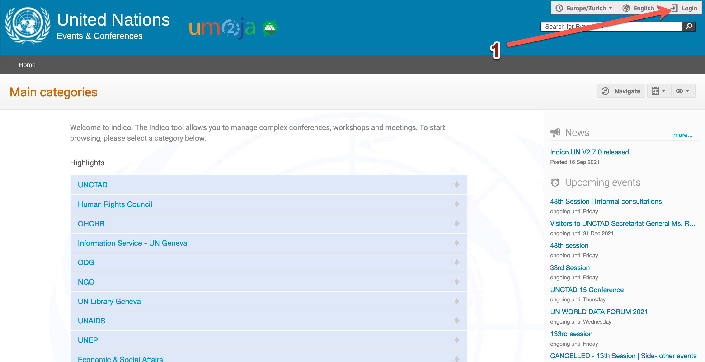
Step 1: Account creation
Demo environment: https://v2-reg-demo.unog.ch/
Production environment: https://indico.un.org/
1. Click on the Login button

Slide 2
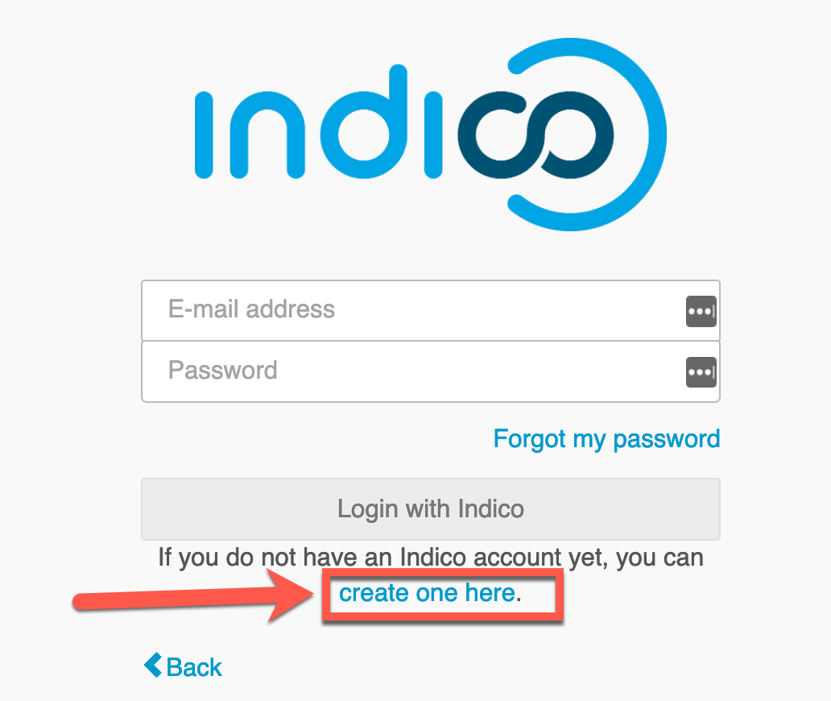
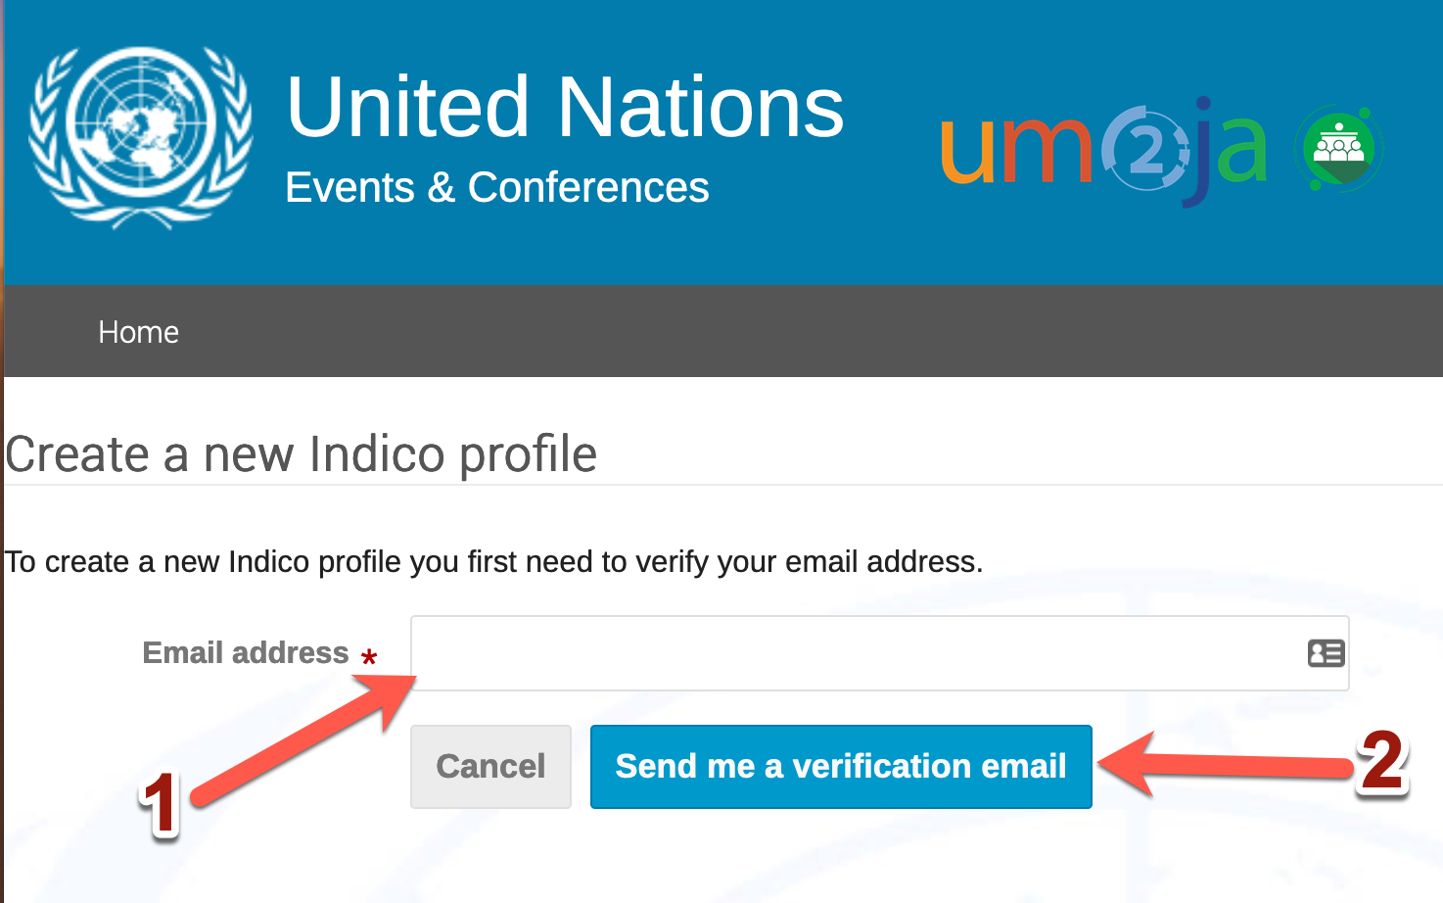
Step 2: Account creation
On the Indico.UN login page, click on “Create one here” to create an account.
Enter your email address.
(kindly use the same email address, first name and last name as of eRegistration)
2. Then click on Send me a verification email
A verification email will be sent to your email address

Slide 3
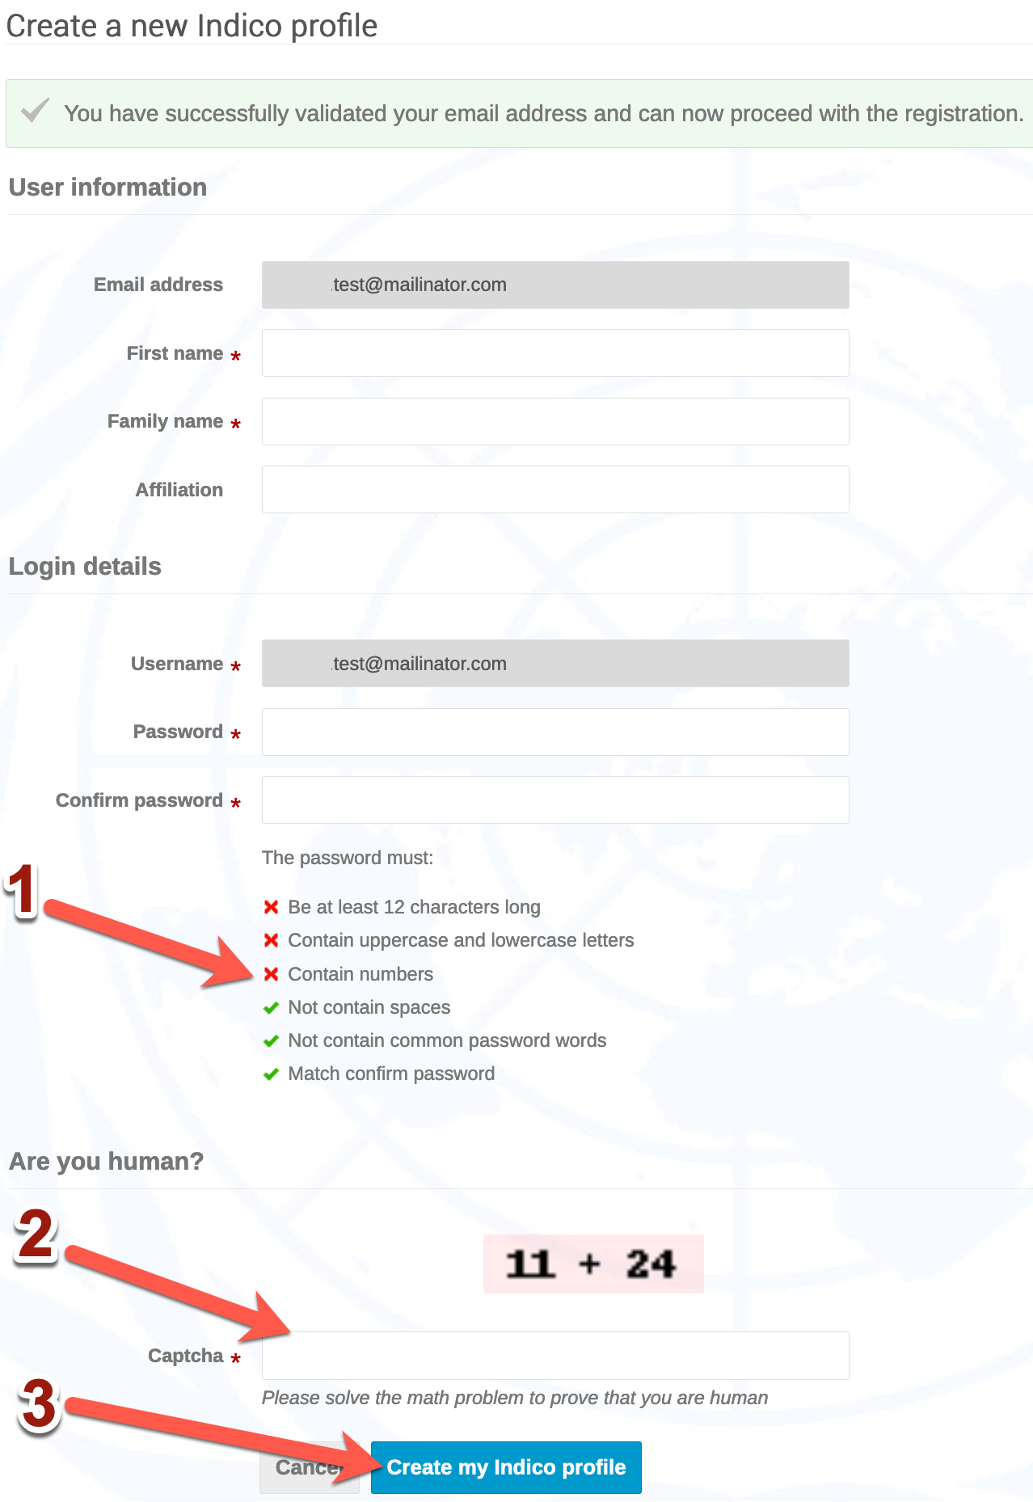
Step 3: Account Creation
Go to your email inbox and open the verification email
Click on the link in the verification email
You will be redirected to the Indico.UN profile form
Fill out the form(first and family name, etc)
Pay attention to the password requirements
Enter the captcha value (addition result)
Click on ”Create my Indico profile”

Slide 4
Step 4: Category Manager role
Now that your Indico.UN profile has been successfully created, you need to get category manager role.
Send an email to the Indico.UN Support support.accreditation@un.org and put in copy your IndicoUN focal point and your IndicoUN contact.
Once you receive a confirmation email that you have been granted the Category Manager role, you can start creating conferences, managing participants, testing the functionalities of the system.

