Slide 1
Indico.un Service desk
Dated: August 2022

Slide 2
$${Service Desk team}^{}$$
Six UN staff, Geneva based:
Houria Chouari
Deidre Windsor
Gaelle Paillot
David Lightbound
Anand Mamtora
Christophe Henry

Slide 3
$${Service Desk activities}^{}$$
User support
Conferences support
Indico.UN administration
Documentation
Investigations
User needs assessment
Training
Migrating clients to Version 2

Slide 4
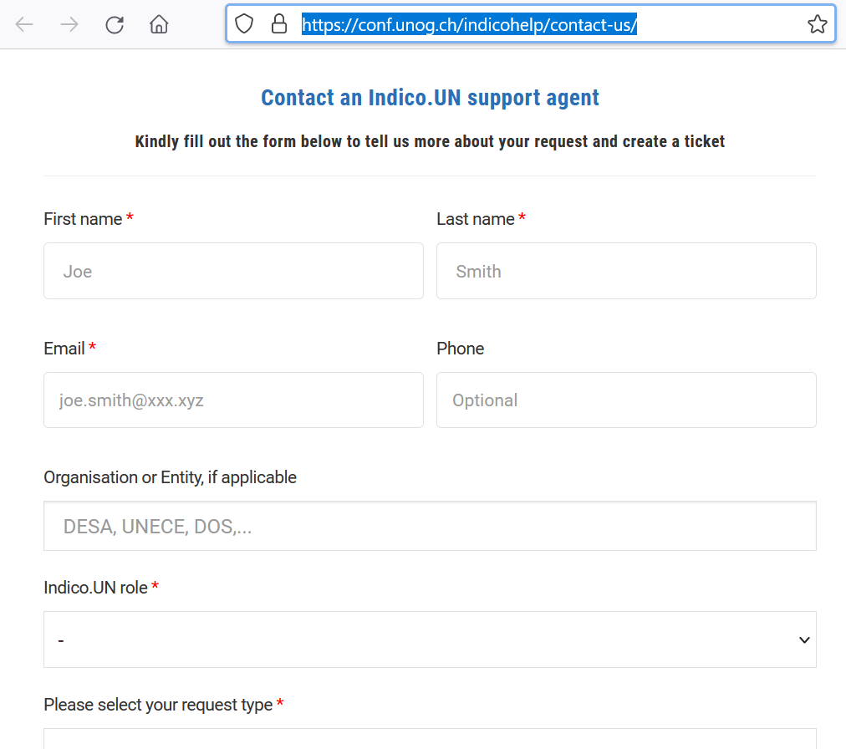
$${Communication channels}^{}$$
Generic email used by conference organizers : support.accreditation@un.org
iNeed platform via our contact form: https://conf.unog.ch/indicohelp/contact-us/
MS team

Slide 5
$${Tools}^{}$$
Indico.UN
iNeed : UN service desk system
Jira : internal DCM ticketing system
Wordpress
Listflow
Indico.UN parallel features: Access authorization module, Analytical module
Fast
gmeets

Slide 6
$${Questions}^{}$$

