Slide 1
FIELD MEDICAL ASSISTANT COURSE (FMAC)
MODULE 12:
HEAD INJURIES

Slide 2
TACTICAL FIELD MEDICAL AID (TFMA)
ROLE-BASED TRAINING SPECTRUM
ROLE 1 CARE
NONMEDICAL PERSONNEL
Buddy First Aid
Field Medical Assistant
MEDICAL PERSONNEL
Paramedic
Nurse
Doctor
You are HERE

Slide 3
STUDENT LEARNING OBJECTIVES
TERMINAL LEARNING OBJECTIVE
T13 Identify a head injury in accordance with TFMA Guidelines
EO68 Identify external forces that can cause a head injury
EO69 Identify signs and symptoms of a head injury
EO70 Identify the critical observations that should be reported to medical personnel for trauma casualties with a suspected head injury in accordance with the Military Acute Concussive Evaluation 2 (MACE 2).

Slide 4
Three PHASES of TFMA
1 CARE UNDER FIRE
RETURN FIRE
AND TAKE COVER
Quick decision-making:
Consider scene safety
Identify and control life-threatening bleeding
Move casualty to safety
2 TACTICAL FIELD CARE
COVER AND
CONCEALMENT
Basic Management Plan:
Maintain tactical situational awareness
Triage casualties as required
MARCH PAWS assessment
3 TACTICAL EVACUATION CARE
More deliberate assessment and treatment of unrecognized life-threatening injuries:
Pre-evacuation procedures
Continuation of documentation
NOTE: This is covered in more advanced TFMA training!
YOU ARE HERE

Slide 5
TACTICAL FIELD CARE
MARCH PAWS
DURING LIFE-THREATENING
MASSIVE BLEEDING #1 Priority
AIRWAY
RESPIRATION
CIRCULATION
HYPOTHERMIA / HEAD INJURIES
AFTER LIFE-THREATENING
PAIN
ANTIBIOTICS
WOUNDS
SPLINTING

Slide 6
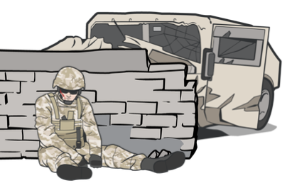
HEAD INJURIES
POTENTIAL MECHANISMS OF HEAD INJURY
Head injury is trauma to the scalp, skull, and/or brain
Involvement in a vehicle blast event, collision, or rollover
Presence within 50 METERS of a blast (inside or outside)
A direct blow to the head or witnessed loss of consciousness
Exposure to more than one blast event (the Service member’s commander will direct a medical evaluation)
OTHER EXTERNAL FORCES MAY ALSO LEAD TO HEAD INJURIES

Slide 7
HEAD INJURIES
SIGNS AND SYMPTOMS OF HEAD INJURY
IED Checklist

Slide 8
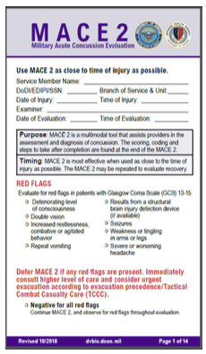
HEAD INJURIES
SIGNS AND SYMPTOMS REQUIRING MACE 2*
EVALUATION BY MEDICAL PERSONNEL
Evaluations are most effective when done as soon as possible after the
injury. Traumatic brain injury (TBI) is likely if the casualty shows signs of
ANY of the following:
Deteriorating level of consciousness
Double vision
Increased restlessness; combative or agitated behavior
Repeat vomiting
Results from a structural brain injury detection device (if available)
Seizures
Weakness or tingling in arms or legs
Severe or worsening headache

Slide 9
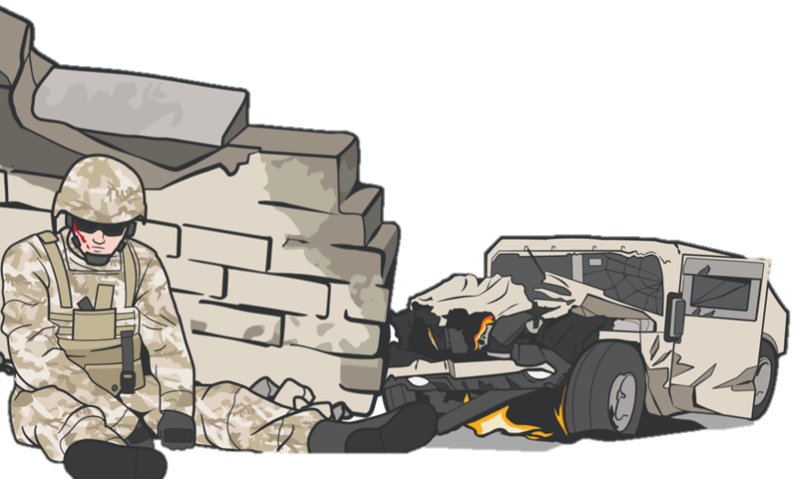
SUMMARY
We defined head injury
We discussed mechanisms of injury
We discussed signs and symptoms
We identified critical observations to report to higher medical personnel

Slide 10
CHECK ON LEARNING
What external forces can cause a head injury?
What are the critical observations that should be reported to medical personnel for trauma casualties with a suspected head injury, in accordance with MACE 2?

Slide 11
ANY QUESTIONS?

