Slide 1
FIELD MEDICAL ASSISTANT COURSE (FMAC)
MODULE 10:
SHOCK RECOGNITION

Slide 2
TACTICAL FIELD MEDICAL AID (TFMA)
ROLE-BASED TRAINING SPECTRUM
ROLE 1 CARE
NONMEDICAL PERSONNEL
Buddy First Aid
Field Medical Assistant
MEDICAL PERSONNEL
Paramedic
Nurse
Doctor
You are HERE

Slide 3
STUDENT LEARNING OBJECTIVES
TERMINAL LEARNING OBJECTIVE
T11 Describe shock assessment in Tactical Field Care in accordance with TFMA Guidelines
EO63 Identify the signs, symptoms, and management steps of shock in a trauma casualty with life-threatening bleeding
EO64 Identify the importance of level of consciousness and radial pulse as indicators of shock in Tactical Field Care

Slide 4
TACTICAL FIELD CARE
MARCH PAWS
DURING LIFE-THREATENING
MASSIVE BLEEDING #1 Priority
AIRWAY
RESPIRATION
CIRCULATION
HYPOTHERMIA / HEAD INJURIES
AFTER LIFE-THREATENING
PAIN
ANTIBIOTICS
WOUNDS
SPLINTING

Slide 5
SHOCK RECOGNITION
SHOCK RECOGNITION
Video can be found on DeployedMedicine.com

Slide 6
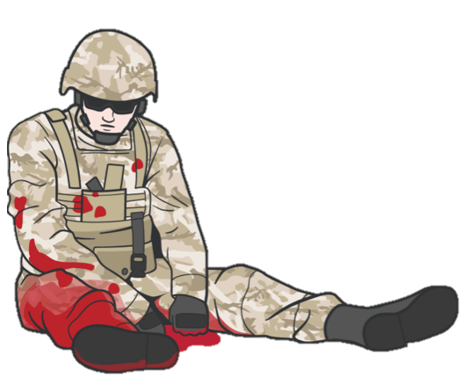
CIRCULATION/SHOCK
SHOCK
Shock is inadequate blood flow to body tissues. Inadequate blood volume inside the circulatory system results in inadequate oxygen delivery to the body’s cells
As cells cease to function, tissues cease to function, then organs cease to function, and eventually the whole body will fail and DEATH follows
IMPORTANT CONSIDERATIONS:
Shock will lead to the casualty's death if not quickly recognized and treated

Slide 7
CIRCULATION/SHOCK
SHOCK
Caused by a decrease in the amount of blood volume circulating in the casualty's blood circulatory system
Shock can have many causes – low blood volume or hypovolemia (dehydration or blood loss), low blood pressure (massive infection), heart failure, or neurologic damage
Usually caused by severe bleeding, but it can also be caused by severe burns (second- and third-degree burns on 20 percent or more of the body surface)
On the battlefield, assume shock is from severe blood loss (also called hemorrhagic shock)
Hemorrhagic shock can result in the casualty's death
M A R C H

Slide 8
CIRCULATION/SHOCK
GENERAL INDICATORS OF SHOCK
SIGNS AND SYMPTOMS
OF SHOCK INCLUDE:
Mental confusion
Rapid breathing
Sweaty, cool, clammy skin
Pale/grey skin
Weak or absent radial pulse
Nausea
Excessive
Thirst
Previous severe bleeding
M A R C H

Slide 9
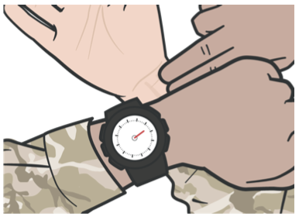
CIRCULATION/SHOCK
GENERAL INDICATORS OF SHOCK
IMPORTANT
Indicator:
Mental confusion
IMPORTANT
Indicator:
Weak or absent radial pulse
If BOTH indicators exist, the casualty has lost a SIGNIFICANT amount of blood
As previously stated, shock will lead to the casualty's death if not quickly recognized and treated

Slide 10
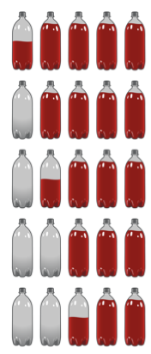
CIRCULATION/SHOCK
GENERAL INDICATORS OF SHOCK
Blood Volume | Blood Loss | Signs/Symptoms | Effectme
4 liter bottles full, 1 bottle1/2 empty | 500cc | Possible increased HR | Usually no effects
4 liter bottles full, 1 empty | 1000cc | Radial pulse >100 Breathing probably normal | Unlikely to die from this amount of loss
31/2 bottles full, 11/2 empty | 1500cc | Change in mental status Weak radial pulse >100 Increased respirations | Still unlikely to die
3 bottles full, 2 empty | 2000cc | Confusion and lethargy Very weak radial pulse >120 High respiratory rate >35 | Very possibly fatal if not managed
21/2 bottles full and 21/2 bottles empty | 2500cc | Unconscious No radial pulse, carotid pulse, HR >140 Respirations > 35 | Fatal without immediate and rapid interventions
M A R C H

Slide 11
CIRCULATION/SHOCK
PREVENT SHOCK BY CONTROLLING BLEEDING
#1- Reassess to confirm all bleeding
control measures are still effective
It is better to prevent shock with hemorrhage control than to treat it
If shock is present, though, the most critical first step is to control the bleeding
Internal bleeding from chest or abdominal trauma may not be controllable, and shock may develop later, so continuously assess the casualty
Medical personnel will provide other treatments, but you can save them time if extremal bleeding is controlled
Ensure TQs and pressure dressings
remain tight
Check radial pulse
DO NOT WAIT for signs and
symptoms of shock to occur
M A R C H

Slide 12
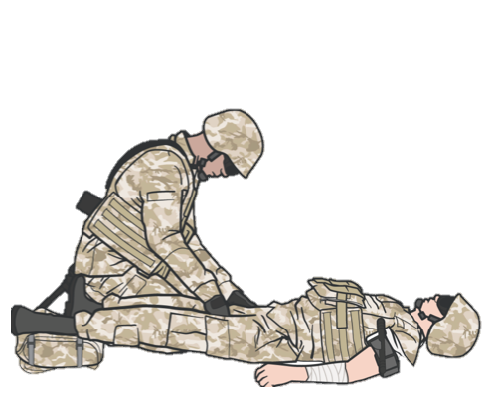
CIRCULATION/SHOCK
ASSESS/MONITOR FOR HEMORRHAGIC SHOCK
Assess for signs and symptoms of shock as soon as hemorrhage is controlled, the airway is open, and respirations have been managed
The best indicators of shock are a decreased state of consciousness (if casualty has not suffered a head injury) and/or an abnormal, weak, absent radial pulse
Assess for hemorrhagic shock (altered mental status in the absence of brain injury and/or weak or absent radial pulse)
Reassess/monitor for changes in the level of consciousness by checking for alertness or responsiveness to verbal or physical stimulation
M A R C H

Slide 13
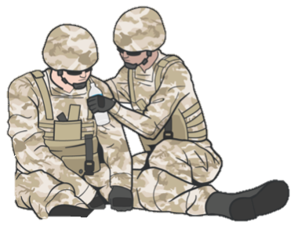
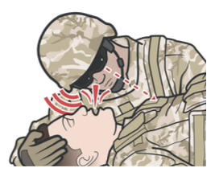
SHOCK RECOGNITION
REASSESS
Level of consciousness
Check casualty every 15 minutes for AVPU
Alertness - Knows who, where they are
Verbal - Orally responds to verbal commands
Pain - Level of pain felt when the sternum is
briskly rubbed with the knuckle (if needed)
Unconscious - Unresponsive
Decreasing AVPU could indicate condition worsening
Breathing rate
Monitor respirations
Thoracic trauma may indicate tension pneumothorax (needle decompression of the chest required)
If a casualty becomes unconscious or their breathing rate drops below two respirations every 15 seconds, insert a nasopharyngeal airway

Slide 14
CIRCULATION/SHOCK
SHOCK MANAGEMENT
Fluids by mouth are permissible if the casualty is conscious and can swallow
Evacuate the casualty if medical help is not available
Place casualty in recovery position
Reassess the casualty frequently
for the onset of shock

Slide 15
CIRCULATION/SHOCK
HYPOTHERMIA MANAGEMENT
REMEMBER:
Keep the casualty warm and prevent hypothermia. Even in very hot environments, a casualty in hemorrhagic shock (blood loss) is at EXTREME risk for hypothermia
Place a poncho or blanket under the casualty to protect from the temperature or dampness of the ground
Cover the casualty with a survival blanket or other available materials to keep them warm and dry

Slide 16
SUMMARY
IMPORTANT
Indicator:
Mental confusion
We defined shock
We identified indicators of shock
We discussed prevention measures for shock
We discussed the management of shock
We introduced hypothermia
IMPORTANT
Indicator:
Weak or absent radial pulse

Slide 17
CHECK ON LEARNING
What is shock?
What are the best indicators of shock?
What is the most important action to prevent hemorrhagic shock?

Slide 18
ANY QUESTIONS?

