Slide 1
FIELD MEDICAL ASSISTANT COURSE (FMAC)
MODULE 02:
MEDICAL EQUIPMENT

Slide 2
TACTICAL FIELD MEDICAL AID (TFMA)
ROLE-BASED TRAINING SPECTRUM
ROLE 1 CARE
NONMEDICAL PERSONNEL
Buddy First Aid
Field Medical Assistant
MEDICAL PERSONNEL
Paramedic
Nurse
Doctor
You are HERE

Slide 3
STUDENT LEARNING OBJECTIVES
TERMINAL LEARNING OBJECTIVE
TO3 Describe the use of individual medical equipment components in accordance with TFMA Guidelines
    EO9 Describe the use of a first aid kit in accordance with UN policy.
    EO10 Identify the contents of an individual Buddy First Aid Kit (BFAK), and/or other UN specific first aid kits.
    EO11 Describe the general maintenance and resupply procedures for trauma materials in a first aid kit in accordance with UN guidelines.
    EO12 Identify the contents of a UN Trauma Pack (UNTP), and/or other UN specific first aid kits.
    EO13 Describe the use of the components of a UN Trauma Pack (UNTP) in accordance with UN policy

Slide 4
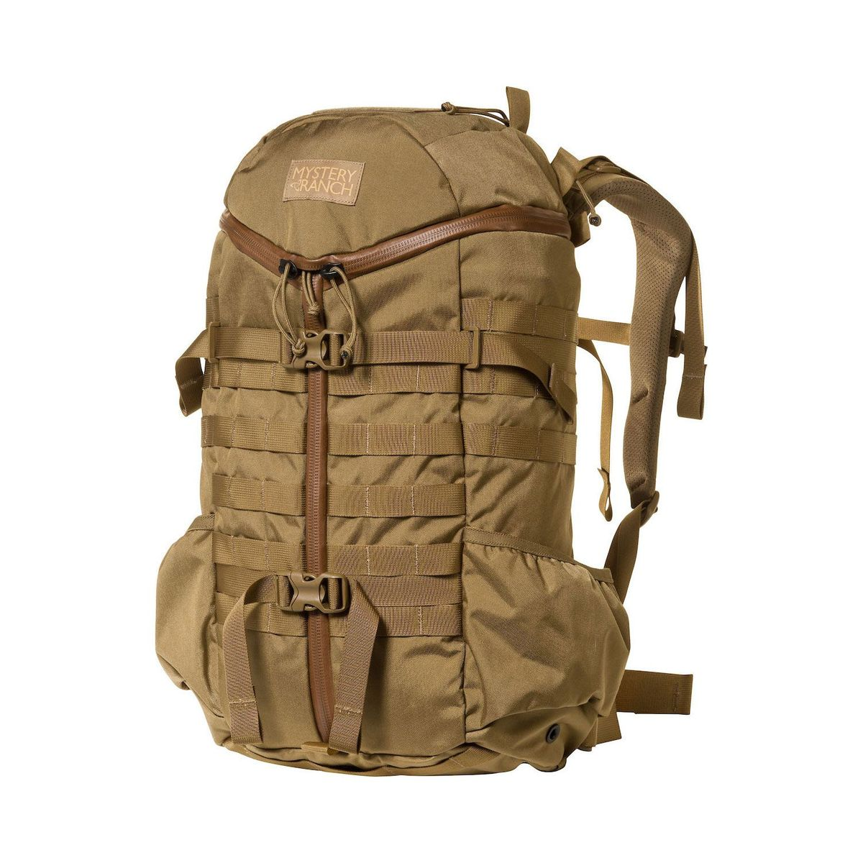
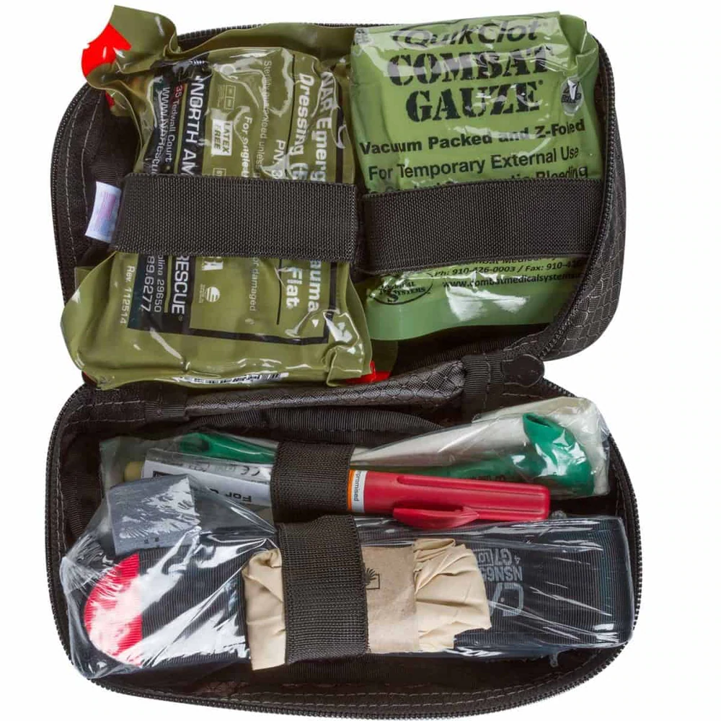
MEDICAL SUPPLIES
MEDICAL EQUIPMENT
WHAT YOU WILL NEED TO PROVIDE AID AND SAVE A LIFE:
Medic Pack
UN Trauma Pack (UNTP)
Individual
Buddy First Aid Kit (BFAK)
BE FAMILIAR WITH YOUR INDIVIDUAL AND
UN/UNIT-SPECIFIC MEDICAL EQUIPMENT!
Notes:
Replace Images

Slide 5
MEDICAL EQUIPMENT
CONTENT LIST
Medic Pack
UN Trauma Pack (UNTP)
See Handbook
Individual
Buddy First Aid Kit (BFAK)
See Handbook
Notes:
CAT Tourniquet pic from Internet
I Z fold hemostatic gauze dressing pic from internet
Emergency pressure bandage pic from internet

Slide 6
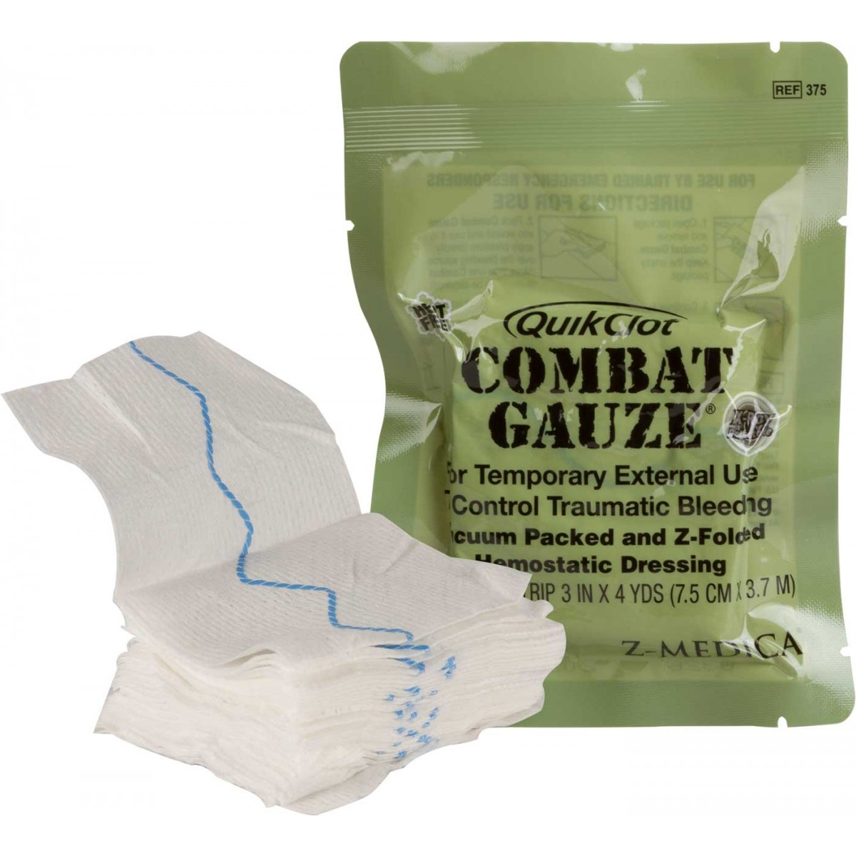
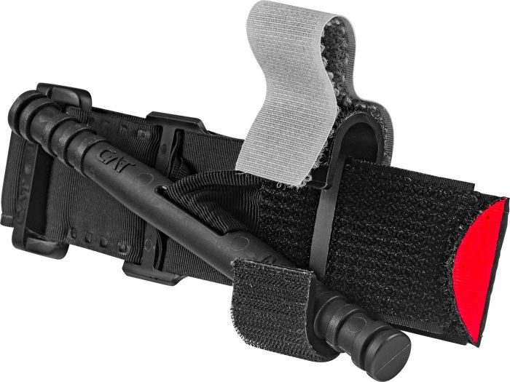
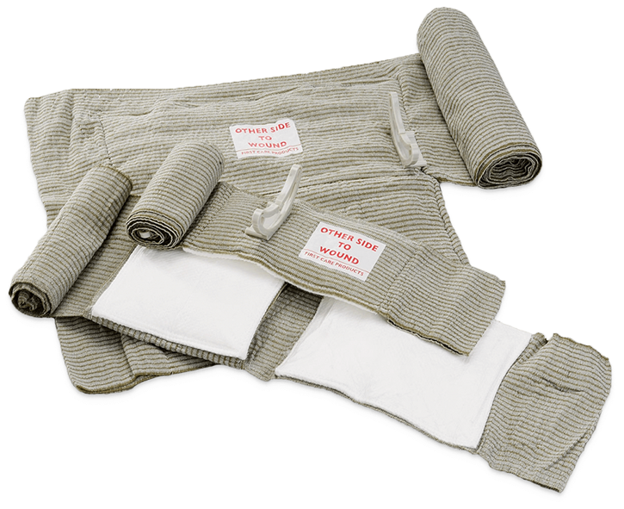
MEDICAL EQUIPMENT
CONTENT OVERVIEW
TOURNIQUET
A device to stop massive
bleeding
HEMOSTATIC GAUZE
Gauze rolls used to stop major life-threatening bleeding
EMERGENCY BANDAGE/
TRAUMA DRESSING
Elastic bandage used as a pressure dressing and/or standard dressing
Notes:
CAT Tourniquet pic from Internet
I Z fold hemostatic gauze dressing pic from internet
Emergency pressure bandage pic from internet

Slide 7
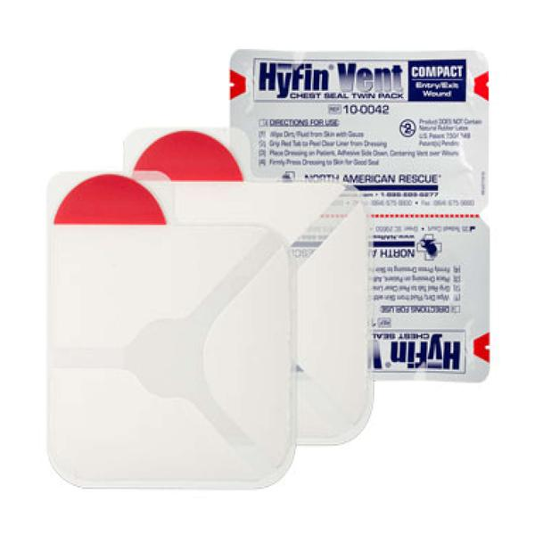
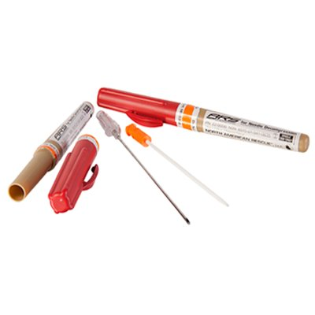
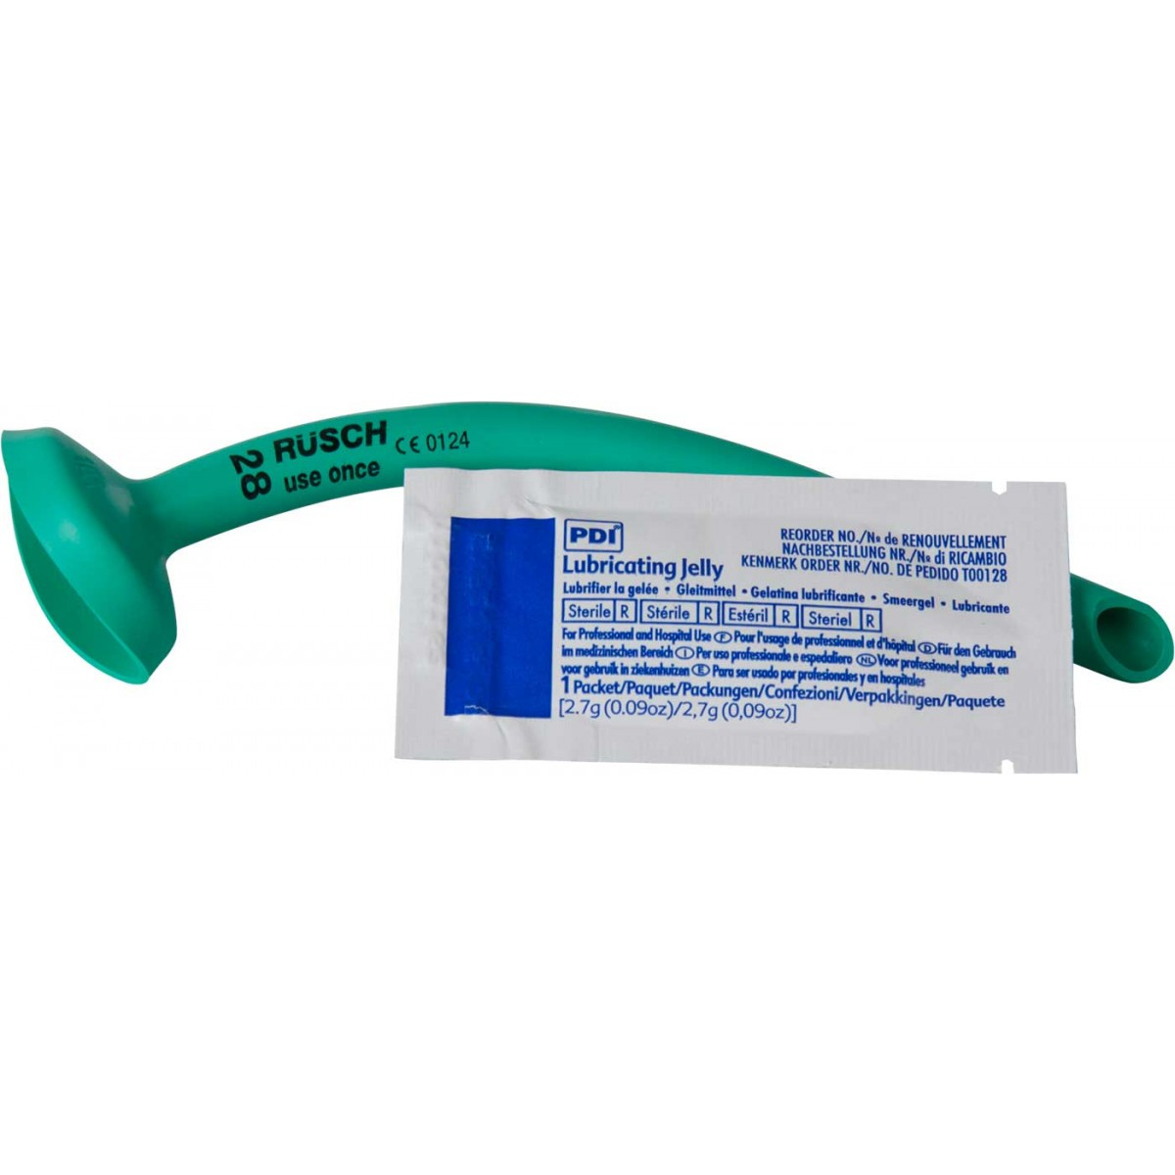
MEDICAL EQUIPMENT
CONTENT OVERVIEW
NASOPHARYNGEAL AIRWAY (NPA) WITH WATER-BASED LUBRICANT
Nonsterile, rubber tube-shaped device that can be inserted into the casualty’s nostril
VENTED CHEST SEAL
Vented and adhesive chest seal for treating penetrating wounds to the chest
NDC 10-14 GAUGE 3.25”
NEEDLE CATHETER
Catheter-over-needle device that can be inserted into the casualty’s chest to treat tension pneumothorax
Notes:
NPA with water based lubricant pic from internet
Vented chest seal (Halo or Hyfin 2 pack) from internet
NDC 10-14 gauge needle catheter form internet

Slide 8
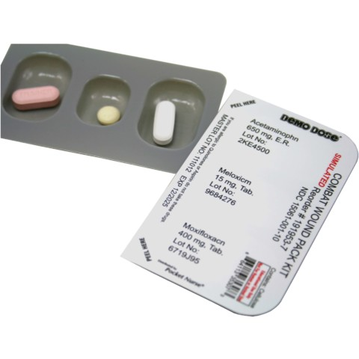
MEDICAL EQUIPMENT
CONTENT OVERVIEW
Moxifloxacin 400mg tablet
Meloxicam 15mg tablet
Acetaminophen x2 650mg
NOTE:
Each of the three medications (in unit dosages) is contained in a single blister pack
The Combat Wound Medication Pack (CWMP) is an example of medication that might be used ONLY for traumatic injuries and ALL penetrating injuries.
Drugs should only be administered by trained medical personnel
Notes:
Does the UN have a pill pack?

Slide 9
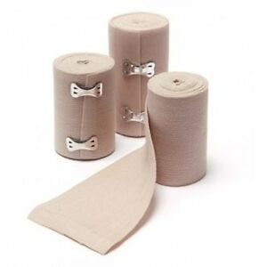
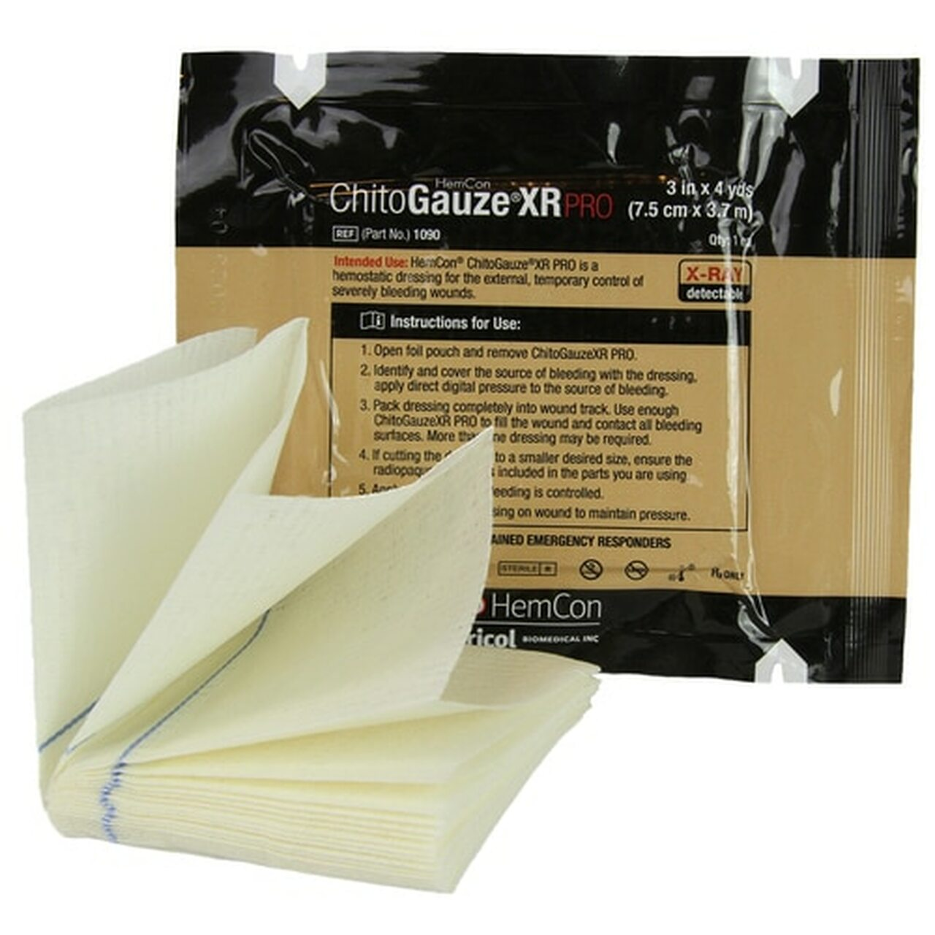
MEDICAL EQUIPMENT
CONTENT OVERVIEW
GAUZE/PACKING DRESSING
Gauze rolls used to stop minor bleeding or as bulky material for packing wounds
ELASTIC BANDAGE
Stretchable bandage that
creates localized pressure
used for pressure dressings
Notes:
S rolled gauze pic from internet
Elastic bandage pic from internet

Slide 10
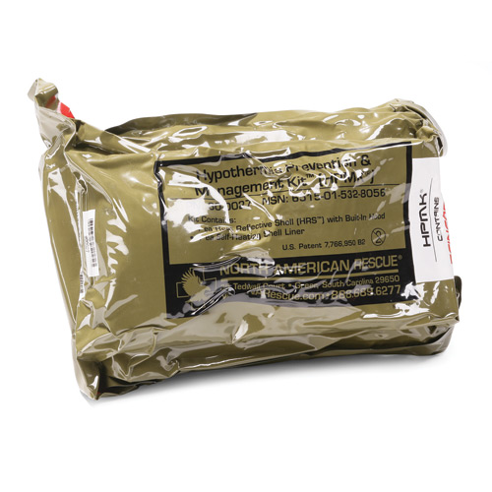
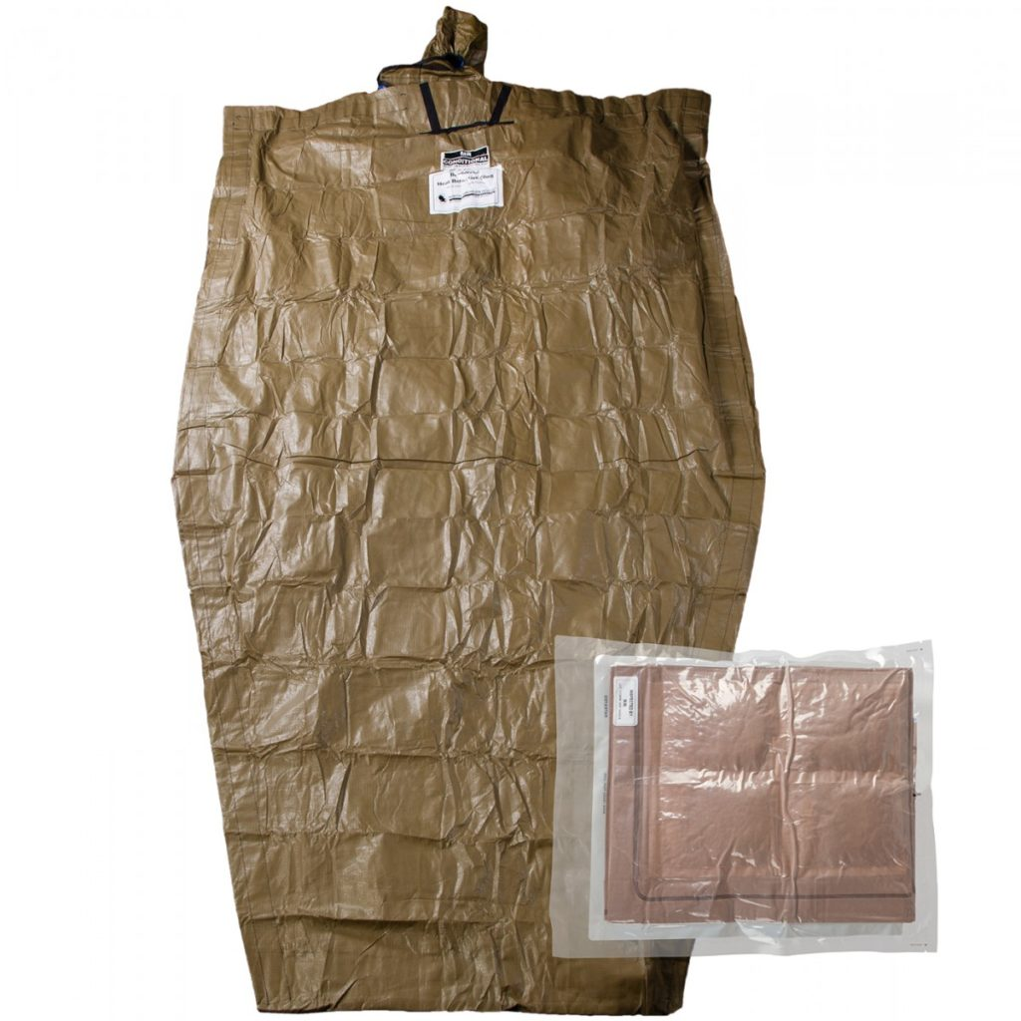
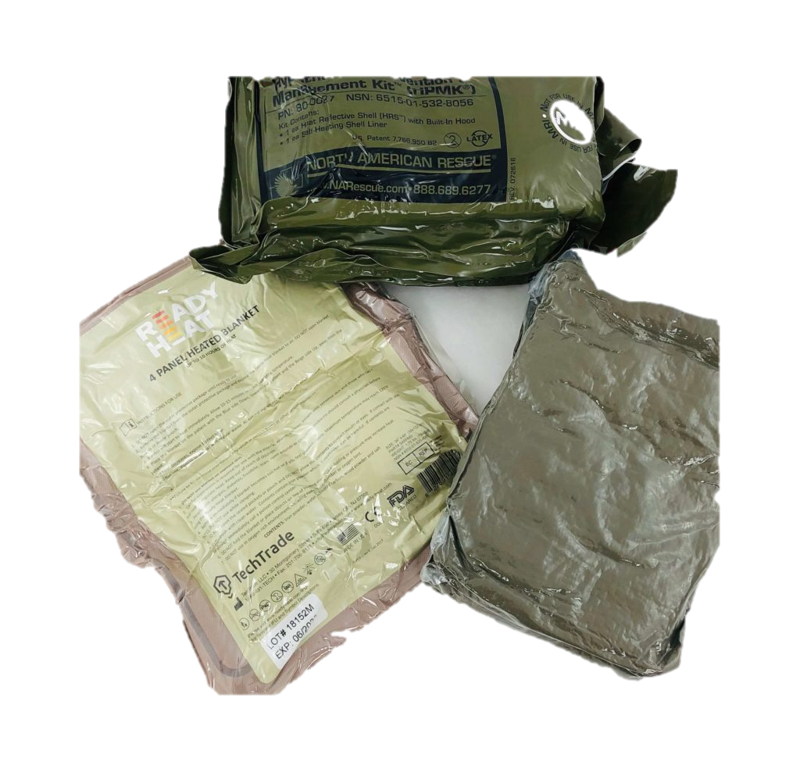
MEDICAL EQUIPMENT
CONTENT OVERVIEW
ACTIVE
PASSIVE
ACTIVE/PASSIVE HYPOTHERMIA BLANKET
Used to prevent and manage hypothermia
Notes:
Hpmk Thermo blankets pic from internet (Pat I will still look for better pics just for now)

Slide 11
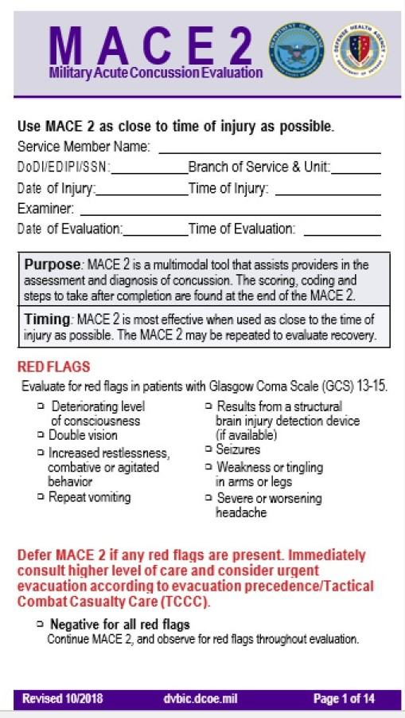
MEDICAL EQUIPMENT
DOCUMENTATION
MILITARY ACUTE CONCUSSION EVALUATION (MACE2)
Used for identifying possible traumatic brain injury (TBI)
Notes:
MACE 2 Document from internet

Slide 12
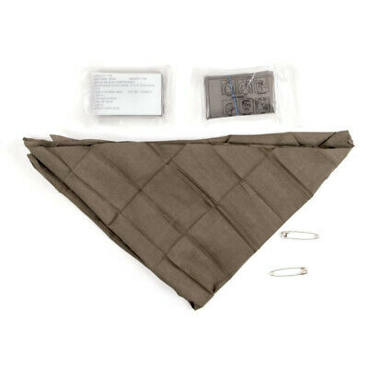
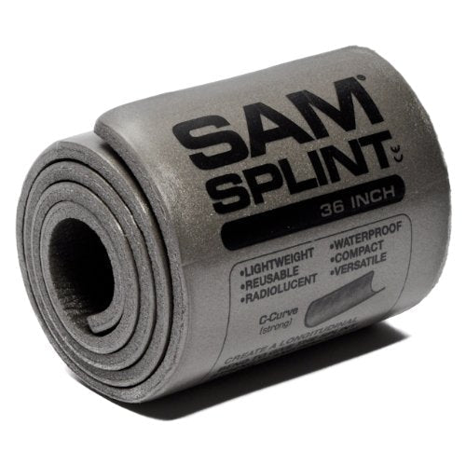
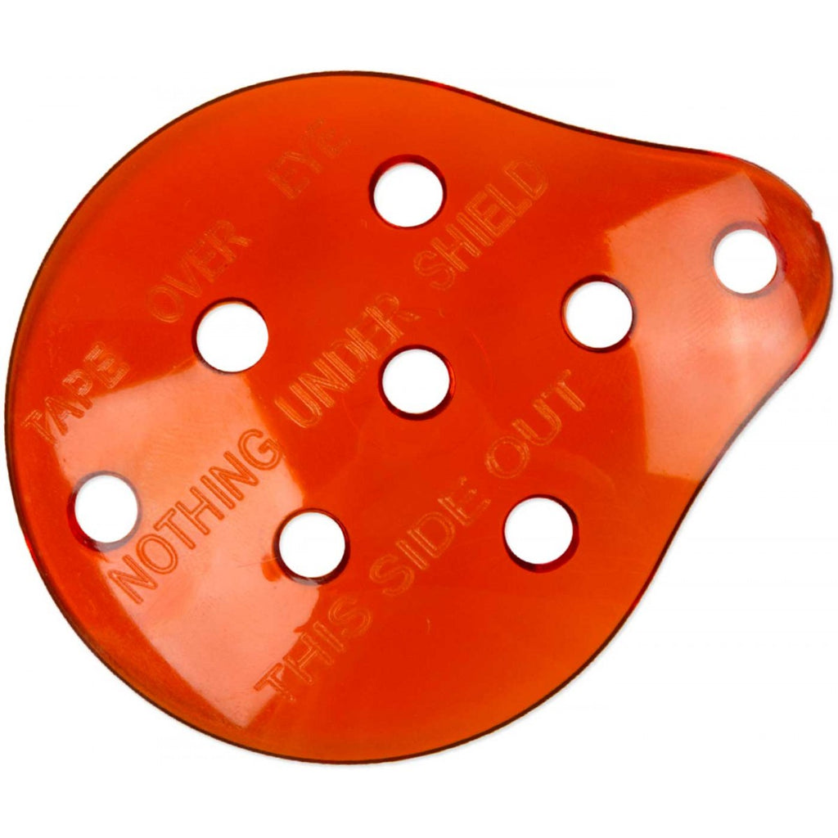
MEDICAL EQUIPMENT
CONTENT OVERVIEW
RIGID EYE SHIELD
A shield that provides a domed protection of eye injuries WITHOUT applying pressure
MALLEABLE SPLINTING
Semirigid material that can be formed to the injured limb to assist in immobilizing
CRAVATS
Used to assist in immobilizing the injured limb or protrusion
Notes:
Rigid eye shield, Sam splint and Cravats triangular bandage pics from internet

Slide 13
MEDICAL EQUIPMENT
DOCUMENTATION
UN Evacuation 4 Liner
Call procedure that is divided into 4 lines of information for evacuation crews
Cas Card
UN Approved casualty card
Notes:
On original slides this contains the 9 line (medivac form) and the DD 1380 TCCC Front and back
MACE 2 form from internet

Slide 14
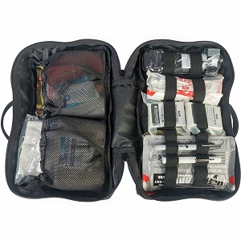
MEDICAL EQUIPMENT
MAINTENANCE AND RESUPPLY
REMEMBER:
Regularly inspect your BFAK, UNTP and other service-specific medical kits:
  BEFORE
  DURING
  AFTER
ALL training events and missions
Notes:
JFAK pic from internet

Slide 15

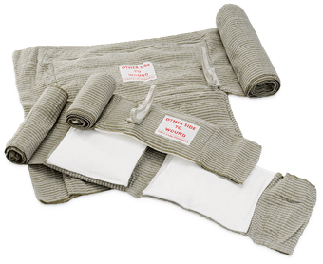
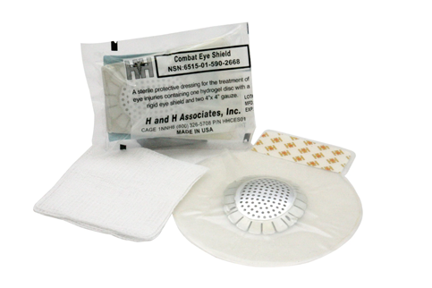
MEDICAL EQUIPMENT
MAINTENANCE AND RESUPPLY
Check to be sure all equipment is in the kit
Check seals and wrappers
  REPLACE items with broken or unsealed wrappers
Check expiration dates
  REPLACE if expired or the expiration date DOES NOT exceed your expected deployment timeframe
BEWARE OF EQUIPMENT THAT IS NOT UN APPROVED!
DO NOT DEPLOY WITH MISSING, PREVIOUSLY USED FOR TRAINING, OR EXPIRED EQUIPMENT

Slide 16
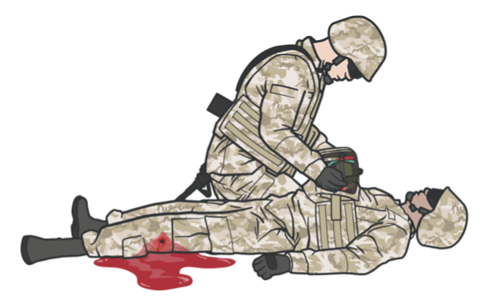
UN TRAUMA PACK
Always use the casualty’s BFAK first
UN Trauma Pack
When supplies are exhausted from the casualty’s BFAK, resort to using supplies from the UNTP
Notes:
JFAK pic and FMA kit from internet

Slide 17
SKILL STATION
Familiarization with BFAK and UNTP

Slide 18

MEDICAL EQUIPMENT
SUMMARY
Familiarize yourself with the content of the UNTP and BFAK.
Ensure you are aware of the resupply procedures and how to maintain your equipment.
Regularly inspect your BFAK, UNTP, and other UN specific medical kits:
  • BEFORE
  • DURING
  • AFTER
ALL training events and missions.
Be sure to use proper documentation when needed; MACE2, 4-Line, and Casualty Card.
BUDDY AID
UN Trauma Pack (UNTP)
INDIVIDUAL
Buddy First Aid Kit (BFAK)

Slide 19
CHECK ON LEARNING
When providing “buddy aid,” should you use your BFAK or the casualty’s BFAK?
What is the most important lifesaving item in the BFAK?
When should medications and medical-grade equipment be replaced in the BFAK?

Slide 20
ANY QUESTIONS?

