Slide 1
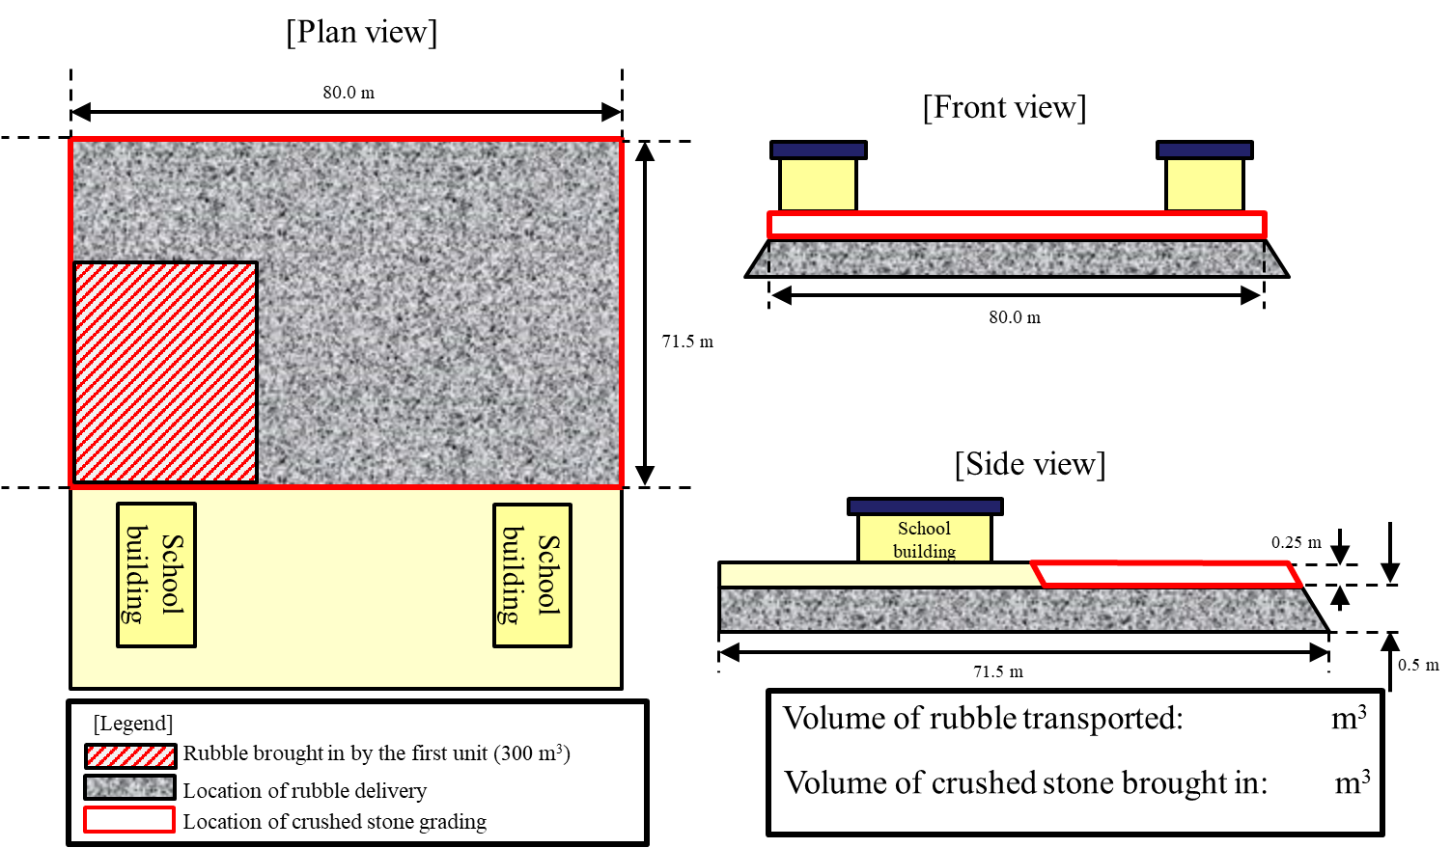
[General Problems (A) Preparation of Progress Chart]
You are the platoon leader of a unit that will be dispatched as the second unit of a PKO to build a site for the “Cité Soleil School” in order to support the reconstruction of the country.
(1) Based on the following drawings, calculate the required work volume and prepare a work cost estimation chart (the chart should include work rate percentages).
(2) Prepare a progress chart based on the work cost estimation chart.
Some of the rubble was already brought in and leveled by the first unit.
[Prerequisites] * Bulking factor is not taken into consideration. (Round to first decimal place.)
Base course construction (rubble): 71.5 m in width, 80 m in depth, and 0.5m in thickness
Surface construction(crushed stone): 71.5 m in width, 80 m in depth, and 0.25m in thickness
(Includes 300 m³ of rubble brought in by the first unit)
Human power: 1 man-day = 8 man-hours
Mechanical power: 1 machine-day = 7 machine-hours

